Slide 1
Verifying Large Multipliers by Combining SAT and Computer Algebra
By:-
Daniela Kaufmann, Armin Biere, Manuel Kauers
Presented at:-
2019 Formal Methods in Computer Aided Design (FMCAD)

Slide 2
Brief Overview
Problem Statement
Notations and Terminologies
How SAT can solve this
Comparison with previous state of the art
Attempt at Bonus Marks

Slide 3
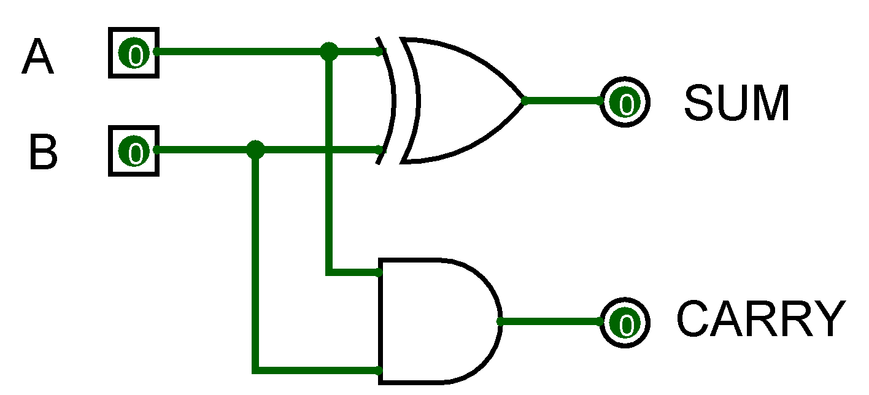
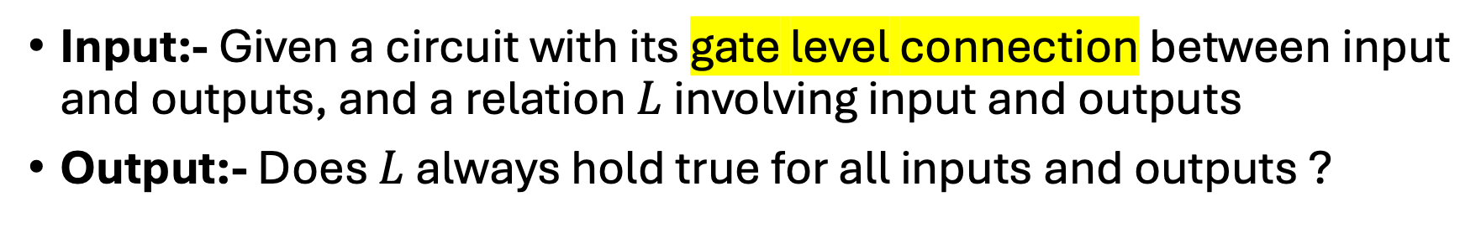
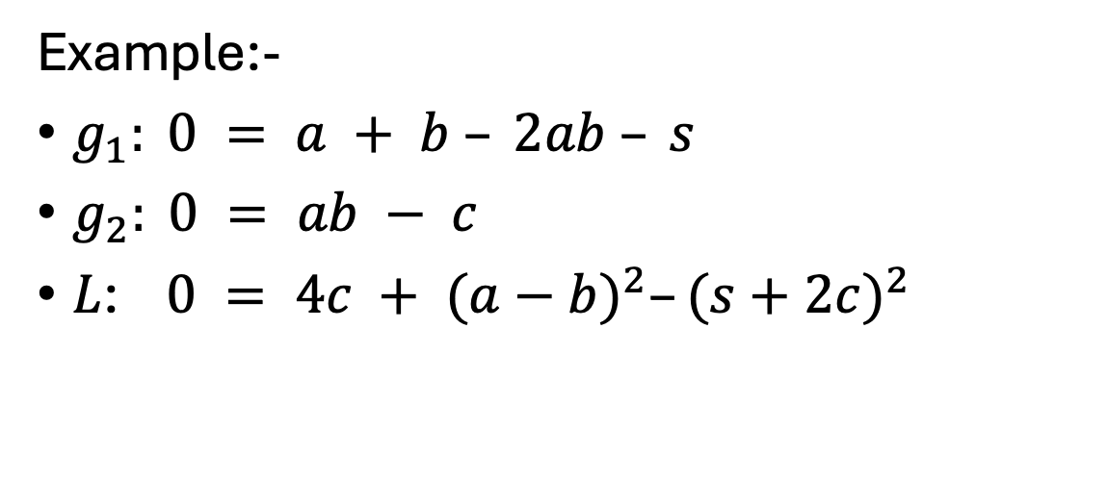
Problem Statement
Input:- Given a circuit with its gate level connection between input and outputs, and a relation $L$ involving input and outputs
Output:- Does $L$ always hold true for all inputs and outputs ?
g1
Example:-
$g_{1}: 0 = a + b – 2ab – s$
$g_{2}: 0 = ab − c$
$L$: $0 = 4c + {(a−b)}^{2}–{(s+2c)}^{2}$
g2
$$L=g_{1}\left(a+b+s−2c\right)+2g_{2}(a+b+s−2c−2)$$

Slide 4
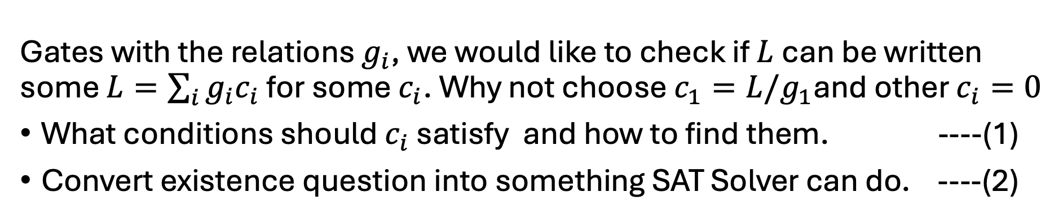
How will we approach the problem ?
Gates with the relations $g_{i}$, we would like to check if $L$can be written some $L=\sum_{i}{g_{i}c_{i}}$ for some $c_{i}$. Why not choose $c_{1}=L/g_{1}$and other $c_{i}=0$
What conditions should $c_{i}$ satisfy and how to find them. ----(1)
Convert existence question into something SAT Solver can do. ----(2)
Why is it necessary or Why do we care ?
For the project
Complicated gate level implementation to solve problems faster
Even simple circuits can grow very fast, Wallace 8 Bit Multiplier has 600-750 gates as compared to simple multiplier with 300-350 gates

Slide 5
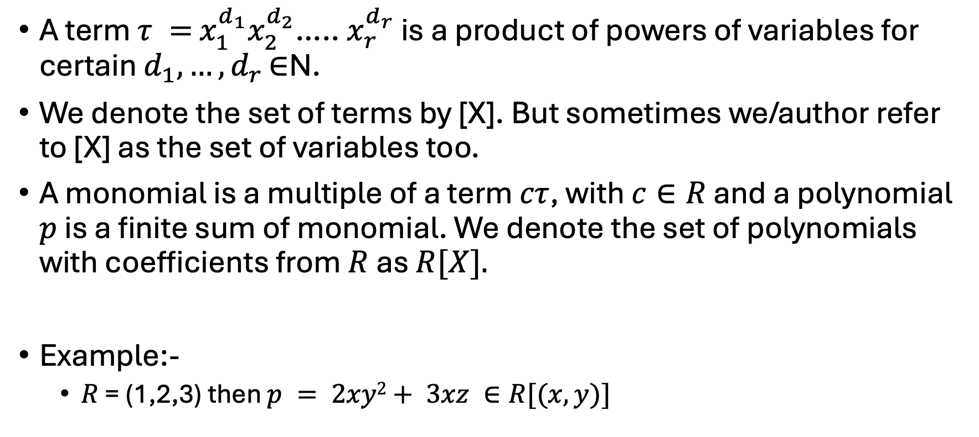
Term and Polynomials
A term $τ =$ $x_{1}^{d_{1}}x_{2}^{d_{2}}$….. $x_{r}^{d_{r}}$ is a product of powers of variables for certain $d_{1}, …,d_{r }$∈N.
We denote the set of terms by [X]. But sometimes we/author refer to [X] as the set of variables too.
A monomial is a multiple of a term $cτ$, with $c∈R$ and a polynomial $p$ is a finite sum of monomial. We denote the set of polynomials with coefficients from $R$ as $R[X].$
Example:-
$R$ = (1,2,3) then $p = 2xy2+ 3xz ∈R[(x,y)]$
Note:- R is not Real Numbers, can be anything
Note:- We will focus more on the case where R(coefficients) form a ring with a multiplicative identity

Slide 6
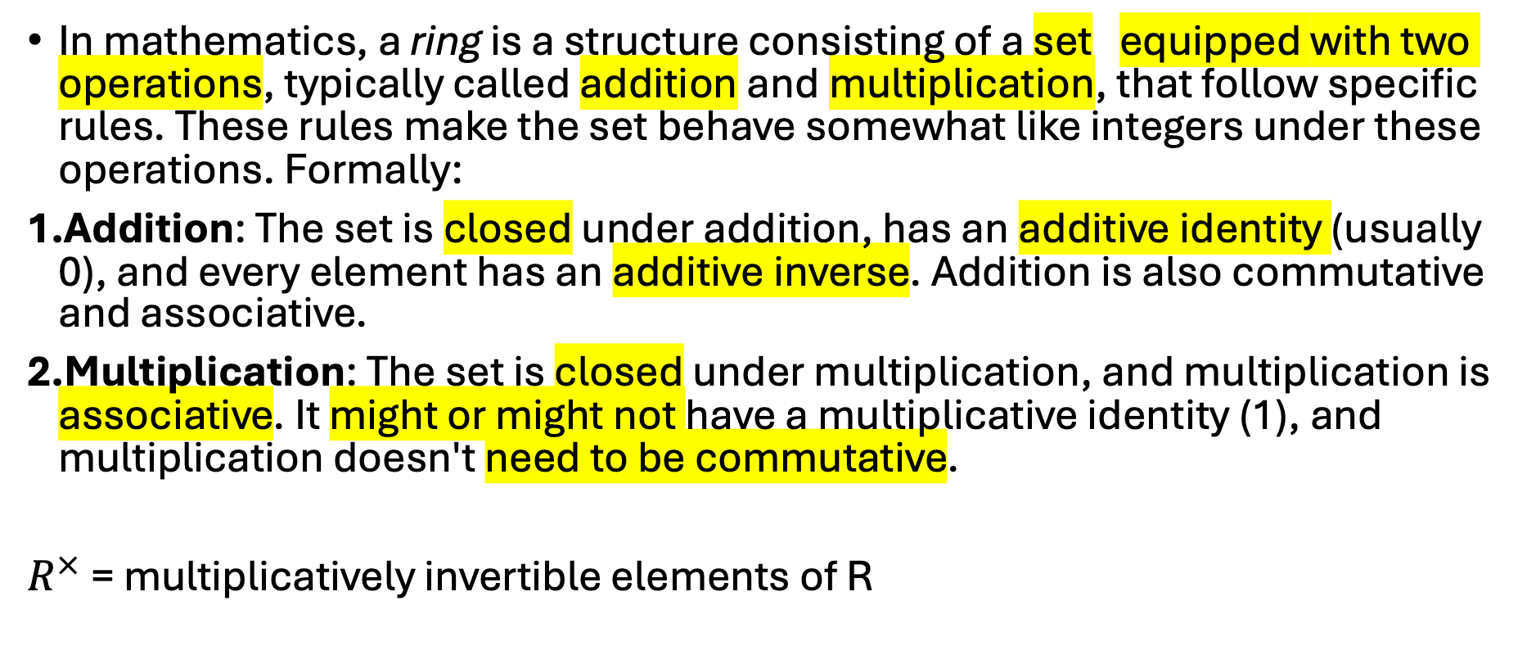
Ring Recap
In mathematics, a ring is a structure consisting of a set equipped with two operations, typically called addition and multiplication, that follow specific rules. These rules make the set behave somewhat like integers under these operations. Formally:
Addition: The set is closed under addition, has an additive identity (usually 0), and every element has an additive inverse. Addition is also commutative and associative.
Multiplication: The set is closed under multiplication, and multiplication is associative. It might or might not have a multiplicative identity (1), and multiplication doesn't need to be commutative.
$R^{×}$ = multiplicatively invertible elements of R

Slide 7
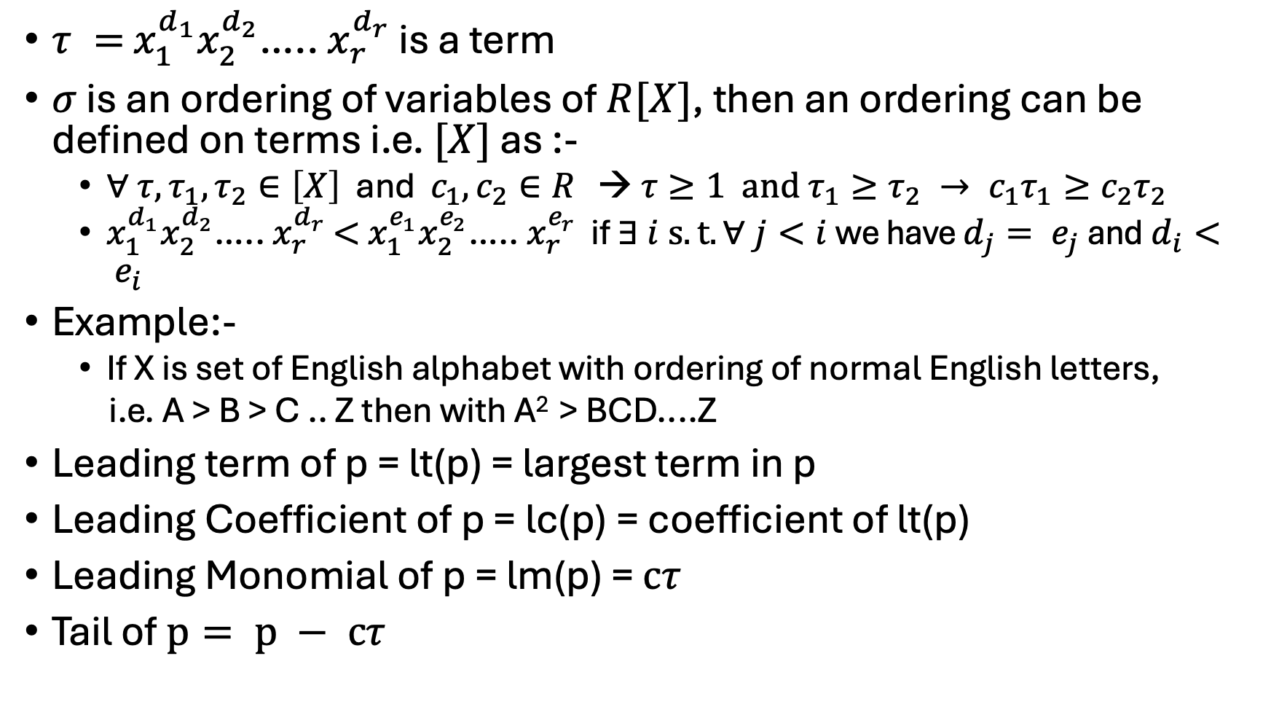
Lexicographic Ordering on Terms
$τ =$ $x_{1}^{d_{1}}x_{2}^{d_{2}}$….. $x_{r}^{d_{r}}$ is a term
$σ$ is an ordering of variables of $R[X]$, then an ordering can be defined on terms i.e. $[X]$ as :-
$∀ {τ, τ}_{1},τ_{2}∈\left[X\right]$ and $c_{1},c_{2}∈R$ → $τ≥1 and{ τ_{1}≥τ_{2} → c}_{1}τ_{1}≥c_{2}τ_{2}$
$x_{1}^{d_{1}}x_{2}^{d_{2}}$….. $x_{r}^{d_{r}}$ $<$ $x_{1}^{e_{1}}x_{2}^{e_{2}}$….. $x_{r}^{e_{r}}$ if $∃ i s.t. ∀ j<i$we have $d_{j}= e_{j}$and$d_{i}< e_{i}$
Example:-
If X is set of English alphabet with ordering of normal English letters,
i.e. A > B > C .. Z then with A² > BCD....Z
Leading term of p = lt(p) = largest term in p
Leading Coefficient of p = lc(p) = coefficient of lt(p)
Leading Monomial of p = lm(p) = $cτ$
Tail of $p= p − cτ$

Slide 8
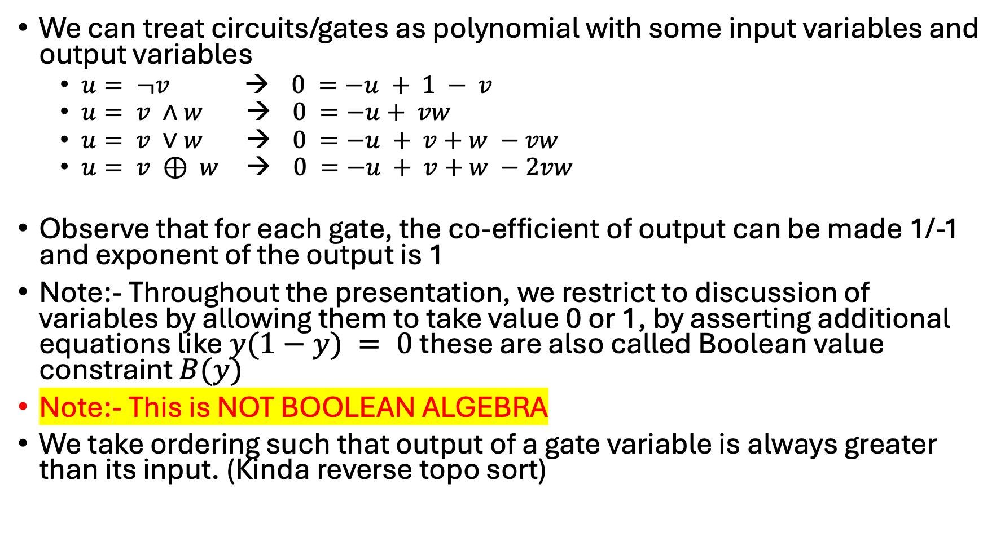
What’s the point ?
We can treat circuits/gates as polynomial with some input variables and output variables
$u= ¬v$ → $0 =−u + 1 − v$
$u= v ∧w$ → $0 =−u+ vw$
$u= v ∨w$ → $0 =−u + v+w −vw$
$u= v ⊕ w$ → $0 =−u + v+w −2vw$
Observe that for each gate, the co-efficient of output can be made 1/-1 and exponent of the output is 1
Note:- Throughout the presentation, we restrict to discussion of variables by allowing them to take value 0 or 1, by asserting additional equations like $y(1−y) = 0$these are also called Boolean value constraint $B(y)$
Note:- This is NOT BOOLEAN ALGEBRA
We take ordering such that output of a gate variable is always greater than its input. (Kinda reverse topo sort)

Slide 9
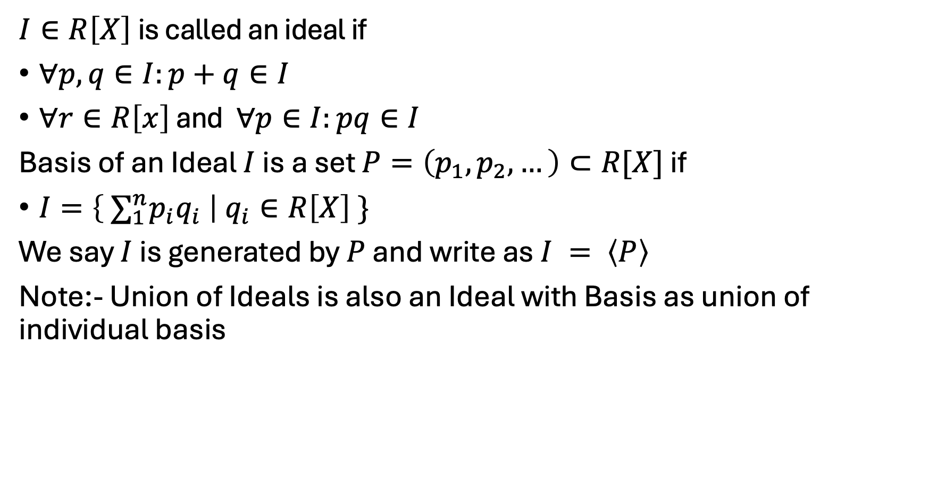
Ideals and Basis of Ideals
$I∈R\left[X\right]$is called an ideal if
$∀p,q∈I:p+q∈I$
$∀r∈R\left[x\right]$ and $∀p∈I:pq∈I$
Basis of an Ideal $I$ is a set $P=\left(p_{1},p_{2},…\right)⊂R[X]$ if
$I=\left\{ ∑_{1}^{n}p_{i}q_{i} \right| q_{i}∈R\left[X\right] \}$
We say $I$ is generated by $P$ and write as $I = \left\langle P\right\rangle$
Note:- Union of Ideals is also an Ideal with Basis as union of individual basis
Note that q_{i} belongs to R[X]

Slide 10

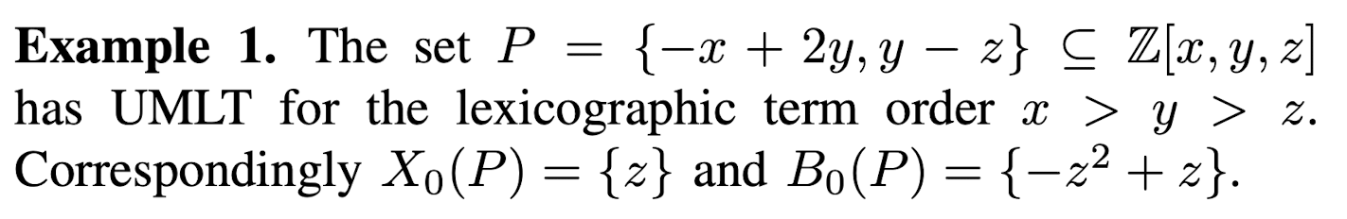
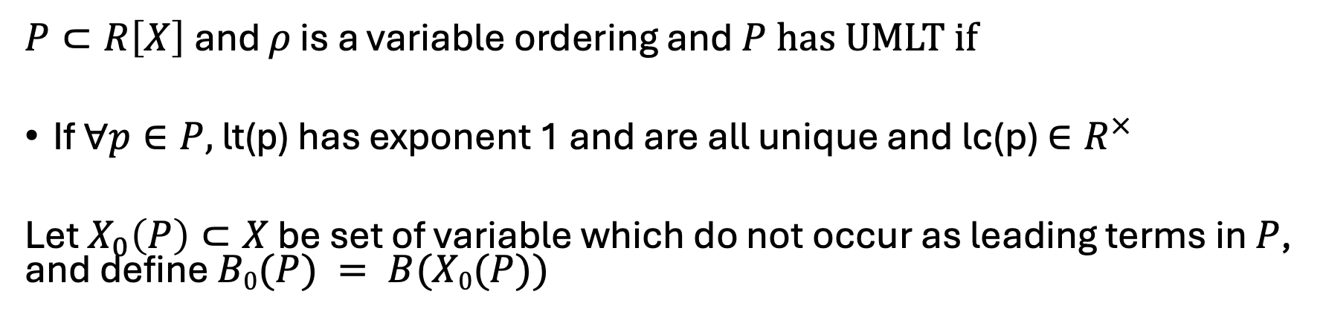
Unique Monic Leading Term (UMLT)
$P⊂R\left[X\right]$and $ρ$ is a variable ordering and$P$has UMLT if
If $∀p∈P,$lt(p) has exponent 1 and are all unique and lc(p) $∈R^{×}$
Let $X_{0}\left(P\right)⊂X$ be set of variable which do not occur as leading terms in $P$, and define $B0(P) = B(X0(P))$
1. Unique Leading Term
2. Exponent = 1
3. Leading Coefficient is invertible

Slide 11

Deduction
Let $P⊂R\left[X\right]$ be a finite set with UMLT, then a polynomial $q$ can be “deduced” from $P$ if $q∈ \left\langle P\right\rangle + \left\langle B_{0}(P)\right\rangle$ and is written as $P ⊢_{R}q$
Models
A model is an assignment $φ$such that $∀p∈P:φ(p) = 0$, for a polynomial $q$, we write $P ⊨_{R}q$ if every model of $P$ is also a model of $\{q\}$

Slide 12
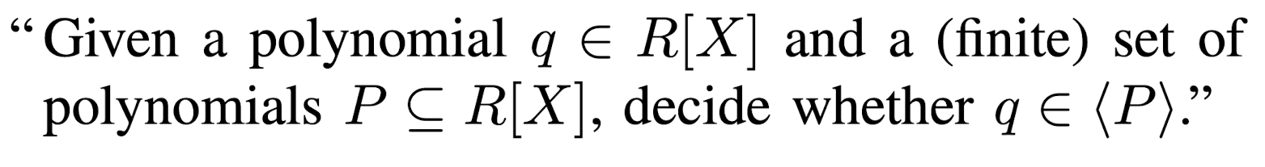

Sneak Peak into the Future
We will show by the end of the presentation that whether $L$ (constraint among input-output) is implied by gate polynomials $C$ can be reduced to Ideal Membership Test.

Slide 13
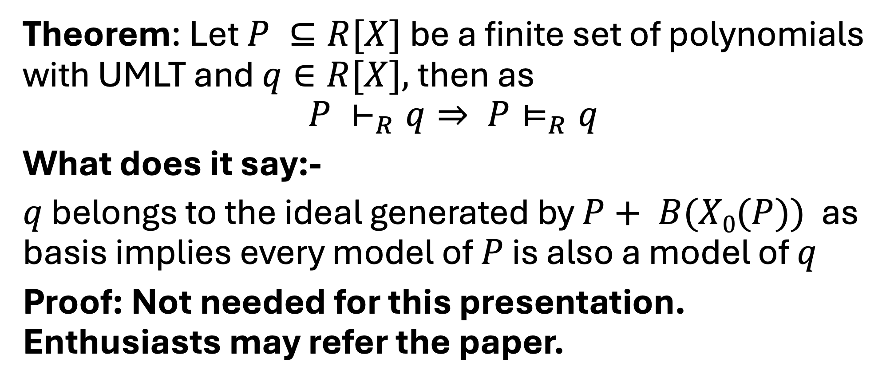
Soundness
Theorem: Let $P ⊆R[X]$ be a finite set of polynomials with UMLT and $q∈R[X],$then as
$$P ⊢_{R}q⇒ P⊨_{R}q$$
What does it say:-
$q$ belongs to the ideal generated by $P+ B(X0(P))$ as basis implies every model of $P$ is also a model of $q$
Proof: Not needed for this presentation. Enthusiasts may refer the paper.

Slide 14
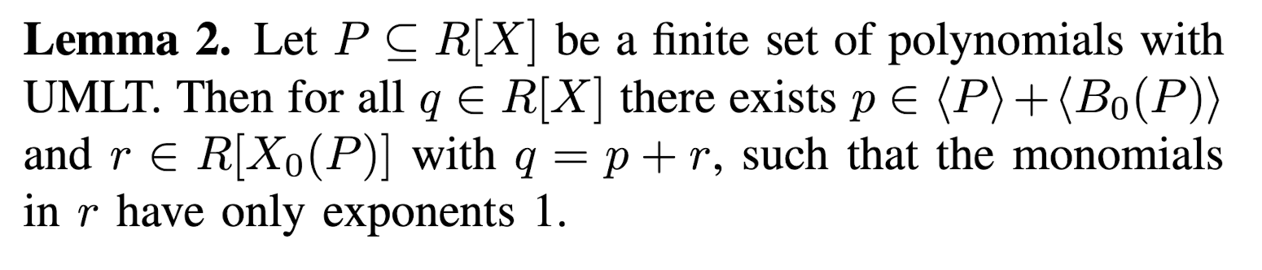
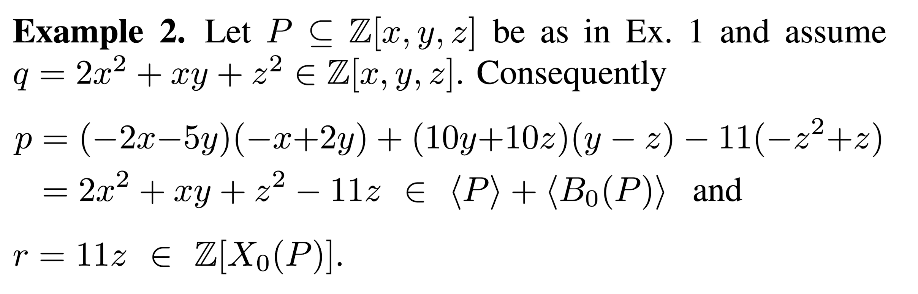

Soundness
Lemma1:- If $P⊨_{R}p$and $P⊨_{R}q$then $P⊨_{R}p+q$

Slide 15
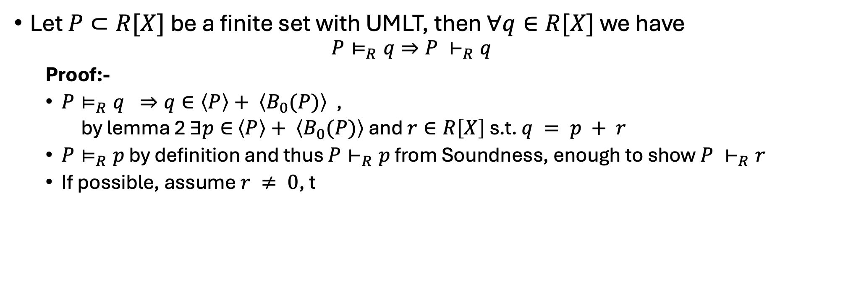
Completeness
Let $P⊂R[X]$ be a finite set with UMLT, then $∀q∈R[X]$ we have
$$P⊨_{R}q⇒P ⊢_{R}q$$
Proof:-
$P⊨_{R}q ⇒q∈\left\langle P\right\rangle + \left\langle B_{0}(P)\right\rangle$ ,
by lemma 2 $∃p∈$ $\left\langle P\right\rangle + \left\langle B_{0}(P)\right\rangle$ and $r∈R\left[X\right]$ s.t. $q = p + r$
$P⊨_{R}p$ by definition and thus $P⊢_{R}p$ from Soundness, enough to show $P ⊢_{R}r$
If possible, assume $r ≠ 0$, t

Slide 16
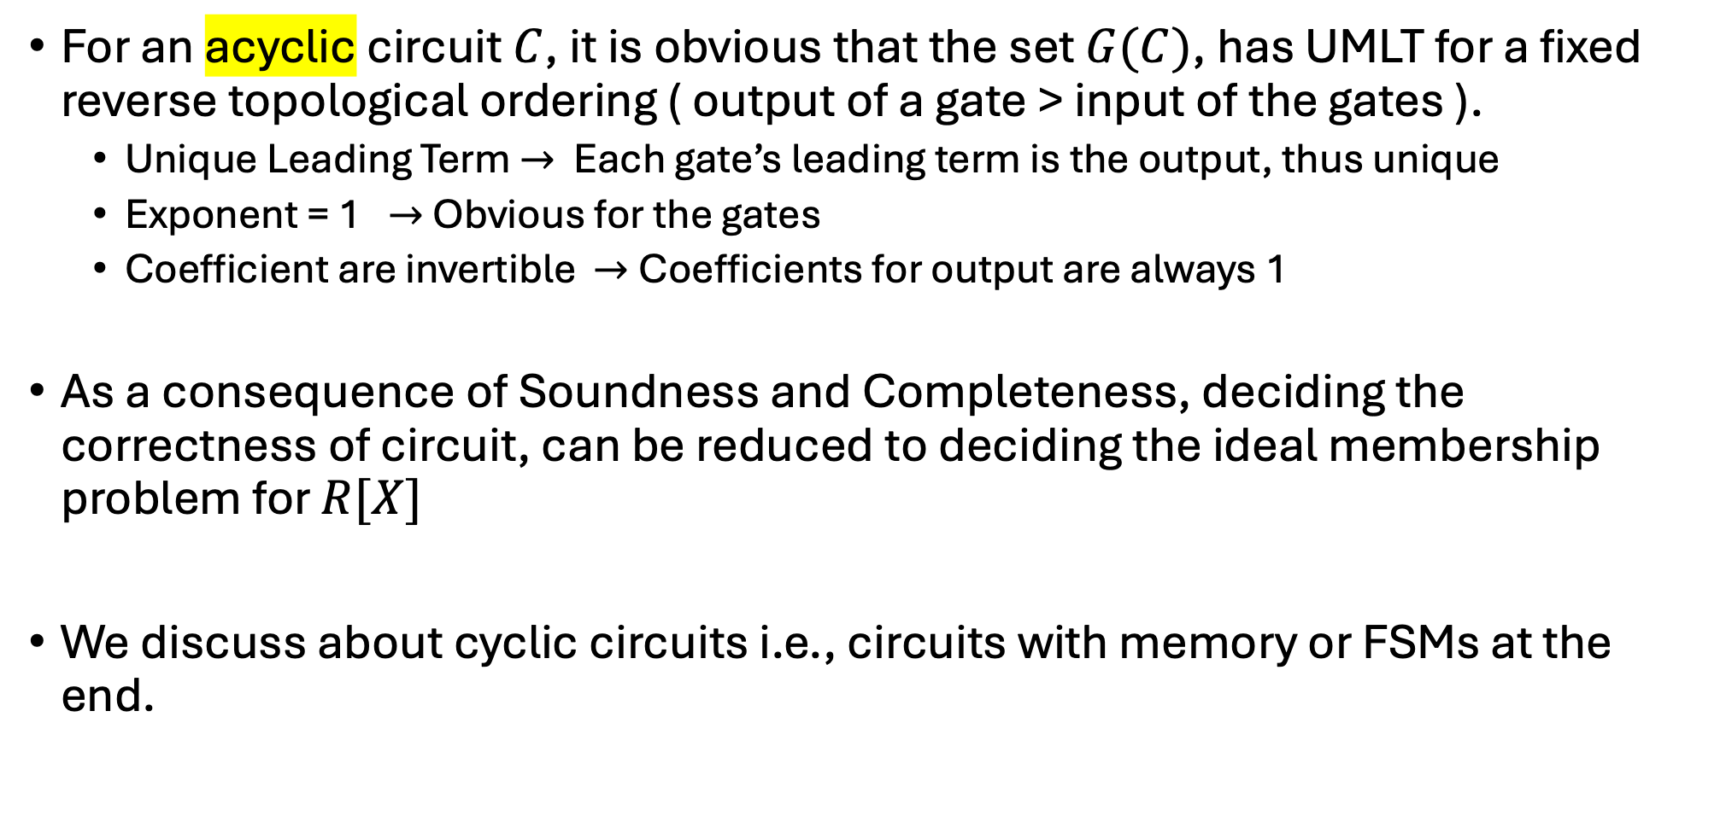
Don’t know what to name
For an acyclic circuit $C$, it is obvious that the set $G(C)$, has UMLT for a fixed reverse topological ordering ( output of a gate > input of the gates ).
Unique Leading Term $→$ Each gate’s leading term is the output, thus unique
Exponent = 1 $→$Obvious for the gates
Coefficient are invertible $→$Coefficients for output are always 1
As a consequence of Soundness and Completeness, deciding the correctness of circuit, can be reduced to deciding the ideal membership problem for $R[X]$
We discuss about cyclic circuits i.e., circuits with memory or FSMs at the end.

Slide 17


$I$ and $J$ and $U$
Let $I\left(C\right)=\left\{f∈R\left[X\right]:G\left(C\right)⊨_{R}f\right\}.$
Let $B_{0}\left(C\right)= B_{0}(G\left(C\right))$ then define $J\left(C\right)= \left\langle G\left(C\right)⋃B_{0}(C)\right\rangle$
$𝒰_{n}=(\sum_{i=0}^{2n−1}{2^{i}s_{i})−(\sum_{i=0}^{n−1}{2^{i}a_{i}})(\sum_{i=0}^{n−1}{2^{i}b_{i}})}$
For all assignments $φ$ we have $φ\left(𝒰_{n}\right)∈[{−2}^{2n}+1,2^{2n}−1]$

