Slide 1
Data science week 18
Winter 2020 Data Science Cohort

Slide 2

Agenda
Today’s Agenda:
Unsupervised Learning
K-Means Clustering
Coursera quiz!
Feature Scaling and Embeddings for Clustering
Google Colab Notebook

Slide 3
Unsupervised learning
What is the difference between supervised and unsupervised learning?
When might we need to use unsupervised learning?

Slide 4
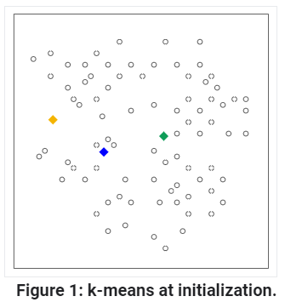
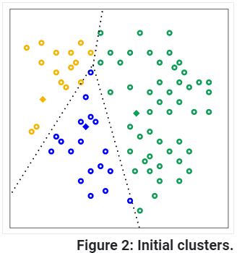
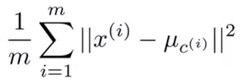
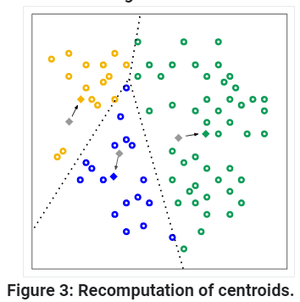
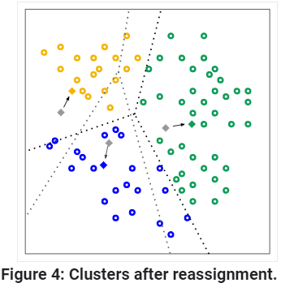
K-means clustering
K-means clustering
Cost function:

Slide 5
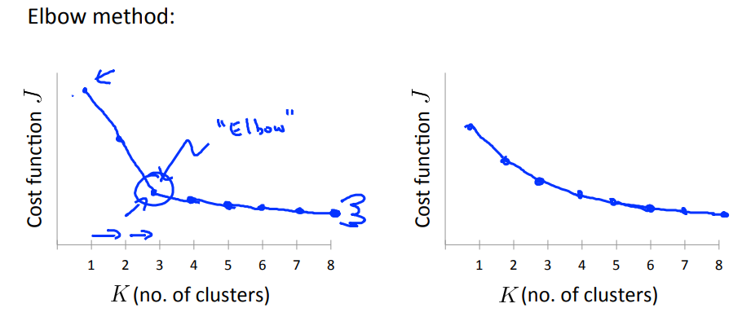
K-Means Clustering
Considerations for k-means
What’s the right value for k?
Random initialization: a cautionary tale

Slide 6
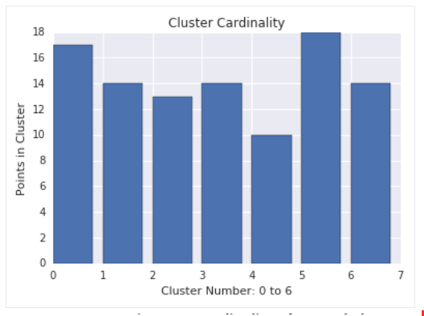
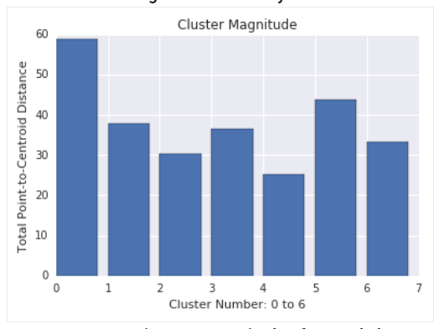
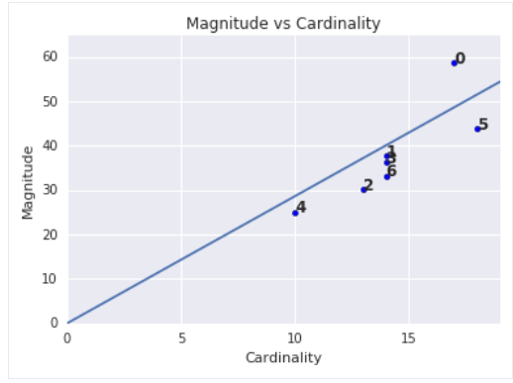
K-Means Clustering
Evaluating unsupervised learning models: how do you know if your clusters are good?
Check cardinality – points/cluster
Check magnitude – sum of distances to centroid
Check downstream performance

Slide 7
Coursera Quiz: Unsupervised learning

Slide 8
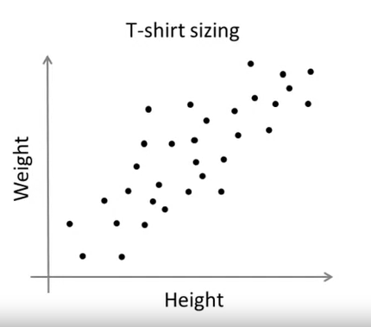
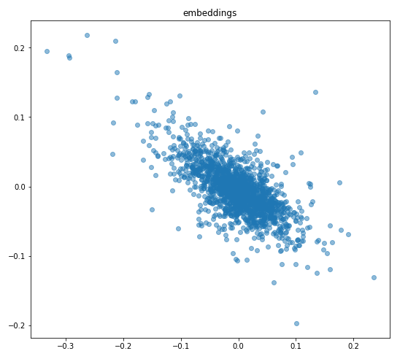
Embeddings
Embeddings
Calculate the similarity between two examples by combining all the feature data for those examples into a numeric value

Slide 9
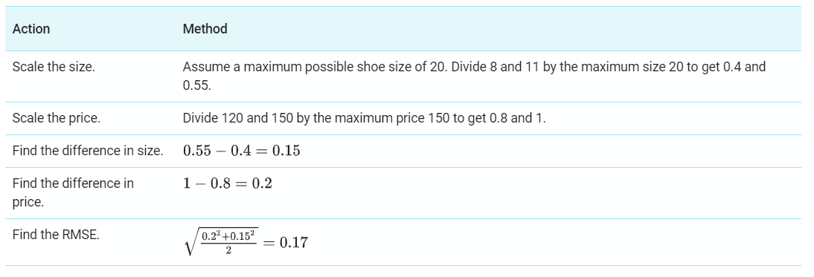
Embeddings
How to generate embeddings:
Manually:
Consider a shoe dataset where you have the size and price for every shoe. How similar is a $120 size 8 shoe and a $150 size 11 shoe?

Slide 10
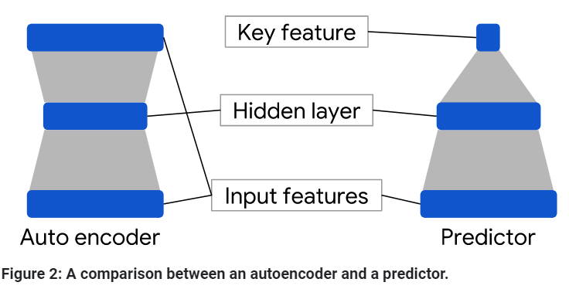
Embeddings
How to generate embeddings:
Automatically: use a deep neural network (DNN)
Autoencoder: a DNN that learns how to predict labels given a set of labels.
Learns a compressed representation of the dataset: called an embedding
Predictor: try to predict one of the more relevant labels (e.g. house price) from the other labels

Slide 11
Embeddings
Key takeaway points for embeddings
Clustering works on distance from a cluster center
You can do that with feature values, like Andrew Ng showed you, or you can do it by reducing your features to an “embedding”: one vector expressing similarity
You can make embeddings manually or use DNN
Make sure to feature scale before you do, because…

Slide 12
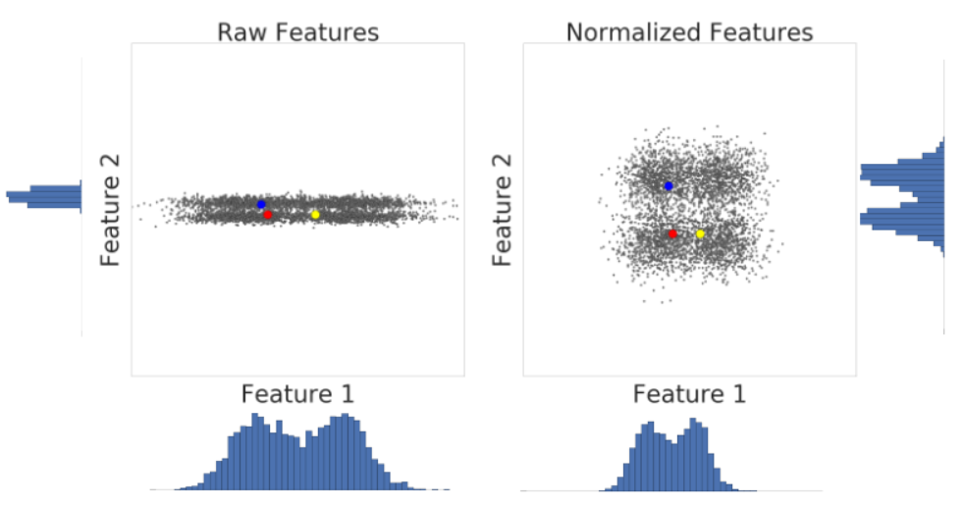
Feature scaling

Slide 13
Google Colab notebook

Slide 14
In-class: k-means notebook

