Slide 1
Data science week 12
Winter 2020 Data Science Cohort

Slide 2

Attendance Code
Attendance code time: ProgrammingPowers

Slide 3
Agenda
Today’s Agenda:
Notebook Review
Representation
Feature Crosses
Neural Networks
Boolean functions with neural networks
Intro to the in-class notebook

Slide 4
Harvard CS109 notebook: bias, variance, cross-validation

Slide 5
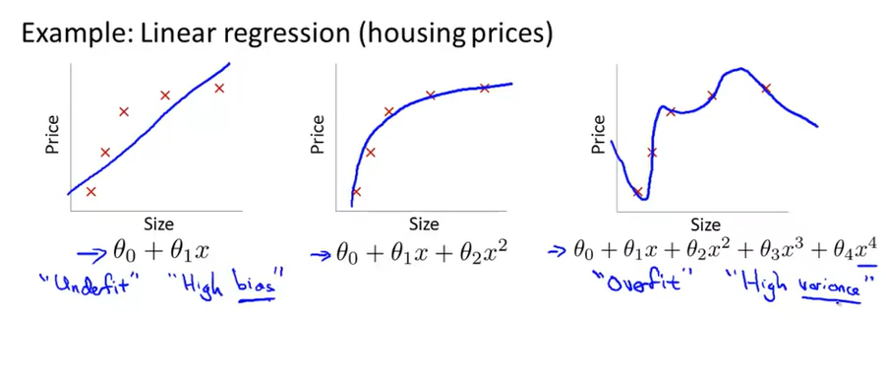
overfitting
Let’s talk now about overfitting and what to do about it
What is overfitting?

Slide 6
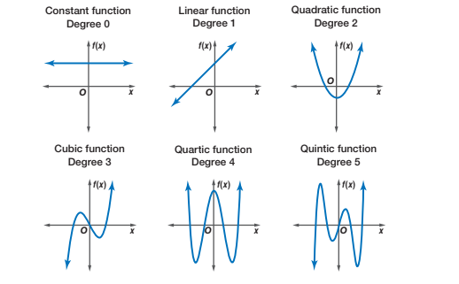
Polynomials

Slide 7
Harvard CS109 notebook: Sklearn, regression, pca

Slide 8
Some terminology for this notebook
Key notebook terms:
PCA
Principal Component Analysis
Unsupervised learning technique
Reduce the dimensions of your data
More on this at the end of May
SPLOM
Scatterplot matrix
Look at correlation between variables
Diagonal = kde in this notebook
Grid Search
Automatic way to check and find the best hyperparameter values

Slide 9
Google ML - Representation
Features and Feature Engineering
What is feature engineering?
Choosing which features to feed into your model, preparing them for use in ML
“One way developers hone a model is by adding and improving its features”
Feature mapping
Numerical data vs categorical data – handled differently

Slide 10
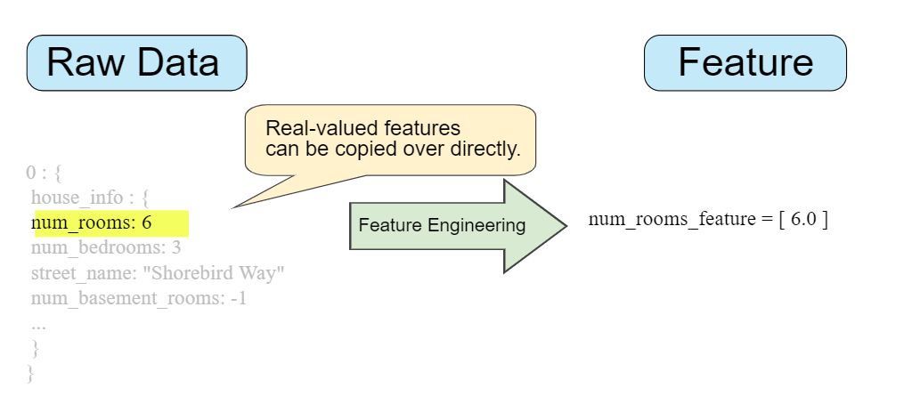
Google ML – Feature mapping
Numerical Data

Slide 11
Google ML – Feature mapping
Categorical Data:
Could do:
Charleston Road = 0
North Shoreline Boulevard = 1
Shorebird Way = 2
Rengstorff Ave = 3
Instead, One-Hot Encoding:
Charleston [1 0 0 0]
North Shoreline [0 1 0 0]
Shorebird [0 0 1 0]
Rengstorff [0 0 0 1]

Slide 12

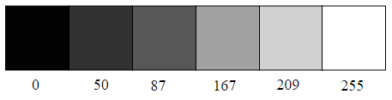
Google ML – Feature Scaling
Feature Scaling:
What is it?
Why do we do it?
Imagine you are looking at image data, where pixel intensity/brightness can be represented by a value of 0-255:
Divide each pixel value by 255 – will range from 0-1

Slide 13
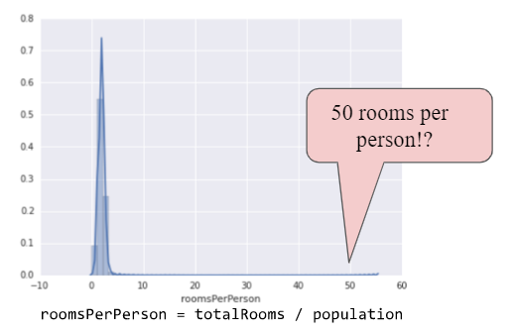
Google ML – Handling outliers
Handling outliers:

Slide 14
Google ML – Handling outliers
Handling outliers:
Logarithmic scaling
Take the log of values
Clipping
All values greater than some threshold are set to that threshold
Binning
Group values into discrete bins – e.g. latitude and longitude
Scrubbing
Delete bad data
Any downsides to this?

Slide 15
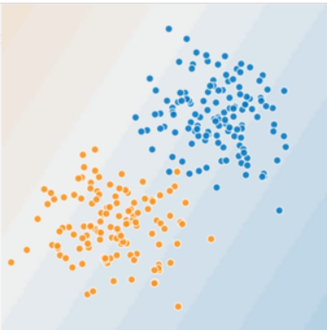
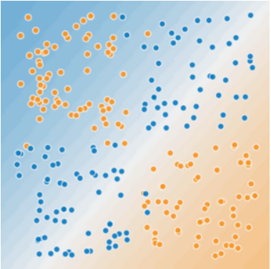
Google ML – Feature crosses
Feature Crosses
Lets linear models fit nonlinear data
Can let the model learn more nuanced things
E.g. latitude x bedrooms example: is a 3-bedroom worth more in Sacramento than it is in San Francisco
These are also great reasons for neural networks, but we’ll get there at the end of class today

Slide 16
Feature Cross Playground https://developers.google.com/machine-learning/crash-course/feature-crosses/playground-exercises

Slide 17
Feature Cross Programming https://colab.research.google.com/github/google/eng-edu/blob/master/ml/cc/exercises/representation_with_a_feature_cross.ipynb

Slide 18
Okay so hang on
Alright I got into Machine Learning to do cool stuff so let’s get to it, Michelle
You’re right, let’s talk about image recognition and stuff

Slide 19

How could we train a classifier to recognize digits?

Slide 20
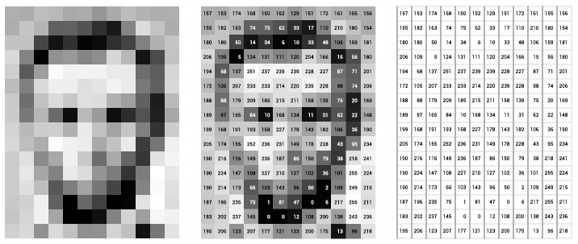
Pictures are just pixels, so maybe we could use all the pixel intensity values as features!

Slide 21
What kinds of feature crosses would we need to make to recognize the number 5?
…. Is there a better way of learning from relationships between features? Some kind of slicker mathematical and more elegant computational machine learning algorithm?

Slide 22
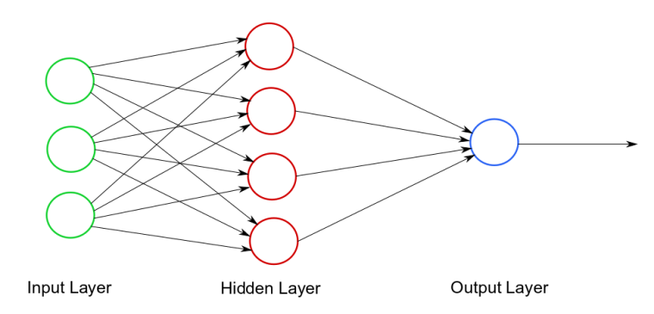
Neural networks!
Yes! Neural Networks!

Slide 23
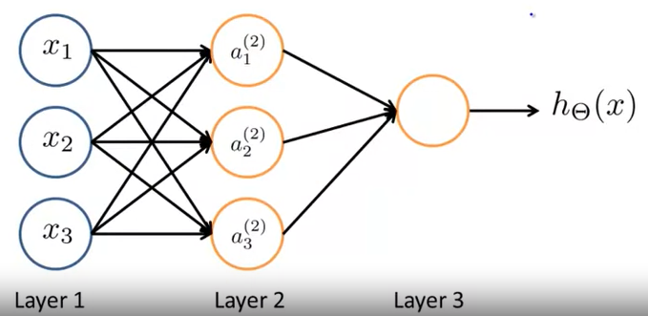
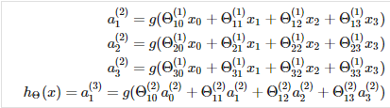
Neural networks!
Let’s talk about neural networks

Slide 24
Neural networks!
Let’s talk about neural networks
Hypothesis (y, h_{θ}(x)
Features (x)
Weights (θ or w)
Sigmoid Function

Slide 25
Neural networks!
Goal for now: let’s start small with neural networks
Boolean functions with neural networks
AND: Both variables true
OR: Either or both variable true
NOR: Neither variable is true
XNOR: Both inputs are the same (both true or both false)
Let’s walk through building an XNOR network

Slide 26
Neural networks!
Goal for now: let’s start small with neural networks
Boolean functions with neural networks
AND: Both variables true
OR: Either or both variable true
NOR: Neither variable is true
XNOR: Both inputs are the same (both true or both false)
Let’s walk through building an XNOR network

Slide 27
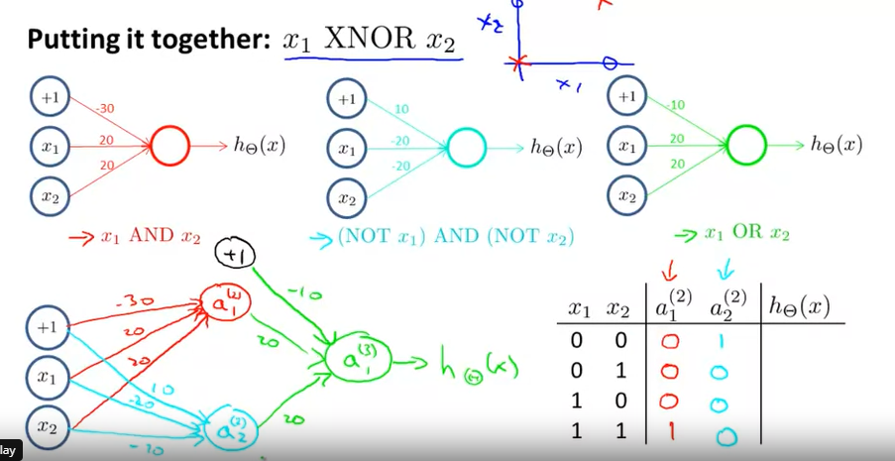
Neural networks: AND

Slide 28
Neural networks: NOR

Slide 29
Neural networks: OR

Slide 30
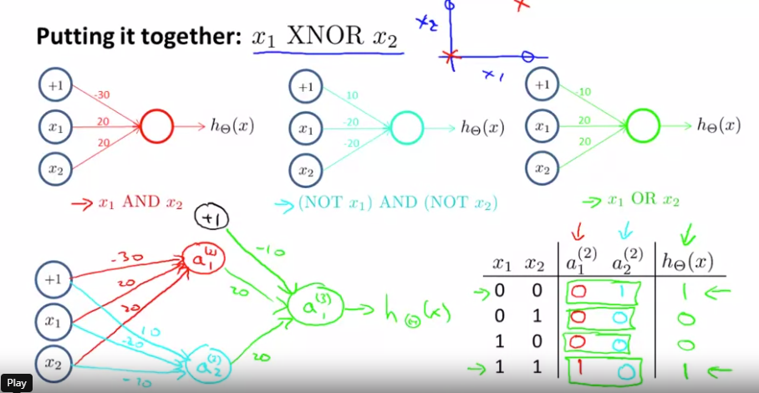
Neural networks: XNOR

Slide 31
In-class: MNIST notebook

