Slide 1
Data science week 11
Winter 2020 Data Science Cohort

Slide 2

Attendance Code
Attendance code time: WebDevWitchcraft

Slide 3
Survey results
Take it away Julie!

Slide 4
Agenda
Today’s Agenda:
Logistic Regression
Concept Review
Coursera Quiz
Regularization
Concept Review
Coursera Quiz
Google ML playground
Google ML check your understanding
Overfitting and Train/Validation/Test
Concept Review
Programming Exercise

Slide 5
Logistic regression – concept review
Logistic Regression
Classification vs Regression?
Logistic regression is used when we need to classify data into a category
E.g. is this email spam or not spam? Tumor malignant or not?
Predicts binary classes – 1 or 0
In logistic regression, our model doesn’t predict 1 or 0, but predicts the probability that the observation is 1 or 0
So why can’t we use linear regression?

Slide 6

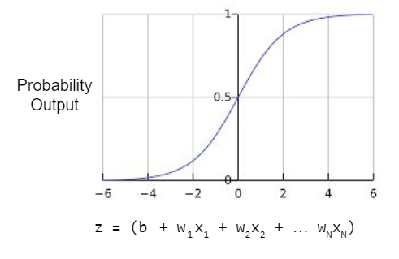
Logistic regression – Sigmoid function
Sigmoid Function

Slide 7





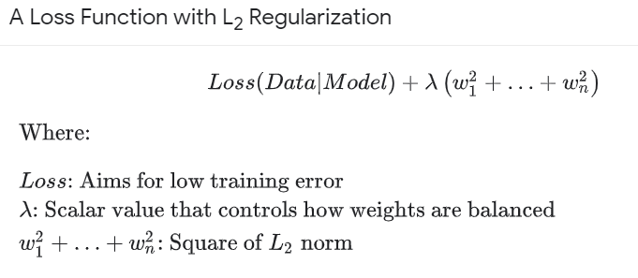

Logistic regression translation
Google ML vs Coursera translator
Logistic Regression Concept | Google | Coursera
Sigmoid function
z | b + w₁x₁ +w₂x₂ + … w_{n}x_{n} | θ₀ + θ₁x₁ +θ₂x₂ + … θ₃x_{n}
Cost Function
Regularization

Slide 8
Logistic regression – Decision boundary
Decision Boundary
Output a probability that observation is e.g. spam or not spam
If probability >= 0.5, spam.
Sigmoid function = 0.5 when z = 0
Decision boundary is the line for all values of z that equal 0. Separates your data classes

Slide 9
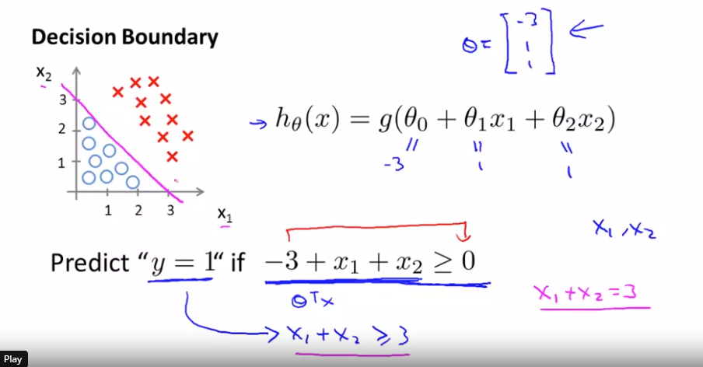
Logistic regression – Decision boundary

Slide 10
Logistic regression – Cost Function
Logistic Regression Cost Function Properties
If prediction is 1 and actual class is 1, cost is 0
As prediction probability gets closer and closer to 0, cost approaches infinity, so penalty for wrong guesses gets very high
Opposite but same idea for actual class is 0

Slide 11
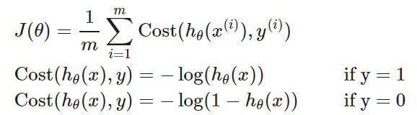
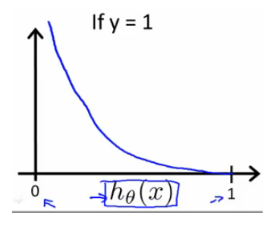
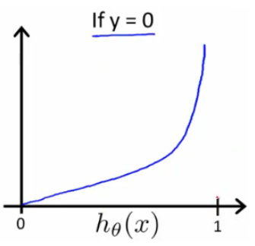
Logistic regression – Cost Function
Logistic Regression Cost Function

Slide 12
Quiz: Coursera Logistic Regression

Slide 13
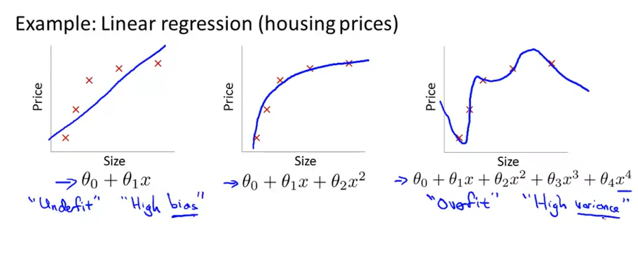
overfitting
Let’s talk now about overfitting and what to do about it
What is overfitting?

Slide 14
overfitting
So what can we do to combat overfitting?
Reduce number of features
Careful train/validation/test split design
Regularization

Slide 15

Google Regularization: Concept Review
Regularization:
What is it?
L2 Regularization:
So far in ML we’ve talked about picking the weights that go into your model equation by minimizing your cost function. That means the model tries to pick weights that makes predictions as close to the observed values as possible.
With regularization, you penalize both with the cost function AND a penalty for model complexity.

Slide 16
Google Regularization: Concept Review
L2 Regularization:
Coursera version:

Slide 17
Quiz: Coursera Regularization

Slide 18
Google Playground regularization https://developers.google.com/machine-learning/crash-course/regularization-for-simplicity/playground-exercise-examining-l2-regularization

Slide 19
Google regularization Check your understanding https://developers.google.com/machine-learning/crash-course/regularization-for-simplicity/check-your-understanding

Slide 20
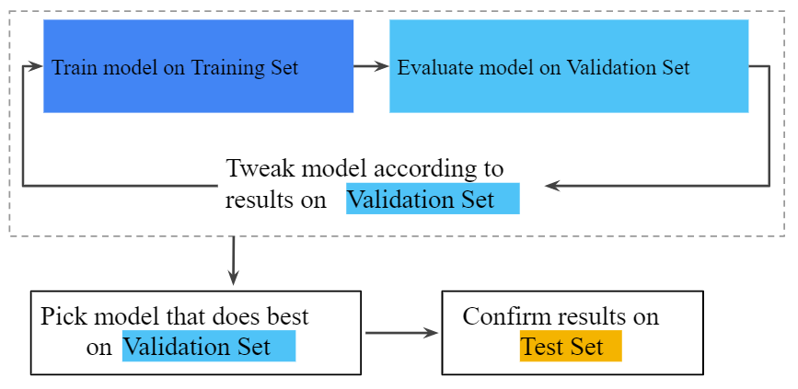
Google concept review
Google ML Crash course
Training/test set
Validation set

Slide 21
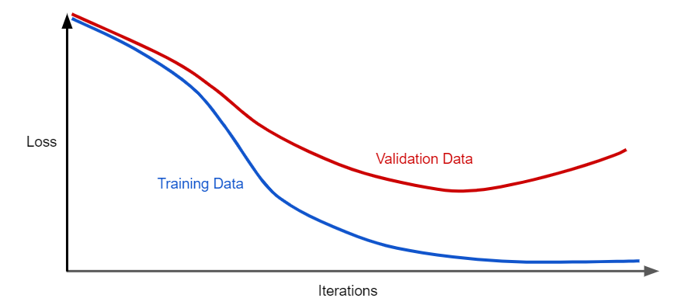
Google Concept review
Overfitting:

Slide 22
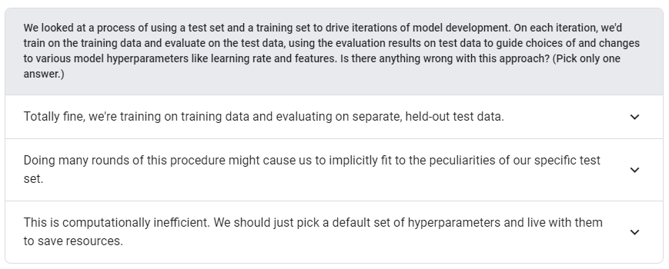
Google Intuition check
Check your intuition: validation set
https://developers.google.com/machine-learning/crash-course/validation/check-your-intuition

Slide 23
Google validation set programming exercise https://developers.google.com/machine-learning/crash-course/validation/programming-exercise

Slide 24
In-class: sklearn, regression, pca notebook

