Slide 1
Data science week 9
Winter 2020 Data Science Cohort

Slide 2

Attendance Code
Attendance code time: QuirkyQA

Slide 3
Let’s chat
Welcome back to remote Data Science
Be on the lookout for a poll after class
Python Module
Remote learning/progress
Let’s talk about how things are going
How are you?
How are you feeling about machine learning?
What’s a high or low point about the class going remote?

Slide 4
Agenda
Today’s Agenda:
Intro to Machine Learning
Concept reviews
Quizzes from Coursera/Google
Linear Regression
Cost Function
Gradient Descent
Check-in
In-Class Notebooks

Slide 5
Machine learning
Welcome to the Machine Learning module!
Coursera Machine Learning (Andrew Ng)
Pros: very well-known and highly regarded, clear mathematical explanations, intuition behind the math, will quiz you on fine details to enhance your understanding
Cons: very mathematical, coding exercises are in Octave
Google Machine Learning Crash Course
Simpler, more generalized, neat visualizations and notebook programming exercises in python

Slide 6
Machine learning
What is Machine Learning?
Andrew Ng:
The field of study that gives computers the ability to learn without being explicitly taught
A well-posed learning problem is defined as: a computer program is said to learn from experience E with respect to some task T and some performance measure P, if its performance on T, as measured by P, improves with experience E.
Google:
ML systems learn how to combine input to produce useful predictions on never-before-seen data

Slide 7
Machine learning
Supervised vs unsupervised learning
Supervised: the algorithm is trained on labeled data.
You show the machine examples of things you want it to predict, and it will learn how to make more of those predictions
Examples: house prices, spam email filters
Unsupervised: the algorithm is trained on unlabeled data
You give the machine data and ask it to find interesting patterns for you
Examples: customer groups

Slide 8
Machine learning
Supervised learning: regression vs. classifiers
Regression: predicts a continuous variable
E.g. price, temperature, size
Classifier: predicts a category
E.g. loan default or not, tumor malignant or not

Slide 9
Machine learning
Useful vocabulary
Label – Prediction target
Feature – An aspect of the data point that will be used to model/predict a label
Example – one datapoint in your dataset, “one particular instance of your data”
Model – the relationship between features and label
Training – when you show the machine data to generate a model

Slide 10
Quiz: Coursera Introduction https://www.coursera.org/learn/machine-learning/exam/wjqip/introduction

Slide 11
Quiz: Google Framing https://developers.google.com/machine-learning/crash-course/framing/check-your-understanding

Slide 12
Linear Regression
Linear regression: Supervised or unsupervised?
Type of machine learning where you’ll give your program a dataset with some features and labels, and it will fit an equation (line) to predict what other observations’ label will be

Slide 13
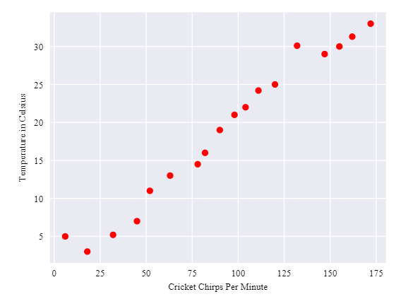
Linear Regression

Slide 14
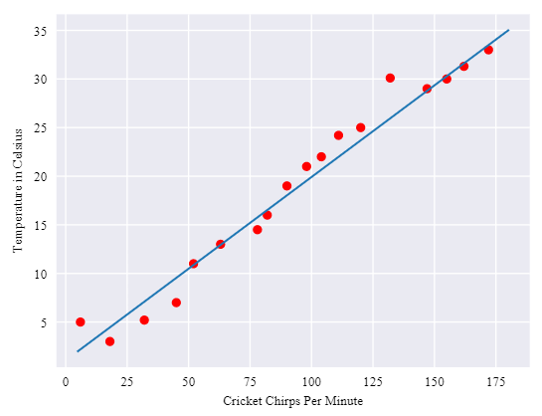
Linear Regression
Algebra class:
y = mx + b
Google:
y’ = b + w₁x₁
Coursera:
h_{θ}(x) = θ₀ + θ₁x
For more features: y’ = b + w₁x₁ +w₂x₂ + … w_{n}x_{n}

Slide 15
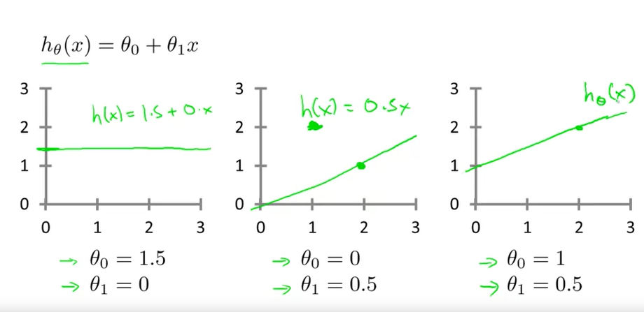
Linear Regression

Slide 16
Cost function
Okay, so in linear regression, you have some data points, you ask the computer to fit an equation to it, you use that equation to predict the label value of new points. Easy.
… how does the computer know what line to fit?

Slide 17
Cost function
Cost function
How a machine learning algorithm figures out if it’s getting better
Cost functions are a way to quantify how wrong the machine learning algorithm’s predictions are
Lower is better for a cost function
There are different type of costs functions for different algorithms. For Linear Regression, we’ve been looking at the squared error

Slide 18
Cost function
Cost function: (∑(prediction – actual)²)/M

Slide 19


Cost function
Google:
Coursera:

Slide 20
Gradient descent
Gradient descent
Initialize your weights randomly (“w” in Google terms, “θ” in Coursera terms)
Loop:
Calculate the cost function for those weights
Look at what it would take in changing the weights to make the cost function go down
Change the weights accordingly

Slide 21
Cost function
Google:
Coursera:

Slide 22
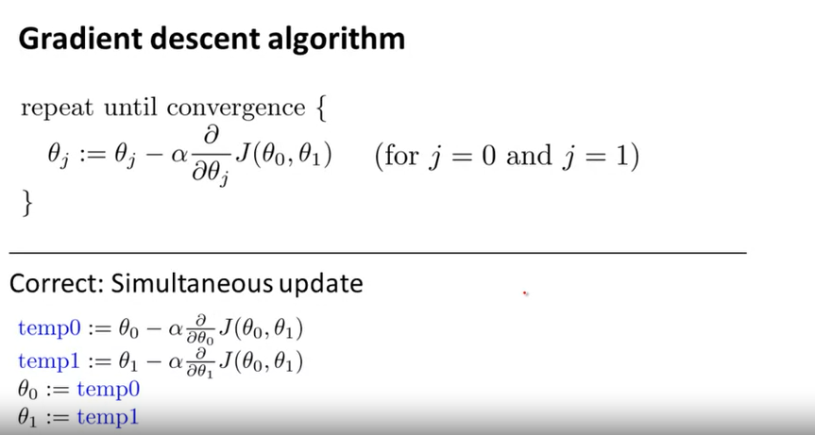
Gradient Descent

Slide 23
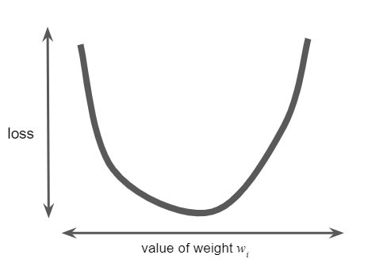
Gradient Descent

Slide 24
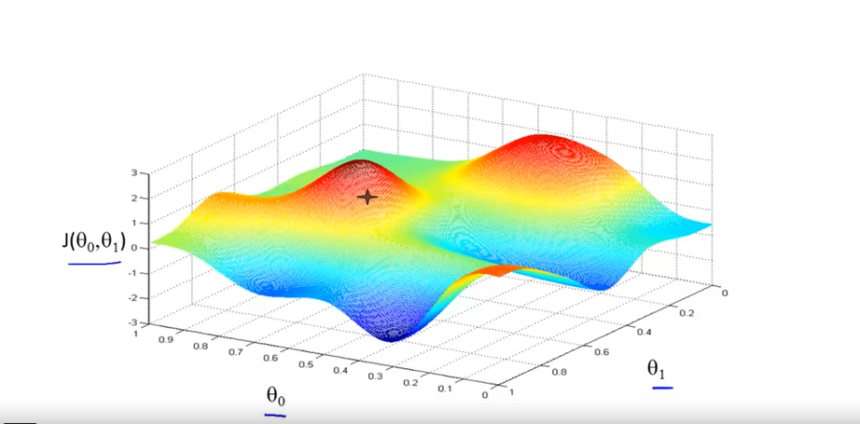
Gradient Descent

Slide 25
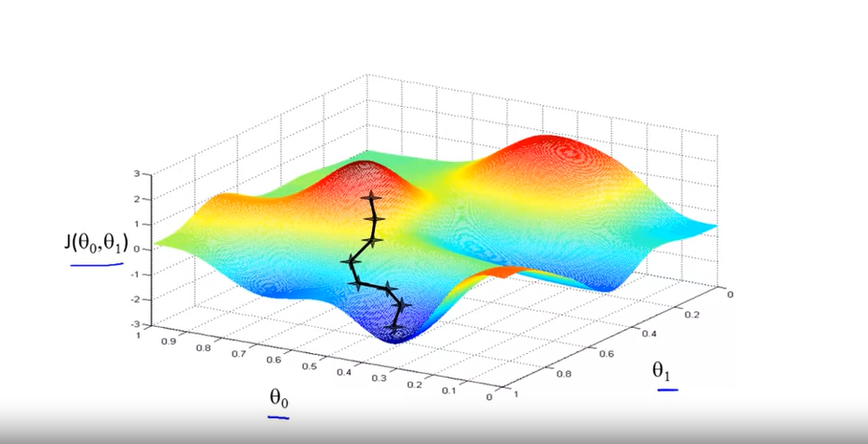
Gradient Descent

Slide 26
Gradient Descent

Slide 27
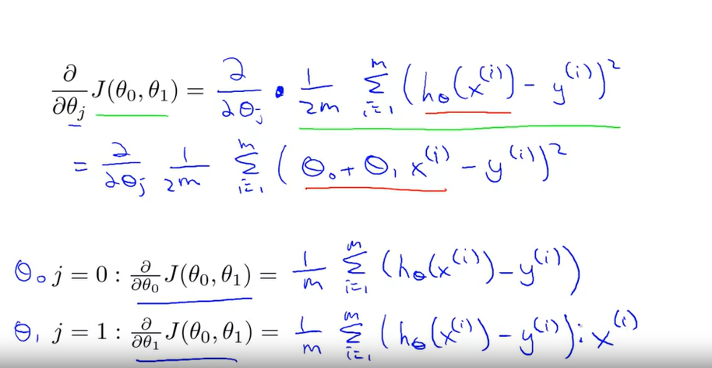
Gradient Descent for linear regression

Slide 28
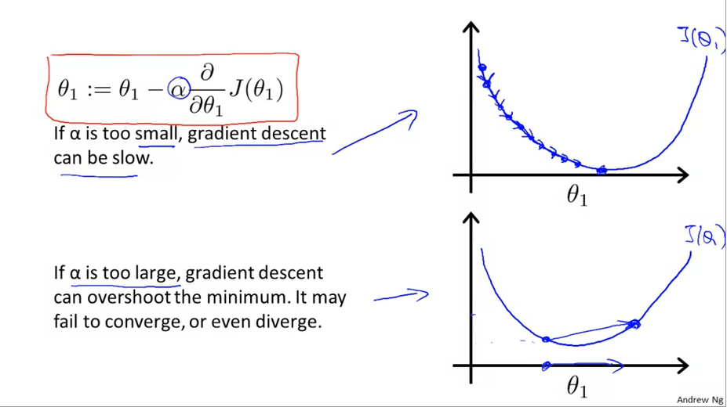
Gradient Descent

Slide 29
Google visualization: learning rate https://developers.google.com/machine-learning/crash-course/fitter/graph

Slide 30
Quiz: google batch gradient descent https://developers.google.com/machine-learning/crash-course/reducing-loss/stochastic-gradient-descent

Slide 31
Quiz: Cousera linear regression with one variable https://www.coursera.org/learn/machine-learning/exam/QeJ50/linear-regression-with-one-variable

Slide 32
Let’s chat
So, how’d this class go?
What was effective, if anything?
What do you need right now for this class that you’re not getting?
Can be about lecture, can also be about your classmates, the pace of the class, etc.

Slide 33
In-class: intro to ml and bootstrapping notebooks

