Slide 1
Data science week 8
Winter 2020 Data Science Cohort

Slide 2

Call notes
Hi Data Scientists! Welcome to virtual class!
Please keep your mics on mute unless you have a question
I think the best way to get my attention for a question will be to ask it on slack in the Data Science channel, I’ll be monitoring it as I go
If I don’t see it or it’s urgent, unmute and interrupt
Feel free to message Leanne/Bhavani for one-on-one questions, I won’t see DMs til after class

Slide 3
Attendance Code
Attendance code time!

Slide 4
Coronavirus notes
So things are different now for a while…
We will be remote for at least 2 weeks
Everyone’s got a different life situation, and these are strange times
If watching these lectures live isn’t working for you, that’s okay with me. Stay on top of the material
Please be in contact with me, Julie, Leanne, Bhavani, Jessi if you need help/ accommodation
Any ideas on how to code with your classmates? Feel free to brainstorm in slack

Slide 5
Agenda
Today’s Agenda:
Stats part 2
Experimental metrics, hypothesis testing, Central Limit Theorem
Not correlation (still important though!)
Review homework notebook
Little less interactive than usual ☹
In-Class:
Bootstrapping reading and video
Can do this on your own time between now and Friday

Slide 6
Statistics and experiments
“There are three kinds of lies: lies, damned lies, and statistics”
- Unknown
“While it is easy to lie with statistics, it is even easier to lie without them.”
- Fred Mosteller

Slide 7
Statistics and experiments
Let’s talk today about questions you can answer with statistics
Experimental sampling – what can I figure out about a population if I can’t measure the whole group?
Hypothesis testing – Are these two groups different? Did my new website feature increase sales? Is one drug treatment better than another? Etc.

Slide 8
Experimental metrics
Very often you can’t measure a whole population, you have to take a sample and make some assumptions about the underlying distribution
E.g. voter polls, coronavirus?
Sampling distributions
Sample mean vs. population mean
Standard deviation vs. standard error

Slide 9
Experimental metrics
Sample mean vs. population mean
From your book: say you want to know the average weight of gorillas living in a wildlife preserve. Weighing a gorilla requires tranquilization and is dangerous
The true mean if you could weigh all the gorillas would be the population mean
The mean of the gorillas you sample (from the book, 9 gorillas) is the sample mean
But what if we got unlucky and picked 9 unusual gorillas? Can we quantify how confident we are in our estimates?

Slide 10
Experimental metrics
Standard deviation vs. standard error
Standard deviation: variability of a measurement. From your book: “standard deviation describes variability in a measured quantity; in this example, the standard deviation of gorilla weight is 7.5 kg”
Standard error: a measure of how precise our estimate is of the mean
How much sample means will vary from the standard deviation of this sampling distribution
From your book: “So the question we answer is: “If the actual values of µ and σ were 90 kg and 7.5 kg, and we ran the same experiment many times, how much would the estimated mean, ¯x, vary?”

Slide 11
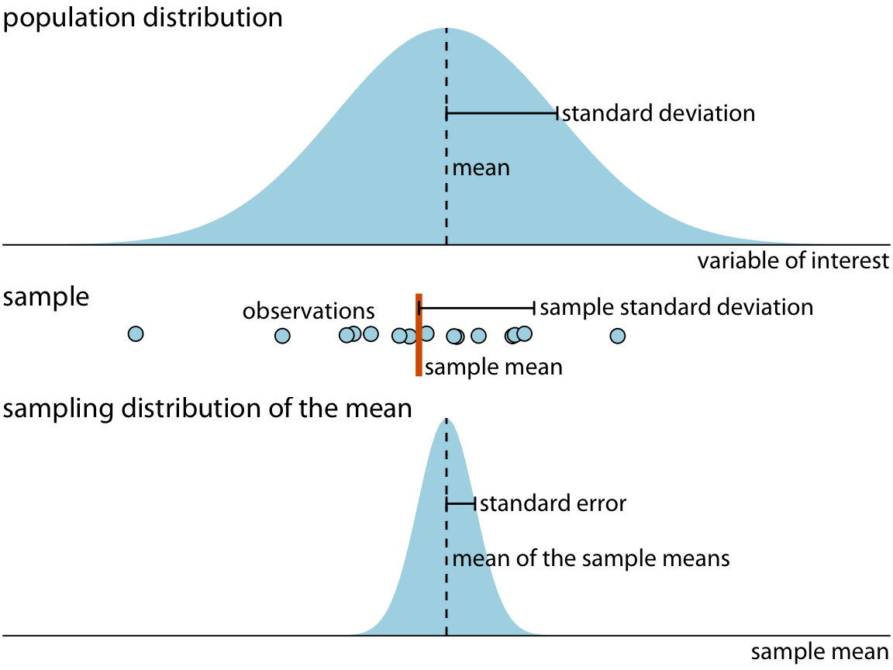
Experimental metrics
https://serialmentor.com/dataviz/visualizing-uncertainty.html

Slide 12
Experimental metrics
Let’s go back to the question: “But what if we got unlucky and picked 9 unusual gorillas? Can we quantify how confident we are in our estimates?”
One way is sample error
Another way is confidence intervals
Confidence intervals work like this: for a 95% confidence interval, if you ran the same experiment 100 times, the true sample mean would fall within that range 95 times
Calculated as a function of mean, standard error, sample size, and z-score
https://seeing-theory.brown.edu/frequentist-inference/index.html

Slide 13
Hypothesis testing
Hypothesis testing in statistics
We’ve talked about distributions. It should feel intuitive that if you’re sampling a population, there’s a chance you could randomly sample a part of the data that could give you an inaccurate understanding of the underlying distribution
E.g., coin flips. Is it possible to flip 100 heads in a row?

Slide 14
Hypothesis testing
Hypothesis testing in statistics
Tough to “prove” things in statistics. E.g., if we flip a coin 100 times and get 100 heads, is it a fair coin? PROBABLY not. But can’t prove it for sure.
We phrase things in terms of the null hypothesis: H₀ is that these two groups are the same, or that there is no difference.
Set a probability threshold: I would expect to see a difference like this by random chance 5% of the time, and that’s good enough for me to “reject the null hypothesis”

Slide 15
Hypothesis testing
Example: In 2008 Obama won 40% of the white male vote. It is 2012, so we sample 200 white male voters to measure their support for Obama. We find 35% support. Has support decreased?
H₀: Support has not decreased
H_{a}: Support has decreased
https://courses.lumenlearning.com/atd-herkimer-statisticssocsci/chapter/introduction-to-hypothesis-testing-4-of-5/

Slide 16
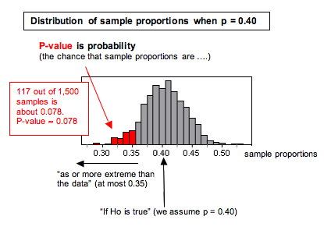
Hypothesis testing
https://courses.lumenlearning.com/atd-herkimer-statisticssocsci/chapter/introduction-to-hypothesis-testing-4-of-5/

Slide 17
Hypothesis testing
P-value
“In general, the P-value is the probability that sample results are as extreme as or more extreme than the result observed in the data if the null hypothesis is true.”
P-values are somewhat arbitrary and should be defined in advance of an experiment
Remember – if you set your P-value threshold at 0.05, 1/20 times you run an experiment you’d expect a false positive
https://xkcd.com/1478/
https://xkcd.com/882/

Slide 18
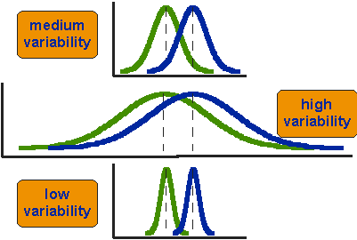
Hypothesis testing
Should feel intuitive that you need to know both the mean and the variance to compare populations
https://socialresearchmethods.net/kb/statistical-student-t-test/

Slide 19
Central limit theorem
The Central Limit Theorem:
We talked last week about the normal distribution and how it is special
Not all data is normally distributed, however, the CLT states:
“Given certain conditions, the arithmetic mean of a sufficiently large number of iterates of independent random variables, each with a well-defined (finite) expected value and finite variance, will be approximately normally distributed, regardless of the underlying distribution.”

Slide 20
Central limit theorem
The Central Limit Theorem:
What?
The CLT states: if you take sufficiently large samples from a distribution, the means of those samples will be approximately normally distributed, even if the distribution you’re sampling from is not normal
(“Sufficiently large?” Depends, ~30, rule of thumb)

Slide 21
Central limit theorem
The Central Limit Theorem:
Let’s take a look at some visualizations:
http://mfviz.com/central-limit/
https://seeing-theory.brown.edu/probability-distributions/index.html

Slide 22
Central limit theorem
The Central Limit Theorem:
So why does this matter?
Statistical methods that work for normal distributions can be applicable to many problems involving other types of distributions
You can then estimate the probability of a population mean given an observed sample mean, and quantify your confidence in that estimate

Slide 23
Homework Review: hypothesis testing notebook

Slide 24
Next week! Machine learning!

Slide 25
In-class: bootstrapping

