Slide 1
Welcome to CoderGirl!
Winter 2019 Data Science Cohort

Slide 2

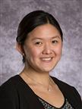
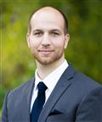
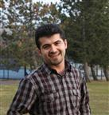
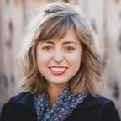
Meet your mentors
Diverse group of Data Scientists at Bayer Crop Science!
Sami Cheong
Chris Schlosberg
Reza Madankan
Rebecca Lowdon

Slide 3

Class Tools
Slack
Workspace: codergirlwinter2019.slack.com
Channel: #data-science
Canvas
Submission for:
Github
Central repository for in class assignments, homeworks
Online Learning
Python - HackerRank
Machine Learning - Google ML Crash Course
Applied Machine Learning - Kaggle
https://github.com/LaunchCoderGirlSTL/Data-Science-Assignments
Homework
In-Class assignment
CoderGirl Attendance

Slide 4
Class Structure
Every Wednesday 6-8pm
Self Attendance Check In
Canvas submission
In Class Activity
Due Fridays 8pm
Homework
Due Wednesdays 6pm

Slide 5
Class expectations
Attendance
Effort outside of class (~10 hours/week)
Keep up with the class pace
If you fall behind, it’s your responsibility to catch up in a timely manner
Participation – Share ideas and experiences
In Class
On Slack
There are no stupid questions
Ask. Someone else probably wants to know too!
Community
We strongly encourage study groups outside class!
Respect for others and an encouraging learning environment

Slide 6
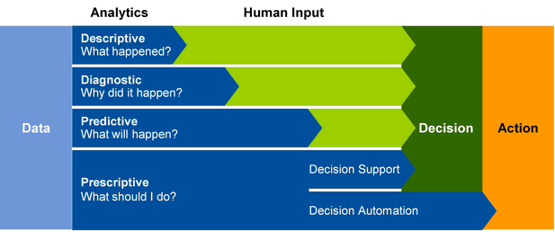
What is Data Science?

Slide 7
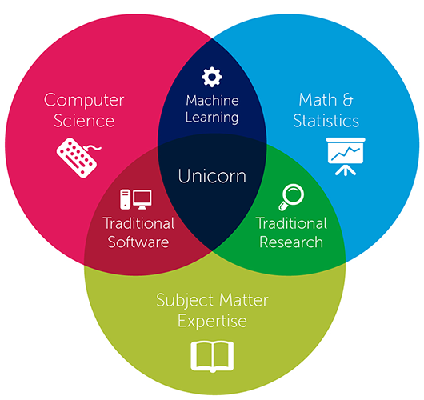
Who is a data scientist?

Slide 8
Designing a data Science career
Traits:
Constant Pursuit of Learning
Insatiable Curiosity
Ability to Prioritize
Impact Drive Mindset
Practical
Healthy Skepticism
Competencies:
Business Acumen
Business Analysis
Problem Solving
Storytelling
Business Communication
Project Management

Slide 9
Syllabus
Programming in Python (8 weeks)
Python
Pandas
Statistics
Machine Learning (13 weeks)
Loss Functions
Overfitting/Underfitting
Supervised/Unsupervised Learning
Applications in Machine Learning (3 weeks)
Your 1st Data Science Project!

Slide 10
Introductions!
Suggestions:
Name
Background – School or work
Where in STL do you call home?
Family? Fur Family?
What do you do now?
Why Data Science?
What are your goals completing this program?

