Slide 1
Data science week 7
Winter 2020 Data Science Cohort

Slide 2

Attendance Code
Attendance code time!

Slide 3
Quick notes
Thanks for documenting bugs and errors on slack!

Slide 4
Agenda
Today’s Agenda:
Descriptive Statistics
In-Class:
More Groupby practice

Slide 5
Statistics and EDA
Statistics and EDA
You just got a new data set. How do you want to look at it?
Different types of descriptive statistics can give you a sense of the data
Visualizing distributions can provide important information

Slide 6
Descriptive statistics for numerical data
Mean
Often called the “average”
Sum all the values and divide by the count of values
Median
Value in the middle of a list of quantities
Mode
Number which appears most often in a set of numbers

Slide 7
Mean vs median vs mode
Mean vs Median vs Mode – when to use?
Mean
What can you expect over the long term/many cases?
Median
What is a typical case?
Mode
What is most common?
The best choice will depend a lot on your data and the question you are trying to answer

Slide 8
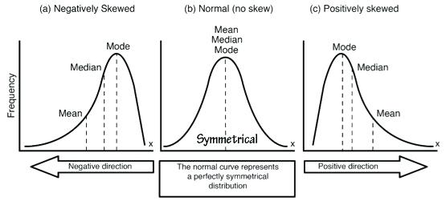
Mean vs median vs mode
Mean vs Median vs Mode – when to use?

Slide 9
Descriptive statistics for numerical data
Mean, median, and mode
Examples

Slide 10
Percentile Ranks/Quartiles
Percentile Rank and Quartiles
Percentile rank - The nth percentile is the smallest number that is greater than or equal to a certain percentage of the data points
E.g. – If you score in the 75th percentile on an exam, you scored better than 75% of people taking the same test
Quartiles – special case of percentiles – divide the data into 25%, 50%, 75% percentiles

Slide 11
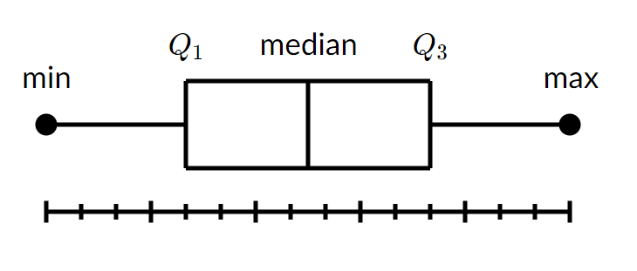
Box plots
Box plots
Box plots are a different way of looking at your data and comparing groups
Draw a box from the first quartile to the third quartile. Line at the median. “Whiskers” out to the min and max values.

Slide 12
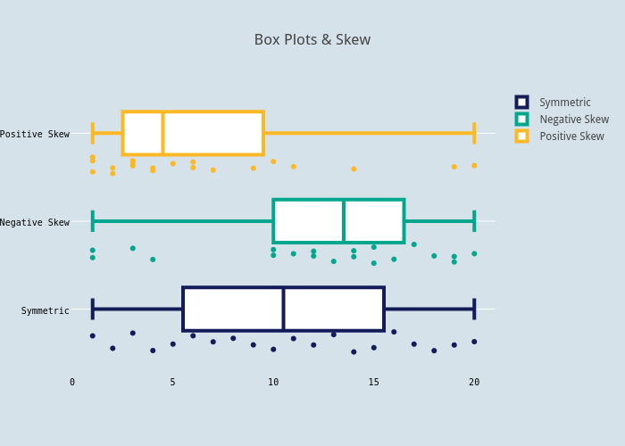
Box plots
Box plots can help you see skewness, outliers, etc.

Slide 13
Box plots
Box plot example

Slide 14
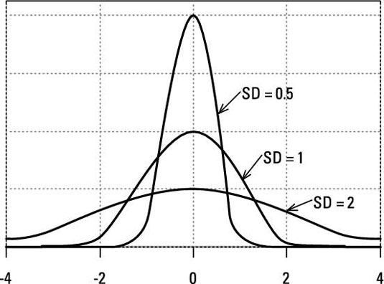
Variance and standard deviation
Variance, standard deviation
These are ways to measure the “spread” of your data
Data with the same mean can have different variances

Slide 15
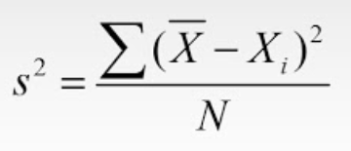
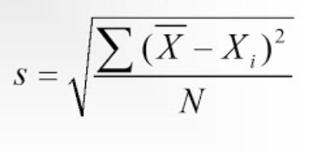
Variance and standard deviation
Variance
Calculated by taking the average squared deviations of values from the mean
Standard deviation
Square root of the variance

Slide 16
Variance and standard deviation
Variance vs. Standard Deviation
Both are measurements of the spread of the data
Standard deviation will be in the same units as the underlying data, while variance will be squared
Both will come up in statistical analysis
A note on N vs N-1
For the population, divide by N. For samples of a population, divide by N-1
If you’re interested in why, go here
If you’re not interested in why, just remember this is why different stdev package functions will give different results

Slide 17
Distributions
We know how to look at things like mean and spread, and we can get an intuition for how this represents the distribution of data
Distributions
All the values of your data and how often they occur
Useful to get a sense for things like:
Any big values skewing my data? Any bimodal type effects? Etc?
Is it normally distributed? (CAN BE VERY IMPORTANT FOR ML)

Slide 18
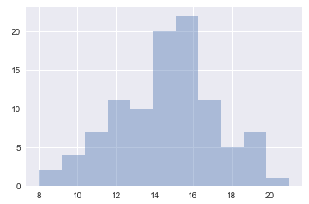
Distributions
So how can we look at distributions?
Histograms
Plot the number of times that values appear in the data
100x 30-coin flip example from warm-up:

Slide 19
Distributions
Ways to look at the distribution of data
Histograms, PMFs, PDFs
PMF – Probability Mass Function
Like a histogram, except normalized by probability
Take the whole dataset and compute the probability of seeing some value
All values in a PMF should sum to 1
PDF – Probability Density Function
Continuous function fit to your PMF

Slide 20
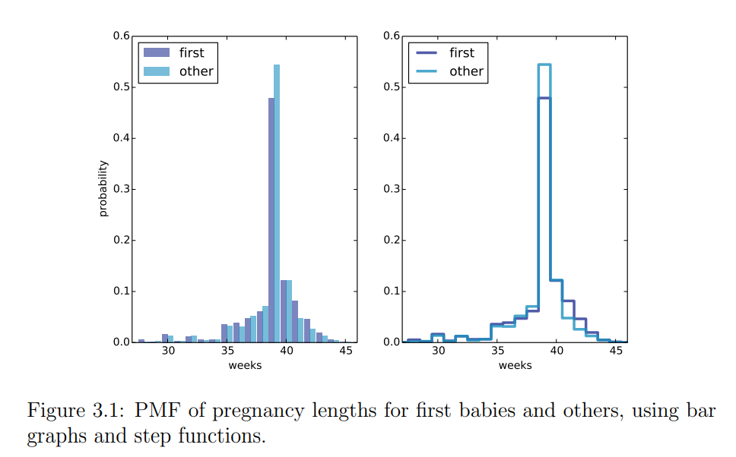
Distributions
Ways to look at the distribution of data
Histogram of counts vs PMF
PMF can be useful if you want to compare histograms from datasets of different sizes, e.g.:

Slide 21
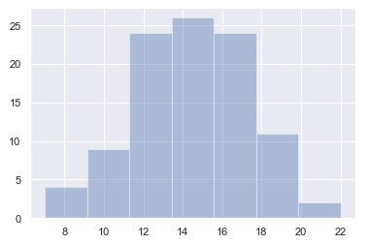
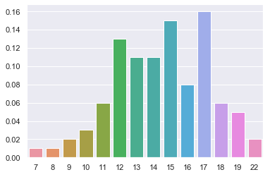
Distributions
Ways to look at the distribution of data
Histogram of counts vs PMF
100x 30 coin flip example:

Slide 22
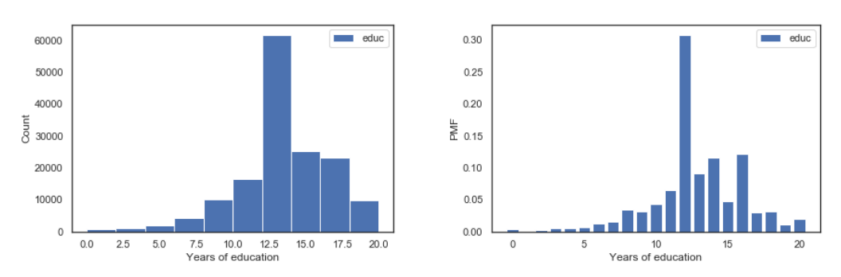
Distributions
Ways to look at the distribution of data
Histogram of counts vs PMF
Education level of survey population
Source: https://s3.amazonaws.com/assets.datacamp.com/production/course_15300/slides/chapter2.pdf

Slide 23
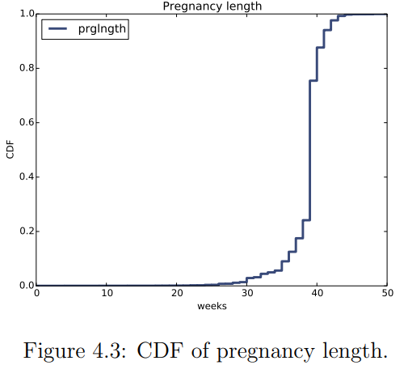
Distributions
Ways to look at the distribution of data
CDFs – map all data to its percentile

Slide 24
The Normal Distribution!
The normal distribution is a special type of distribution that comes up a lot in statistics
Typical “bell shape” distribution
Can be described by two parameters: the mean and the standard deviation
“Standard normal” curves have mean 0 and standard deviation 1

Slide 25
The Normal Distribution!
Why do we like the normal distribution?
Describes many natural phenomena
Blood pressure, height, hand length, etc
Has some magical properties
We will cover the Central Limit Theorem next week
Some mathematical assumptions that power ML models don’t work unless you assume normally distributed data – we’ll cover those when we get there
If we know the mean and stdev, we know how much data falls where

Slide 26
The normal distribution!
In a normal distribution:
50% of the data is above the mean, 50% is below
68/95/99.7 rule:
68% of the data falls within 1 standard deviation of the mean
95% of the data falls within 2 standard deviations of the mean
99.7% of the data falls within 3 standard deviations of the mean

Slide 27
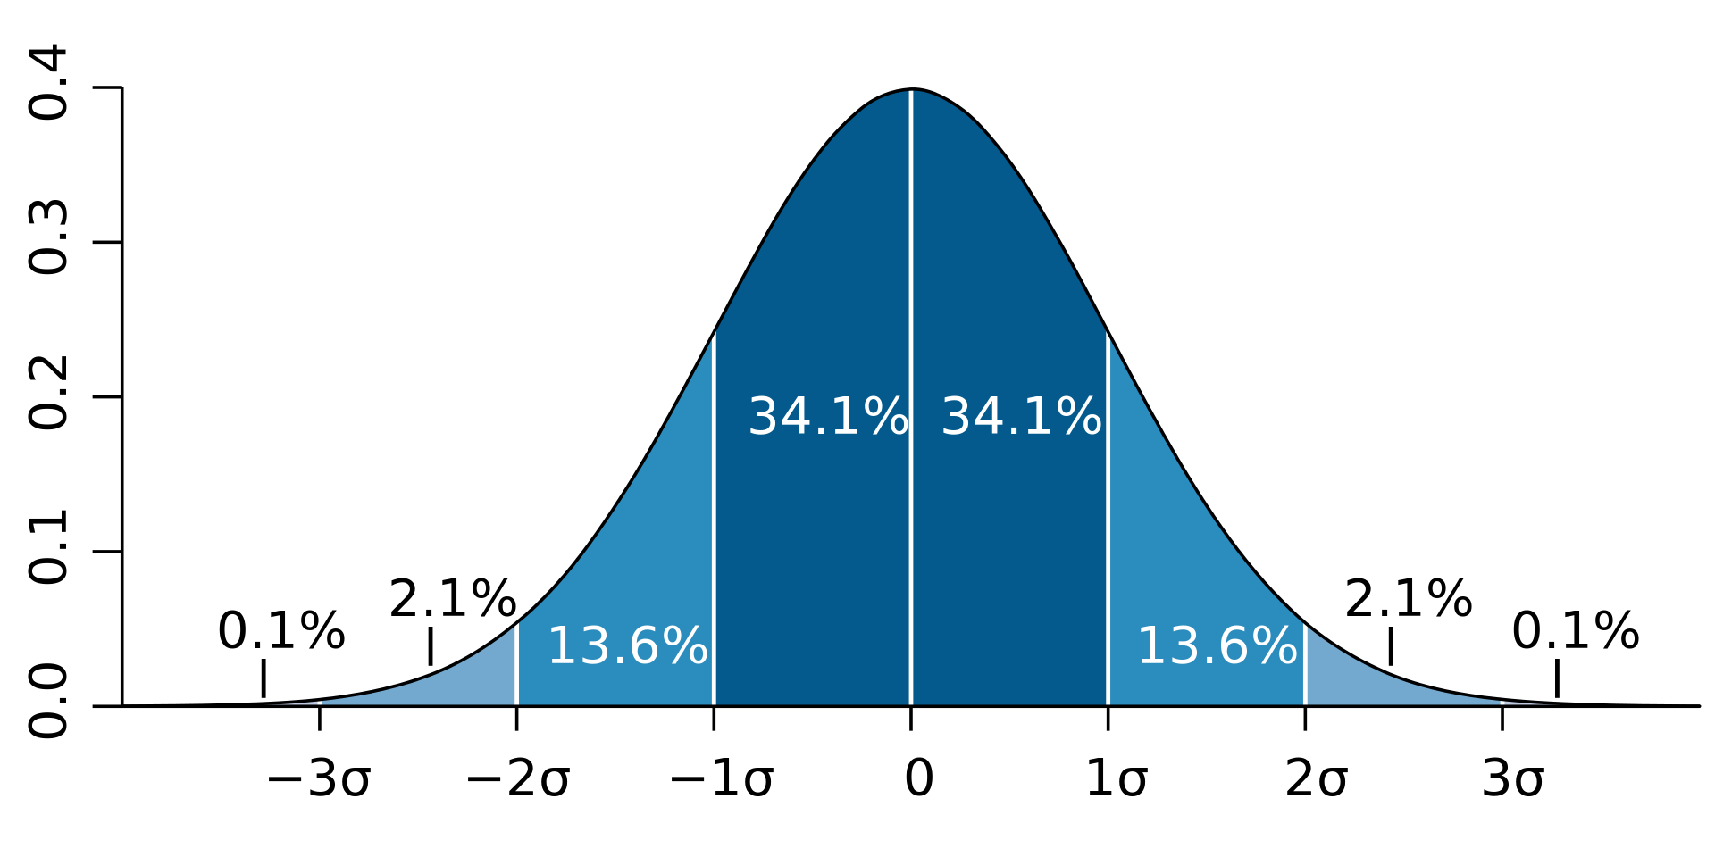
The normal distribution!
68/95/99.7 rule:
Given mean µ and stdev σ:
https://www.khanacademy.org/math/statistics-probability/modeling-distributions-of-data/normal-distributions-library/e/empirical_rule

Slide 28
In-class: groupby reading/notebook

