Slide 1
Data science week 22
Winter 2020 Data Science Cohort

Slide 2

Attendance code
Attendance code:

Slide 3
Agenda
Today’s Agenda:
How’d part 1 go?
Anonymous polls (data on data scientists)
Share tips, discuss concerns, show some code
Fitting a model, quantifying results, markdown

Slide 4
How’d it go?
Submitting an EDA notebook (part 1 homework)
Are you on track?
Yes: I got my EDA notebook submitted and I’m ready for part 2
Kind of: I’m a little behind but I made good progress and can catch up and finish part 2 by Jul 1.
No: I’m way behind and need help
Do you feel like you had the background/skills you needed for part 1?
Do you feel like you have the skills you need to complete part 2?

Slide 5
Part 1 open discussion

Slide 6
Project overview
Timeline and expectations:
Wednesday, July 1:
Submit your github repo link with a 2nd notebook OR extended notebook from part 1
Your notebook should cover:
(Feature engineering, if not captured in the EDA notebook. Sometimes it is easier or makes more sense to do feature engineering in the same notebook as your model.)
Splitting data into train/test sets
Build (at least one) model
Predict test set using model(s)
A quantitative metric of model(s) performance
In-class: 1-10 minute summary of your code

Slide 7
Split
Split
from sklearn.model_selection import train_test_split
X_train, X_test, y_train, y_test = train_test_split(X, y, test_size=0.33, random_state=42)
Note: this shuffles your data by default (can turn that off if you want to).
Setting the random seed will give you the same results if you want your notebook output to always be the same when someone runs it)
I’m going to leave train/test/validation up to you

Slide 8
Train and predict
Let’s try linear regression
from sklearn.linear_model import LogisticRegression
Train a model:
my_model = LogisticRegression(random_state=0) my_model.fit(X_train, y_train)
Predict using that model:
y_pred = my_model.predict(X_test)

Slide 9
Metrics
Evaluating your performance
Accuracy
Remember: this is % you got correct.
(TP + TN)/(TP + TN + FP + FN)
Sklearn estimators have a score method, can vary for each model. For logistic regression models, it’s accuracy.
my_model.score(X_test,y_test)

Slide 10
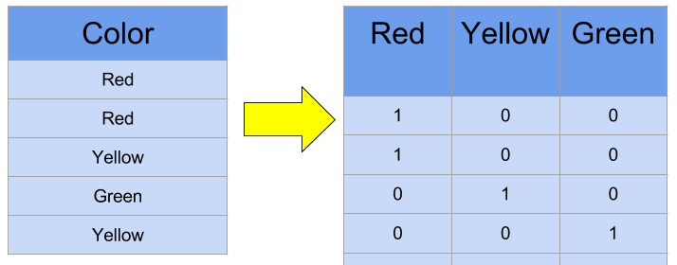
Feature Engineering
Lots you can do for feature engineering, e.g….
Encoding categorical variables
One-Hot Encoding
dataset = pd.get_dummies(df, columns = ['sex','cp'])

Slide 11
What else can I do?
Ideas
Consider your split strategy
Write up your thoughts
Try different classifier models
Decision Tree?
Try different result metrics
Precision/recall?
Try comparing results of the same model after different feature engineering steps
E.g. first try all columns, get baseline accuracy, then select a subset, or normalize, or…

Slide 12
Markdown
Some quick Markdown tips (optional, for style) (Documentation) (Nice cheat sheet)
Italic – single asterisks
Bold – double asterisks
Bullet points – dash space, sub bullet with tab dash space
Headers
Single # followed by space for header
## followed by space for subheader
Links [link text](http://url)
Horizontal lines – three asterisks

