Slide 1
Data science week 16
Winter 2020 Data Science Cohort

Slide 2

Agenda
Today’s Agenda:
Finish up Fashion MNIST notebook – plotting
A brief and very late interlude to look at plotting basics (Part 1)
What were we plotting in the notebook?
Decision Trees, Random Forest, Boosting

Slide 3
Fashion MNIST PLOT REVIEW

Slide 4
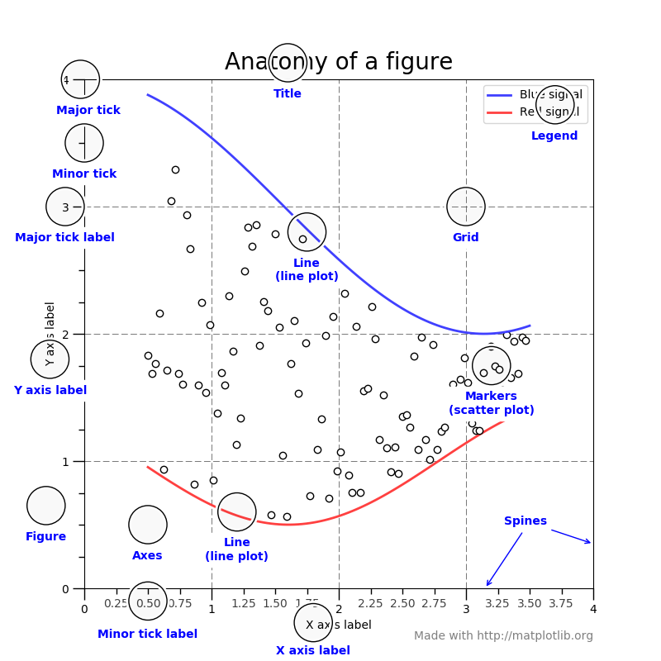
Plotting tips
Anatomy of a matplotlib figure:
Source: https://matplotlib.org/tutorials/introductory/usage.html#sphx-glr-tutorials-introductory-usage-py

Slide 5
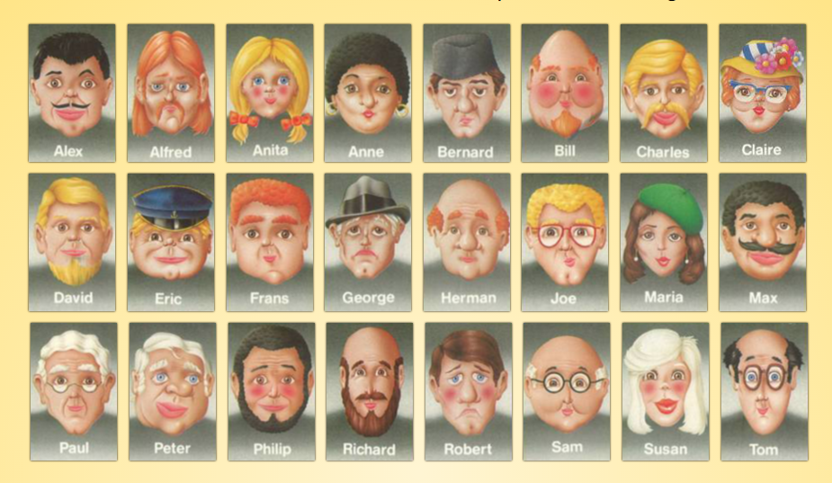
Decision trees

Slide 6
Decision trees
Decision trees:
Supervised learning
Can be used for categorization or regression
General idea:
Take input data
Create a “branch” that separates the data in as informative a way as possible
Repeat step 2 until there’s no more informative separations you can make – this results in a “leaf”

Slide 7
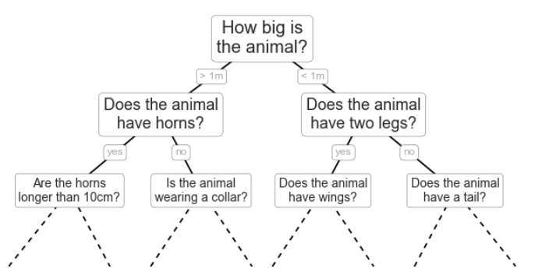
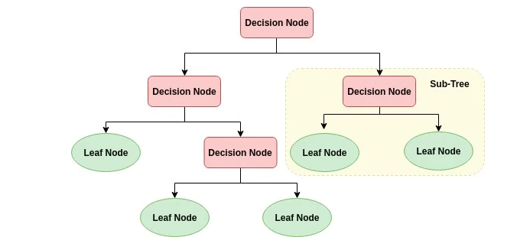
Decision trees

Slide 8
Decision trees
Okay so what do we mean when we say we separate the data in the most informative way?
Quantitative measures of information:
Gini index
Entropy/information gain

Slide 9

Decision trees
Gini index
Formula:
pi = proportion of data labeled as class ci
Imagine we have 4 gumballs and are trying to predict gumball color
If a branch would split gumballs into 4 red gumballs and 0 blue gumballs:
If a branch would split gumballs into 2 red and 2 blue:

Slide 10

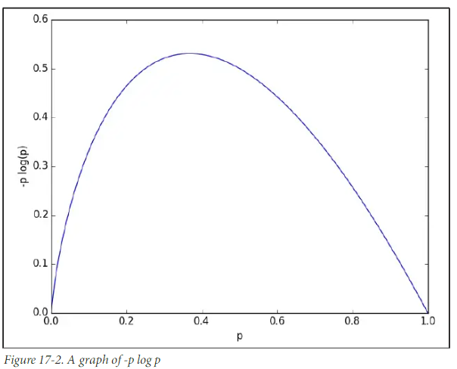
Decision trees
Entropy
Formula:
Entropy lowest when pi is 0 or 1

Slide 11
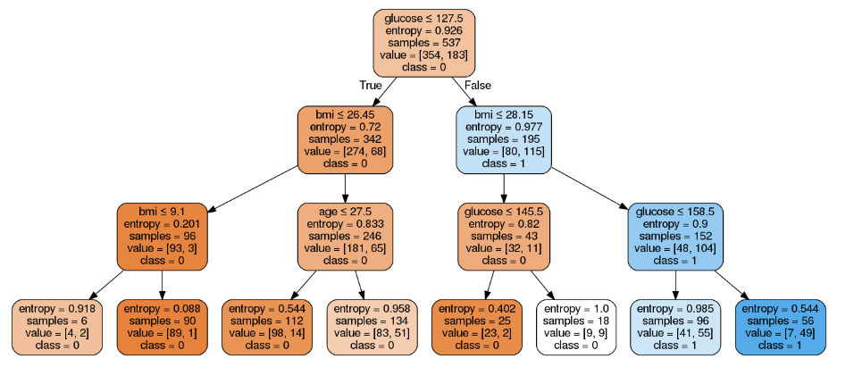
Decision trees
The good news about decision trees: explainable!

Slide 12
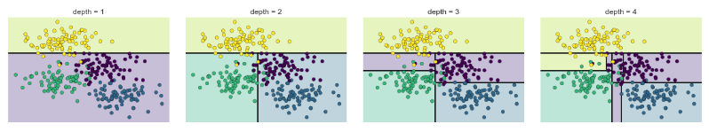
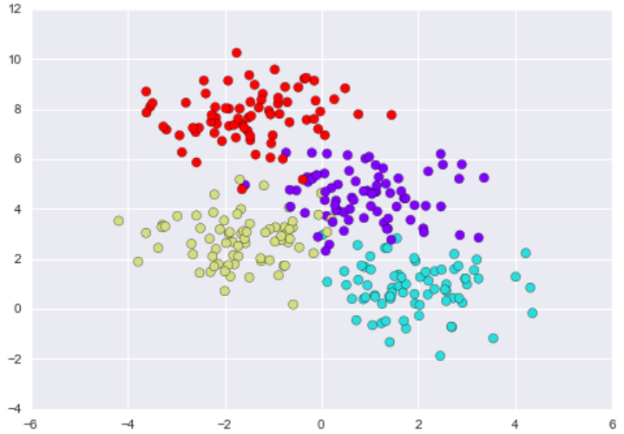
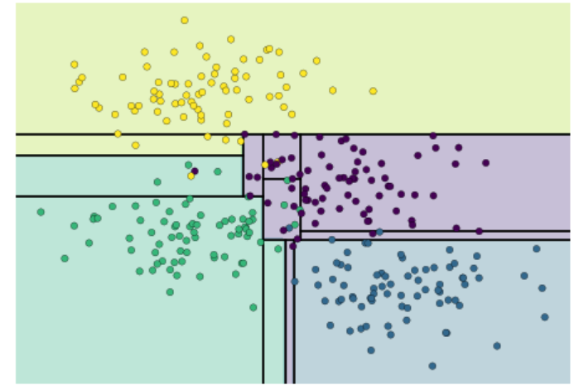
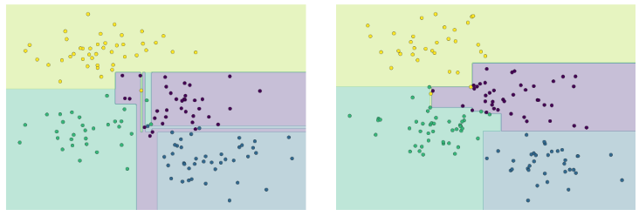
Decision trees
The bad news about decision trees: overfitting!

Slide 13
Random forest
If you take a decision tree, and add bagging to prevent overfitting, you have a Random Forest
Bagging (Bootstrap Aggregating)
Remember bootstrapping? Take random subsets of your data and perform an operation like distribution of means?
Random Forest models:
Take random subsets of the data
Take random subsets of the features
Fit decision trees
Each decision tree outputs a prediction. At the end, have them “vote” to determine the final prediction

Slide 14
Boosting
Improve random forest predictions with boosting
Boosting:
Train a decision tree (stump/weak learner), generate a prediction.
Calculate the error and find the misclassified points
Weight the misclassified points more heavily
Use the unevenly weighted points to train the next decision tree
All trees vote proportional to their overall weighted error

Slide 15
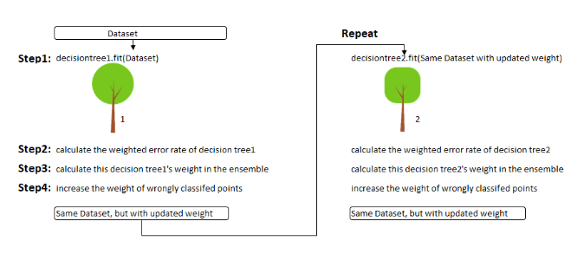
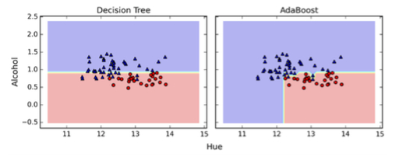
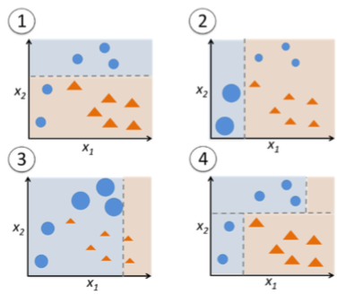
Boosting

Slide 16
Takeaways
Decision trees/random forests are another kind of supervised learning algorithm
Intuitive and easy to explain
Prone to overfitting, but Random Forests help
Boosting is a common technique to improve performance
You’ll see lots of random forests + boosting if you get into kaggle

Slide 17
In-class: Boosting blog posts

