Slide 1
Data science week 21
Winter 2020 Data Science Cohort

Slide 2

Attendance code
Attendance code:

Slide 3
Let’s Talk
Whiteboarding
3 classes left (OMG)

Slide 4
Agenda
Today’s Agenda:
Mini project overview
Plotting and EDA
Set up our environments and write some code

Slide 5
Project overview
The dataset: https://www.kaggle.com/ronitf/heart-disease-uci
The ML goal: given a set of information about a patient, predict whether the patient has heart disease (in this dataset, 0 = heart disease)
Bonus goals:
Learn how to pick up a dataset on Kaggle
Get practice tying all the skills you’ve learned together
Mini project for your portfolio

Slide 6
Project overview
Timeline and expectations:
Wednesday, June 24th:
Submit a link to your github repo with a notebook that covers EDA of the dataset
Your notebook should cover:
Data issues: missing values, duplicate values, outliers
Data cleaning solutions: imputation/estimation, dropping entries -- justify your choices!
Describe the relationship of features to your target (should include at least a few plots).
Feature engineering (transformation, normalization, creating new combinations of features, etc), if you think this is necessary. Describe your rationale.
In-class: review obstacles, prepare for model fitting

Slide 7
Project overview
Timeline and expectations:
Wednesday, July 1:
Submit your github repo link with a 2nd notebook OR extended notebook from part 1
Your notebook should cover:
(Feature engineering, if not captured in the EDA notebook. Sometimes it is easier or makes more sense to do feature engineering in the same notebook as your model.)
Splitting data into train/test sets
Build (at least one) model
Predict test set using model(s)
A quantitative metric of model(s) performance
In-class: 1-10 minute summary of your code

Slide 8
Project overview
How to get help and collaborate:
From each other:
Feel free to work together, discuss code/ideas, talk out issues you run into on slack, share code snippets
Please don’t entirely copy someone else’s notebook
From the course mentors:
Ask for help on slack, let me know if you need office hours for this project!
From the internet:
Kaggle has column descriptions, discussion forums and notebooks
Don’t entirely copy a kaggle notebook either please

Slide 9
eda
Useful commands for EDA:
What’s my data structured like?
data.head()
How many rows and columns?
data.shape
What are my columns like?
data.info()
How is my data distributed?
data.describe()
Any null values?
data.isnull().sum()
What features are correlated?
data.corr()

Slide 10
Plotting in python
Generating plots in python
Matplotlib
Import matplotlib.pyplot as plt
plt.plot(some data)
plt.show
https://matplotlib.org/tutorials/introductory/pyplot.html
Seaborn
Import seaborn as sns
sns.boxplot(some data)
https://seaborn.pydata.org/introduction.html

Slide 11
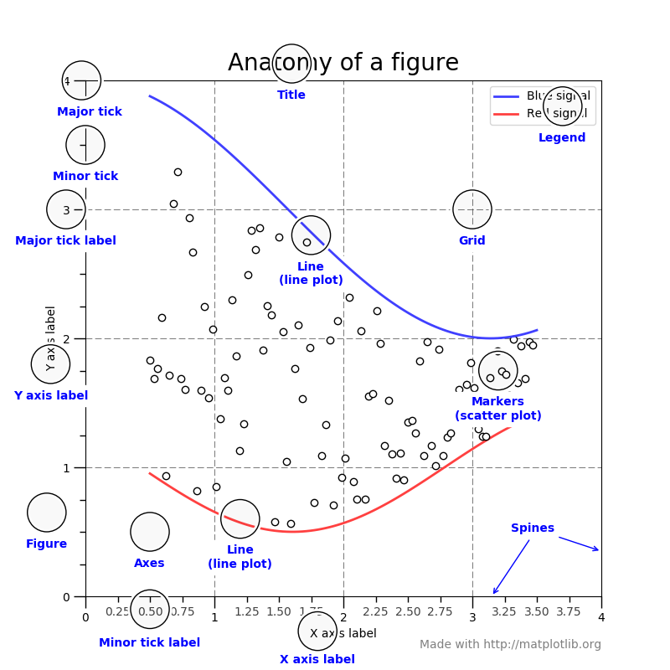
Plotting tips
Anatomy of a matplotlib figure:
Source: https://matplotlib.org/tutorials/introductory/usage.html#sphx-glr-tutorials-introductory-usage-py

Slide 12
Plot practice
Useful plot: a bar plot
Let’s make a bar plot breaking out the distribution of men and women in the dataset
Matplotlib:
df['sex'].value_counts()
x = ['men','women']
y = [207,96]
plt.bar(x,y)
Seaborn:
sns.countplot(x="sex", hue="target", data=df)
https://seaborn.pydata.org/generated/seaborn.countplot.html

Slide 13
Plot practice
Useful plot: distributions
Some plots to look at data distribution:
Box and whisker:
plt.boxplot(df['age'])
sns.boxplot(df['age'])
Histogram/KDE:
plt.hist(df['age'])
sns.distplot(df['age'])

Slide 14
Plot practice
Useful plot: features by target
plt.figure(figsize = (10, 8))
sns.kdeplot(df.loc[df['target'] == 0, 'age'], label = 'Heart Disease')
sns.kdeplot(df.loc[df['target'] == 1, 'age'], label = 'No Heart Disease')
# Labeling of plot
plt.xlabel('Age (years)'); plt.ylabel('Density'); plt.title('Distribution of Ages');

Slide 15
Plot practice
Useful plot: correlation plot
Seaborn heatmap:
correlations = df.corr()
sns.heatmap(correlations)
Try arguments like cmap = plt.cm.RdYlBu_r
https://seaborn.pydata.org/generated/seaborn.heatmap.html
https://seaborn.pydata.org/tutorial/color_palettes.html
Seaborn pairplot:
sns.pairplot(df)
Try hue = target or limiting columns
https://seaborn.pydata.org/generated/seaborn.pairplot.html

