Slide 1
Data science week 3
Winter 2020 Data Science Cohort

Slide 2

Attendance Code
Attendance code time!

Slide 3
Quick notes!
Welcome back!
Introductions
Homework submission

Slide 4
Getting Fancy with python
Today’s Agenda:
Debugging tips
Lambda functions and list comprehensions
Homework Review
In-class assignment

Slide 5
debugging
You’ll probably see lots of error messages in your programming life
This is normal
Strategies for debugging:
IDE Linters/Notifications
Read the traceback
Use print statements
Use Spyder breakpoints
Google it!
StackOverflow

Slide 6
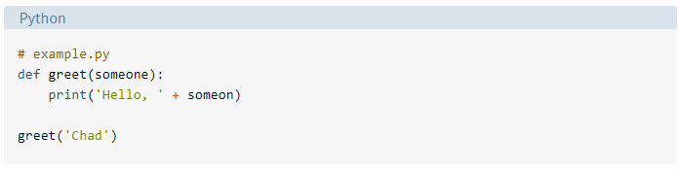
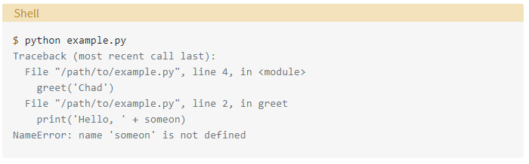
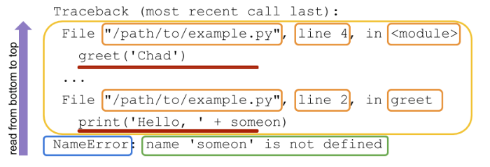
Traceback anatomy
Exception name
Error message
Code location
Code that was executed
Source: https://realpython.com/python-traceback/

Slide 7
Debugging demo

Slide 8
Lambda and list comprehension
Lambda functions
A more efficient way of writing functions
Define a function in-line vs. separately
Iterate with map, filter, reduce
They’re a little controversial
“…there aren't a whole lot of places where you really need to write very short local functions”

Slide 9
Anatomy of a function
Function name (should be descriptive)
Inputs (what you send in)
“Def” means define, tells Python
this is a function, don’t run it yet
def greet(name):
greeting = "Hello " + name + ", it's nice to meet you"
return greeting
All the code saying what is gonna happen to the inputs (indent it)
Return [variable] says what you are going to return when you call this function. If you say a = greet(name), a will be equal to what you return here, which is greeting. You do not have to name this the same as the variable you’re assigning it to in your main code

Slide 10
Lambda function anatomy
Function:
def doubler(x):
return x*2
new_var = doubler(2)
Lambda:
new_var = lambda x: x*2
Arguments
Expression

Slide 11
Lambda and list comprehension
List Comprehension
A more efficient way of flattening nested loops, iterating over lists
Can do all the things lambda functions can without worrying about map and filter

Slide 12
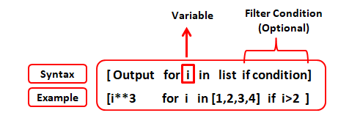
List comprehension anatomy
Source: https://www.listendata.com/2019/07/python-list-comprehension-with-examples.html

Slide 13
Lamda/List/Loop demo

Slide 14
Lambda and list comprehension
Why do we learn these things?
They can be a useful tool
Can make for cleaner code
Can be faster
This seems trivial but don’t forget that Data Science is all about giant piles of data
You might see them in others’ code
If you don’t get it… don’t worry about it

Slide 15
Homework review 1
Hackerrank: List Comprehensions
Print all coordinate combinations that do not sum to N
https://www.hackerrank.com/challenges/list-comprehensions/problem

Slide 16
Homework review
Other HackerRank questions?

Slide 17
In-class assignment: Intro Python Notebook

Slide 18
In-Class assignment
Work through a python notebook
First, we’ll fork and clone the repo so the notebook is on your system

