Slide 1
Data science week 15
Winter 2020 Data Science Cohort

Slide 2

Attendance Code
Attendance code time: TerrificTSQL

Slide 3
Agenda
Today’s Agenda:
Fashion MNIST Notebook walk-through
Bias/Variance notebook if we have time

Slide 4
Let’s chat
Finish off neural networks tonight
Spend time trying to match up all the theory we’ve learned with the code that we’ve written for neural networks
Next week on to other machine learning algorithms!
If you feel like you haven’t 100% mastered neural networks by the end of tonight… that’s normal!

Slide 5
Fashion MNIST Notebook walk-through

Slide 6
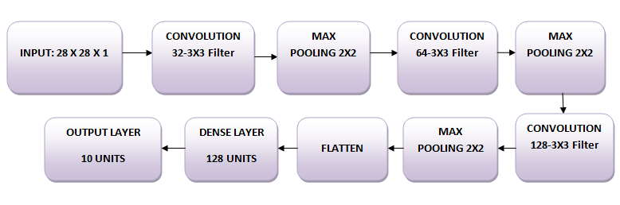
Let’s build a neural network!
Here are our instructions:
You'll use three convolutional layers:
The first layer will have 32-3 x 3 filters,
The second layer will have 64-3 x 3 filters and
The third layer will have 128-3 x 3 filters.
In addition, there are three max-pooling layers each of size 2 x 2.
Use Leaky ReLUs
End with a dense layer with a softmax activation function

Slide 7
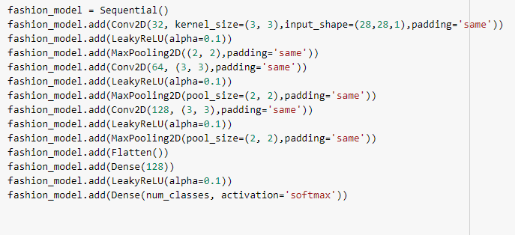
The Code:
Code:

Slide 8
The Code:
Let’s go through it step by step:

Slide 9
The Code:
Step 0: Initialize the model
fashion_model = Sequential()
Tell python to create a fashion_model object and let it know you’re going to build it out sequentially

Slide 10
The Code:
Step 1: First convolutional layer
“The first layer will have 32-3 x 3 filters”
fashion_model.add(Conv2D(32, kernel_size=(3, 3),input_shape=(28,28,1),padding='same'))
What’s going on here? Let’s go back to “An Intuitive Explanation of Convolutional Neural Networks”

Slide 11
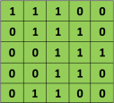

Convolutional Layers
What’s convolution?
Purpose: extract “features” from an image
Reason: computers can’t “see” like you can, they just get pixel intensities, so you have to give them a way to figure out how pixels “go together” so they can learn
How to do it: slide a matrix over your image:
Filter
Image

Slide 12
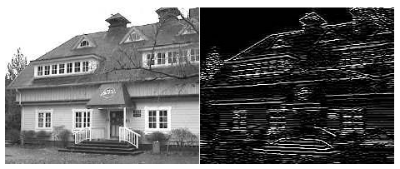
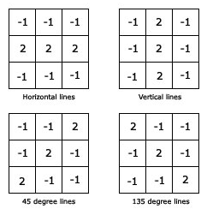
Convolutional Layers
What’s convolution?
Source: https://aishack.in/tutorials/image-convolution-examples/

Slide 13
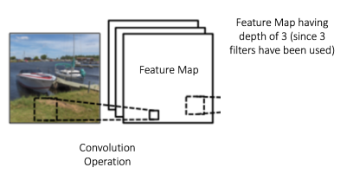
Convolutional Layers
Arguments for convolution
Depth: How many layers of convolution
Kernel Size: shape of the matrix you slide
Stride: How many pixels you slide the matrix
Padding: whether you pad your image matrix with zeros around the edges so you can apply your filter to border pixels

Slide 14
Convolutional Layers
Back to the code:
fashion_model.add(Conv2D(32, kernel_size=(3, 3),input_shape=(28,28,1),padding='same'))
Depth = 32: 32 layers of convolution (more here)
Kernel size = 3x3: slide a 3x3 matrix over your image
Input_shape = 28x28x1: images are 28x28 pixels, one color channel
Padding = ‘same’: pad the input image with 0s on the borders so that your output convolved image is the same size. (note: if padding = valid, no padding is added and your image shrinks)

Slide 15
Leaky Relu layers
Finish step 1:
fashion_model.add(Conv2D(32, kernel_size=(3, 3),input_shape=(28,28,1),padding='same'))
fashion_model.add(LeakyReLU(alpha=0.1))
After each convolution layer, you add these leaky ReLU layers. Why?

Slide 16
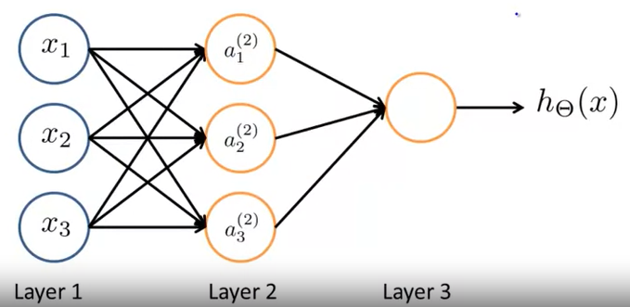
Leaky Relu layers
Leaky ReLU
Remember that Coursera and Google ML told us how neural networks allow nonlinear transformation of input data
Adding the activation layer is just specifying what kind of nonlinear activation function you want to use in your neuronal nodes

Slide 17
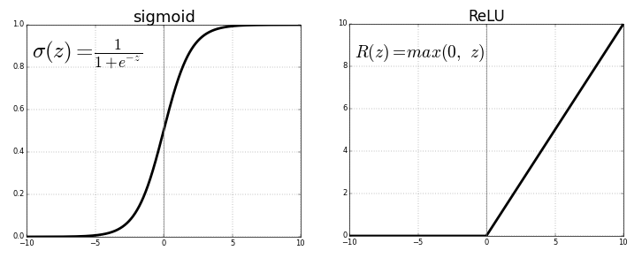
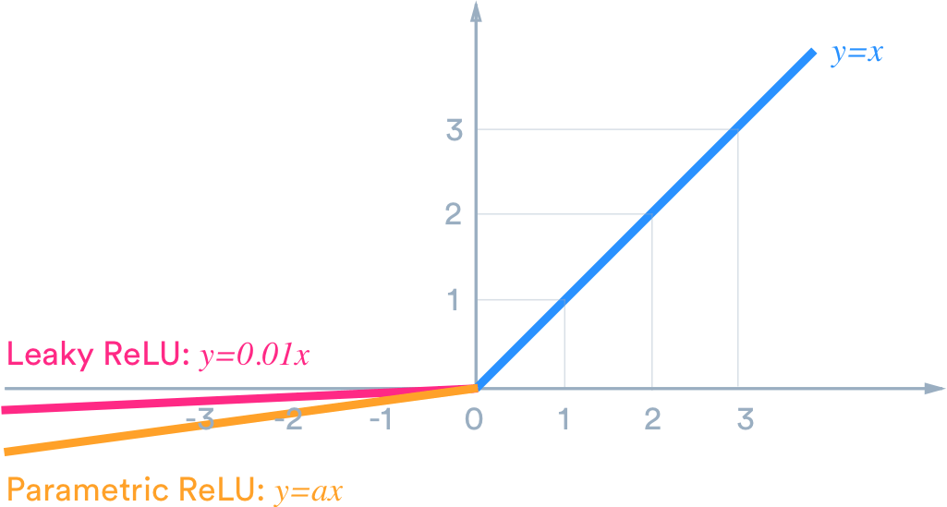
Leaky Relu layers
Why Leaky ReLU?
Sigmoid vs ReLU: ReLU has wider dynamic range
ReLU vs leaky ReLU: avoids problems of dying ReLUs

Slide 18
The Code:
Let’s go through it step by step:

Slide 19
The Code:
Let’s go through it step by step:

Slide 20
Pooling layers
Step 2: Add a pooling layer
“In addition, there are three max-pooling layers each of size 2 x 2.”
fashion_model.add(MaxPooling2D((2, 2),padding='same'))
What’s going on in our pooling layer?

Slide 21
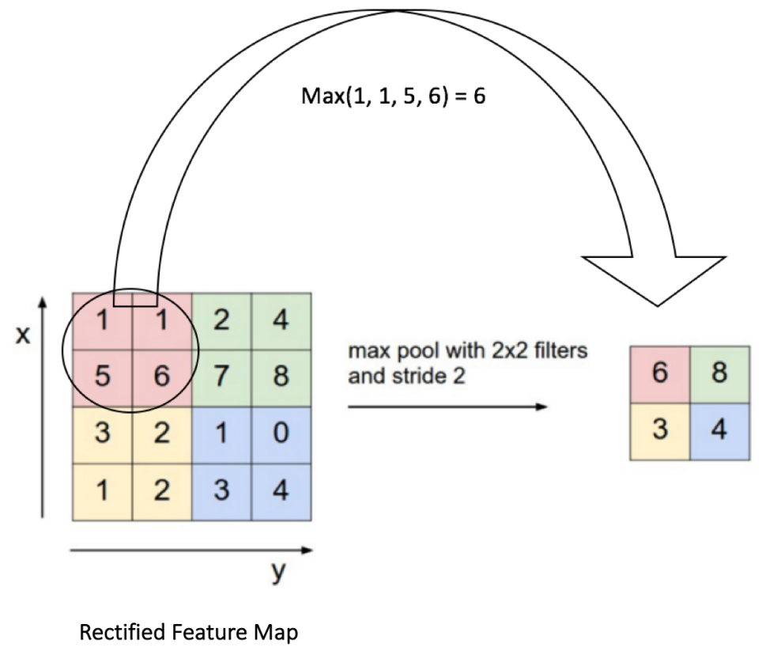
Pooling
Pooling
Back to the intuitive understanding article:

Slide 22
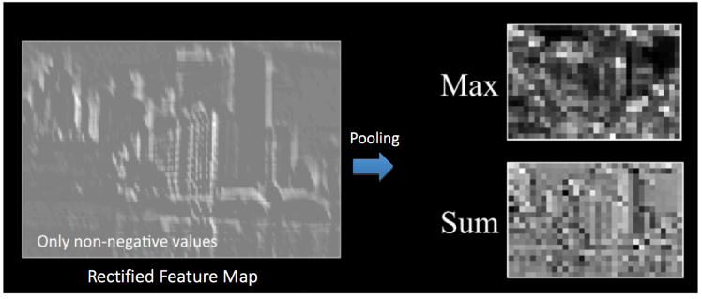
Pooling
Pooling
Back to the intuitive understanding article:

Slide 23
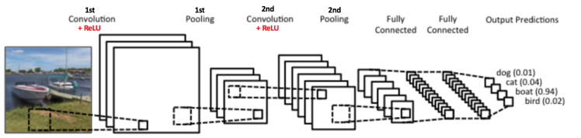
Pooling
Why do we do it?
Progressively reduce the spatial size of the input
Make the input representations (feature dimension) smaller and more manageable
Reduce the number of parameters and computations in the network, therefore, controlling overfitting
Make the network invariant to small transformations, distortions and translations in the input image
Help us arrive at an almost scale invariant representation of our image

Slide 24
Pooling layers
Step 2: Add a pooling layer
fashion_model.add(MaxPooling2D((2, 2),padding='same'))
MaxPooling2D: Take maximum pixel value in a region
(2,2): Look at 2x2 regions (will reduce your dimension by that factor, so expect your x and y size to be cut in half)
Padding = ‘same’: add 0s to get the edges

Slide 25
The Code:
Let’s go through it step by step:

Slide 26
The Code:
Let’s go through it step by step:

Slide 27
The Code:
Let’s go through it step by step:

Slide 28
Dense layer
Step 3: Flatten and add a dense layer
fashion_model.add(Flatten())
fashion_model.add(Dense(128))
fashion_model.add(LeakyReLU(alpha=0.1))
What are we doing with this dense layer?

Slide 29
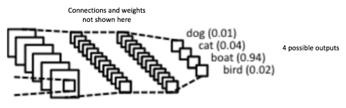
Dense layer
Dense Layer
Purpose: flatten and combine all the high level features our network has learned and pass them into a final classifier layer

Slide 30
Dense layer
The code:
fashion_model.add(Flatten())
fashion_model.add(Dense(128))
fashion_model.add(LeakyReLU(alpha=0.1))
Flatten(): Take an input tensor (matrix) and make it 1-dimensional
Add(Dense(128): Add a dense layer (aka fully-connected layer) with 128 units
add(LeakyReLU(alpha=0.1): Specify that the activation function of those units is a Leaky ReLU

Slide 31
The Code:
Let’s go through it step by step:

Slide 32
The Code:
Let’s go through it step by step:

Slide 33
Softmax output layer
Step 4: Add the output layer
“The last layer is a Dense layer that has a softmax activation function with 10 units, which is needed for this multi-class classification problem.”
fashion_model.add(Dense(num_classes, activation='softmax'))
What’s a softmax layer and why do we need it?

Slide 34
Softmax output layer
Softmax layers
Remember that the whole point of a neural network is to generate some prediction
This architecture doesn’t make much sense when we need to predict which of 10 classes an image belongs to

Slide 35
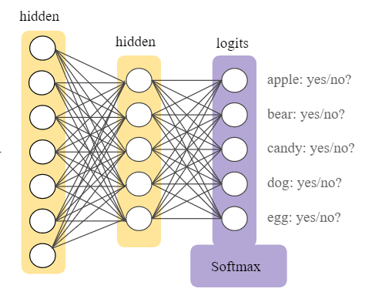
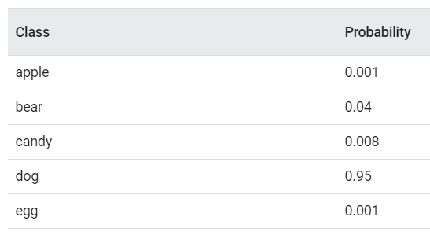
Softmax output layer
Softmax layers
Have one output neuron for each class and make sure the probability of all neurons sums to 1

Slide 36
Softmax output layer
The code
fashion_model.add(Dense(num_classes, activation='softmax'))
Dense(num_classes): Add another dense (fully-connected) layer with a number of nodes equal to num_classes (10)
Activation = ‘softmax’: this is not a ReLU function like other layers we’ve added. It’s still an activation function, but for our final multi-class prediction output, we want to use softmax

Slide 37
The Code:
Let’s go through it step by step:

Slide 38
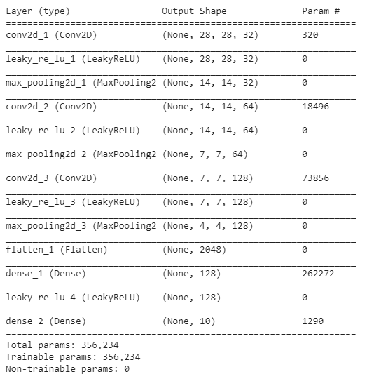
The Code:
Model.summary()

Slide 39
Let’s compile a neural network!
Now we have to compile. Here are our instructions:
Use the Adam Optimizer
Use the categorical cross entropy loss type
Use accuracy as your metric
Code:
fashion_model.compile(loss=keras.losses.categorical_crossentropy, optimizer=keras.optimizers.Adam(),
metrics=['accuracy'])

Slide 40
Let’s compile a neural network!
Code:
fashion_model.compile(loss=keras.losses.categorical_crossentropy, optimizer=keras.optimizers.Adam(),
metrics=['accuracy'])
loss=keras.losses.categorical_crossentropy
Set your loss/cost function. Categorical_crossentropy is used when you are predicting only one of multiple categories. More here and here.
optimizer=keras.optimizers.Adam()
Pick an optimizer to specify how to update weights. Adam (adaptive moment estimation) is like stochastic gradient descent, but fancier. If you’re curious, more on this here or here.
metrics=['accuracy'])
Readable way to judge your model. Not used in training or updating weights.

Slide 41
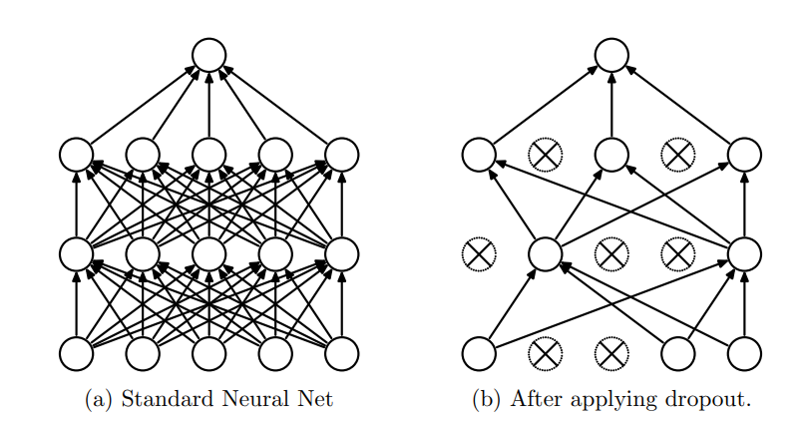
Improving the network with dropout
Problem: Our neural network shows signs of overfitting
This can happen in neural networks – e.g. can “memorize” input noise
Solution: dropout
Randomly turn off neurons during a gradient step and force other neurons to update weights in that thinner network
Source: https://www.cs.toronto.edu/~hinton/absps/JMLRdropout.pdf

Slide 42
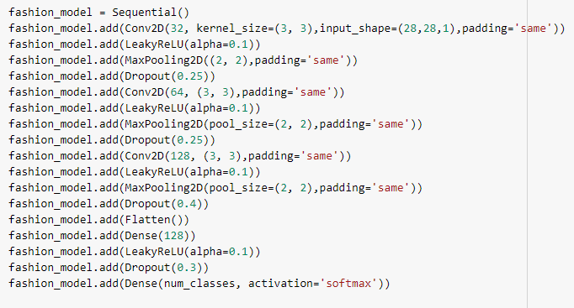
Improving the network with dropout
Instructions:
Add 25% Dropout after first 2 Max Pooling Layers
Add 40% Dropout after last Max Pooling Layer
Add 30% Dropout after last Leaky ReLU Layer
Code:

Slide 43
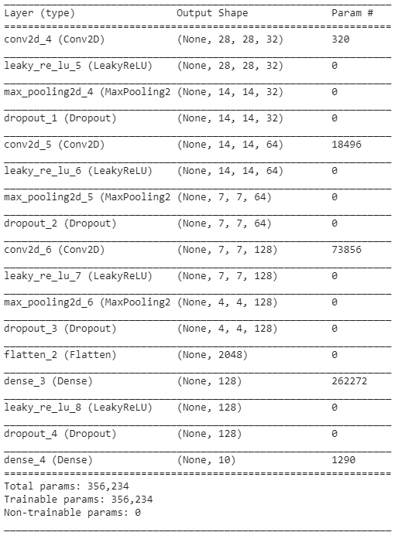
The Code:

Slide 44
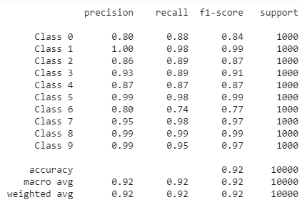
Evaluation
Precision: (true pos) / (true pos + false pos)
Recall: (true pos) / (true pos + false neg)
F1: (precision * recall) / (precision + recall)
Support: how many positive examples in the class

Slide 45
Help, I don’t think I could do this from scratch without help
What you should take away from neural networks:
General sense of their structure
Intuition about the math
Some practice writing code to build their architecture
Don’t panic if you can’t:
Design the perfect architecture from scratch
Remember which cost function/output/etc. goes with what type of inputs/outputs
How to get better at this kind of thing:
Practice on problems other people are solving (e.g. Kaggle)
Try a project with lots of googling as you go
Read the documentation for commands you call
Work experience – what do you really need to know? (e.g. do you ever have to build NN architecture from scratch?)

Slide 46
In-class: bias variance trade-off post

