Slide 1
Data science week 10
Winter 2020 Data Science Cohort

Slide 2

Attendance Code
Attendance code time: UXUnicorns

Slide 3
Quick notes
Thanks for all the feedback!
Thanks Christine and Lisa for finding the Intro to Machine Learning with Python book!

Slide 4
Let’s chat
What did you think of last week’s in-class notebook + textbook?

Slide 5
Agenda
Today’s Agenda:
Linear algebra Coursera quiz
Linear regression with multiple variables Coursera quiz
Google ML
Tensorflow
Hyperparameters
Overfitting
Google ML crash course notebooks review
(P.S. let’s try breaks every hour, please remind me)

Slide 6
Quiz: Coursera Linear algebra review

Slide 7
Quiz: Coursera Linear Regression with multiple variables

Slide 8
Quiz: Coursera Linear Regression with multiple variables

Slide 9
Google concept review
Google ML Crash course
Google is going to teach you TensorFlow
TensorFlow is Google’s open-source ML library
You’ll use it a lot like other Python packages that you’ve been using
You might see discussions/job postings asking about skill in TensorFlow, Pytorch, scikit-learn, etc

Slide 10
Google Vocab
Some vocab review before the notebooks:
Hyperparameter
Learning rate
Epoch
Batch

Slide 11
Google Notebooks: First steps with TF

Slide 12
Google Vocab
How do we know our model is good?
Overfitting
Train/test split

Slide 13
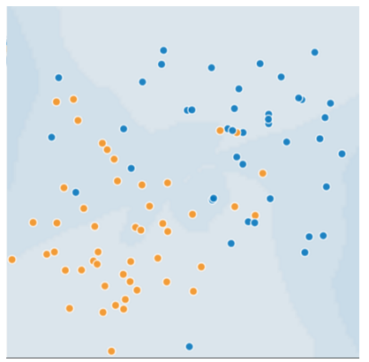
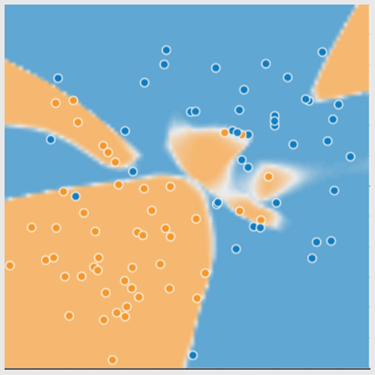
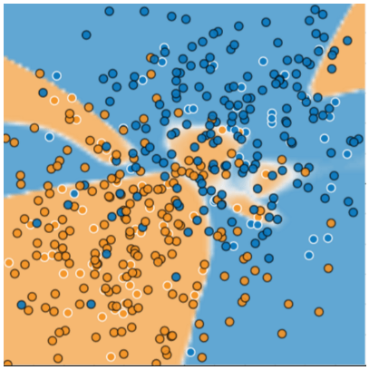
overfitting
Overfitting
When you train a model that performs very well on training data, but does not generalize to unseen data

Slide 14
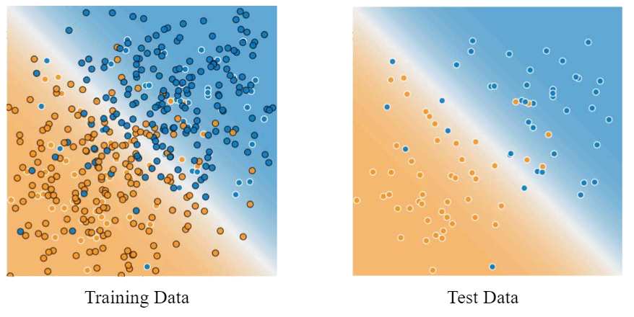
overfitting
Overfitting
When you train a model that performs very well on training data, but does not generalize to unseen data

Slide 15
In-class: Supervised learning notebook (Through linear regression aka ordinary least squares

