Slide 1
WORLD AYURVEDA FOUNDATION
AYURDISHA
Meet the Mentors · Experience Zone
11th World Ayurveda Congress · Bhubaneswar 2026
COMMITTEE PRESENTATION · SEPTEMBER 2026
AYURDISHA
1 / 16

Slide 2
OVERVIEW
What is AYURDISHA?
A digital hall for BAMS mentees at the 11th World Ayurveda Congress — register once, return anytime with your delegate number.
Mentor Q&A — submit focused career questions, track answers, and read published guidance from experienced practitioners.
An integrated congress experience zone connecting delegates, mentors, and organisers before, during, and after the event.
AYURDISHA · Meet the Mentors
2 / 16

Slide 3
AUDIENCE
Who is it for?
BAMS students & delegates — register with email OTP, receive a 6-digit delegate number, ask career questions, and follow ticket status.
Mentors — answer curated question clusters; published responses appear on the Stage and Board for all delegates.
Staff & organisers — curation desk, insights dashboard, mentor packs, and delegate lists for real-time congress coordination.
AYURDISHA · Meet the Mentors
3 / 16

Slide 4
JOURNEY
How it works
1
2
3
4
5
6
Register
→
Enter the Hall
→
Ask Desk
→
Track
→
Knowledge
→
Stage / Board
Email OTP → delegate number
Explore zones & mentors
Submit career question
Follow ticket status
Career guidance by theme
Published mentor answers
STAFF WORKFLOW
Curation → Merge similar questions → Mentor answers → Publish to hall & Track
AYURDISHA · Meet the Mentors
4 / 16

Slide 5
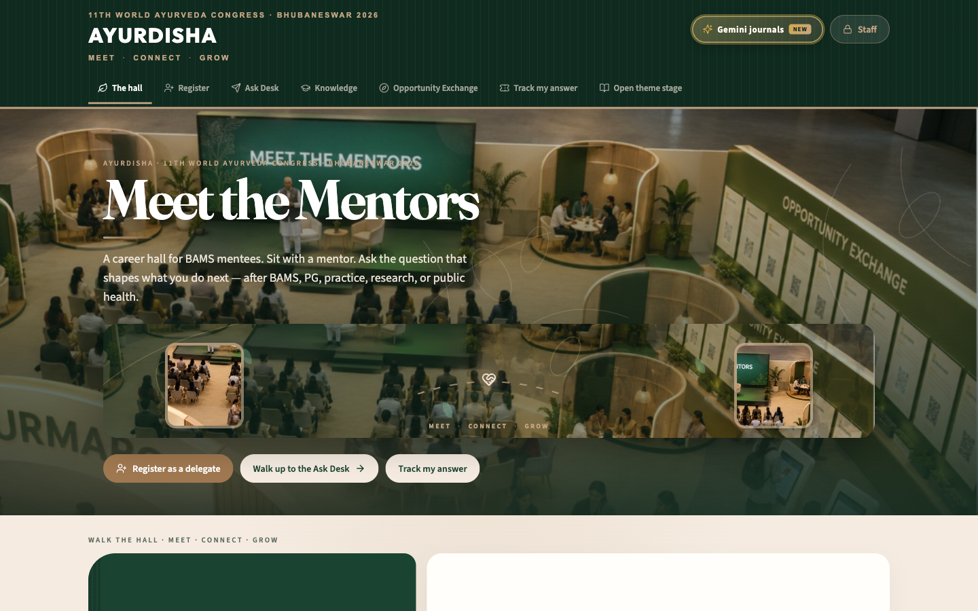
EXPERIENCE ZONE
The Digital Hall
Central navigation hub for the congress experience zone.
Mentor clusters organised by career theme — PG, clinic, research, service, and more.
Quick access to Ask Desk, Knowledge, Track, Stage, and Opportunity Exchange.
AYURDISHA · Meet the Mentors
5 / 16

Slide 6
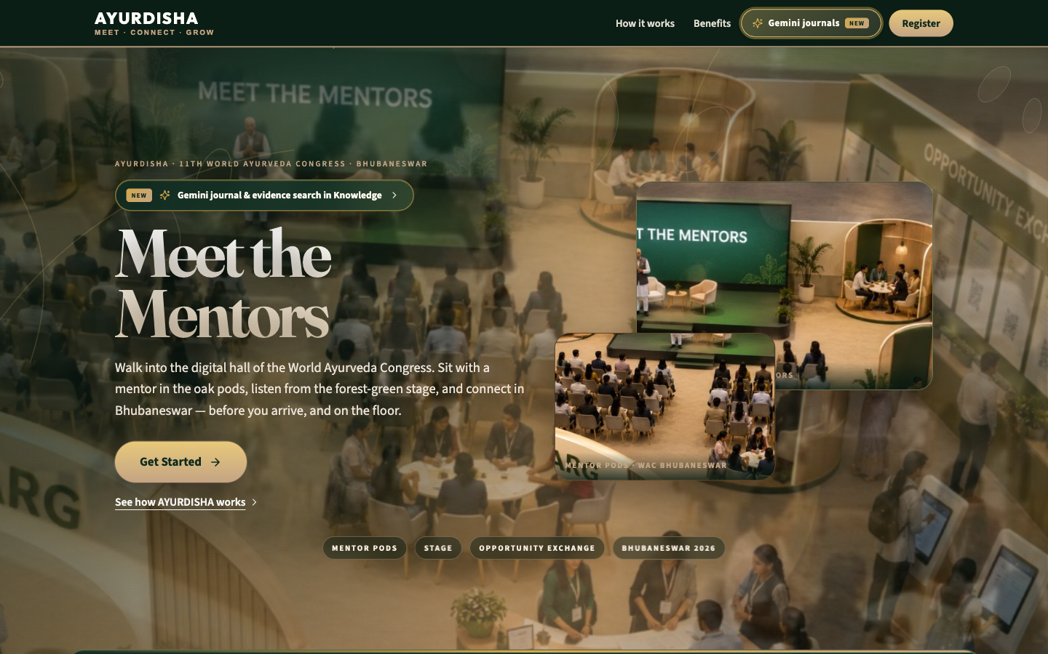
DELEGATE JOURNEY
Registration & Ask Desk
Register with institutional email — OTP verification ensures one delegate per person.
Receive a permanent 6-digit delegate number for all future visits.
Ask Desk — one focused career question per submission; option to merge similar questions for broader hall answers.
AYURDISHA · Meet the Mentors
6 / 16

Slide 7
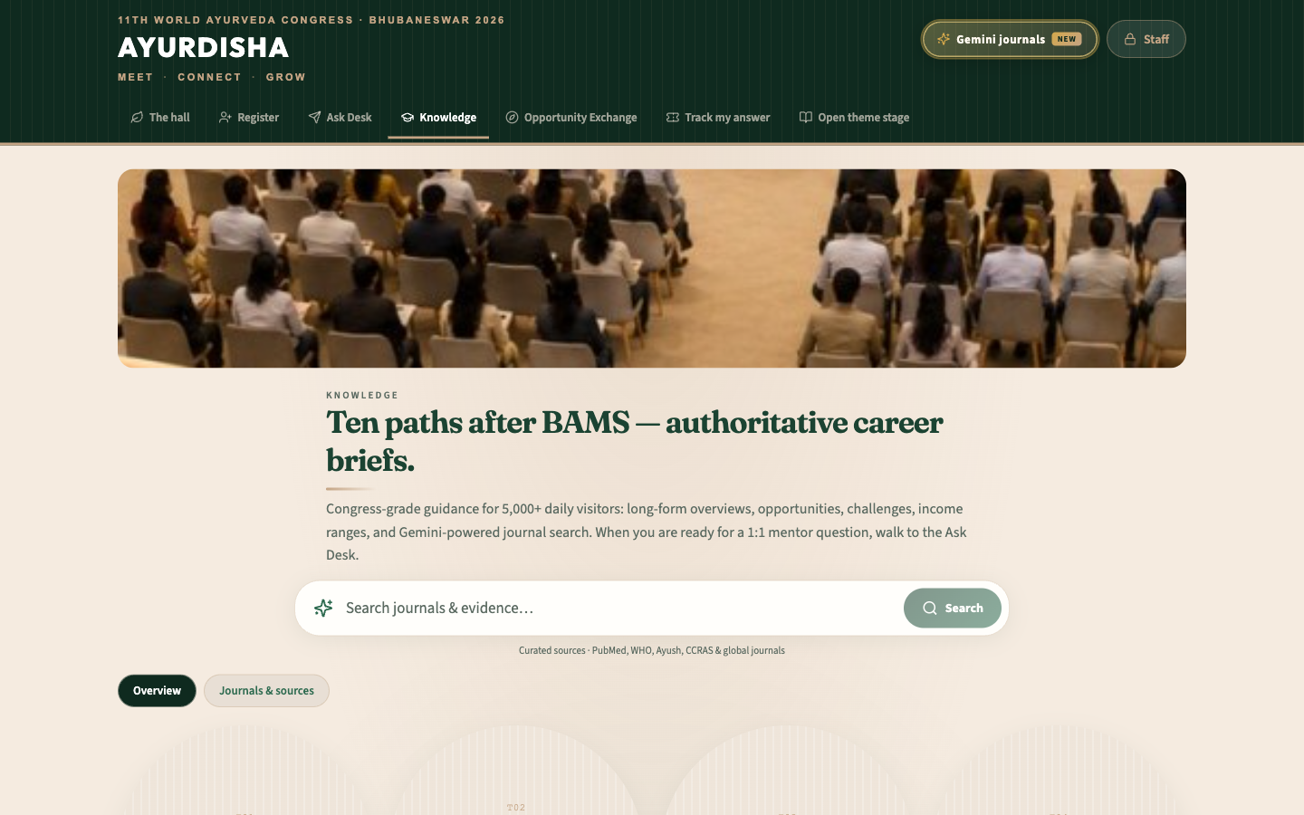
CAREER GUIDANCE
Knowledge Hub
Themed career pods — PG admission, private practice, research, AYUSH service, start-ups, and international pathways.
Curated guidance articles, journal references, and evidence summaries for each theme.
Delegates read evidence first, then submit personal questions at the Ask Desk for mentor answers.
AYURDISHA · Meet the Mentors
7 / 16

Slide 8
OPERATIONS
Staff Tools
Curation desk — review incoming questions, merge similar submissions, assign to mentor clusters, and publish answers.
Insights dashboard — real-time delegate counts, question volume, and theme distribution during congress.
Mentor pack — export curated question batches for offline mentor review and bulk answer import.
Delegate list — searchable registry with registration status, ticket tracking, and in-person shortlist flags.
AYURDISHA · Meet the Mentors
8 / 16

Slide 9
ENGAGEMENT
Opportunity Exchange & Track
Opportunity Exchange — congress announcements, fellowships, internships, and career openings shared with registered delegates.
Track my answer — delegates enter their 6-digit number to check ticket status and read mentor responses.
Stage & Board — published hall answers visible to all; shortlisted mentees may be invited for in-person sessions.
Delegates not shortlisted remain fully connected — same Track page, same delegate number, same hall on any device.
AYURDISHA · Meet the Mentors
9 / 16

Slide 10
PLATFORM
Technology
Serverless architecture — Google Cloud Firestore for data, Vercel for hosting and API functions; no dedicated servers.
Secure OTP registration — transactional email verification with signed HttpOnly session cookies.
Multi-staff coordination — real-time Firestore sync for curation desk, insights, and delegate management.
Production-ready — security rules, App Check, monitoring, and congress-week on-call support planned.
AYURDISHA · Meet the Mentors
10 / 16

Slide 11
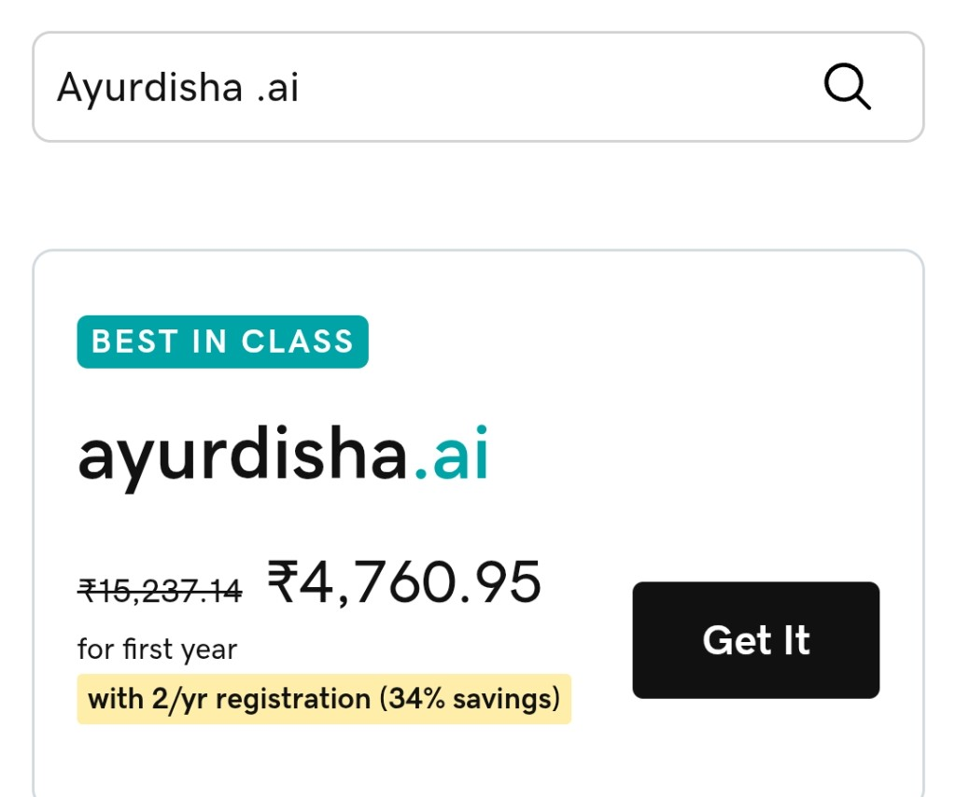
WEB PRESENCE
Domain — ayurdisha.ai
Official congress domain registered via GoDaddy.
ayurdisha.ai — first year: ₹4,761 (registrar quote on file).
DNS cutover planned from preview deployment to production domain before congress.
SSL certificate included; CDN via Vercel for global delegate access.
AYURDISHA · Meet the Mentors
11 / 16

Slide 12
INVESTMENT
Budget Summary — Overview
Total Allocation: ₹1,00,000 (~$1,176 USD)
Scenario | Phase 1 | Phase 2 | Contingency | Total (INR)
Minimum | ₹40,000 | ₹24,000 | ₹11,000 | ₹75,000
Recommended ★ | ₹60,000 | ₹29,000 | ₹11,000 | ₹1,00,000
Maximum | ₹88,000 | ₹30,000 | ₹12,000 | ₹1,25,000
Phase 1: Technical infrastructure & platform development · Phase 2: Personnel & operational support
AYURDISHA · Budget
12 / 16

Slide 13
PHASE 1 — ₹60,000
Technical Infrastructure & Development
 | Category | Amount (INR)
A | Cloud & Infrastructure — Firebase, Vercel, email, domain, SSL, security | ₹26,361
B | Software Engineering & Web Development — design, build, test, deploy | ₹30,000
C | Technical Assurance — congress-week monitoring, on-call, hotfix buffer | ₹3,639
Phase 1 Total (A + B + C) |  | ₹60,000
AYURDISHA · Budget
13 / 16

Slide 14
PHASE 2 + KEY ITEMS
Personnel, Contingency & Line Items
Item | Amount
Phase 2 — Personnel & operations | ₹29,000
Contingency reserve | ₹11,000
Recommended total | ₹1,00,000
Key line items | Amount
Domain — ayurdisha.ai (GoDaddy, 1st year) | ₹4,761
Software engineering fee | ₹30,000
Firebase Blaze (Firestore) | ₹5,500
Vercel Pro — hosting & API | ₹7,500
Resend / SendGrid — OTP email | ₹1,800
Full itemised budget: /docs/INFRASTRUCTURE-BUDGET.pdf
AYURDISHA · Budget
14 / 16

Slide 15
DEMONSTRATION
Live Demo
https://ayushmarg.vercel.app
Production preview — register, explore the hall, and try Ask Desk
Scan or visit for live demonstration
Planned production domain: ayurdisha.ai
AYURDISHA · Meet the Mentors
15 / 16

Slide 16
Thank You
World Ayurveda Foundation
AYURDISHA Technical Team
Questions?
11th World Ayurveda Congress · Bhubaneswar 2026
16 / 16

