Slide 1
sentiment
ANA
ANALYSER
By Anish Manandhar (3.2)
luckyanish47@gmail.com | +91-9363446582

Slide 2
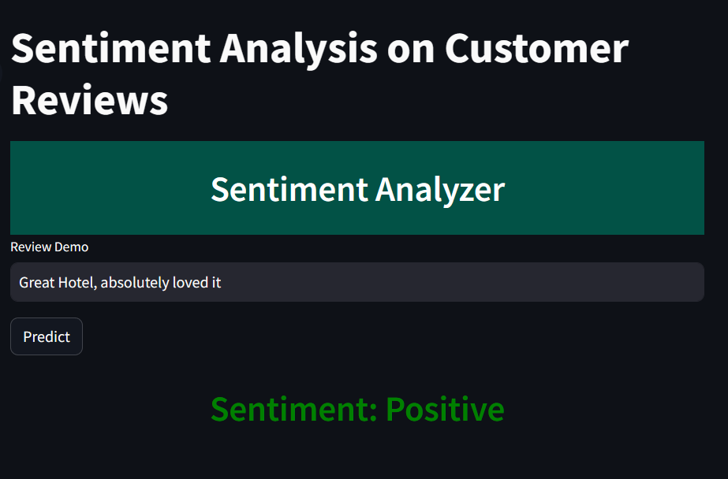
01
ACTIONABLE INSIGHTS
Why us?
By analyzing customer feedback, your company can gain valuable insights into areas needing improvement.
Enhanced Customer Satisfaction:
02
Promptly addressing issues identified through sentiment analysis can lead to a significant improvement in the guest experience
03
Competitive Advantage
Understanding and meeting customer expectations is crucial in a competitive market.
SO WHATS STOPPING YOU FROM THE BENEFITS?

Slide 3
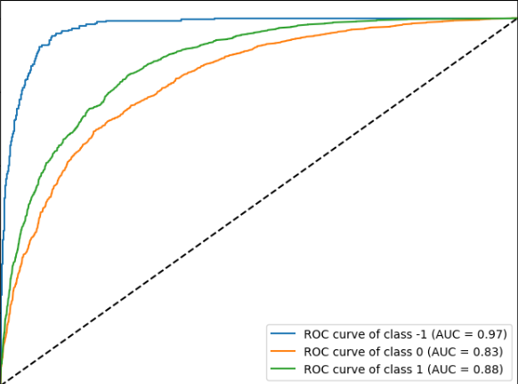
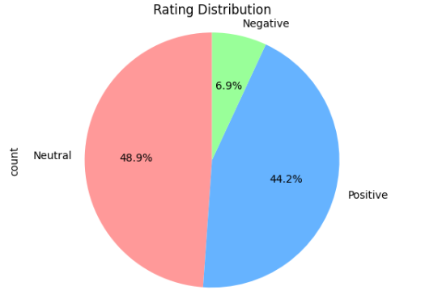
RIGOROUSLY TESTED
Our sentiment analysis model's accuracy is so sharp, it could pinpoint the positivity in a sea of feedback!

