Slide 1
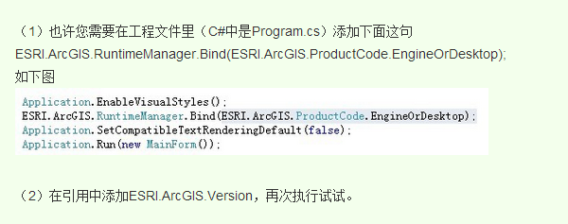

Slide 2
打开program.cs把 ESRI.ArcGIS.RuntimeManager.Bind(ESRI.ArcGIS.ProductCode.EngineOrDesktop); 这句放到Application.SetCompatibleTextRenderingDefault(false);和Application.Run(new Form1());之间，就OK啦

Slide 3
