Slide 1

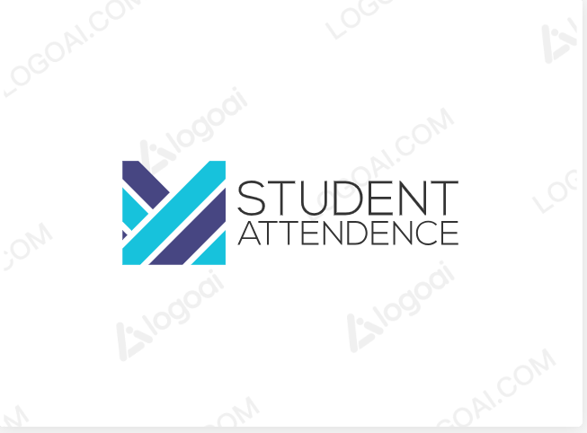
+-----------------+ | External | | Entity | | (e.g., User) | +-----------------+ | v +--------------+ | Processes | +--------------+ | 1. Enter | | Attendance| | 2. Generate | | Reports | +--------------+ | v +--------------+ | Data Stores | +--------------+ | Student Data | | Course D+-------+ +-------+ | Data | | Data | | Flows | | Flows | +-------+ +-------+ | 1. Student | 1. Attendance | Details | Records | 2. Course | 2. Report Data | Details | | 3. Attendance| | Details | | 4. Report | | Results | +--------------
Student Attendence System
Adarsh Underiya
INTRODUCTION
Method Purposed
FEATURES
INTRODUCTION
A student attendance system is a digital or automated tool designed to track and manage the attendance of students in educational institutions such as schools, colleges, and universities. It replaces traditional manual methods of taking attendance, such as calling out names or using paper-based registers. It offers several benefits, including increased accuracy, efficiency, and the ability to generate real-time reports for educators and administrators. Additionally, student attendance systems can help identify trends and patterns, improving overall student engagement and institutional accountability.
Automated Attendance Tracking
Reporting and Analytics
Biometric Authentication
Data Backup and Recovery
Web-Based Interface
Real-time Monitoring
Customizable Alerts
s
Diagram
Problem Statement: Low student attendance in some classes.
Major Causes:
  Lack of Student Engagement
  Inadequate Communication
  Technical Issues
Lack of Student Engagement:
  Poor teaching methods
  Lack of interactive learning materials
  Uninteresting course content
Inadequate Communication:
  Ineffective communication between teachers and students
  Lack of notification system for important events
  Poorly designed course schedule
Technical Issues:
  Unreliable attendance tracking system
  Lack of backup mechanisms
  Insufficient training for teachers and students on using the system
Interrelationships:
  Lack of Student Engagement and Inadequate Communication may lead to decreased motivation to attend classes.
  Technical Issues may result in inaccurate attendance data, causing frustration among students and teachers.
Techonology Stack
Frontend
Html
Css
Javascrip
Backend
Python

