Slide 1
Welcome To CRUDBuilder
By team BDS

Slide 2

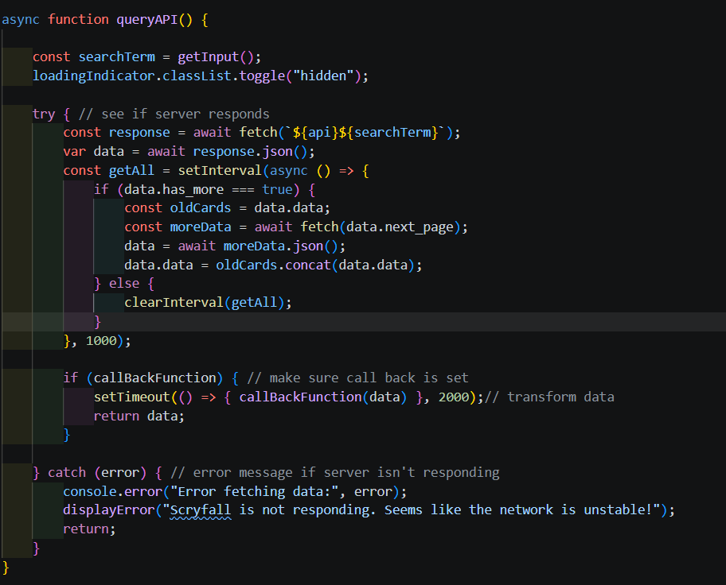
Code Snippet #1
Call back Function
Gathers relevant data
Parses data from API
Error Handling
Passes back data

Slide 3
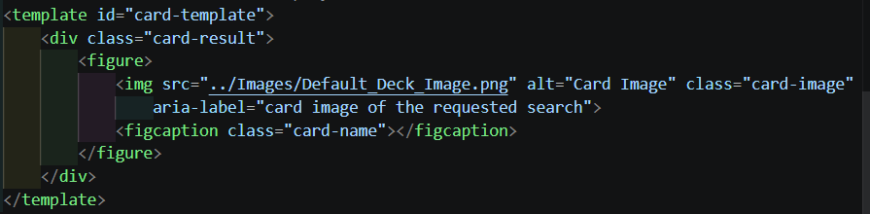
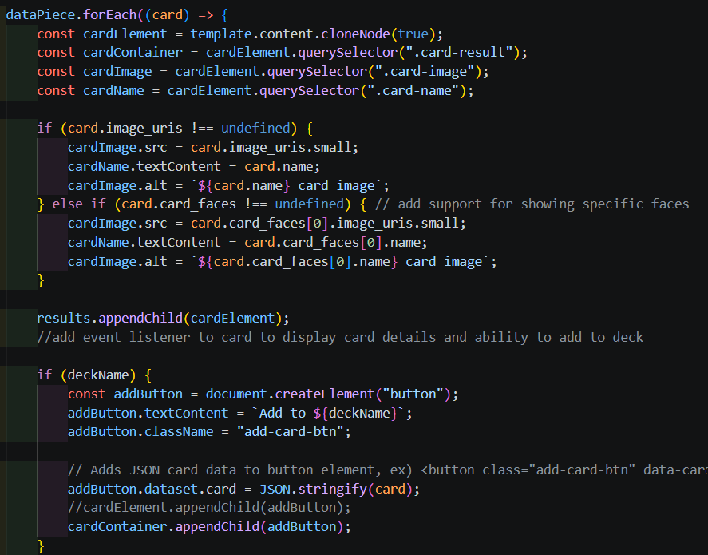
Code Snippet #2
Ease of use
Self Contained
Generality
Reuse

Slide 4
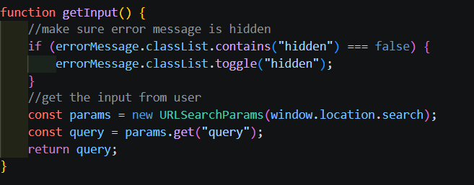
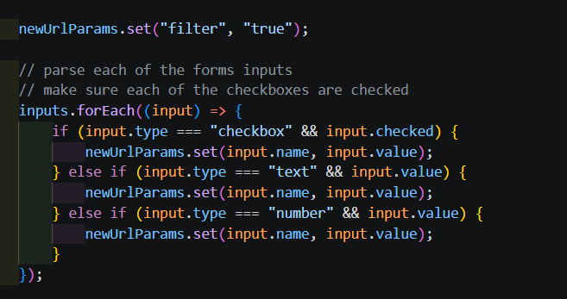
Code Snippet #3
Deep Linking Capabilities
Challenging
Reactive design
Parameter Storage
Filtering

Slide 5

Code Snippet #4
Default Value Notation
Saves a lot of logic
Quick and Easy

Slide 6
How Does Our API Work?
Sending a request
Defined by user query
Data is sent back
Possible Segmentation
Display Results

Slide 7
Persistence
User created object
No data is stored, until User decision
Store the user selection into a user created deck
Several decks are stored
An optional favorites object for the user

Slide 8
Problems
Communication
Goal Setting
Limited Feedback
Other Classes
Unfamiliarity of Javascript
Unrestrictive guidelines

