Slide 1

Chinook Music Online Store Performance Analysis
Group 2
Dai Ahmed
Aya El-Mowafy

Slide 2
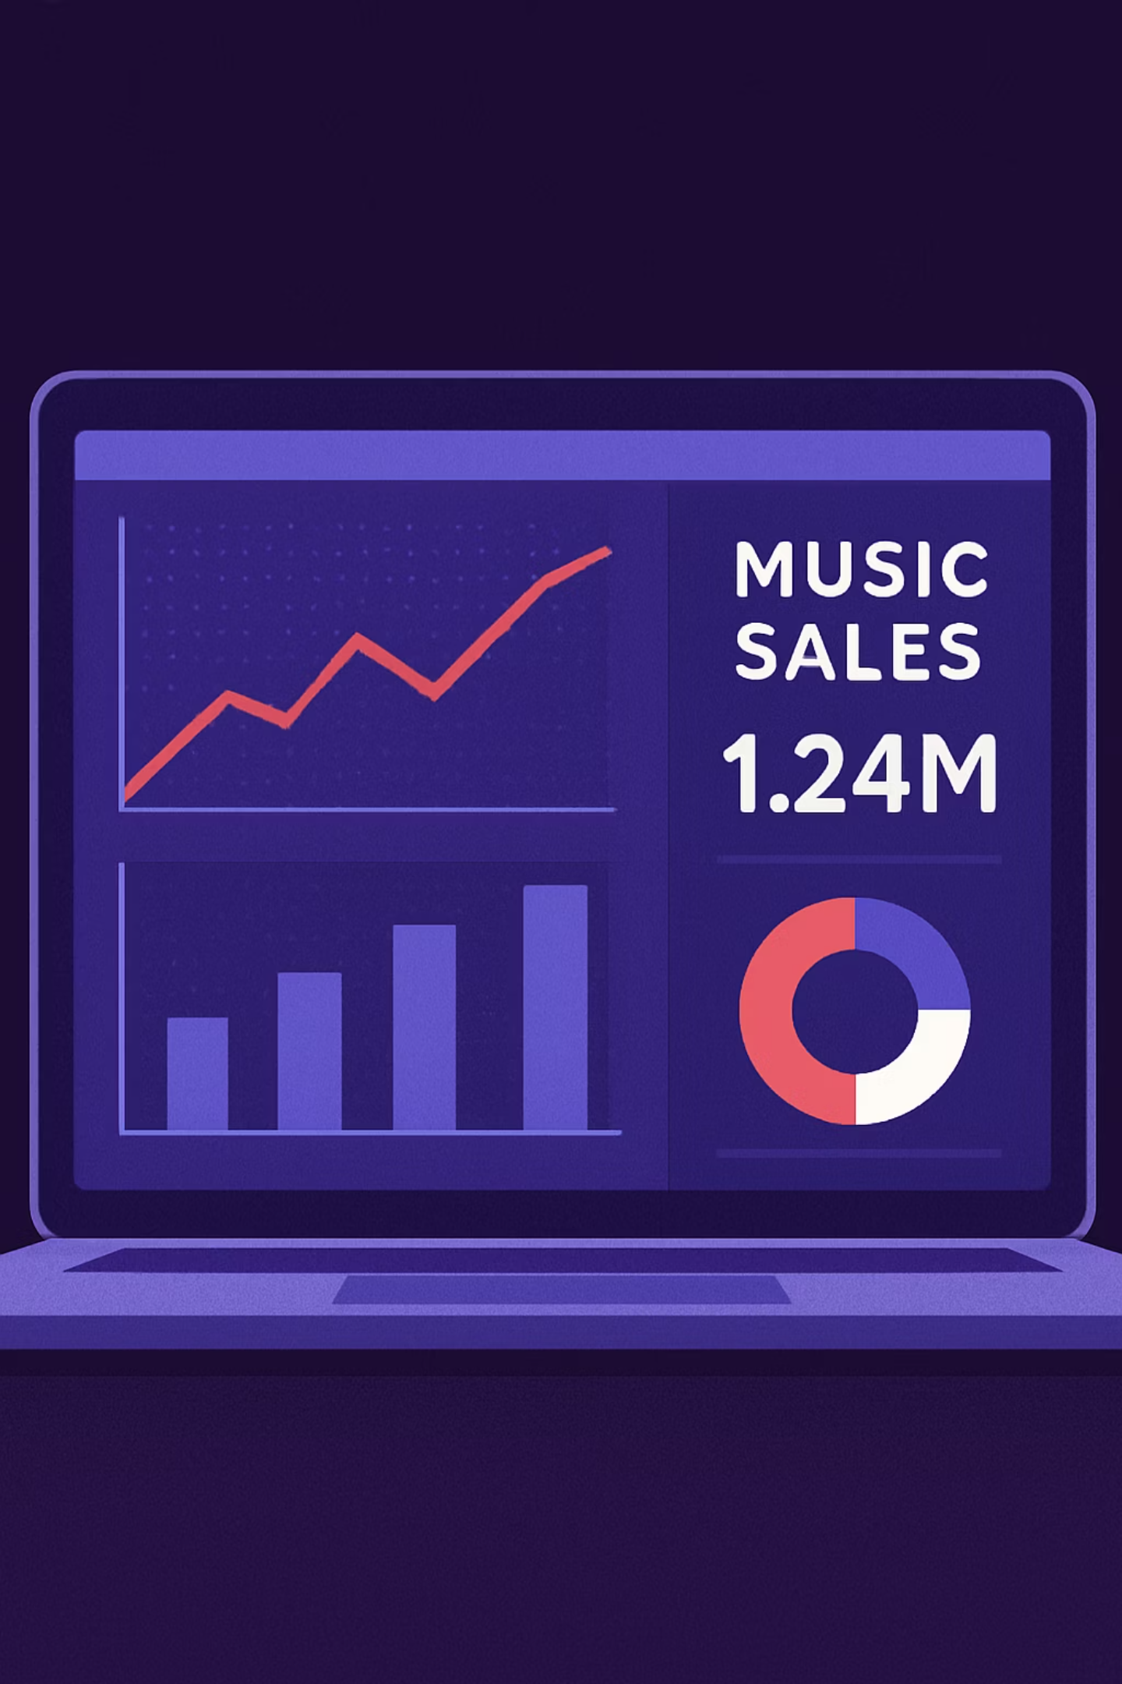
Sales Performance Analysis

Slide 3
1.Sales by Year
Annual sales analysis reveals steady financial performance, with a notable peak in 2022.

Slide 4
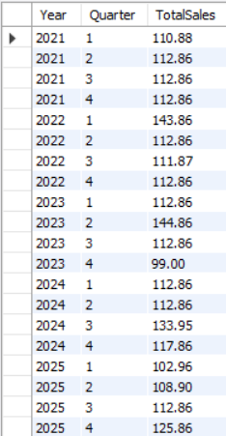
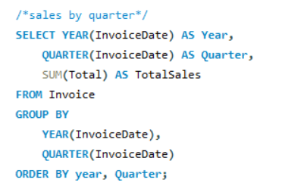
2.Sales by Quarter
Quarterly sales fluctuations indicate seasonal peaks that can be leveraged for intensified marketing campaigns.

Slide 5
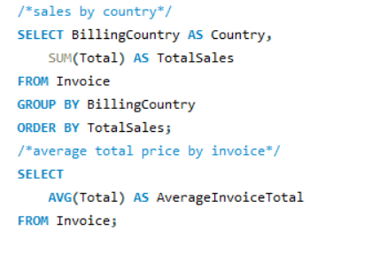
3.Sales by Country
The USA and Canada dominate the majority of sales, clearly defining the primary target geographic markets.

Slide 6
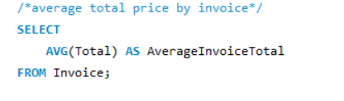

4.Average Price per Invoice (AOV):
The Average Order Value reflects a preference for individual track purchases, presenting an opportunity for product bundling to increase revenue.

Slide 7
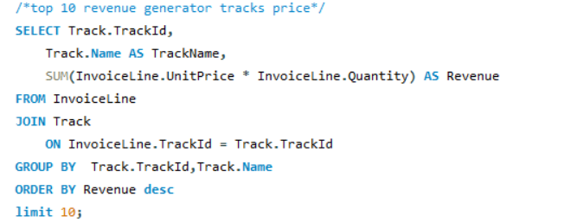
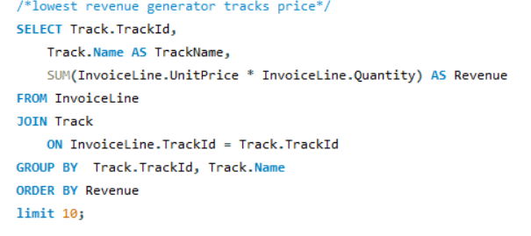
5. Top Revenue-Generator
tracks
6. Bottom 10 Revenue-Generator tracks
Top-selling tracks are concentrated in the Rock genre, while underperforming tracks require a re-evaluation of their place in the catalog.

Slide 8
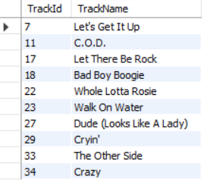
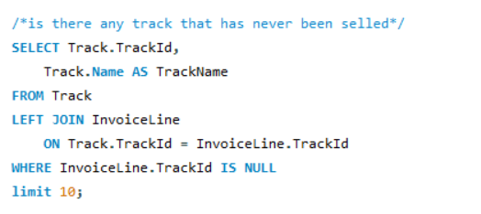
7. Dead-Stock Tracks : Tracks that have never been sold
Identifying non-selling tracks is a crucial first step toward streamlining the database and reducing digital management costs.

Slide 9

Customer Behavior Analysis
Uncovering Global Trends and Audience Preferences

Slide 10
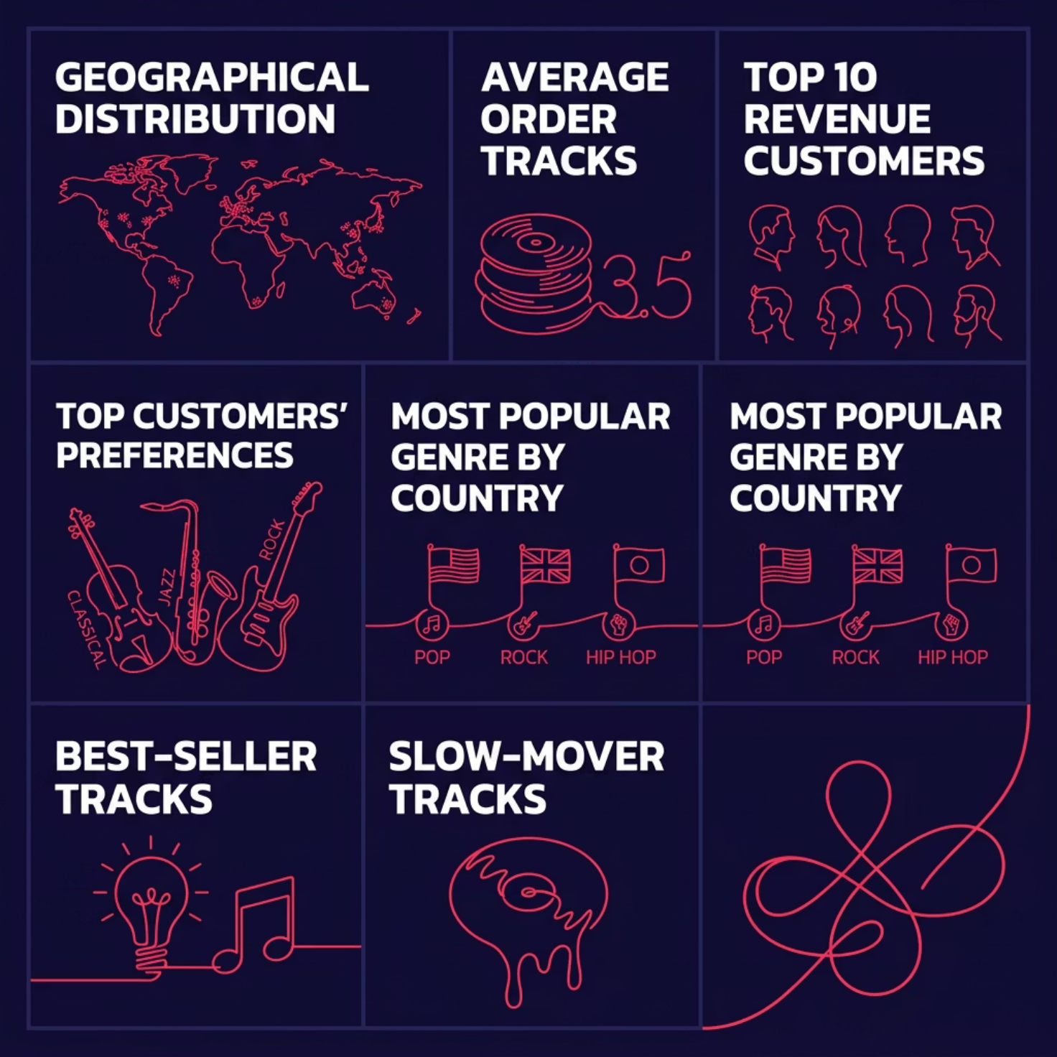

Customer Behavior: Key Topics

Slide 11
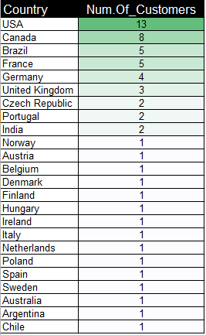
1.Geographical Distribution :
The store has 59 customers distributed among 24 countries.
The table shows that the store is an intercontinental retailer proven by its global reach to 24 countries across 5 continents .
While 15 countries having a single customers , It represents a strategic step for scaling the global presence .

Slide 12

2. Average Order Tracks:
Customers buy an average of 5.4 tracks per order, showing a preference for building custom playlists rather than single-track purchases.

Slide 13
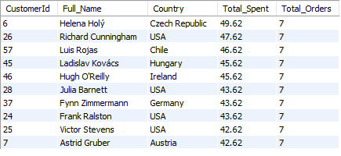
3.Top 10 Revenue-Generator Customers
This table represents the highest 10 customers in terms of revenue .
The total orders of each of the 10 customers is 7 which reflects a consistent buying pattern.
The equality of total orders for all of them shows that the high-value of customers is determined by their cart-value of each time .
Although the store has only 2 customers from ‘Czech Republic’ who are Helena Holy and Ladislav Kovacs , They are the first and fourth highest value-customers.

Slide 14
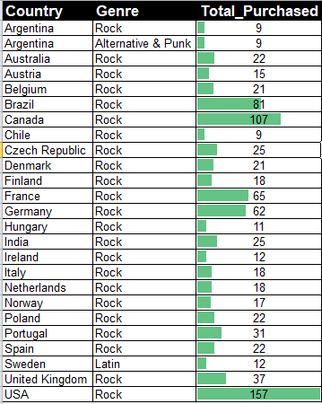
3.Most Popular Musical Genre by Country
Rock Tracks are the most popular among all countries except for Argentina and Sweden .
Alternative & Punk tracks are the most popular for the Argentinian customer while the Sweden customer’s best genre is Latin .

Slide 15
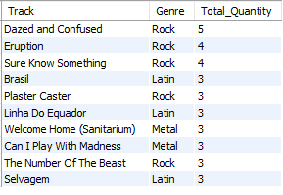
4. Best-Seller Tracks
Rock Leads Sales Volume While Global Genres Maintain Competitive Performance .
Although Rock tracks lead the sales volume , The Latin and Metal tracks
Presence show that Chinook is NOT a one-stop-shop provin the diversity of its catalog.

Slide 16
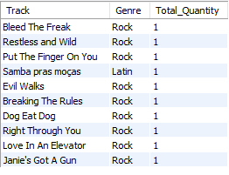
5.Slow-Mover Tracks
Catalog Depth: Capturing the Long Tail Market
The Store has a deep catalog in which some customers may buy an unknown track .

Slide 17
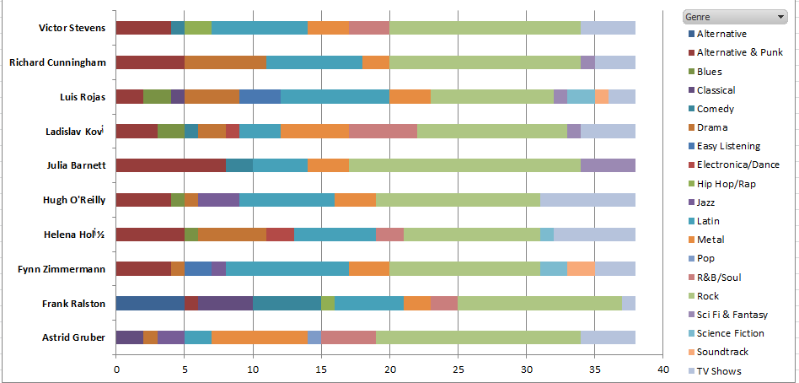
Top 10 Revenue-Generators’ Musical Preferences
Rock dominates as the most popular genre among Chinook's top-spending customers
Alternative & Punk follows as the second-most favored genre
Top customers display high genre diversity — from Rock and Punk to Latin and TV show soundtracks
This diversity suggests premium buyers are eclectic listeners, not single-genre loyalists

Slide 18

Employee Performance Analysis
Sales Representative Agents

Slide 19

This Sections aims to Evaluate Support Team Efficiency & Sales Contribution.
Generally : The performance gab between the three employees is marginal , reflecting a well-balanced workload distribution and consistent service quality among the support team .
Jane Peacock is the best employee in terms of all key metrics generated .

Slide 20
Final Conclusion :
Chinook demonstrates a resilient financial foundation with a robust global footprint spanning 24 countries.
North America remains the primary revenue driver, contributing over 60% of total sales.
The current Average Order Value (AOV) of $5.65 indicates a significant opportunity to convert single-track buyers into bulk album purchasers.
Operational efficiency is high, evidenced by the balanced workload and consistent performance of the sales support team.

Slide 21
Business Recommendations :
Maximize AOV with smart bundling Implementation :
Investment: Capital allocation for web platform updates to enable automated bundling features and targeted promotional marketing campaigns.
Return: A projected 77% increase in Average Order Value (from $5.65 to $10.00) and accelerated liquidation of "Dead-Stock" digital inventory.
Net Impact: Higher profit margins per transaction by offsetting fixed payment processing fees through increased volume per customer.

Slide 22
Business Recommendations :
The VIP-Referral Growth Engine:
Transform our Top 10 Revenue Generators into active Brand Ambassadors through a structured Tiered Incentive Model:
The Offer: A 30% Loyalty Discount on curated "Genre-Specific Packages" for the existing customer.
The Trigger: Reward is unlocked for each successful new customer referral (Referral-for-Purchase).
The Strategy: Replicating the "High-Value Customer Profile" in our most profitable markets (USA, Czech Republic, Canada).

Slide 23
Short-Term Impact (Immediate Gains):
High-Yield ROI: Achieving an immediate 153% Return on Investment per referral, covering the discount cost from the very first transaction.
Rapid Market Penetration: Targeted expansion of the customer base in top-tier regions with zero upfront advertising spend.
Boosted Average Order Value (AOV): Encouraging the purchase of full albums and "TV Show" bundles instead of single tracks.
Long-Term Impact (Future Value):
Compounded Lifetime Value (LTV): Converting a one-time $2.23 discount into a projected $39.55 in total revenue per new customer over their lifecycle.
Organic Growth Ecosystem: Establishing a self-sustaining "Referral Loop" that reduces long-term Customer Acquisition Costs (CAC).
Market Leadership: Solidifying Chinook’s position as a "One-Stop Shop" by building loyal micro-communities around specific musical genres.

