Slide 1
Putt’n Ale
Sean Collings: DB Manager
Jaren Glenn: Frontend Developer
Adam Alder: Backend Developer
Jonathan Gates: Frontend Designer

Slide 2
Putt’n Ale is a web-based app that allows you to quickly and easily set up tournaments. It also allows for tournaments to be sponsored with integrated ad support for the sponsors. Users can sign up for an account and then register for open tournaments. Once they are registered and participating in an active tournament, the app keeps track of their hole and allows them a very easy way to report their scores. Users, while playing, will see a very simple UI. The server keeps track of all the users' scores and can automatically determine the winners at the end. The app also allows for the sale of drinks during the tournament, with an integrated beverage ordering queue system

Slide 3
Agile Practices
Scrum meetings
Allowed for a constant updates on progress
Allowed us to adjust timelines accordingly
Allowed for help to be given when we got behind quickly and effectively
Sprints
Allowed us to split the project into parts so we were not overwhelmed
Reduced over complications
Meetings with the client
Provided feedback during development
Made sure we were on the right track
Prevented us from creating features that were obsolete and unwanted

Slide 4
Why Deploy?
98% of the features have been implemented. The features currency implemented have been tested. The project is in a useable state and satisfies the requirement gathered.
Testing
The testing phase included a complete frontend test of all features as well as writing unit test to test backend api’s.
Code Correctness
We followed the naming conventions on a per language level. Formatting was also enforces using a linter. We made sure to also follow proper code techniques to reduce code reuse and avoid hard to read code

Slide 5
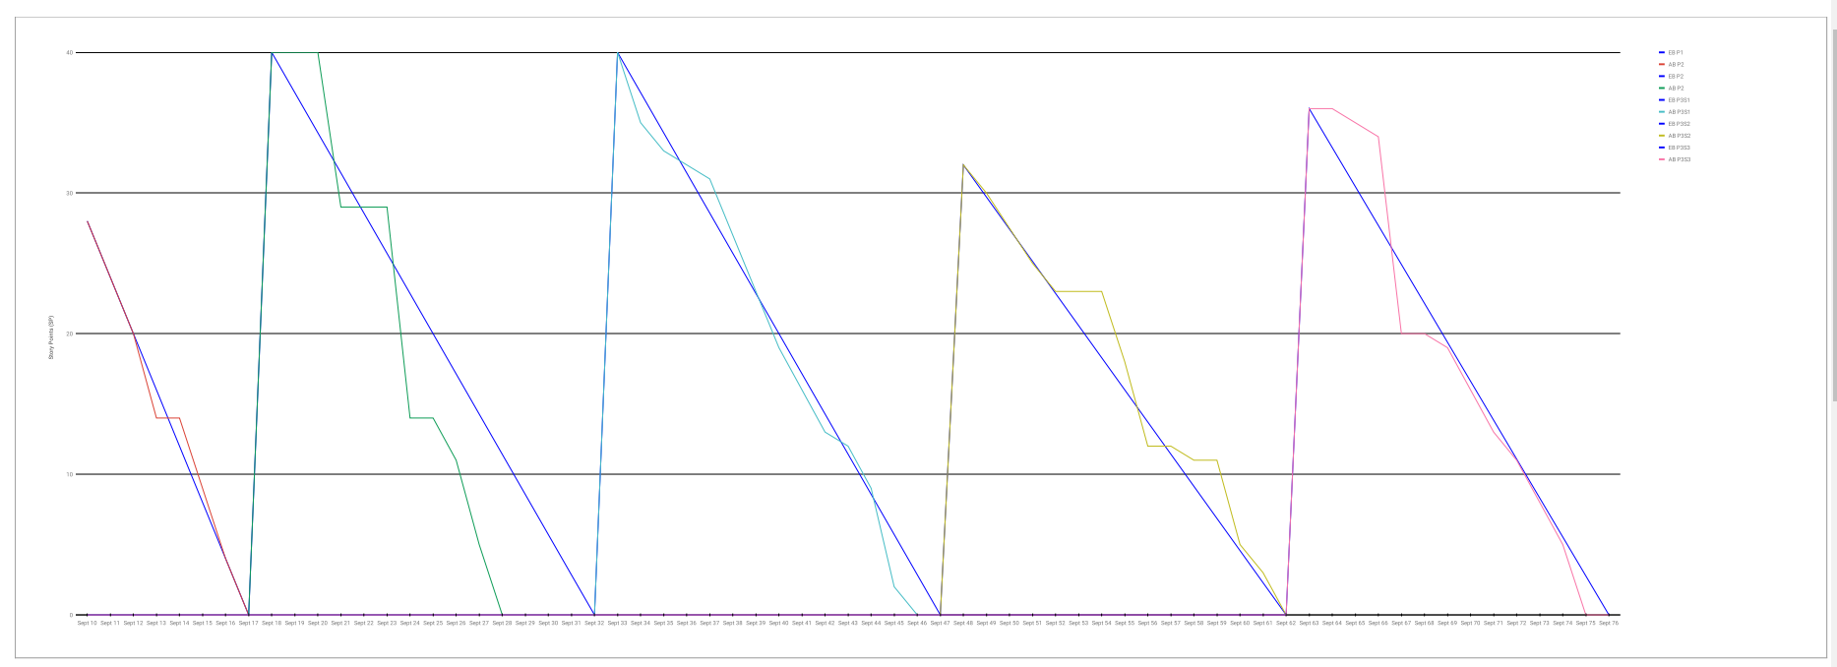

Slide 6
Req 1. User Authentication

Slide 7
Requirements Definition
https://github.com/3450-Group-3/PuttPuttGolf/blob/master/doc/Requirements%20Definition.pdf
User Authentication
On the first visit to the website, a user only has access to the home screen and must sign up for an account to access the rest
When a user signs up, their account is added to the db and automatically given the permissions for player
On subsequent visits, users must sign in to access the website
When a user logs in, their permissions are checked and different options are added to a sidebar navigation menu based on their permissions
Check for the location permission from the browser and give a prompt if it hasn’t been given
When accessing any endpoint, the user’s permissions are checked to see if they have access to that endpoint
Notes:
https://github.com/3450-Group-3/PuttPuttGolf/blob/master/doc/Requirements%20Definition.pdf

Slide 8
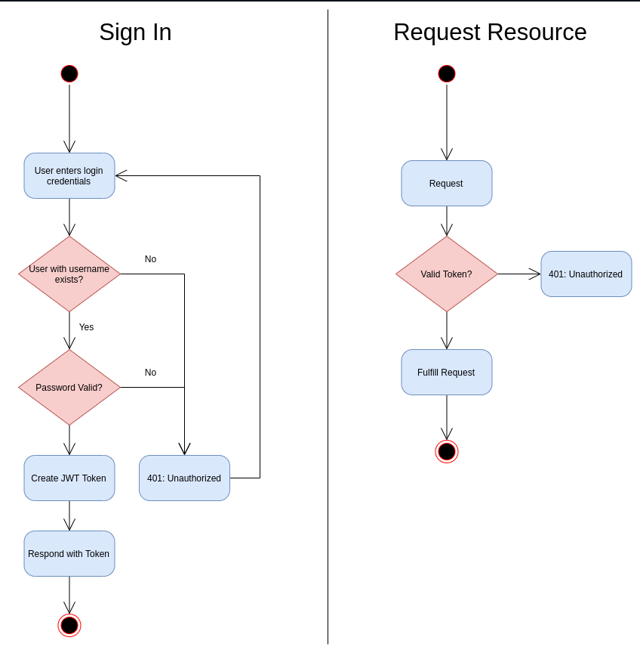
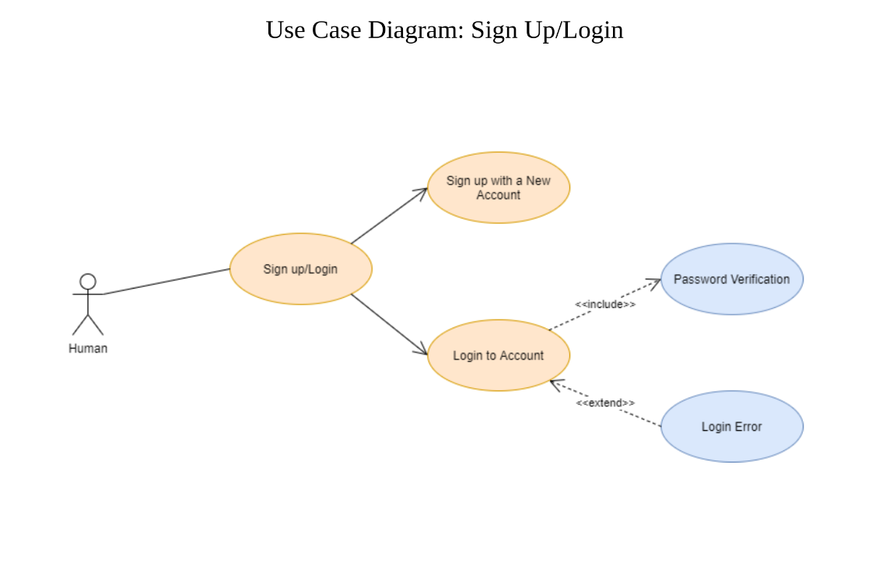
Modeling

Slide 9
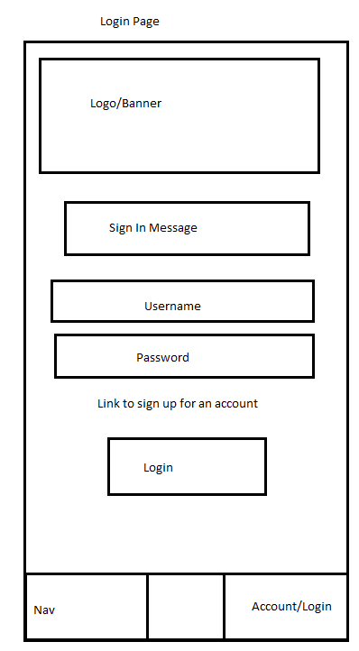
Low-Fidelity Prototype

Slide 10
High Fidelity Prototype
For our high fidelity prototype, we implemented user authorization using this guide: https://fastapi.tiangolo.com/tutorial/security/oauth2-jwt/?h=jwt

Slide 11
Scrum Tasks
Setup Auth - 3 - Sean
Login - 2 - M - Sean
document users and their goals in UML use case diagrams - 5 - All
Signup - 5 - L - Sean

Slide 12
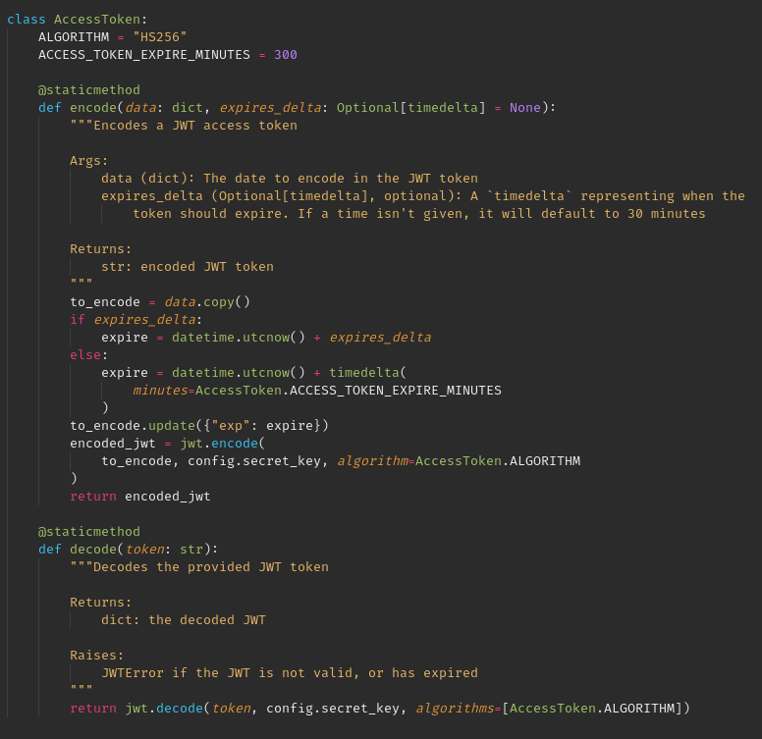
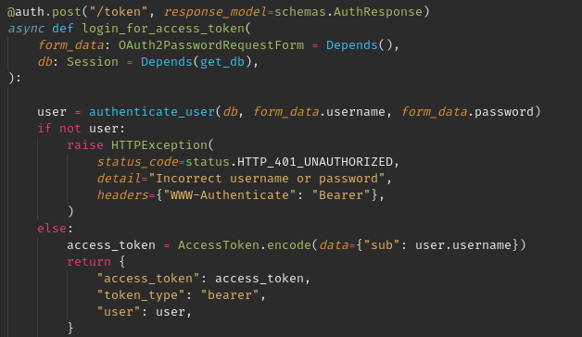
Auth Code Snippets

Slide 13
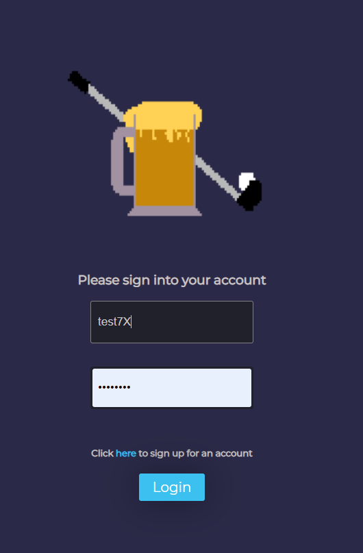
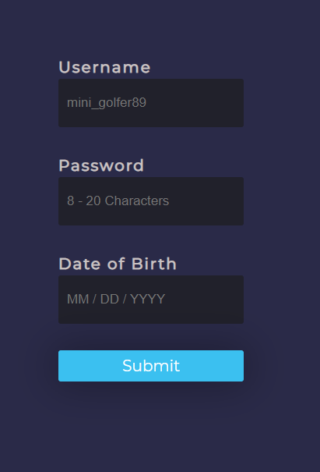
Login and Signup Screenshots

Slide 14
Playing a Tournament

Slide 15
Requirements Definition
Tournament Play System
Allows users with the player permissions to view available tournaments
Lists all present and future tournaments with date and time
Lets the user click on the tournament for more details
Sponsor
Prize pool
Number of holes
Date and time
Currently registered number of users for that tournament
Allows a user to register for a tournament
Notifies a user 10 mins before the start of a tournament
Allows the user to pick their first hole 10 mins before the start of the tournament but not accept score input
Once the tournament starts, allows a user to pick their hole and input their score
Allows a user to view their score, view the leaderboard
https://github.com/3450-Group-3/PuttPuttGolf/blob/master/doc/Requirements%20Definition.pdfefinition.pdf

Slide 16
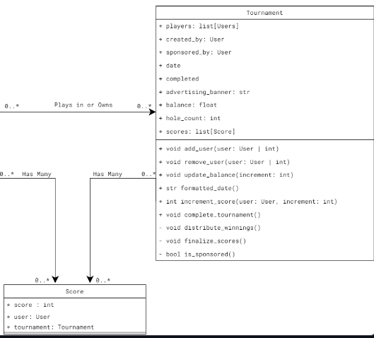
Class Diagram

Slide 17
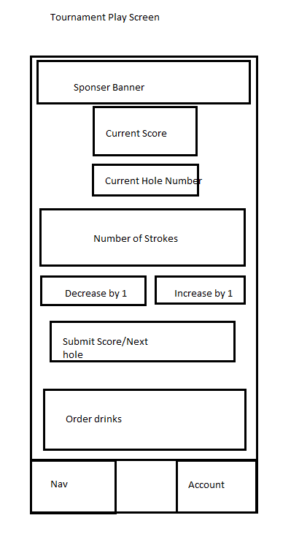
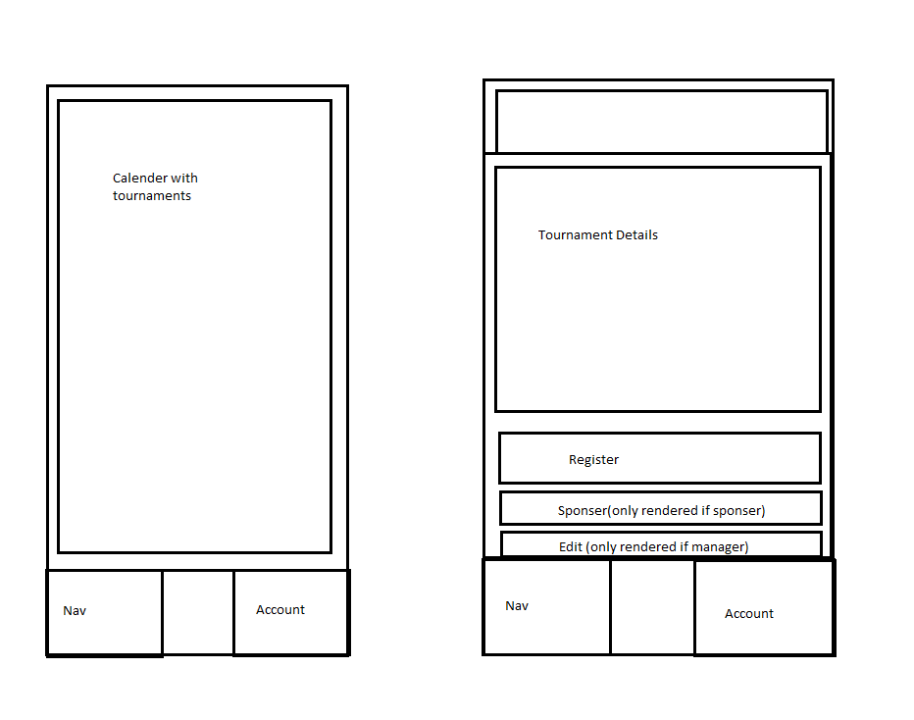
Wireframe Prototype

Slide 18
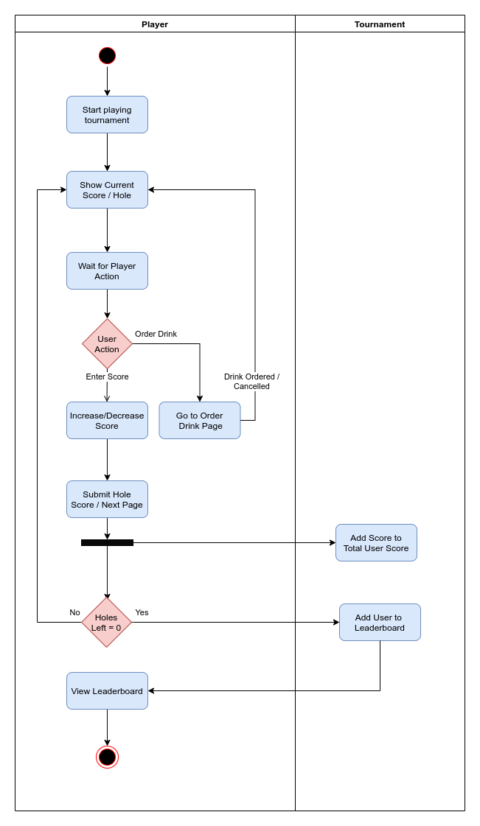
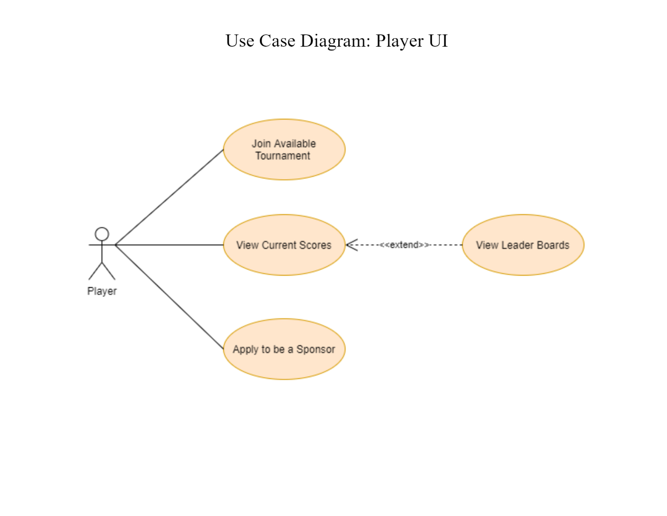
Use Case / Activity Diagram

Slide 19
Scrum Tasks
Tournament Model (Jaren)
Tournament CRUD (Jaren / Sean)
TournamentEnrollment Table (Sean)
Tournaments Page (Sean)
Leaderboards Page (Jaren)
Score CRUD (Jaren)
Tournament CRUD Unit Tests (Jaren)
Play Page (Jaren)
Tournament Completion Logic (Sean)

Slide 20
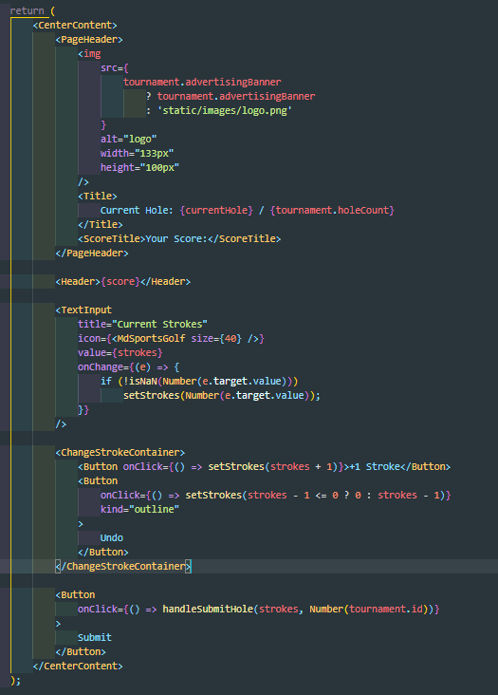
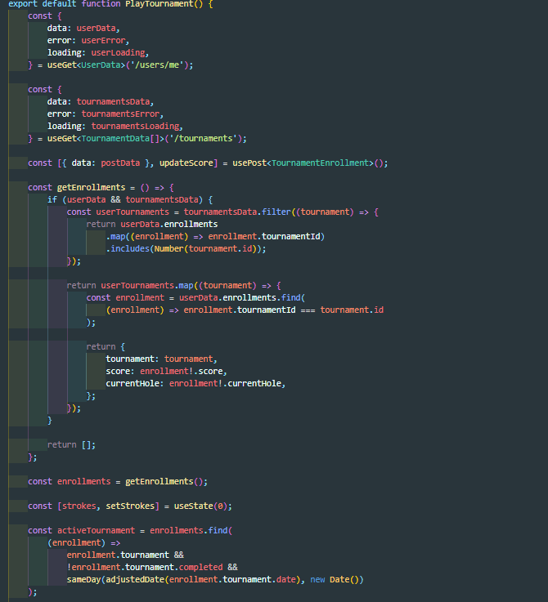
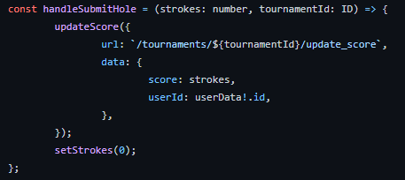
Code Snippets

Slide 21
Requirements Definition
User Permissions
Permissions stack upon each other. EX. a player will have access to the player permissions but a sponsor will have access to the player permission and the sponsor permissions
A user can have player permissions
Has access to the tournament play system, drink ordering system, account management system
A user can have sponsor permissions
Has access to the tournament sponsor system
A user can have drink meister permissions
Has access to the drink delivery system
A user can have manager permissions
Has access to the tournament play system, drink ordering system, account management system, tournament create system, drink delivery system, drink menu management system, user accounts management system, tournament management system, tournament sponsor system

Slide 22
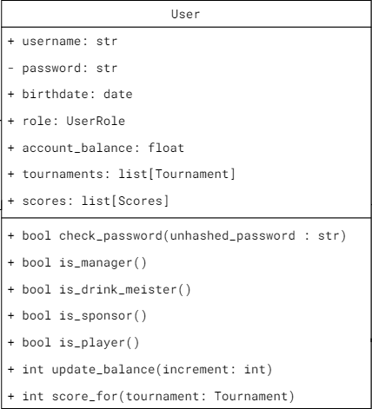
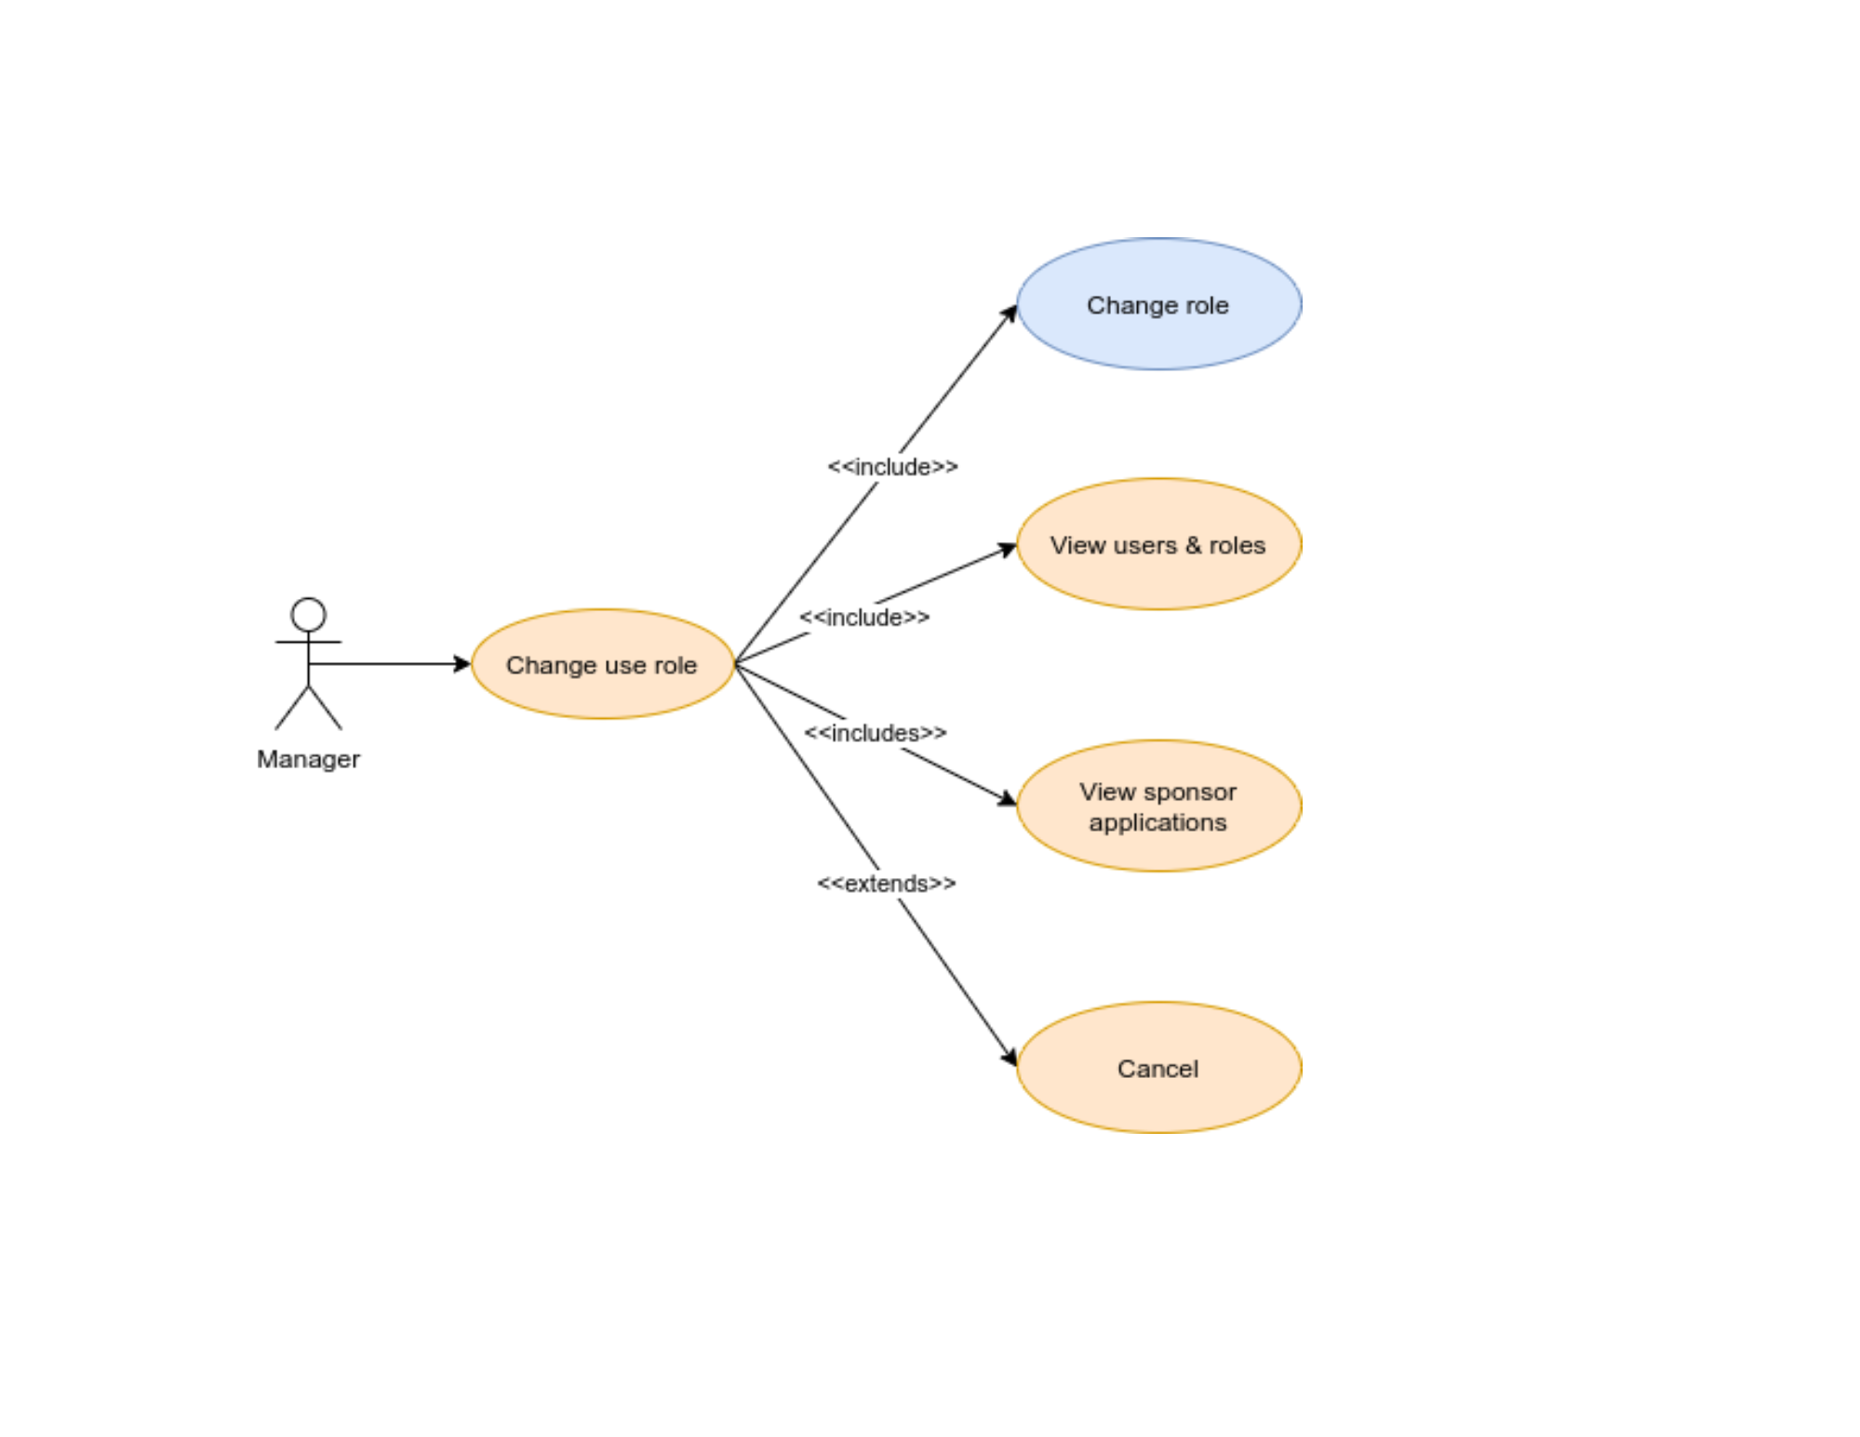
Class / Use Case Diagram

Slide 23
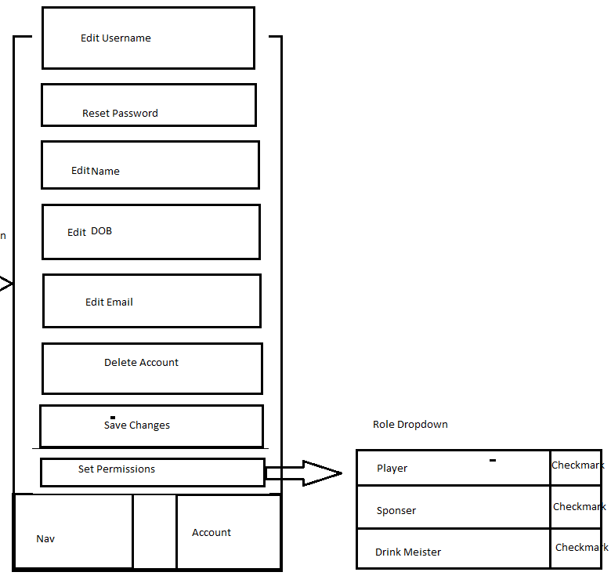
Low-Fidelity Prototype

Slide 24
Scrum Tasks
Account Management (Jaren)
Admin Manager (Sean )

Slide 25
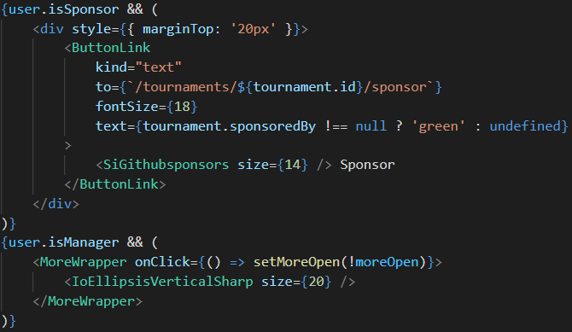
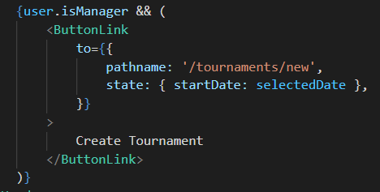
Code Snippet

Slide 26
References
Facebook. (n.d.). Getting started. React. Retrieved December 1, 2021, from https://reactjs.org/docs/getting-started.html.
MicroSoft. (n.d.). The starting point for learning typescript. TypeScript. Retrieved December 1, 2021, from https://www.typescriptlang.org/docs/.
Python 3.10.0 documentation. 3.10.0 Documentation. (2021, November 3). Retrieved December 1, 2021, from https://docs.python.org/3/.
SQLALCHEMY 2.0 documentation. SQLAlchemy Documentation - SQLAlchemy 2.0 Documentation. (n.d.). Retrieved December 1, 2021, from https://docs.sqlalchemy.org/en/20/.
Styled-Components. (n.d.). API Reference. Styled Components. Retrieved December 1, 2021, from https://styled-components.com/docs/api.
Tutorial - User Guide. FASTAPI. (n.d.). Retrieved December 1, 2021, from https://fastapi.tiangolo.com/.

Slide 27


Slide 31
Questions?

