Slide 1


Boeing Bluetooth Protocol Analytical Research, Semester 2 Sprint 1
LAX Airport Police Internship
JA
By: Caroline Terre, Matthew Irvin, Gianna Scarangelli, Jonah Rowell, Connal Grace

Slide 2
Sprint Overview
Ordered new equipment
Focusing on Flipper Zero research
Receiving and decoding Bluetooth Low Energy packets
Collecting data from last semester
Notes:
Insert brief summary of what we’ve done//what the next slides will go over in details

Slide 3
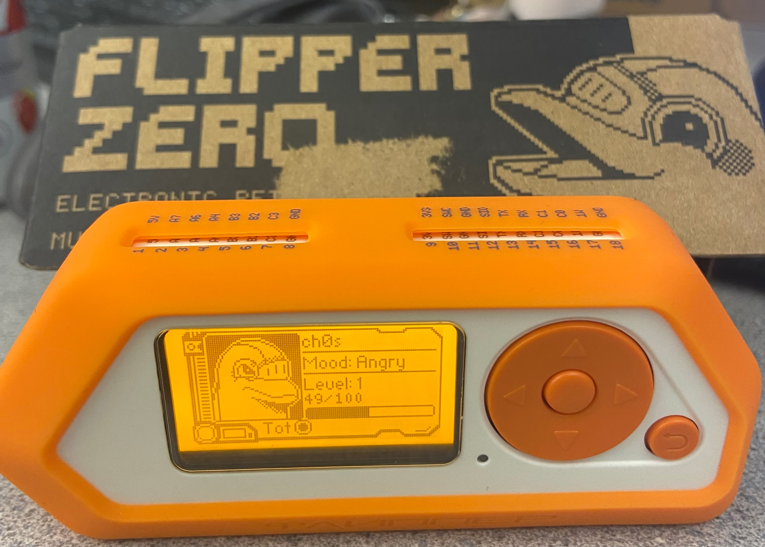
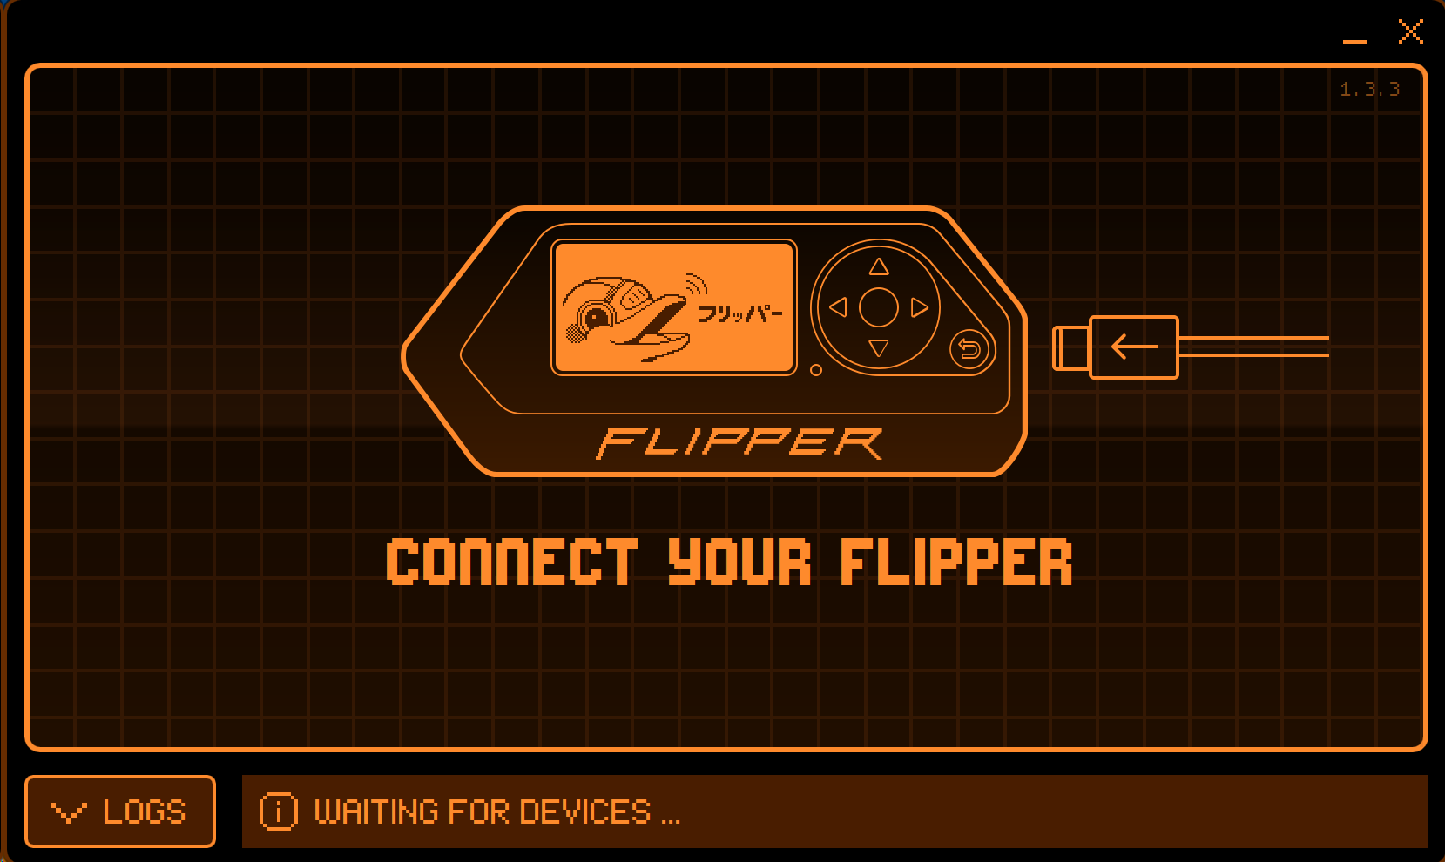
Flipper Zero
Virtual Pet Game: various emulating capabilities
Capitalizing off of its Bluetooth Low Energy Capabilities
Has Bluetooth to connect to iPhone app, for example, but cannot use Bluetooth otherwise

Slide 4
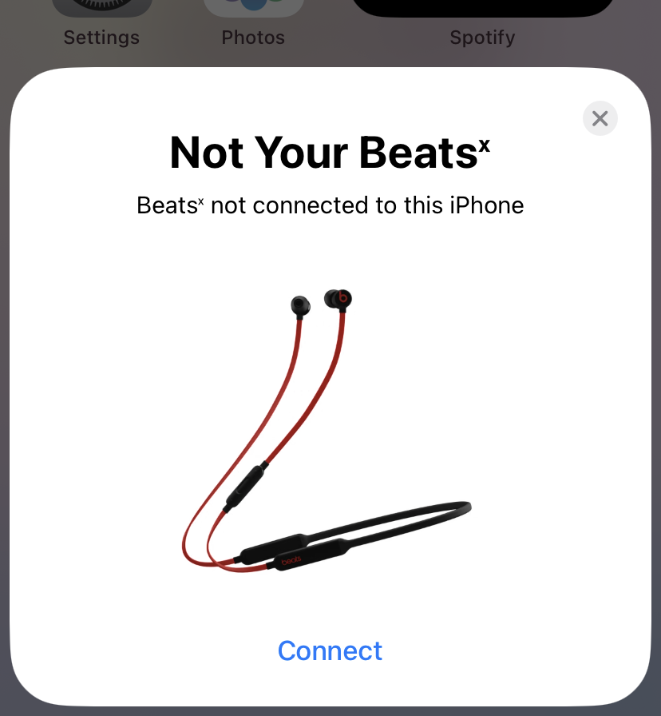
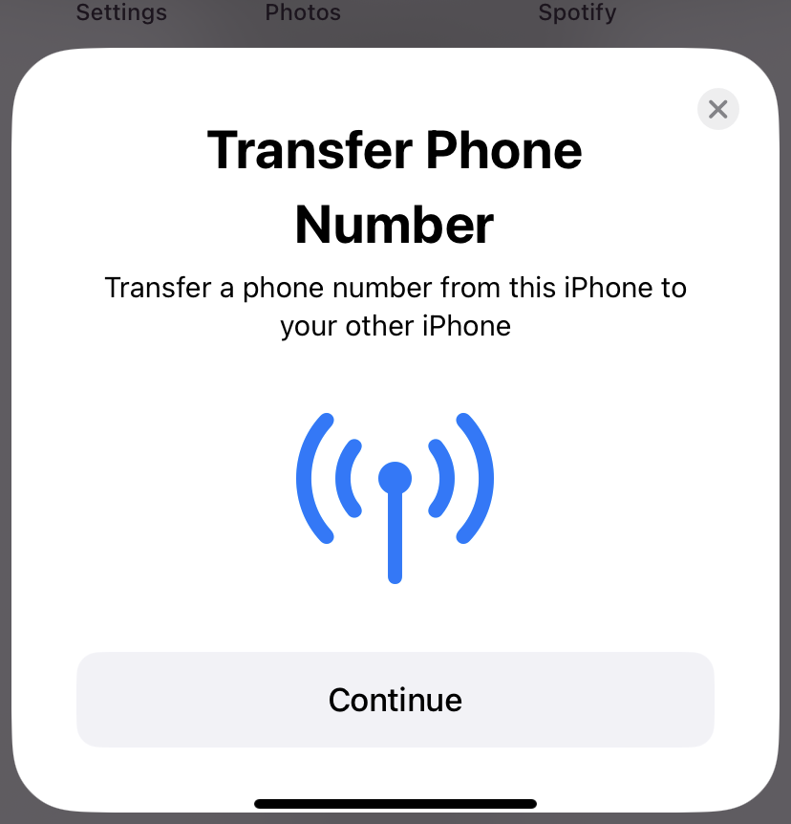
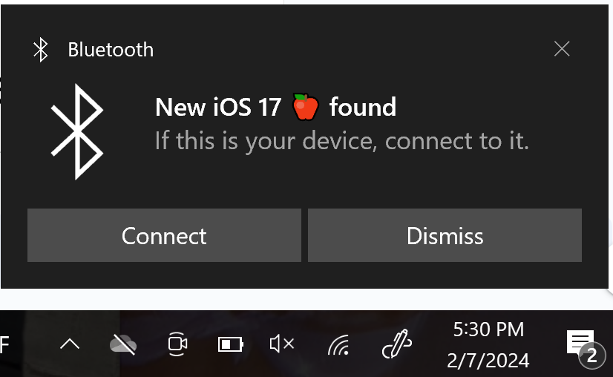
Flipper Zero
Firmware from Github with excellent document
Allows BLE attacks such as:
iOS 17 Lockup Crash
Apple Device Popup
Windows Device Found

Slide 5
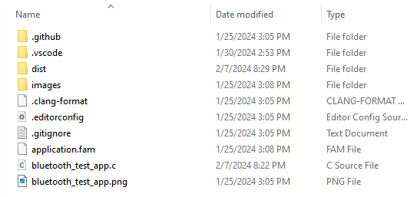
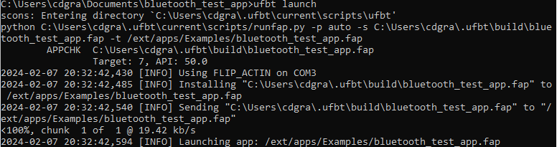
Flipper Zero Apps
Flipper Zero apps - custom programs for the flipper zero that can interact with the Flipper Zero’s built in Bluetooth
uFBT - a python library that simulates the Flipper Zero’s firmware to help create apps

Slide 6
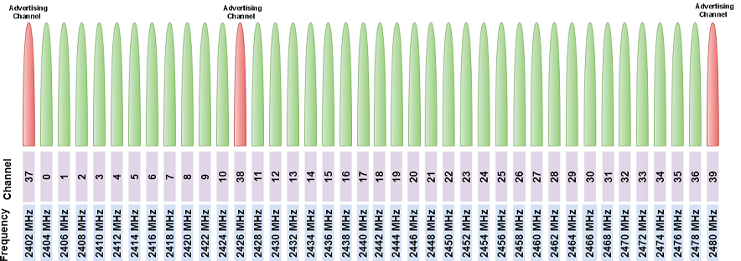
Bluetooth Low Energy
Designed for low power and short range applications
Operates in the 2.4GHz band with range of 100 meters
Uses 40 channels compared to 80 with classic Bluetooth
Channels 37, 38, 39 are used for advertising
Notes:
Advertising channels are used to send device information

Slide 7
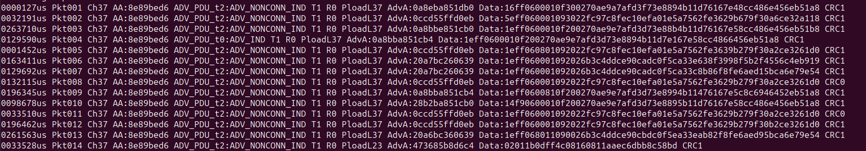
BTLE Packet Analyzer
Open source software developed by Jiao Xianjun
BTLE monitor and transmitter
Sniffs BTLE packets and provides corresponding data
Uses HackRF SDR
Notes:
BTLE Packet Analyzer - Developed by JiaoXianjun
- Open source SDR BTLE software
- Monitors BTLE channels (only one at a time)
- transmits BTLE packets with adjustability in size, power, and target device with advertising address
- Sniffs BTLE packets and provides corresponding time, data and address all of which can be recorded for future use and analysis
- Has the ability to track channel hopping and patterns
- Utilizes HackRF SDR
- Software is ran on unix based system (in our case raspberry pi Unbuntu)

Slide 8
BTLE Packet Analyzer
0032191us Pkt1002 Ch37 AA:8e89bed6 ADV_PDU:t2:ADV_NONCONN_IND TxAdd:1 R0 Pload:37 AdvA:0a0ceba851db0 Data:1eff0600010f30027
0032191us
Pkt1002
Ch37
AA:8e89bed6
ADV_PDU:t2:ADV_NONCONN_IND
6. TxAdd:1 7. R0 8. Pload:37 9. AdvA:0a0ceba851db0 10. Data:1eff0600010f30027
Notes:
Insert brief summary of what we’ve done//what the next slides will go over in details

Slide 9
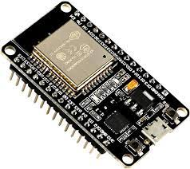
ESP 32 Test Bed
Connection Verification
Server: Call and Response
Client: Message Prediction
Data Collection
Statistical Analysis
Notes:
Insert brief summary of what we’ve done//what the next slides will go over in details

Slide 10
Difficulties with Sprint 1
Still understanding Flipper Zero & how to customize
Very little official documentation on how to make apps for the Flipper Zero
Still waiting on equipment that we already have plans for
Notes:
caroline

Slide 11
Future Goals
Monitor all 40 BTLE channels and record packet data
Decode and track BTLE channel hopping
Continue understanding what we can do with the Flipper Zero and further see how can we utilize these capabilities ourselves
Produce final white paper
Notes:
gia

