Slide 1
Software Quality

Slide 2
What are we going to talk about?
What is Software Testing? Definition, Basics & Types
7 Software Testing Principles
V-Model in Software Testing
Types of software Testing ( Unit, Integration, UAT, Acceptance testing)

Slide 3
What is software Testing ?
Software Testing is a method to check whether the actual software product matches expected
requirements and to ensure that software product is Defect free.
Purpose of software testing:
Identify errors
Identify gaps
identify missing requirements
actual requirements
VS

Slide 4
Why is Software test important ?
Properly tested software product ensures:
reliability
security
and high performance
time saving,
cost effectiveness
and customer satisfaction.

Slide 5
What is the need of Testing ?
software bugs could be expensive or even dangerous
software bugs can potentially cause monetary and human loss
1. Starbucks
Starbucks was forced to close about 60 percent of stores in the U.S and Canada due to software failure
2. China Airlines Airbus A300
China Airlines Airbus A300 crashed due to a software bug on April 26, 1994, killing 264 innocents live
3. Nissan cars
recalled over 1 million cars from the market due to software failure

Slide 6
What are the benefits of Software Testing ?
Cost-Effective
Security
Product quality
Customer Satisfaction

Slide 7
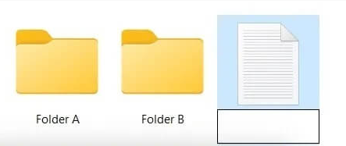
Principles of Software Testing
Scenario
Trying to move the file when it is Open
You do not have security rights to paste the file in Folder B
Think of all the possible ways
you can test this.
Folder “B” is on a shared drive and storage capacity is full
Folder “B” has file with the same name
5 ^15 = 3. 051 757 81 * 10e
The list of possibility is endless
Conclusion: We need certain principles and strategies to optimize the testing effort !

Slide 8
7 Testing Principles
1. Exhaustive testing is not possible
5. Absence of Error -fallacy
2. Defect Clustering
6. Early Testing
3. Pesticide Paradox
7. Testing is Context dependent
4. Testing shows a presence of defects

Slide 9
1. Exhaustive testing is not possible
Instead, we need the optimal amount of testing based on the risk assessment of the application.
And the million dollar question is, how do you determine this risk?
Example
In your opinion, Which operation is most likely to cause your Operating system to fail?
A
Opening
Excel
Document
B
Opening
Google
Chrome
C
Opening
10 heavy applications

Slide 10
2. Defect Clustering
Defect Clustering which states that a small number of modules contain most of the defects detected.
Pareto Principle: approximately 80% of the problems are found in 20% of the modules.

Slide 11
3. Pesticide Paradox
If the same set of repetitive tests are conducted,
the method will be useless for discovering new defects.
To overcome this problem:
the test cases need to be regularly reviewed & revised
adding new & different test cases to help find more defects.
We can never claim your product is bug-free !
Example: Windows 98 public lunch live crashed on CNN TV

Slide 12
4. Testing shows presence of Defects
Testing talks about the presence of defects and
don’t talk about the absence of defects.
but even if no defects are found, it is not a proof of correctness.

Slide 13
5. Absence of Error - fallacy
But what if, you work extra hard, and make your software product 99% bug-free.
but the software does not meet the needs & requirements of the clients ?
System is tested thoroughly for the wrong requirement.
Finding and fixing defects does not help if the system build is unusable and does not fulfill the user’s needs & requirements.

Slide 14
6. Early Testing
But how early one should start testing?
It is recommended that you start finding the bug the moment the requirements are defined.
It is much cheaper to fix a Defect in the early stages of testing.

Slide 15
7. Testing is Context dependent
Using a different
approaches,
methodologies,
techniques,
and types of testing
depending upon the application type.
Example: For instance testing, any POS system at a retail store will be different than testing an ATM machine.

Slide 16
Types of Software Testing
Functional Testing
Functional Testing
Non-Functional Testing
Unit Testing
Integration Testing
Maintenance Testing
Acceptance Testing
System Testing (UAT)

Slide 17
V-Model
represents a software development process
organizes the software development process in phases
individual development phases have test phases

Slide 18
Example to understand the v-model
Requirement Gathering Stage
Design Stage
Build Stage
Test Stage
Deployment Stage
Maintenance Stage

Slide 19
Problem with the waterfall model
testing doesn't start until after implementation
it is easy to overlook the most important details in the initial statges
the customer is delivered a completely wrong product, and you may have to start the project all over again

Slide 20
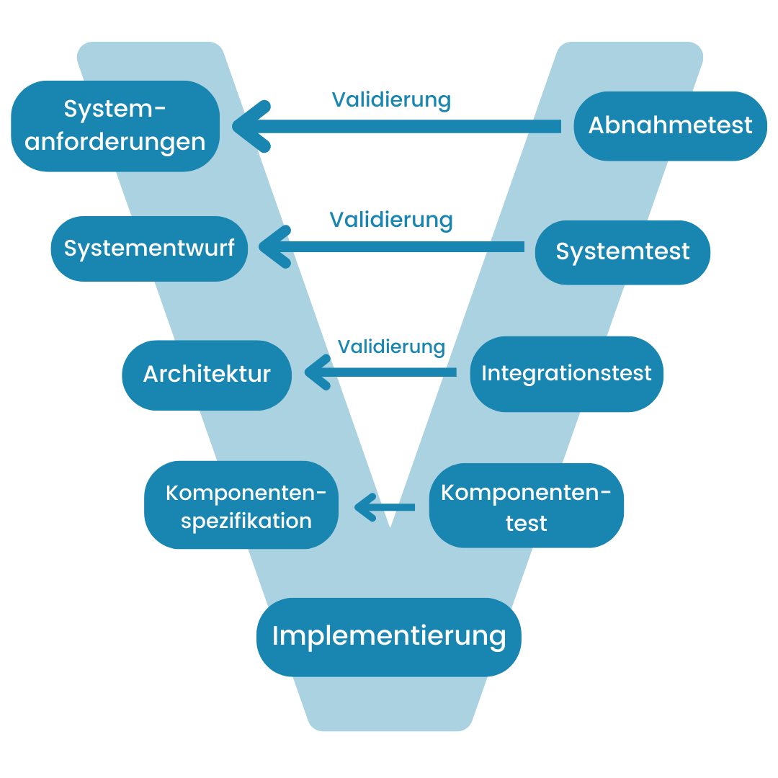
Solution = V-model
a corresponding test stage for each stage in the development
SDLC
STLC

Slide 21
Unit testing
is a software development process
The main goal is to isolate written code to test and determine if it works as intended
they can help uncover bugs in the code early on that may be harder to find in later testing stages

Slide 22
Key reasons to perform unit tests
The earlier a problem is detected, the fewer compound errors occur
The cost of fixing a problem early can quickly outweigh the cost of fixing it later
Debugging processes are made easier
Developers can quickly make changes to the code base
Developers can also reuse code and migrate it to new projects

Slide 23
Implementing Unit Tests in practice
a component test is carried out by the developers themselves
individual components can be tested at an early stage or parallel to development
unit tests can be carried out continuously and ensure the runnability and quality at each iteration

Slide 24
Unit Test Frameworks
automatically create a stand-alone environment and independently read the source code for errors
Developers have the main task of defining test cases for the unit

Slide 25
Examples of frameworks
JUnit – Framework for Java
JSUnit - Framework for JavaScript
CUnit - Framework for C
CppUnit - Framework for C++
PHPUnit - Framework for PHP

Slide 26
The disadvantages of Unit testing
It takes time to write test cases
It’s difficult to write tests for legacy code
Tests require a lot of time for maintenance
It can be challenging to test GUI code
Unit testing can’t catch all errors

Slide 27
Module tests as automated tests
One of the biggest advantages of module testing is the possibility of automation
being able to check the individual components quickly and in a way that is easy to understand
module tests can be carried out continuously and therefore allow faster development through the immediate detection of errors within the units

Slide 28
What is Integration Testing?
Integration Testing is defined as a type of testing where software modules are integrated logically and tested as a group
a software project consists of multiple software modules, coded by different programmers
the purpose of this level of testing is to expose defects in the interaction between these software modules

Slide 29
Why do Integration Testing?
Although each software module is unit tested, defects still exist for various reasons like:
A Module, in general, is designed by an individual software developer whose programming logic may differ from other programmers
At the time of module development, there are wide chances of change in requirements by the clients
Inadequate exception handling could cause issues

Slide 30
Entry and Exit Criteria of Integration Testing
Entry Criteria:
Unit Tested Components/Modules
All High prioritized bugs fixed and closed
All Modules to be code completed and integrated successfully
Exit Criteria:
Successful Testing of Integrated Application
Executed Test Cases are documented
All High prioritized bugs fixed and closed

Slide 31
Software Testing – Integration Testing Tools
Citrus Java-based test framework
VectorCAST/C++ Developers who use the C or C++ programming languages use the VectorCAST/C++ tool
LDRA For more than 40 years, LDRA has been the market leader in software quality tools.

Slide 32
What is System Testing?
System Testing is a level of testing that validates the complete and fully integrated software product
the purpose of a system test is to evaluate the end-to-end system specifications

Slide 33
Types of System Testing
Usability Testing – mainly focuses on the user’s ease to use the application
Regression Testing – is necessary to know that a software solution will perform under real-life loads
Regression Testing – involves testing done to make sure none of the changes made over the course of the development process have caused new bugs

Slide 34
Types of System Testing
Recovery Testing – is done to demonstrate a software solution is reliable
Migration Testing – is done to ensure that the software can be moved from older system infrastructures to current system infrastructures without any issues
Hardware/Software Testing – Testing on the interactions between the hardware and software during system testing
Functional Testing – involves trying to think of any possible missing functions

Slide 35
What is User Acceptance Testing (UAT)
Is a type of testing performed by the end user or the client to verify/accept the software system before moving the software application to the production environment
UAT is done in the final phase of testing after functional, integration and system testing is done

Slide 36
Purpose of UAT
The main Purpose of UAT is to validate end to end business flow
It does not focus on cosmetic errors, spelling mistakes or system testing
User Acceptance Testing is carried out in a separate testing environment with production-like data setup

Slide 37
Need of User Acceptance Testing
Arises once software has undergone Unit, Integration and System testing
Developers might have built software based by their own understanding and further required changes during development may not be effectively communicated to them
For testing whether the final product is accepted by client/end-user, user acceptance testing is needed

Slide 38
How to execute UAT Tests
UAT is done by the intended users of the system or software
Tasks need to be performed by the testers:
Analysis of Requirements
UAT plan Creation
Identify Test Scenarios
Creation of UAT Test cases
Test Data Preparation
Test Run
Confirm business objectives

Slide 39
Code Example

