Slide 1
BIG DATA AND HADOOP
Presented by
S.keerthana

Slide 2
BIG DATA
Large amount of data
Complex data
Managing and analyzing data
Traditional data cannot be processed or analyzed.
Data’s are stored in TB or PB.

Slide 3
TYPES OF BIG DATA
Structured data
- Any data can be processed.
Semi-structured data
-It contain both type of data.
Unstructured data
-Does not have any format.

Slide 4
CHARACTERISTICS OF BIG DATA
Volume
-The size is big
Velocity
-The speed generated by data.
Variety
-It can contain both structured and unstructured data
Veracity
-Uncertainty of data
Value
-potential characteristics.

Slide 5
HADOOP
It is an Open Source framework.
It supports processing and storage of extremely large data sets.
It is a part of apache Software
Hadoop is being used by Facebook ,Google ,Twitter.
It works on Master-Slave architecture.

Slide 6
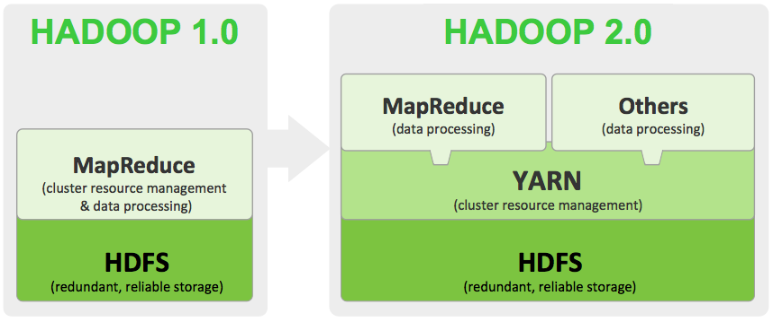
HADOOP ARCHITECTURE 1.X

Slide 7
LIMITATION OF ARCHITECTURE 1.X
The default block size is 64 MB so it is difficult to store large datas.
It support upto 4000 nodes per cluster.
Job tracker is know as single point point of failure.
Map reduce needs to perform both processing and cluster management.

Slide 8
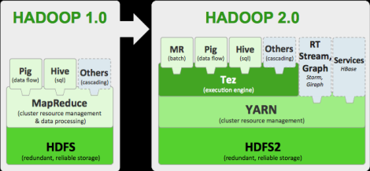
HADOOP ARCHITECTURE 2.X

Slide 9
LIMITATION OF ARCHITECTURE 2.X
The limitation 1.x architecture has been resolved using new architecture.
It support upto 1000 nodes per cluster.
By using YARN we perform cluster management.
By using MR2 component we can perform processing

Slide 10
YARN
Yarn-yet another resource negotiator.
The components of yarn are
-Resource manager
Application manager
Scheduler
-Node manager
-Application master
-Capacitor

Slide 11
COMPONENTS OF HADOOP
HDFS
-Used for storing data.
MAPREDUCE
-Used for Processing data.

Slide 12
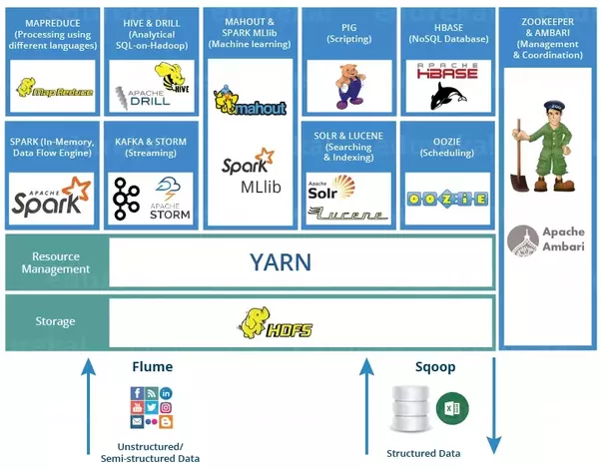
HADOOP ECOSYSTEM

Slide 13
HDFS
Hadoop distributed file system.
It is used for storing data
It has two main components
-Name node
-Data node
The default block size is 128.
By default it has three replication factor.
The replication are stored in rack.

Slide 14
COMPONENT OF HDFS
Name node
-Master node.
- It stores the metadata of hdfs.
Data node
-Slave node.
-Send heartbeat signal to namenode.

Slide 15
MAP REDUCE
It is used for processing data.
It contains structured ,unstructured and semi-structured data.
It has two main components
-Job tracker
-Task tracker
It has three phases
-Map
-Sort and Shuffle
-Reduce

Slide 16
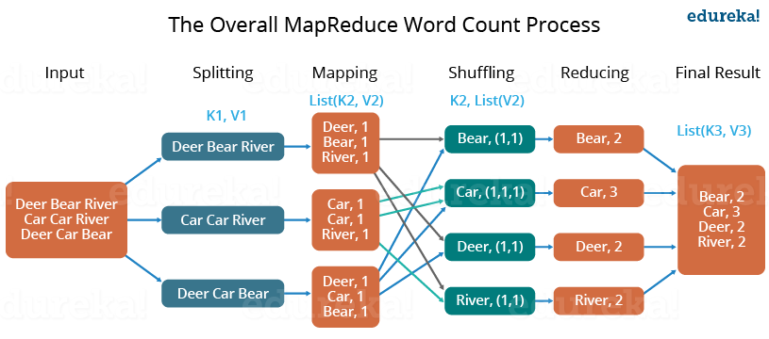
WORD COUNT

Slide 17
HIVE
It is used to process structured data.
We can process map reduce by using hive.
It uses hive querying language.
Metastore is used to store schema of table.
It provides SQL type language for querying called HiveQL.

Slide 18
PIG
It is scripting language.
Pig can have structured and semi-structured data and unstructured data.
It can work with complex data
Pig can be done with any language.
By using pig we can process map reduce efficiently.

Slide 19
SQOOP
Sqoop is a tool designed to transfer data between hadoop and relational database.
Sqoop provides command line interface.
It is used to import and export data.
Import data from RDBMS to hadoop.
Export data from Hadoop to RDBMS.

