Slide 1
Analyzing Global Cybersecurity Threats (2015–2024)

Slide 2
Introduction
The Global Cybersecurity Threats Dataset (2015–2024) offers in-depth information on cyberattacks, malware types, targeted industries, and affected countries. This project aims to uncover global cyber threat patterns using SQL for querying and Power BI for data visualization.
By analyzing this dataset, we can:
Track evolving cybersecurity trends
Identify high-risk countries and sectors
Support data-driven strategies for digital protection
This analysis serves as a foundation for threat intelligence, predictive forecasting, and future AI-driven cybersecurity solutions.
Data set : link Repository : link

Slide 3
Project Break Down
Attributes | Description | Data type
Country Year Attack Type Targeted Industry Financial Loss (in Million $) Number of affected users Security Vulnerability Type Defense Mechanism Used Incident time in sec | Country where the attack occurred Year of the incident Method of attack (e.g., Phishing, SQL Injection) Industry targeted (e.g., Finance, Healthcare) Estimated loss(in millions $) Users affected weaknesses or flaws in systems Cyber defense strategy applied (e.g., Firewall, IDS) Time taken to fully resolve the incident | VARCHAR VARCHAR VARCHAR VARCHAR DOUBLE INT VARCHAR VARCHAR INT
The data set involves the following :

Slide 4
Cleaning And Querying Data through SQL
Using MySQL data base and wrangling Through RDBMS(xamp)

Slide 5
Total number of incidents per year ?
Total loss per year / country
Which are the most common types of attack globally and by country ?
What is the average impact by attack type ?
Which industries are the most frequently targeted ?
Which are sources cause the highest financial loss ?
Which countries have the fastest/slowest resolution type ?
Most exploited vulnerabilities and their average financial loss ?

Slide 6
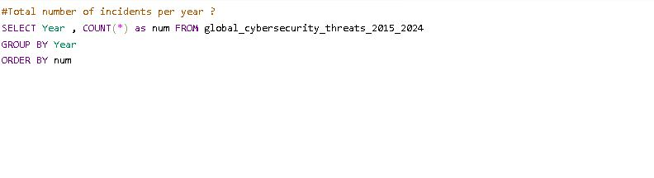
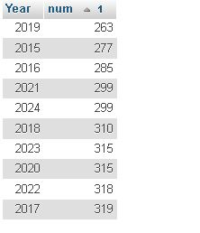
The highest number of incidents occurred in 2017 and the minimum cases recorded in the year 2019 .

Slide 7

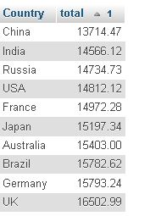
The UK faced the highest financial loss due to cybersecurity threats, totaling $16,502.99 million, followed by Germany and Brazil. China experienced the lowest total loss at $13,714.47 million. Overall, developed nations show consistently high losses, indicating larger-scale attacks or higher-value systems targeted.

Slide 8
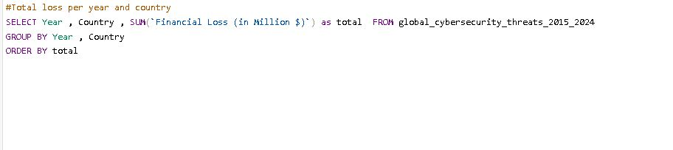
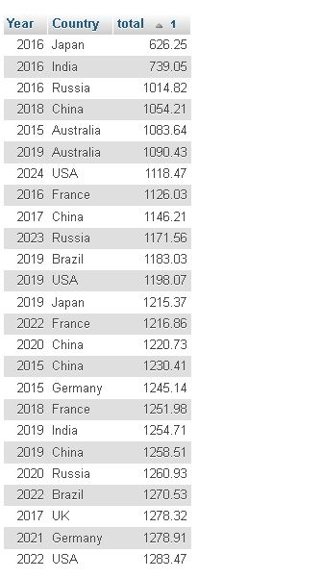
Here is the combine insight for year and country upon total loss

Slide 9

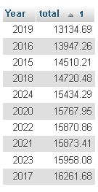
The lowest financial loss was recorded in the year was 2019 about 13134.69 million $ and highest was recorded in year 2017 about 16261.08 million $

Slide 10

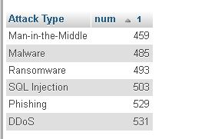
The most common types of attacks are DDos and the least number of attacks are man in the middle

Slide 11
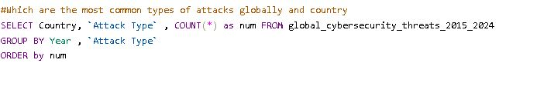
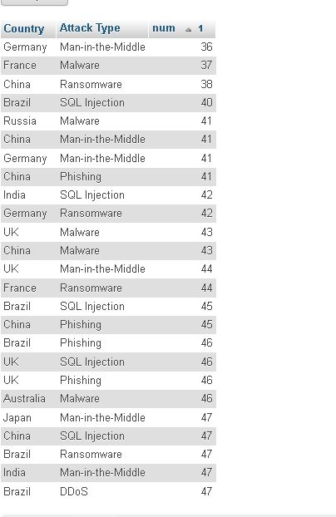
Here is the combine insight for country and attack types

Slide 12
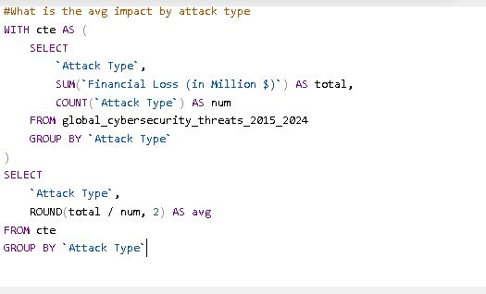
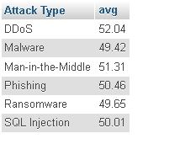
DDoS attacks have the highest average financial loss at $52.04 million, indicating significant disruption costs. Malware and Ransomware show relatively lower losses, around $49.4–$49.6 million. Overall, all attack types cause substantial financial impact, with only slight variation in average losses.

Slide 13
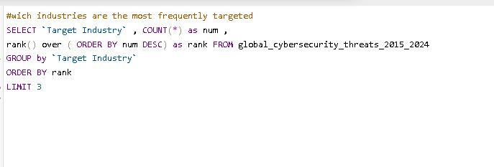
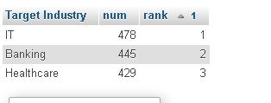
The most frequently targeted industries are IT, banking, and healthcare

Slide 14
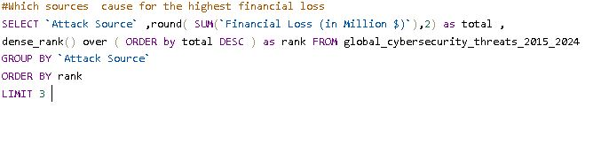
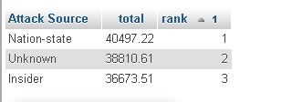
Most cyberattacks originate from nation-state actors, unknown sources, and insiders. This highlights the diverse and complex nature of cyber threat actors. Organizations need robust security strategies to address both external and internal threats.

Slide 15
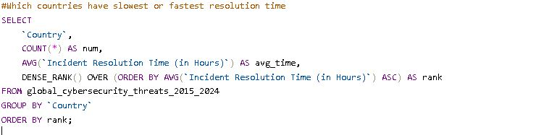
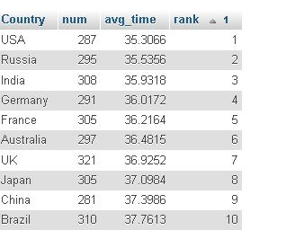
The USA, Russia, and India have the fastest incident resolution times, with averages around 35 seconds. Lower resolution time indicates quicker response and handling of issues. Efficient resolution can improve system reliability and reduce potential damage.

Slide 16
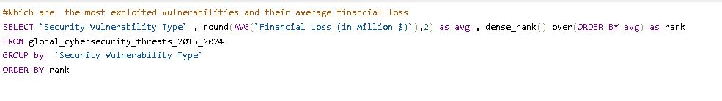
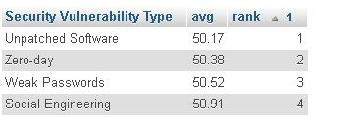
The most exploited cybersecurity vulnerability is Unpatched Software, with the lowest average loss of $50.17 million. Other major vulnerabilities include Zero-day, Weak Passwords, and Social Engineering. While all cause significant damage, keeping systems updated can notably reduce financial impact.

Slide 17
The dataset is now connected to Power BI through an ODBC connector for visualization

Slide 18
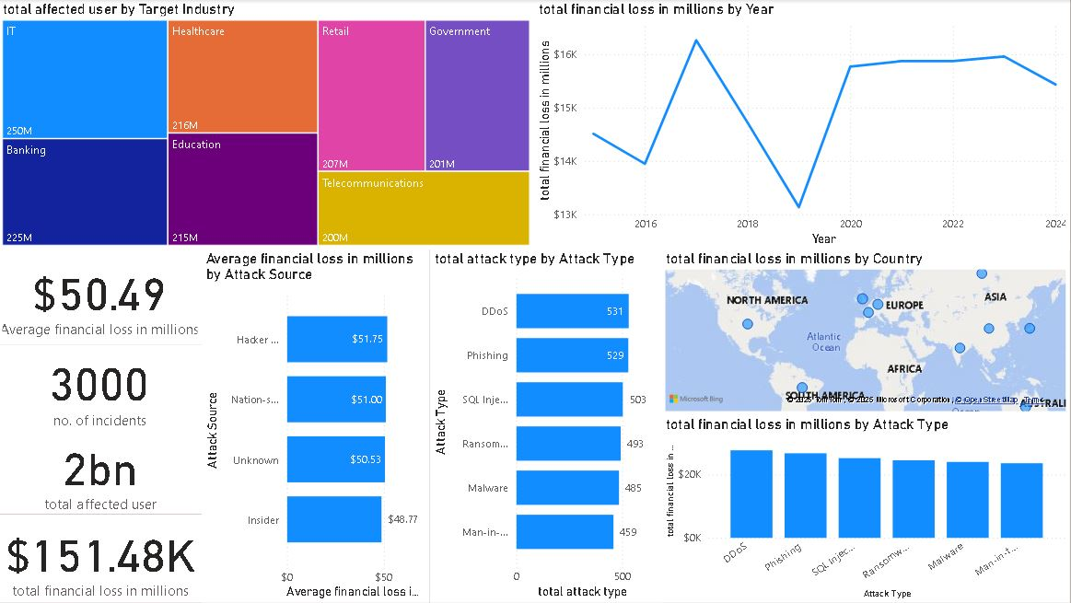

Slide 19
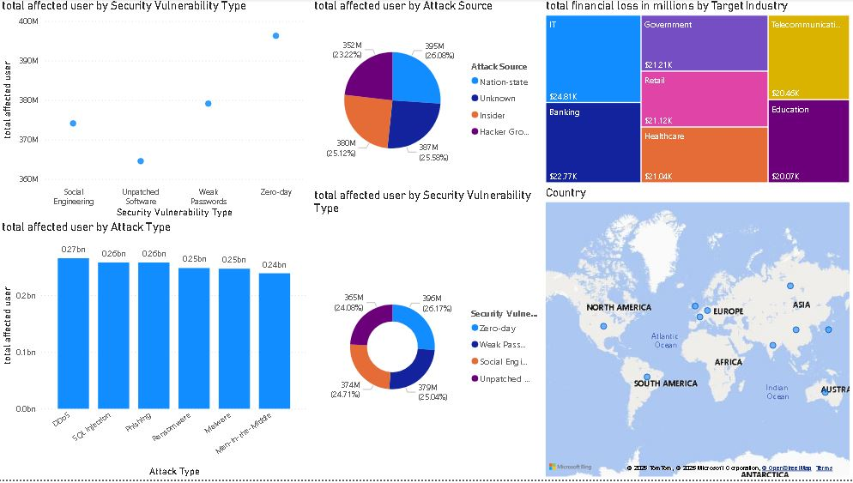

Slide 20
Visuals Used
KPIs:
Average financial loss in millions [AVERAGE(global_cybersecurity_threats_2015_2024_1[Financial Loss (in Million $)])]
No. of incidents: [COUNT(global_cybersecurity_threats_2015_2024_1[Incident Resolution Time (in Hours)])]
Total affected users :
[SUM(global_cybersecurity_threats_2015_2024_1[Number of Affected Users])]
Total Financial loss in millions:
[SUM(global_cybersecurity_threats_2015_2024_1[Financial Loss (in Million $)]]
Key Visualizations used :
Tree map : Total affected users vs targeted industry
Line chart : Total financial loss in millions vs year
Stacked bar chart : Average financial loss in millions vs attack source
Stacked bar chart : total attack type vs attack type
Map : total loss in millions vs country
Stack column chart : total loss in millions vs attack type
Scattered chart : Total affected users vs security vulnerability
Pie chart : total affected users vs attack source
Donut chart : Total affected users vs security vulnerability
Tree map : total financial loss in millions vs targeted industry
Map : Total attack vs country

Slide 21
KPIs
Average total loss in millions $ = 50.49
No.of incidents = 3000
Total Affected users = 2bn
Total financial loss in millions $ = 151.48k

Slide 22
INSIGHTS DRIVEN
The highest loss was recorded in the year 2017 about 16,261.58 $ million
About 250 million users were targeted in IT industry
The highest average financial loss, approximately $51.7 million, was caused by hacker-type attack sources
The UK faced the highest financial loss due to cybersecurity threats, totaling $16,502.99 million.
The highest financial loss was received by IT industry about 24,809 $ million

Slide 23
CONCLUSIONS
This comprehensive analysis of global cybersecurity threats from 2015 to 2024 reveals a clear escalation in both the scale and sophistication of cyberattacks, particularly in high-value sectors and developed nations. The year 2017 marked a peak in global financial losses, with the UK and IT industry suffering the most significant economic impacts. DDoS attacks emerged as the most financially damaging, while unpatched software remained the most exploited vulnerability, emphasizing the need for consistent system updates.
Moreover, our findings highlight that the majority of cyber threats originate from unknown or nation-state actors, underscoring the complexity of modern cybersecurity challenges. Despite this, nations like the USA, India, and Russia have demonstrated efficient incident resolution times, reflecting robust response mechanisms.
By integrating SQL-driven data exploration with Power BI visual storytelling, this project not only identifies critical patterns and risks but also empowers organizations and policymakers to make data-driven decisions in building resilient cybersecurity strategies. Looking ahead, these insights provide a foundational layer for developing AI-enhanced threat detection systems and predictive security frameworks.

