Slide 1
Julia Lightning Round MIT IAP Tutorial January 15, 2013
Doug Bates
Jeff Bezanson
Britni Crocker
Iain Dunning
Alan Edelman
Keno Fischer
Stefan Karpinski
Miles Lubin
Jameson Nash
Viral Shah
John Myles White

Slide 2
Quitting
Two ways to quit the interactive session
(known as a REPL: Read-Eval-Print-Loop)
<cntl> D
quit() ← Need Parens
Clear the current Command at the prompt:
<cntl> C

Slide 3
Julia Documentation
Well written!
http://docs.julialang.org/en/latest/
google: julia documentation
Much of Julia is written (elegantly!) in Julia – it won’t take you long before you start looking at Julia to learn Julia
When you are ready: google “julia source” and click on “base” or “examples” and browse around

Slide 4
Indexing: 1 based Square brackets
A=rand(5,5)
A[1,1]
rand(5,5)[1,1]
Remember
parens for functions,
square brackets for indexing

Slide 5
Comprehensions (elegant “array constructors”)
[i for i=1:5]
[trace(rand(n,n)) for n=1:5]
x=rand(10); [ x[i]+x[i+1] for i=1:9 ]
{eye(n) for n=1:5}
[i+j for i=1:5, j=1:5]
Vision: automatic parallelism

Slide 6
Parentheses also used for multiple outputs
A=rand(5,6);
svd(A)
(u,s,v)=ans
Notice that s is a vector
type<tab> #tab completion
ndims(u), typeof(u)
ndims(s), typeof(s)

Slide 7
Ternary Operator
si(x) = (x>0) ? 1 : -1
si(x) = (x>0) ? 1 : ((x<0) ? -1: 0) # Chained
“sign” (Comment: “#”)

Slide 8
Complex Numbers
im
typeof(2im)
typeof(2.0im)
complex(3,4)
complex(3,4.0) #multiple dispatch (more later)
sqrt(-1)
sqrt(complex(-1))

Slide 9
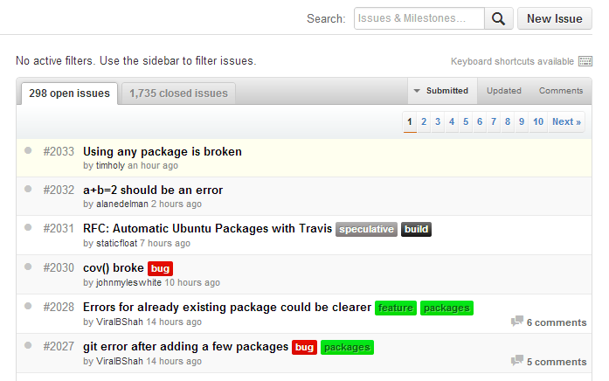
Issues Culture
Old days: wait for a new release
Julia: easy bugs fixed at the speed of light, rationale explained
No newbie question too embarrassing
Press me:
Don’t be shy
https://github.com/JuliaLang/julia/issues

Slide 10
Vectors
A=rand(5,5)
v=rand(5,1) ; w=rand(5)
typeof(v) # Array{Float64,1}
typeof(1.0 : 5) #Range1{Float64}
w=1.0: 5; A*w; #error (maybe shouldn’t be?)
w=[1.0:5]; A*w; #ok
ones(5) #vector!
eye(5) #matrix (makes sense!)

Slide 11
running a file
include(“file.jl”)
note that commands without semicolons won’t print without “println” (print line)

Slide 12
Deployment
deploy.jl
n=int(ARGS[1])
println(randn(n,n))
in shell:
./julia deploy.jl 5
(lots more in “Getting Started” doc)

Slide 13
.. or even better
dice
#! fullpath/julia
n=int(ARGS[1])
println(randn(n,n))
count=0
for i=1:n
a=randi(6,3)
count += (3==length(unique(a)))
end
println(count/n)
in shell:
chmod +x dice
./dice 1000

Slide 14
Outside Calls
Shell
run(`cal`)
run(`cal` | `grep Sa`)
C-function call
ccall(:clock, Int32, ())
bytestring(ccall(:ctime, Ptr{Uint8}, ()))

Slide 15
Punctuation Review
() Parentheses:
Function Calls
Required! quit(),tic(),toc(),help()
Output Arguments
[] Brackets:
Indexing
Array Constructors
Comprehensions
{} Braces:
Any Arrays

Slide 16
Packages
check out all the available packages off of docs.julialang.org
Click, for example, on Calendar and get to the github project page
Pkg.add(“Calendar”) #Only first time
using Calendar #Calendar exists now
Calendar.now()
now()

Slide 17
Packages (cont)
now()
Calendar.<tab>
quit() # get out of julia and back in
now # find line number in source
#click on “src”
typeof(now())
n=now()
n.tz
n.millis
z=convert(Array, @parallel [ Calendar.now().millis for x=1:10]);z-mean(z)

Slide 18
Interesting Type
strang(n)=SymTridiagonal(2*ones(n),-ones(n-1))
lit=strang(500)
big=full(strang(500))
@time eigvals(lit)
@time eigvals(big)
big+big;
lit+lit; #watch it break
import Base.+
xdump(lit)
+(a::SymTridiagonal,b::SymTridiagonal)=SymTridiagonal(a.dv+b.dv,a.ev+b.ev)
lit+lit

Slide 19
Tasks (“produce”) “pause” and “play” later
function stepbystep()
for n=1:3
produce(n^2)
end
end
p=Task(stepbystep);
consume(p)
consume(p)
consume(p)
consume(p) #What should happen now?

Slide 20
Parallelism (more later)
julia –p 5 #5 local processes
julia –machinefile file #hosts in file
addprocs_local(5) #inside a julia session
@parallel #execute using every processor

Slide 21
Design Decisions
Return type should not depend on value
sqrt(-1) #error
anothersqrt(x) = x<0 ? sqrt(complex(x)) : sqrt(x)
[anothersqrt(x) for x=-2:3]

