Slide 1
Julia Tutorial Setup Possibilities
Add a second monitor to your laptop
Need VGA Cable (unless you have dvi)
Login to athena, then julia.mit.edu on workstations or your machine (ssh)
Download julia for your laptop
xming on windows for julia.mit.edu graphs

Slide 2
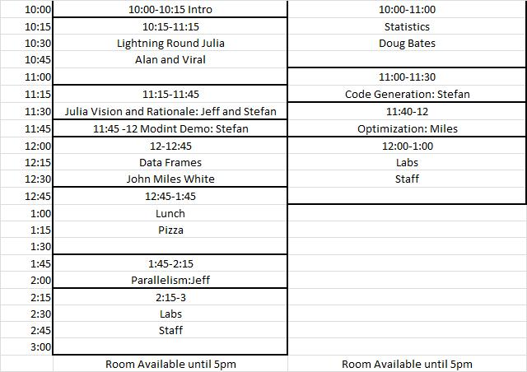
Schedule

Slide 3
Julia Lightning Round MIT IAP Tutorial January 15, 2013
Doug Bates
Jeff Bezanson
Britni Crocker
Iain Dunning
Alan Edelman
Keno Fischer
Stefan Karpinski
Miles Lubin
Jameson Nash
Viral Shah
John Myles White

Slide 4
Quitting
Two ways to quit the interactive session
(known as a REPL: Read-Eval-Print-Loop)
<cntl> D
quit() ← Need Parens
Clear the current Command at the prompt:
<cntl> C

Slide 5
Julia Documentation
Well written!
http://docs.julialang.org/en/latest/
google: julia documentation
Much of Julia is written (elegantly!) in Julia – it won’t take you long before you start looking at Julia to learn Julia
When you are ready: google “julia source” and click on “base” or “examples” and browse around

Slide 6
Indexing: 1 based Square brackets
A=rand(5,5)
A[1,1]
rand(5,5)[1,1]
Remember
parens for functions,
square brackets for indexing

Slide 7
Comprehensions (elegant “array constructors”)
[i for i=1:5]
[trace(rand(n,n)) for n=1:5]
x=rand(10); [ x[i]+x[i+1] for i=1:9 ]
{eye(n) for n=1:5}
[i+j for i=1:5, j=1:5]
Vision: automatic parallelism

Slide 8
Parentheses also used for multiple outputs
A=rand(5,6);
svd(A)
(u,s,v)=ans
Notice that s is a vector
type<tab> #tab completion
ndims(u), typeof(u)
ndims(s), typeof(s)

Slide 9
Ternary Operator
si(x) = (x>0) ? 1 : -1
si(x) = (x>0) ? 1 : ((x<0) ? -1: 0) # Chained
“sign” (Comment: “#”)

Slide 10
Complex Numbers
im
typeof(2im)
typeof(2.0im)
complex(3,4)
complex(3,4.0) #multiple dispatch (more later)
sqrt(-1)
sqrt(complex(-1))

Slide 11
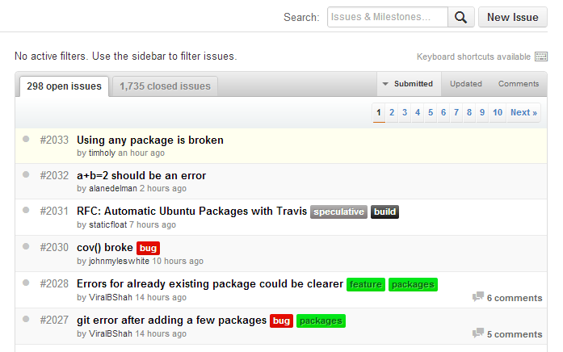
Issues Culture
Old days: wait for a new release
Julia: easy bugs fixed at the speed of light, rationale explained
No newbie question too embarrassing
Press me:
Don’t be shy
https://github.com/JuliaLang/julia/issues

Slide 12
Vectors
A=rand(5,5)
v=rand(5,1) ; w=rand(5)
typeof(v) # Array{Float64,1}
typeof(1.0 : 5) #Range1{Float64}
w=1.0: 5; A*w; #error (maybe shouldn’t be?)
w=[1.0:5]; A*w; #ok
ones(5) #vector!
eye(5) #matrix (makes sense!)

Slide 13
running a file
include(“file.jl”)
note that commands without semicolons won’t print without “println” (print line)

Slide 14
Deployment
deploy.jl
n=int(ARGS[1])
println(randn(n,n))
in shell:
./julia deploy.jl 5
(lots more in “Getting Started” doc)

Slide 15
.. or even better
dice
#! fullpath/julia
n=int(ARGS[1])
println(randn(n,n))
count=0
for i=1:n
a=randi(6,3)
count += (3==length(unique(a)))
end
println(count/n)
in shell:
chmod +x dice
./dice 1000

Slide 16
Outside Calls
Shell
run(`cal`)
run(`cal` | `grep Sa`)
C-function call
ccall(:clock, Int32, ())
bytestring(ccall(:ctime, Ptr{Uint8}, ()))

Slide 17
Punctuation Review
() Parentheses:
Function Calls
Required! quit(),tic(),toc(),help()
Output Arguments
[] Brackets:
Indexing
Array Constructors
Comprehensions
{} Braces:
Any Arrays

Slide 18
Packages
check out all the available packages off of docs.julialang.org
Click, for example, on Calendar and get to the github project page
Pkg.add(“Calendar”) #Only first time
using Calendar #Calendar exists now
Calendar.now()
now()

Slide 19
Packages (cont)
now()
Calendar.<tab>
quit() # get out of julia and back in
now # find line number in source
#click on “src”
typeof(now())
n=now()
n.tz
n.millis
z=convert(Array, @parallel [ Calendar.now().millis for x=1:10]);z-mean(z)

Slide 20
Interesting Type
strang(n)=SymTridiagonal(2*ones(n),-ones(n-1))
lit=strang(500)
big=full(strang(500))
@time eigvals(lit)
@time eigvals(big)
big+big;
lit+lit; #watch it break
import Base.+
xdump(lit)
+(a::SymTridiagonal,b::SymTridiagonal)=SymTridiagonal(a.dv+b.dv,a.ev+b.ev)
lit+lit

Slide 21
Tasks (“produce”) “pause” and “play” later
function stepbystep()
for n=1:3
produce(n^2)
end
end
p=Task(stepbystep);
consume(p)
consume(p)
consume(p)
consume(p) #What should happen now?

Slide 22
Parallelism (more later)
julia –p 5 #5 local processes
julia –machinefile file #hosts in file
addprocs_local(5) #inside a julia session
@parallel #execute using every processor

Slide 23
Design Decisions
Return type should not depend on value
sqrt(-1) #error
anothersqrt(x) = x<0 ? sqrt(complex(x)) : sqrt(x)
[anothersqrt(x) for x=-2:3]

