Slide 1


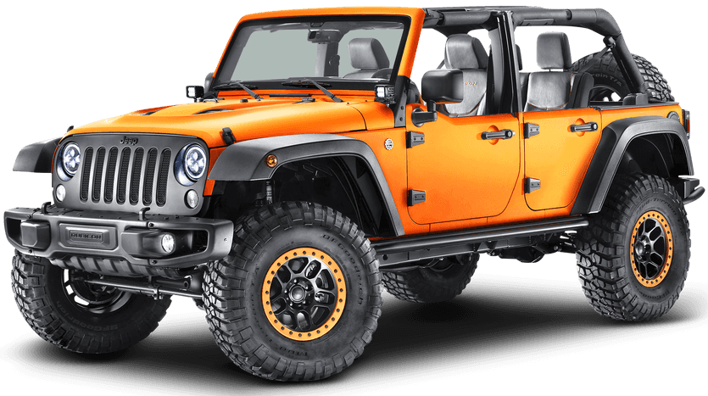
Old Wheels New Deals
Project Title: Old Wheels New Deals
Presented By:
Name: PATEL URVIBEN V.
Enrollment no:23002171210129
Roll No:45
Class:B2

Slide 2
Introduction
Old wheels New deals is website for resale old vehicles.
Purpose: A platform to buy and sell used vehicles efficiently
Technologies used: HTML, CSS, JavaScript, PHP, MySQL,XAMMP

Slide 3
Features Overview
User Authentication (Signup, Login, Forgot Password)
Home Page
Buy Car (Search, Sorting, View Details, Add to Cart, Buy Now)
Sell Car
User Cart
About
Contact
Reviews & Ratings
Logout

Slide 4
Technology Stack
Frontend: HTML, CSS, JavaScript
Backend: PHP
Database: MySQL

Slide 5
Database Schema (MySQL)
User
Car_listing
Cart

Slide 6
Future Enhancements
AI-based car price prediction
Integration with payment gateways
Real time chat feature
User-friendly UI improvements

Slide 7
Conclusion
The project successfully provides a seamless platform for buying and selling used vehicles.
It simplifies the resale process with advanced search, sorting, and transaction features.
With future enhancements like AI-based pricing and payment integration, the platform aims to become more user-centric and efficient.
Overall, 'Old Wheels, New Deals offers a convenient and reliable solution for old vehicle resale.

Slide 8
Thank You!

