Slide 1
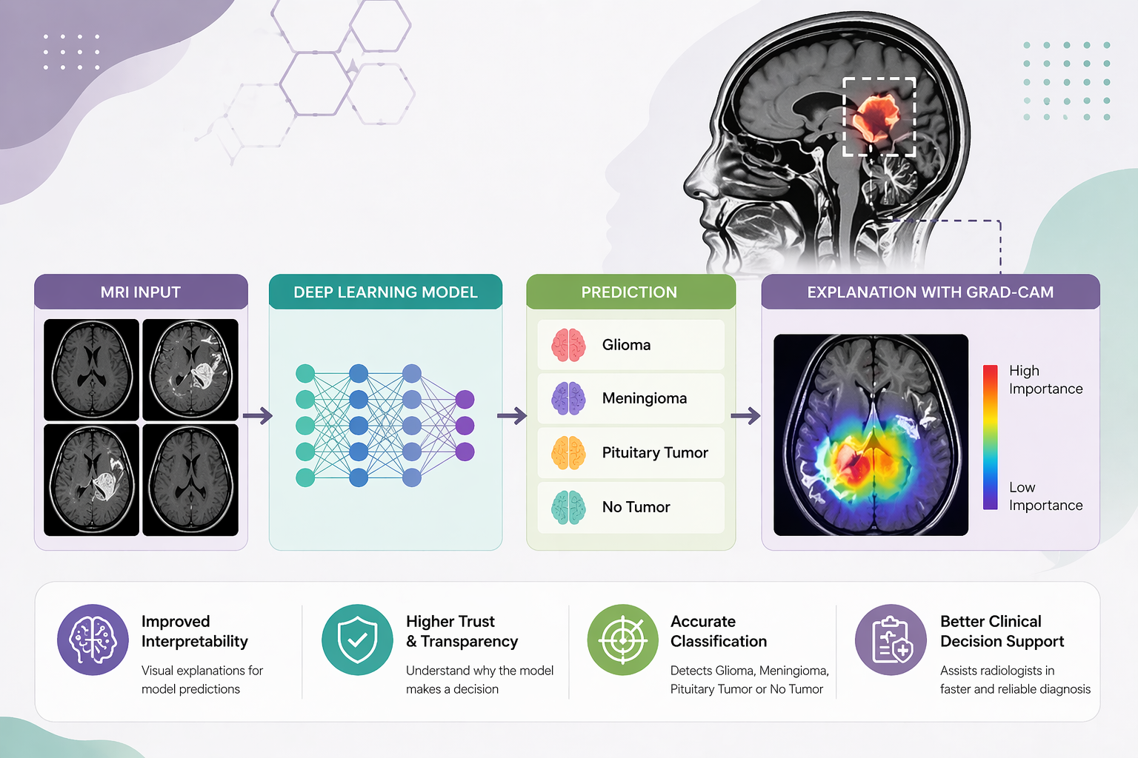
Explainable deep learning for brain tumor classification in MRI images using Grad-CAM
Notes:
This slide presents an explainable deep learning framework for brain tumor classification using MRI images. The system takes MRI scans as input and processes them through a trained deep learning model to classify tumor types such as glioma, meningioma, pituitary tumor, or no tumor. Grad-CAM provides visual explanations highlighting important regions, improving interpretability. This approach enhances diagnostic accuracy, builds trust in AI systems, and supports clinicians in making faster, more reliable medical decisions.

Slide 2

Group Github Link[Week 1-12] : https://github.com/35056525/Group10-DataScience-Brain
Notes:
This slide presents the members of Group 10 and their respective roles in the project. Balu Krishna Gade serves as Project Lead and GitHub Coordinator, while Molla Ganja Shaida is the Data Engineer. Vijayagayathri Guntupalli handles model development and evaluation, Venkat Naga Suresh Kumar leads XAI and presentation, and Mounika Chinta manages documentation. The team collaboratively developed the project, with their GitHub repository providing complete code and progress from weeks 1 to 12.

Slide 3
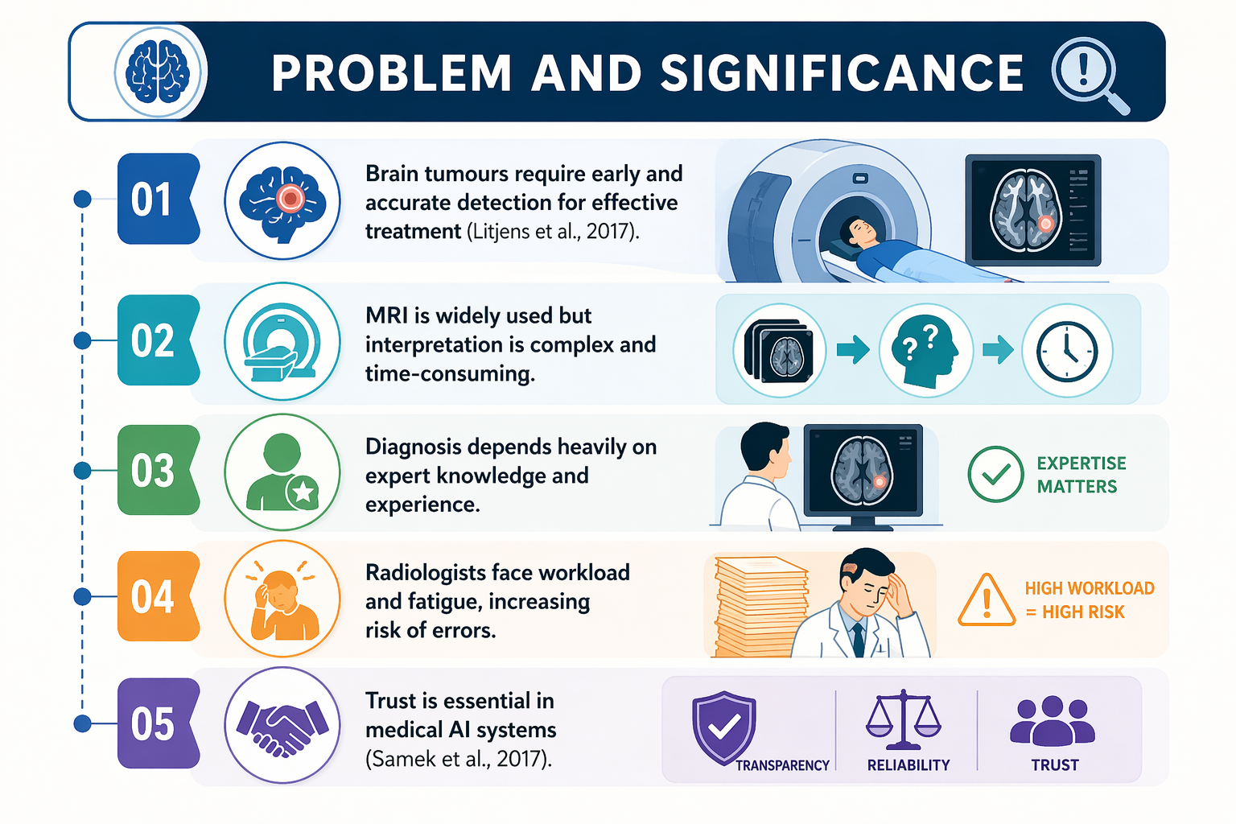
PROBLEM AND SIGNIFICANCE
Brain tumors require early and accurate detection for effective treatment (Litjens et al., 2017).
MRI is widely used but interpretation is complex and time-consuming.
Diagnosis depends heavily on expert knowledge and experience.
Radiologists face workload and fatigue, increasing risk of errors.
Trust is essential in medical AI systems (Samek et al., 2017)
Notes:
This slide highlights the importance of early and accurate brain tumor detection for effective treatment. Although MRI is widely used, its interpretation is complex and time-consuming, relying heavily on expert knowledge. Radiologists often face high workload and fatigue, increasing the risk of diagnostic errors. These challenges emphasize the need for reliable AI support. Building trust through transparency and explainability is essential to ensure medical AI systems are accepted and effectively used in clinical practice.

Slide 4
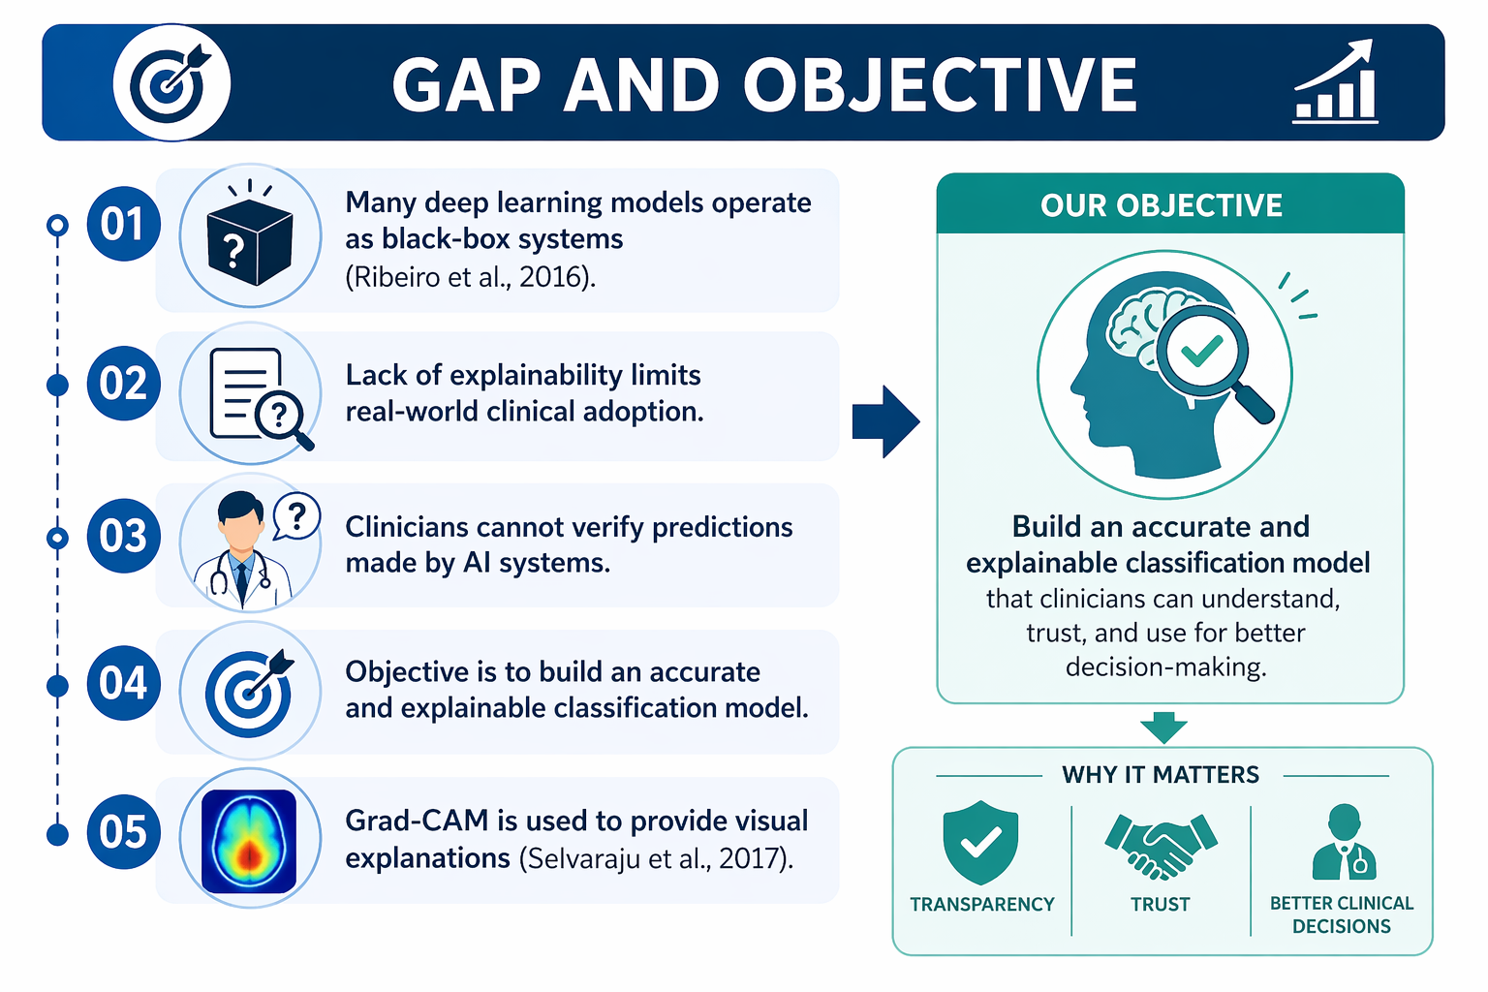
GAP AND OBJECTIVE
Many deep learning models operate as black-box systems (Ribeiro et al., 2016).
Lack of explainability limits real-world clinical adoption.
Clinicians cannot verify predictions made by AI systems.
Objective is to build an accurate and explainable classification model.
Grad-CAM is used to provide visual explanations (Selvaraju et al., 2017).
Notes:
This slide outlines the gap and objective of the project. Many deep learning models function as black-box systems, limiting transparency and trust in clinical settings. The lack of explainability prevents clinicians from verifying AI predictions, reducing real-world adoption. To address this, the objective is to develop an accurate and explainable classification model. Grad-CAM is used to provide visual explanations, helping clinicians understand model decisions, improving trust, and enabling better, more reliable clinical decision-making.

Slide 5
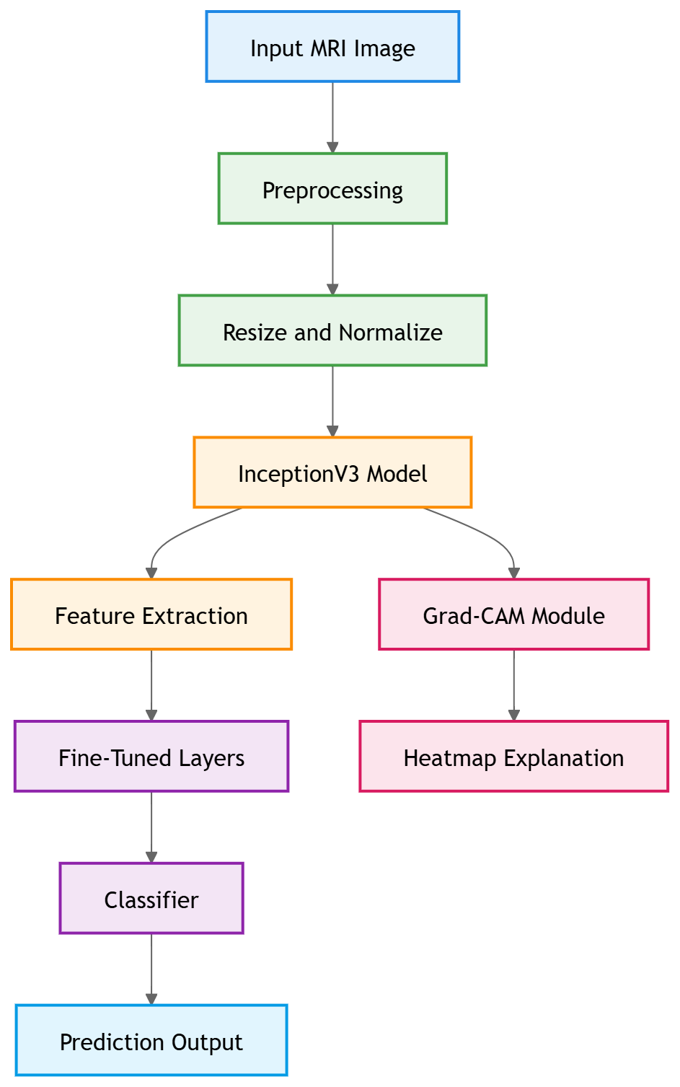
PROPOSED SOLUTION
A CNN-based system is developed for MRI image classification.
Transfer learning is applied using InceptionV3(Szegedy et al., 2016).
Fine-tuning improves performance on medical data.
Grad-CAM is integrated to highlight important regions.
Combines accuracy with interpretability (Chollet, 2017).
Notes:
This slide presents the proposed solution using a CNN-based approach for brain tumor classification from MRI images. Transfer learning with InceptionV3 is applied to leverage pre-trained knowledge, while fine-tuning enhances performance on medical data. The system includes preprocessing, feature extraction, and classification stages. Grad-CAM is integrated to highlight important regions in the images, providing visual explanations. This approach effectively combines high accuracy with interpretability, enabling reliable predictions and supporting better clinical decision-making.

Slide 6
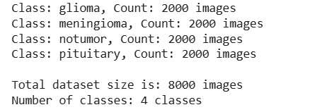
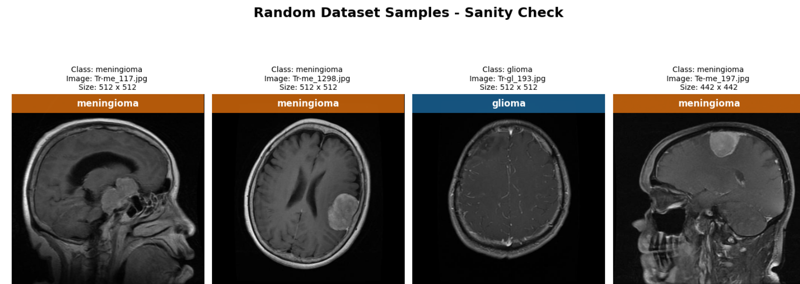
DATASET
Brain tumor MRI dataset collected from Kaggle.
Four classes: glioma, meningioma, pituitary, no tumor.
Dataset balanced using augmentation techniques.
Balanced data improves model performance (Goodfellow et al., 2016).
Augmentation increases diversity (Shorten and Khoshgoftaar, 2019).
Notes:
This slide describes the dataset used for brain tumor classification. The MRI dataset is collected from Kaggle and consists of four classes: glioma, meningioma, pituitary tumor, and no tumor, with a total of 8000 images. Data augmentation techniques are applied to balance the dataset and improve diversity. A balanced dataset enhances model performance and generalization, enabling more accurate predictions and robust learning for reliable brain tumor classification.

Slide 7
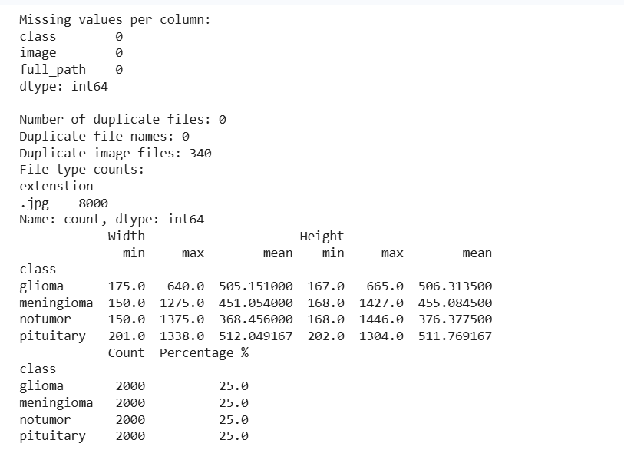

DATA PREPROCESSING
Images resized to 224 x 224 for model input.
Pixel values normalized for stable training.
Data augmentation applied: rotation, flipping, zoom.
Helps reduce overfitting and improve generalization.
Important for deep learning performance (LeCun et al., 2015).
Notes:
This slide explains the data preprocessing steps used for the model. MRI images are resized to 224×224 to match model input requirements, and pixel values are normalized to ensure stable training. Data augmentation techniques such as rotation, flipping, and zooming are applied to increase dataset diversity. These steps help reduce overfitting and improve generalization. Effective preprocessing is essential for enhancing deep learning model performance and achieving accurate, reliable brain tumor classification results.

Slide 8
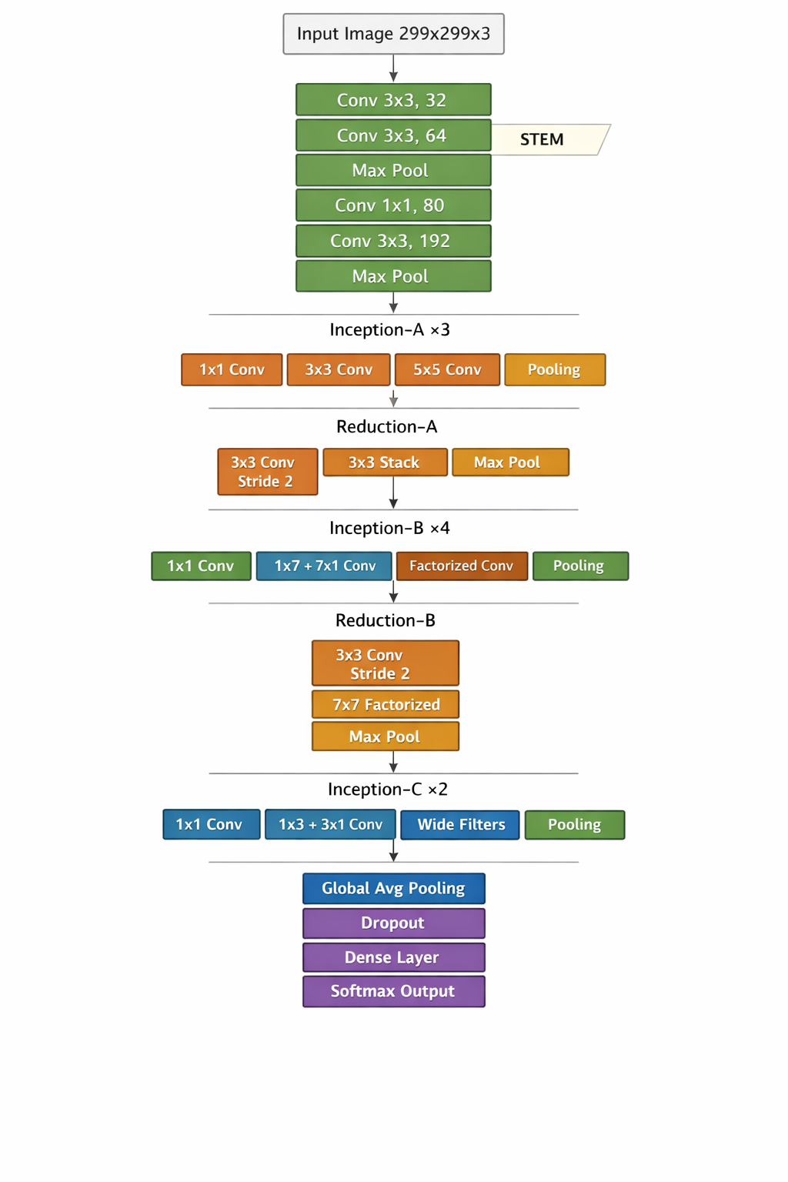
MODEL ARCHITECTURE
InceptionV3 used as the base model.
Pretrained on ImageNet dataset (Deng et al., 2009).
Transfer Learning reduces learning time.
Fully connected layers added for classification.
CNNs are effective for image analysis (Szegedy et al., 2016).
Notes:
This slide describes the model architecture used for brain tumor classification. InceptionV3 serves as the base model, pretrained on the ImageNet dataset to leverage rich feature representations. Transfer learning reduces training time and improves performance. Additional fully connected layers are added for classification of tumor types. The architecture combines convolutional layers, pooling, and dense layers to effectively extract features. Overall, CNN-based models like InceptionV3 are highly effective for medical image analysis tasks.

Slide 9
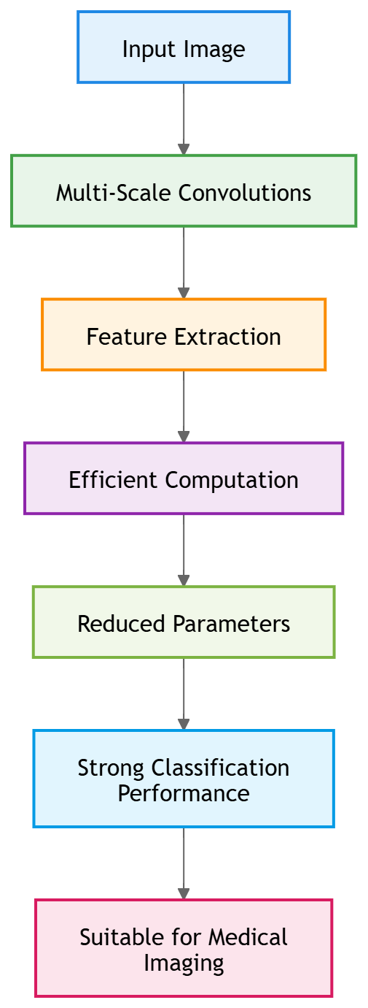
WHY INCEPTIONV3
Captures multi-scale features efficiently.
Reduces computational cost compared to deeper models.
Performs well in image classification tasks (Szegedy et al., 2016).
Suitable for medical imaging problems.
Efficient architectures improve results (Tan and Le, 2019).
Notes:
This slide explains why InceptionV3 is chosen for the model. It efficiently captures multi-scale features, enabling better understanding of complex patterns in MRI images. The architecture reduces computational cost while maintaining strong performance compared to deeper networks. It has proven effectiveness in image classification tasks and is well-suited for medical imaging applications. Its efficient design and reduced parameters lead to improved accuracy, making it a reliable choice for brain tumor classification.

Slide 10
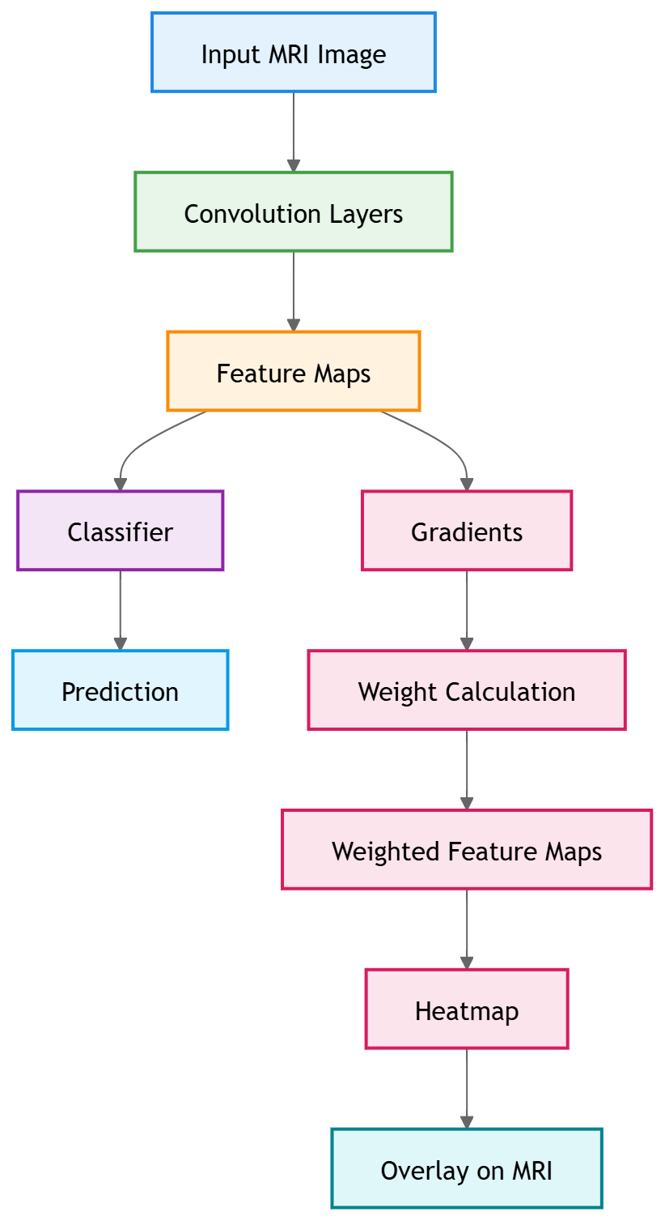
EXPLAINABILITY USING GRAD-CAM
Grad-CAM generates heatmaps highlighting important regions.
Uses gradients from convolutional layers.
Helps visualize model decision-making process.
Improves trust in AI systems (Samek et al., 2017).
Widely used in explainable AI (Selvaraju et al., 2017).
Notes:
This slide explains the use of Grad-CAM for model explainability. Grad-CAM generates heatmaps that highlight important regions in MRI images influencing predictions. It uses gradients from convolutional layers to understand feature importance and visualize the model’s decision-making process. These visual explanations make AI outputs more transparent and interpretable. Grad-CAM improves trust in AI systems and is widely used in explainable AI to support reliable and understandable medical image analysis.

Slide 11
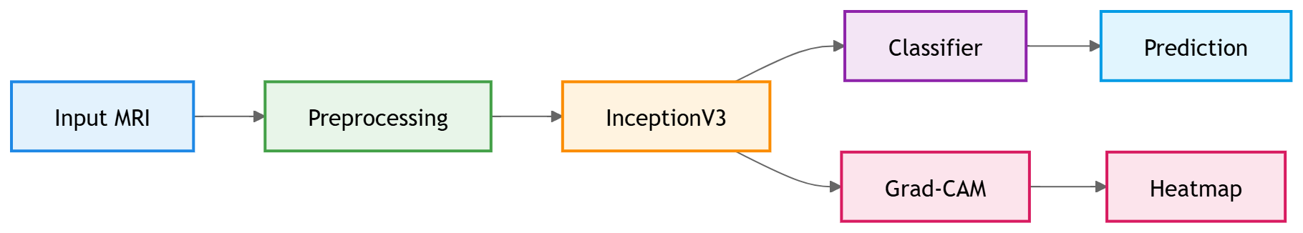
SYSTEM PIPELINE
Input MRI image is provided to the system.
Preprocessing prepares the image.
CNN extracts features and predicts tumor class.
Grad-CAM generates visual explanation.
Produces both prediction and interpretation.
Follows deep learning workflow (Goodfellow et al., 2016).
Notes:
This slide illustrates the system pipeline for brain tumor classification. An input MRI image is first processed through preprocessing steps such as resizing and normalization. The CNN model, based on InceptionV3, extracts features and predicts the tumor class. Simultaneously, Grad-CAM generates a heatmap to provide visual explanations of important regions. The system outputs both prediction and interpretation, ensuring accuracy and transparency while following a standard deep learning workflow for reliable medical image analysis.

Slide 12
LIVE DEMONSTRATION
Load trained InceptionV3 model.
Input a new MRI scan image.
Model predicts tumor class.
Output includes prediction confidence.
Notes:
This slide presents the live demonstration of the developed system. The trained InceptionV3 model is first loaded, followed by providing a new MRI scan as input. The model processes the image and predicts the tumor class based on learned features. The output includes both the predicted class and its confidence score. This demonstration showcases the system’s practical usability, enabling real-time, accurate, and interpretable brain tumor classification.

Slide 13
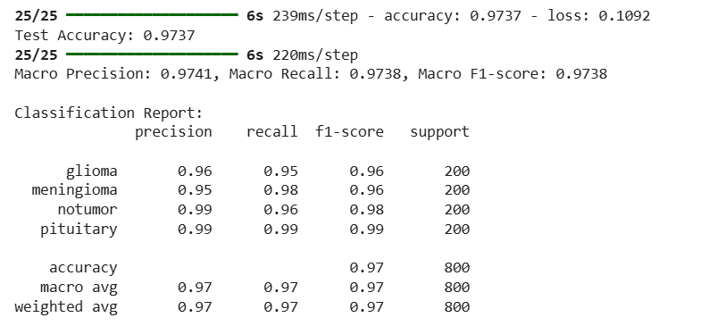
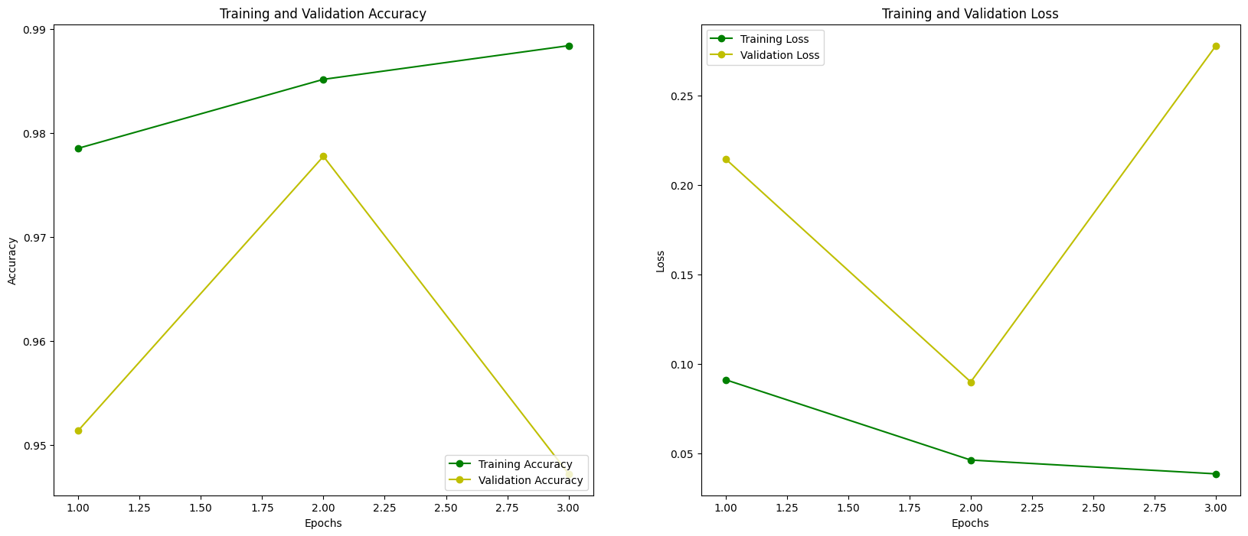
EVALUATION: OVERALL PERFORMANCE
Test Accuracy achieved: 0.9737 (97.37%).
Macro Precision: 0.9741.
Macro Recall: 0.9738
Macro F1-score: 0.9738
Indicates strong and balanced model performance.
Reliable evaluation metrics (Sokolova and Lapalme, 2009; Powers, 2011).
Notes:
This slide presents the overall performance of the model on the test dataset. The model achieved a high accuracy of 97.37%, indicating strong predictive capability. Macro precision, recall, and F1-score are all around 0.97, showing balanced performance across all classes. These metrics confirm the model’s reliability and effectiveness. The training and validation curves further demonstrate stable learning, highlighting that the model generalizes well and performs consistently in brain tumor classification tasks.

Slide 14
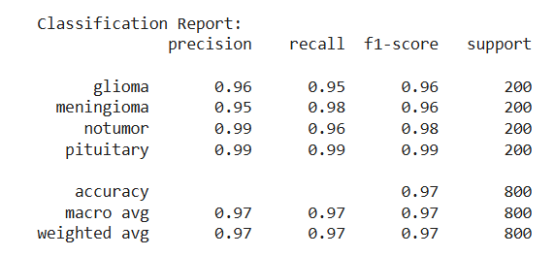
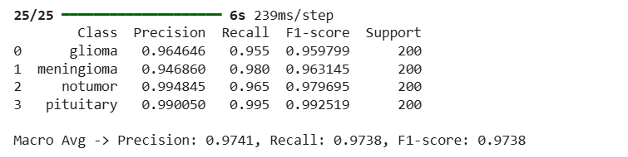
EVALUATION: CLASS-WISE PERFORMANCE
Glioma: F1-score ≈ 0.96.
Meningioma: F1-score ≈ 0.96.
No Tumour: F1-score ≈ 0.98.
Pituitary: F1-score ≈ 0.99.
High performance across all classes
Balanced dataset improves consistency (He and Garcia, 2009; Goodfellow et al., 2016)
Notes:
This slide presents class-wise performance of the model. The F1-scores indicate strong results across all categories: glioma and meningioma around 0.96, no tumor around 0.98, and pituitary tumor achieving the highest at approximately 0.99. These results demonstrate consistent and reliable classification performance. The balanced dataset contributes to this stability, ensuring that the model performs well across different classes without bias, leading to accurate and robust brain tumor detection.

Slide 15
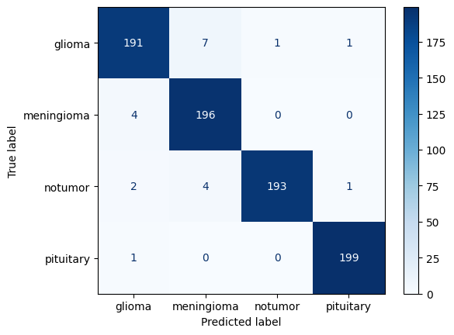
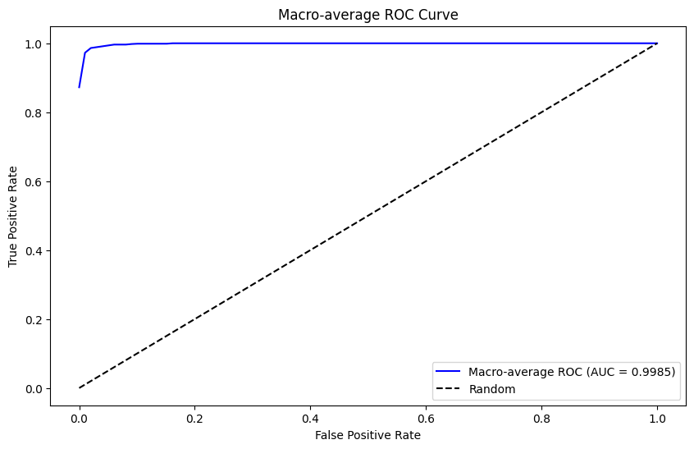
EVALUATION: ROC AND CONFUSION MATRIX
ROC AUC score ≈ 0.9985, indicating excellent classification ability.
Confusion matrix shows very few misclassifications.
Model performs well across all tumor types.
Low false positives and false negatives.
Strong evaluation confirms robustness (Fawcett, 2006; Powers, 2011).
Notes:
This slide presents ROC and confusion matrix evaluation results. The model achieves an excellent ROC AUC score of approximately 0.9985, indicating strong classification capability. The confusion matrix shows very few misclassifications, with most predictions correctly identified across all tumor classes. Low false positives and false negatives highlight the model’s reliability. Overall, these metrics confirm robust and consistent performance, demonstrating the model’s effectiveness in accurate brain tumor classification.

Slide 16
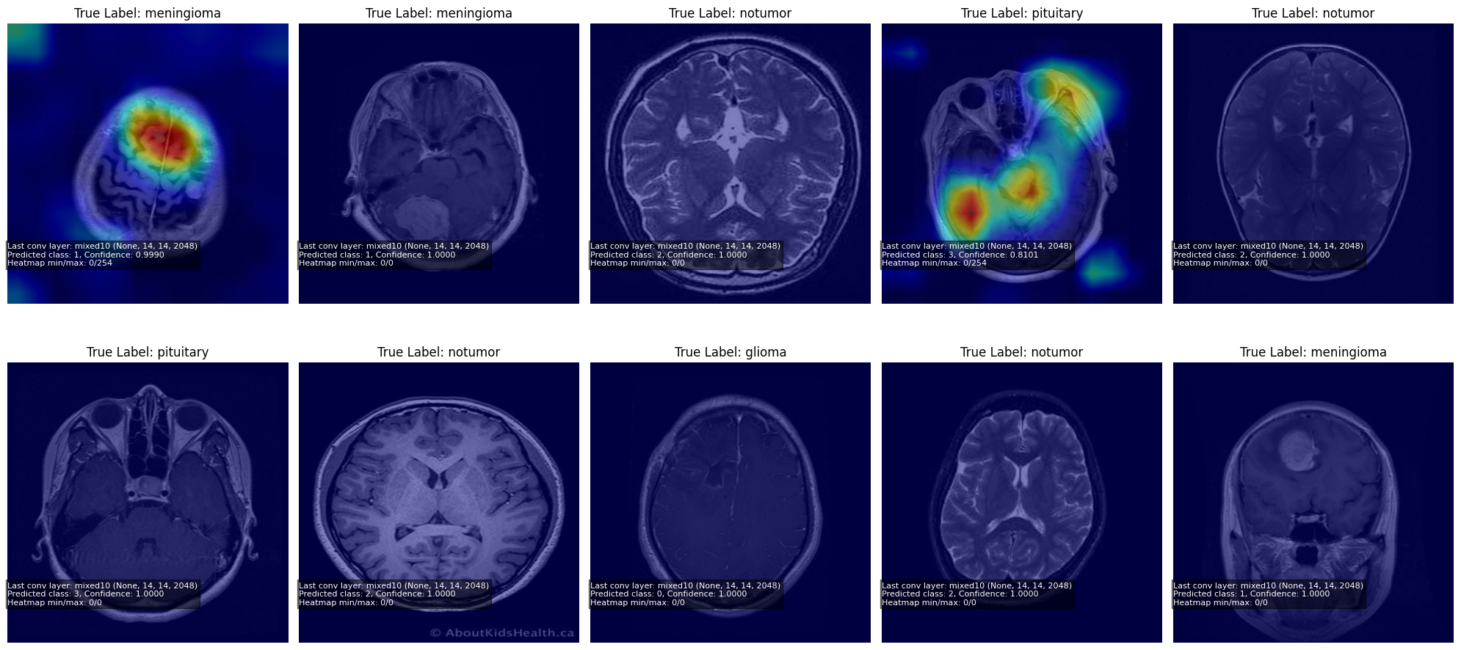
GRAD-CAM RESULTS
Grad-CAM highlights important regions in MRI images (Selvaraju et al., 2017).
High activation is observed in tumor regions for correct predictions.
Minimal activation is seen in “no tumor” cases.
Confirms the model focuses on relevant medical features.
Improves transparency and trust in predictions (Samek et al., 2017)
Notes:
This slide presents Grad-CAM results for model explainability. The heatmaps highlight important regions in MRI images that influence predictions. High activation is clearly observed in tumor areas for correct classifications, while minimal activation appears in no-tumor cases. These results confirm that the model focuses on clinically relevant features. Grad-CAM enhances transparency by visualizing decision-making, helping build trust in the system and supporting reliable, interpretable brain tumor classification.

Slide 17
ETHICAL CONSIDERATIONS
Dataset bias may affect model predictions.
Limited diversity may reduce generalization.
Risk of incorrect predictions in medical use.
System should assist clinicians, not replace them.
Ethical AI is essential in healthcare (Floridi et al., 2018; Mittelstadt et al., 2016).
Notes:
This slide highlights ethical considerations in the proposed system. Dataset bias and limited diversity can affect model fairness and generalization. There is a risk of incorrect predictions, which is critical in medical applications. Therefore, the system should support clinicians rather than replace them. Ensuring transparency, accountability, and responsible use is essential. Adhering to ethical AI principles helps build trust and ensures safe, reliable deployment of AI in healthcare settings.

Slide 18
IMPACT
Supports radiologists in faster diagnosis.
Reduces workload and improves efficiency.
Provides visual explanations for trust.
Useful in low-resource healthcare environments.
Enhances decision-making (Litjens et al., 2017; Topol, 2019)
Notes:
This slide highlights the impact of the proposed system in healthcare. It supports radiologists by enabling faster and more accurate diagnosis, reducing workload and improving efficiency. The use of Grad-CAM provides visual explanations, increasing trust in AI predictions. The system is especially useful in low-resource settings where expert availability is limited. Overall, it enhances clinical decision-making, contributing to better patient outcomes and more reliable, accessible healthcare solutions.

Slide 19
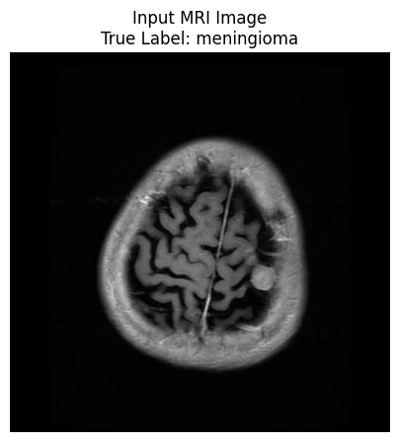
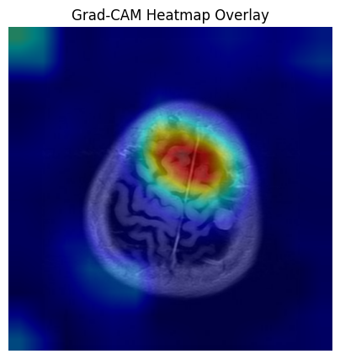
CONCLUSION
An explainable deep learning model was developed for brain tumor classification.
InceptionV3 achieved high performance in MRI image classification (Szegedy et al., 2016).
Grad-CAM provided clear visual explanations of model predictions (Selvaraju et al., 2017).
The system combines accuracy with interpretability for medical use.
Supports clinicians in making reliable and informed decisions (Litjens et al., 2017).
Notes:
This slide concludes the project by summarizing key outcomes. An explainable deep learning model was developed for brain tumor classification using MRI images. InceptionV3 delivered high accuracy, while Grad-CAM provided clear visual explanations of predictions. The system successfully combines performance with interpretability, making it suitable for medical applications. It supports clinicians in making reliable, informed decisions, ultimately improving diagnostic efficiency and contributing to better patient care.

Slide 20
FUTURE WORK
Use real-world hospital datasets.
Extend to 3D MRI analysis.
Improve model robustness and generalization.
Deploy as web or clinical application.
Future AI in healthcare is promising (Esteva et al., 2017; Topol, 2019)
Notes:
This slide outlines future work for enhancing the system. It includes using real-world hospital datasets to improve reliability and extending the model to 3D MRI analysis for richer feature extraction. Further improvements aim to enhance robustness and generalization across diverse data. Deploying the model as a web or clinical application is also planned. Overall, these steps will strengthen performance and support wider adoption of AI-driven solutions in healthcare.

Slide 21
REFERNECES

Slide 22



