Slide 1


Slide 2




HyperV 2016, S2D, PowerShell
Mateusz Czerniawski
Arcontar
mczerniawski@arcon.net.pl
@Arcontar
arconnetblog.wordpress.com

Slide 3
Agenda:
1. HomeLab – how, where, why
2. Where magic happens
3. What’s next?

Slide 4
HomeLab:
Azure Dev/Test Lab
Lability – VirtualEngine
GUI – clicky click
PowerShell

Slide 5
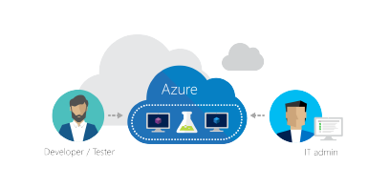

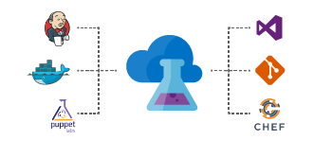
Azure Dev/Test Lab:
https://azure.microsoft.com/pl-pl/services/devtest-lab/
Policies and limits ($)
Custom images
Integration with CI/CD

Slide 6
Lability:
https://github.com/VirtualEngine/Lability
DSC configuration document with DSL
(Domain-specific language) = Lability + DSC

Slide 7
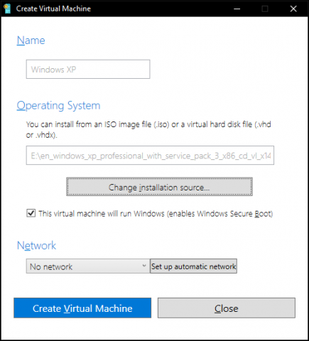
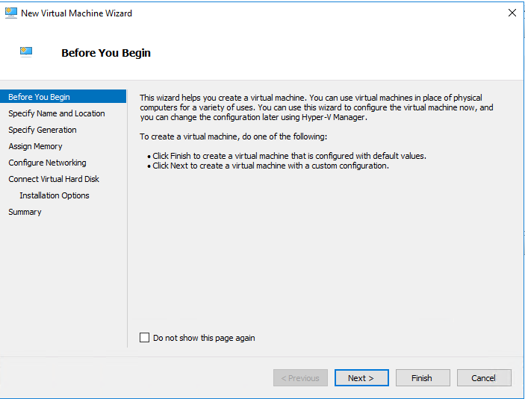
GUI:
DIY and again and again and again
Quick Create – Windows 10, 1703

Slide 8
PowerShell:
Prepare Host for PSRemoting (1.After-Install.ps1)
Prepare HV Host configuration file (2.Prepare-HVHostConfig.ps1)
Deploy HV Host from configuration file (3.Deploy-HVHost.ps1)
Copy necessary files (Folder CopyFiles)
Prepare VM Templates – Gold Images (5.Run-PrepareVMTemplates.ps1)
Prepare VMs configuration files (6. Run-PrepareVM.ps1)
Deploy VMs from configuration files (7.Run-CreateVMs.ps1)

Slide 9
Architecture

Slide 10

Demo Time

Slide 11
What’s next
Pester + OVF
Validation of resources
GIT + AppVeyor
FUN

