Slide 1

https://cdn.discordapp.com/attachments/539252745258008586/540291585363935328/1ad790985f7dc81b7153134eba58dc2.png
Frozen
Frog

Slide 2
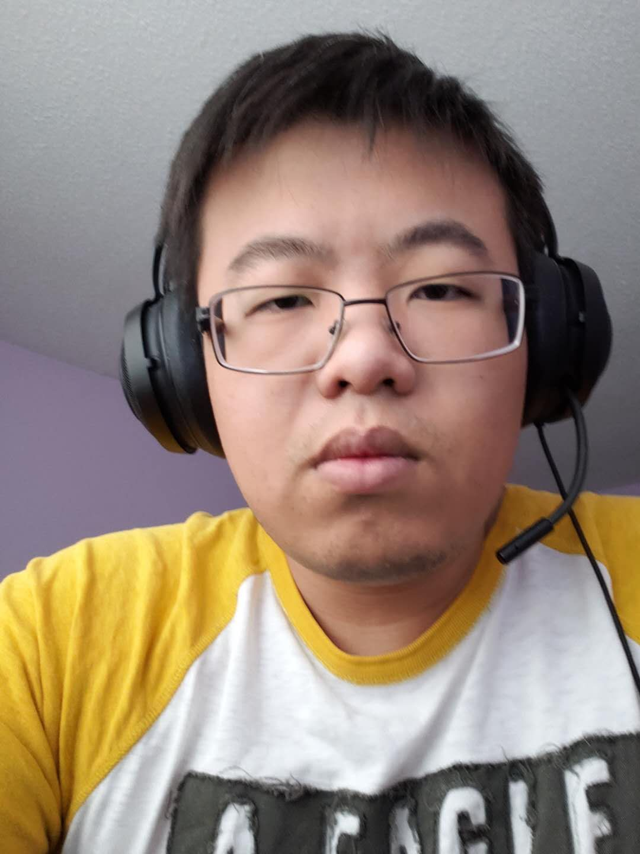
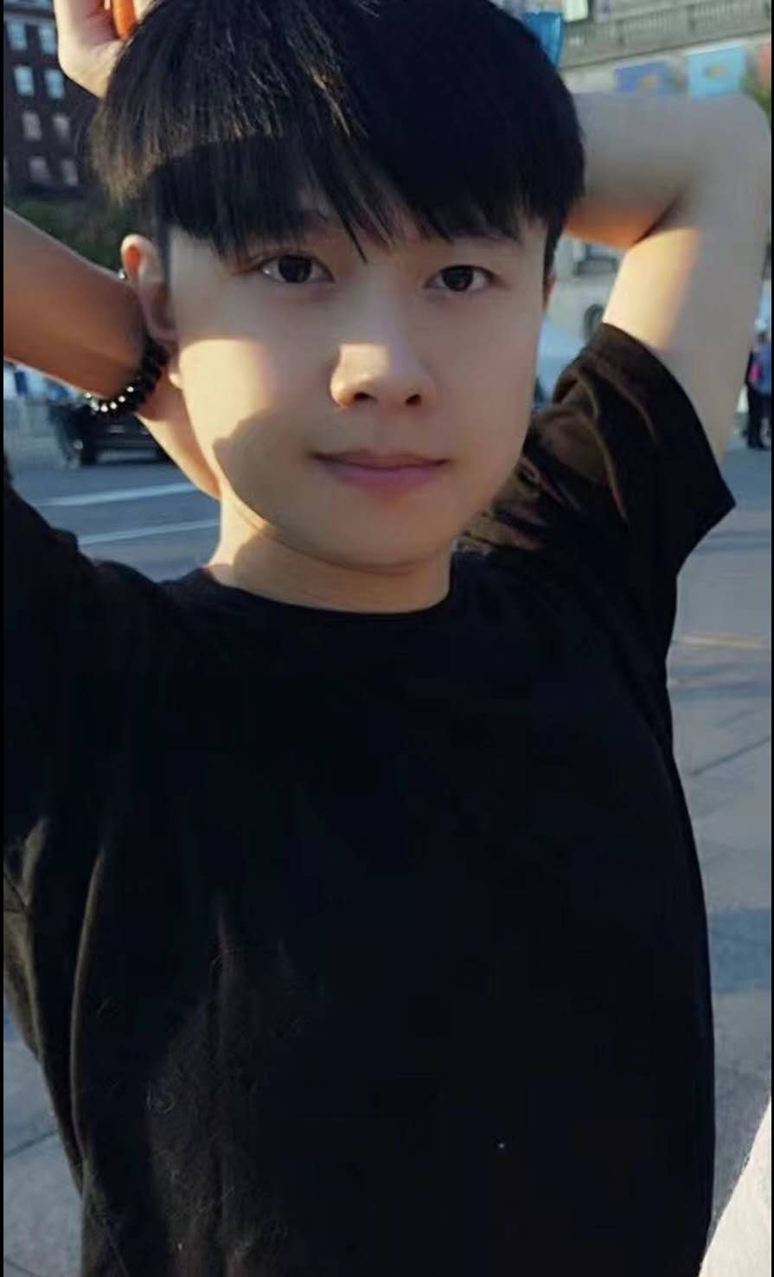
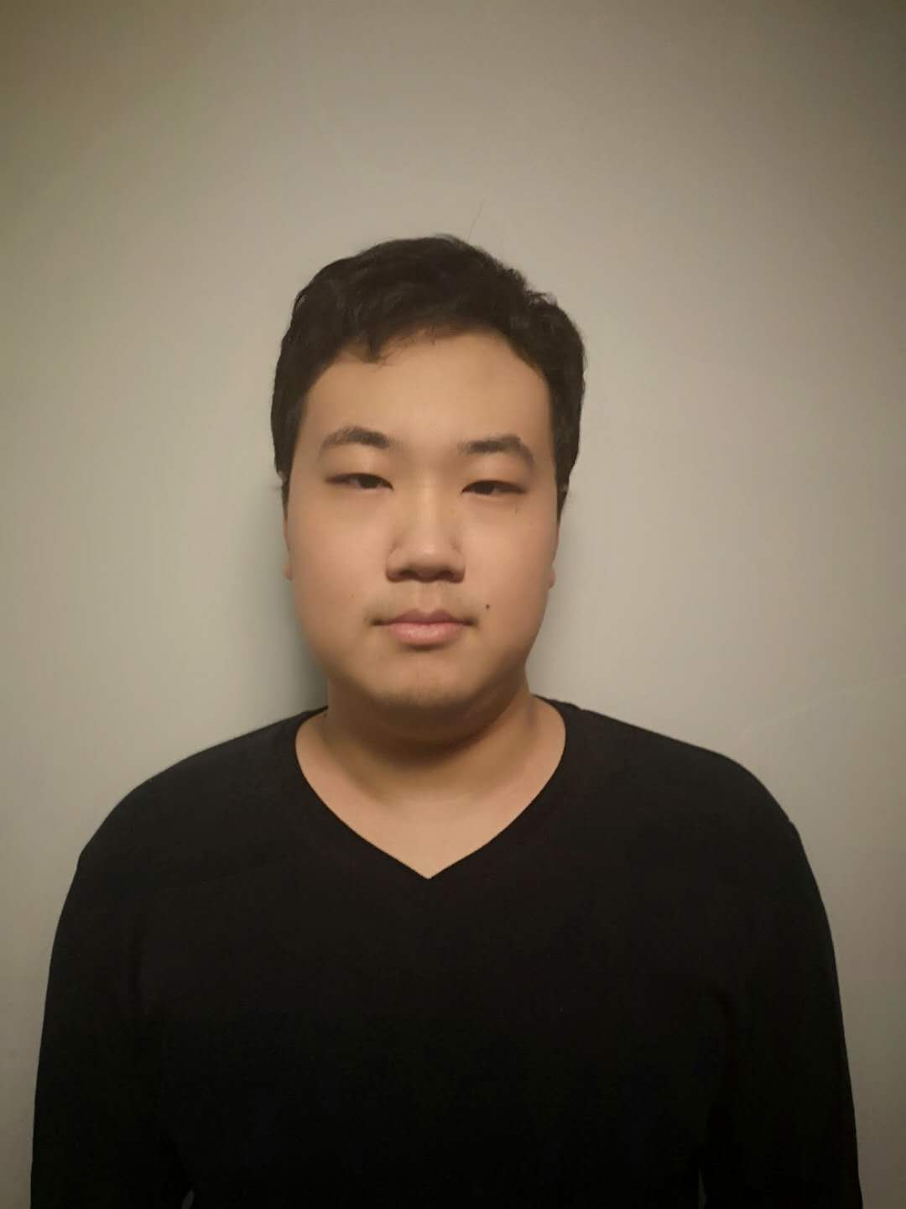
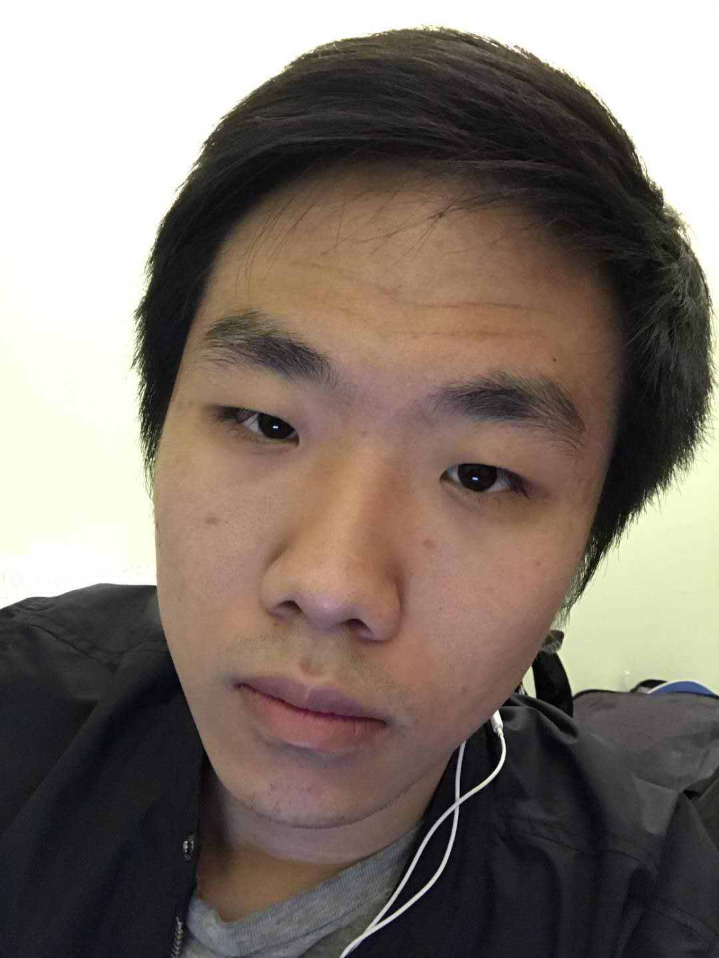
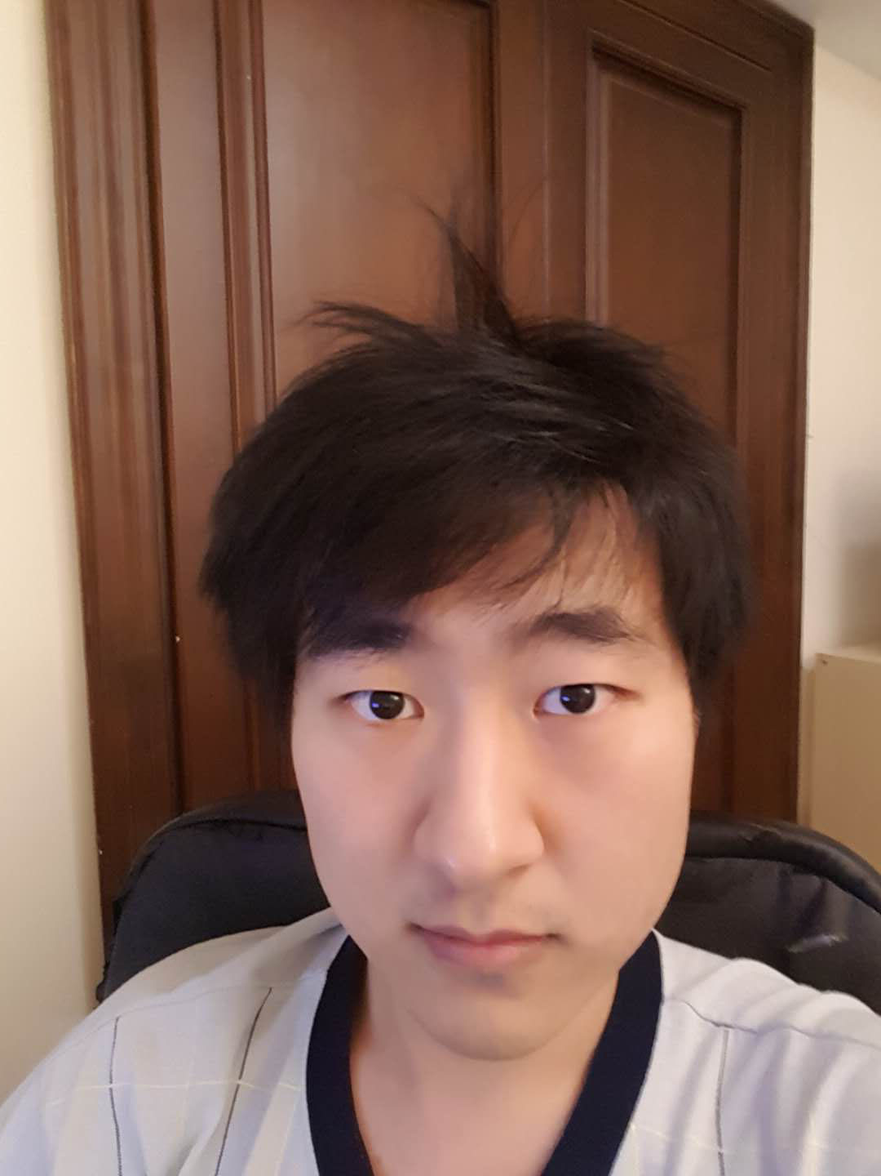
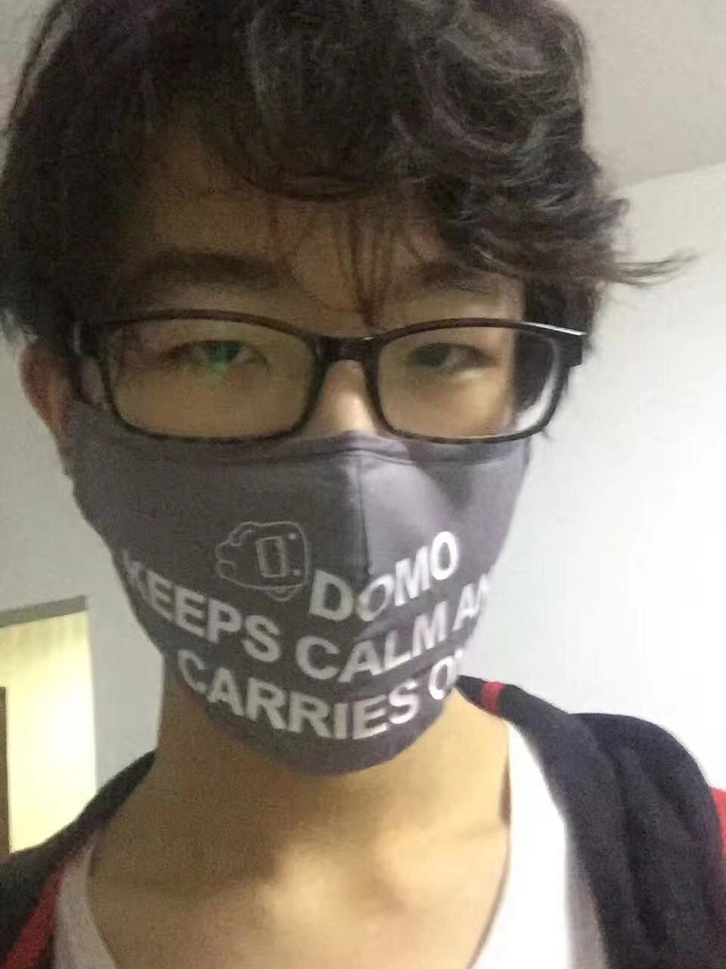
https://cdn.discordapp.com/attachments/539252745258008586/540291585363935328/1ad790985f7dc81b7153134eba58dc2.png
Frozen
Frog
Xian Zhang, AS
Ao Li, SE
YuYang Ma, GD
Guanwu Chen, PM
Run Wu, SE
Yang Gu, QA

Slide 3
I
Influences
Contents
II
Game Overview
III
MDA
IV
Planning

Slide 4
I
Influences

Slide 5
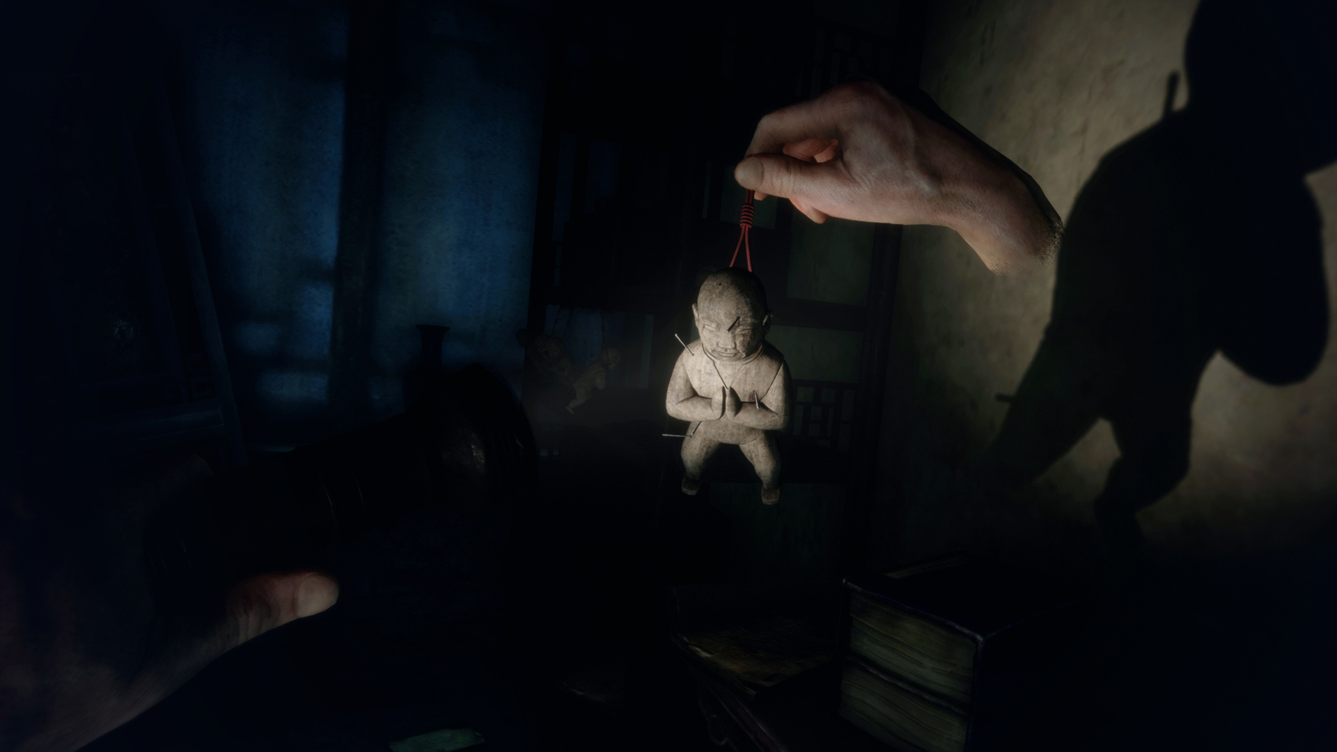
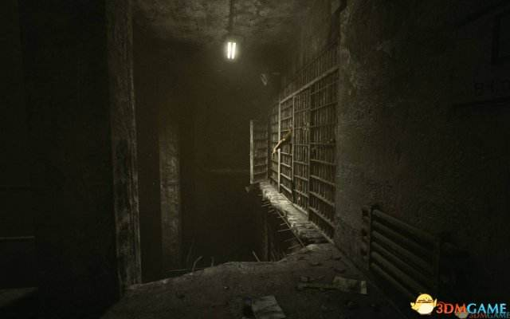
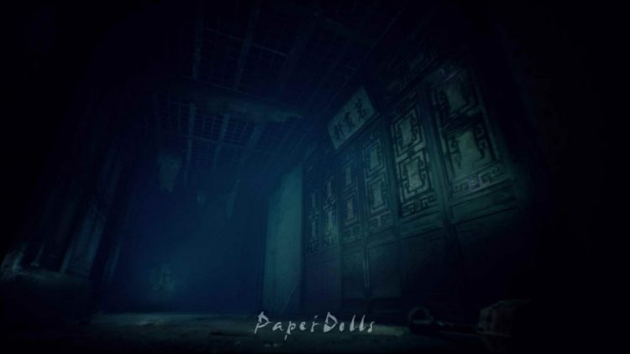
Outlast
Soul Dimension
Paper Dolls

Slide 6
II
Game Overview

Slide 7
Game Logline
Game Story introduction
The whole game happened in 1966. In order to escape the pursuer, you hid into a scraped hospital which build in the war, then you got stunned, when you waked up, you discovered that you were in the basement of a hospital. For the surviving, you started escape from this hospital.
First person VR Horror puzzle game. Player search items, solve puzzles and finally defeat the boss ghost to win.

Slide 8
III
MDA

Slide 9
Mechanics
I
II
III
When ghosts (Enemies) touch player, player will lose HP, escape from the hospital before HP got 0.
Use controller to move, Turn head around to confirm the surroundings.
Aim to target the items and get them.

Slide 10
Dynamics
I
II
III
Player search and use the items, solve the puzzle to clear the way.
Dodge or defeat the ghosts which blocking the way by the items.
Player can get bonus scores by find some scraps of paper which explain the whole game world background clearly.

Slide 11
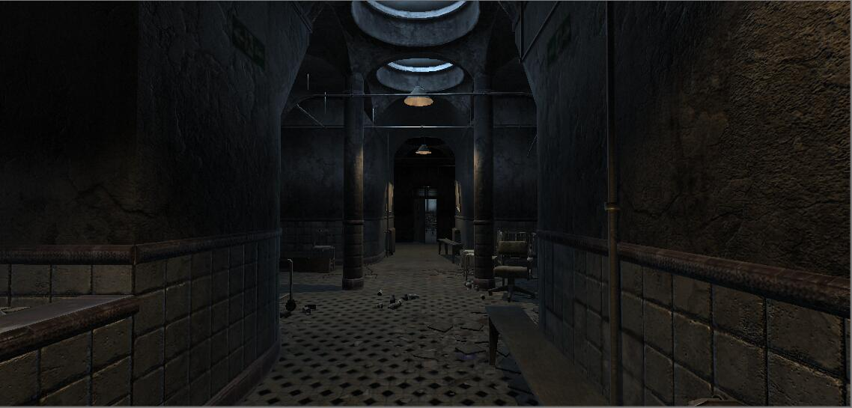
Aesthetics
An old abandoned hospital with dim and dilapidated styles as the main map.
Horror style background sounds.
Real ambient sounds.

Slide 12
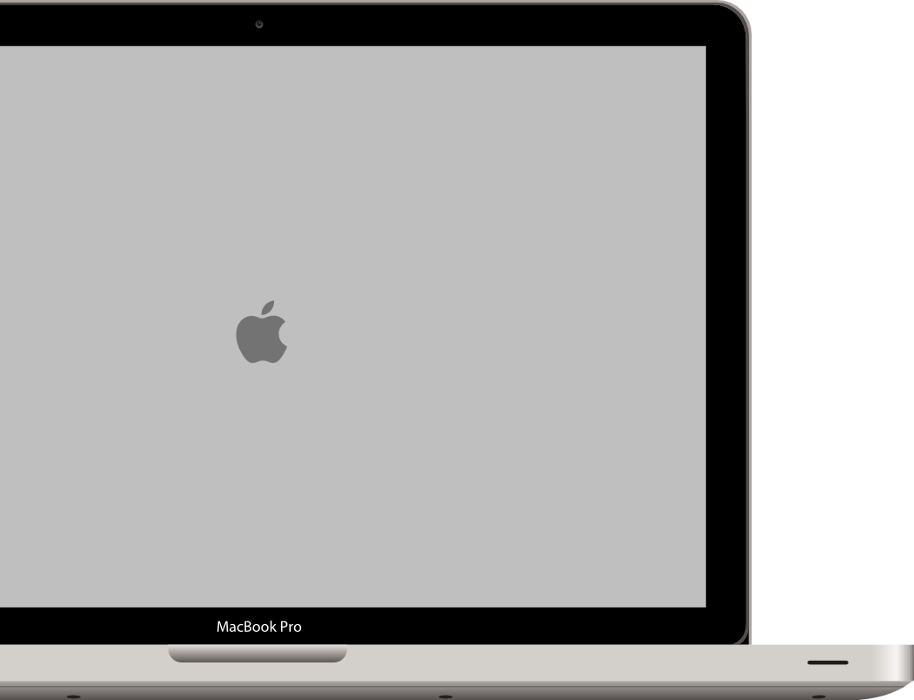
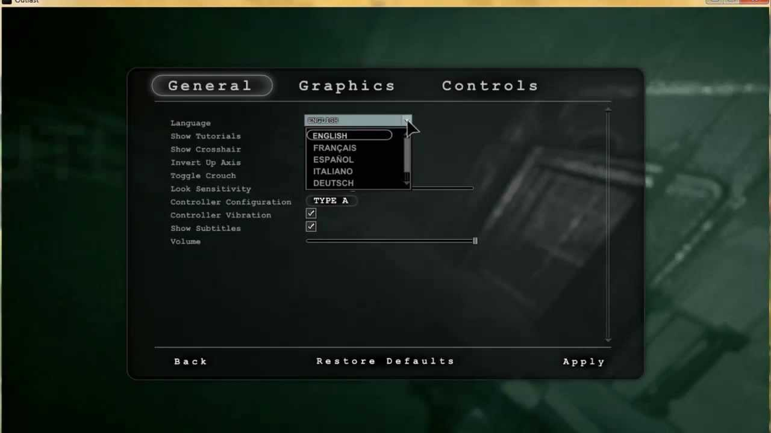
Aesthetics
Simple user interface

Slide 13
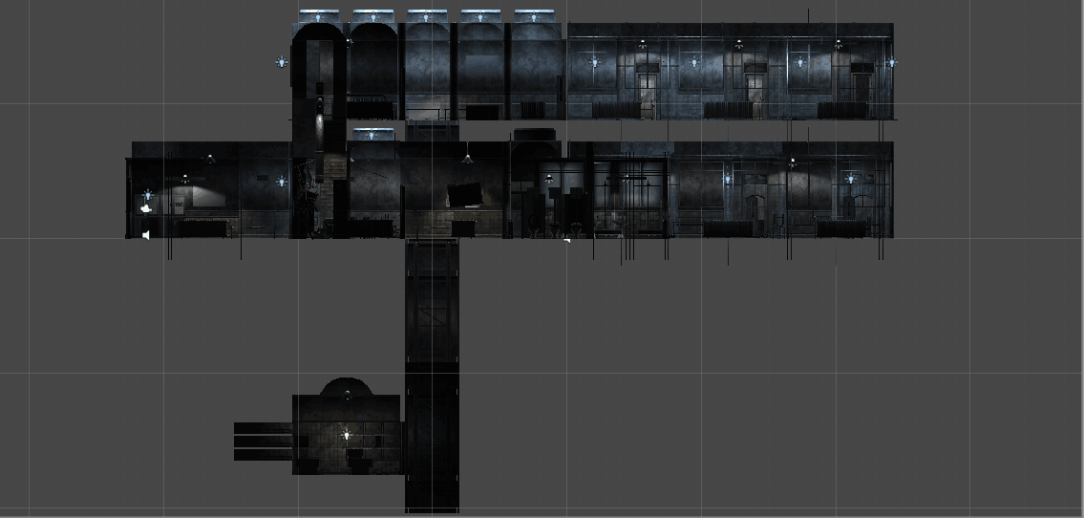
Aesthetics
Map Floor Plan:

Slide 14
IV
Planning

Slide 15
Beta Release
Audios with audio trigger events.
Puzzles and solutions.
Complete models in the map.
Scoring System
Week
6
aa
Week 11
First Playable
Week 9
First Ghost(Enemy)
Aim
Player Movement
Final Release
Complete UI
Complete Tutorial
Test everthing and fix bugs.
Alpha Release
All ghosts' AI
All items with their trigger event(except the puzzles).
Start screen and game over screen
Win event(Defeat the boss)
Week 14

Slide 16
Thank You For Watching

