Slide 1
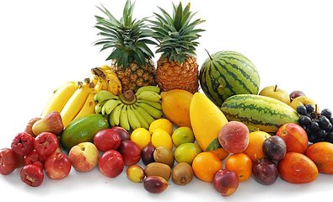
I Like Fruit!
河北师大附属实验小学 赵云

Slide 2

Let’s sing!

Slide 3
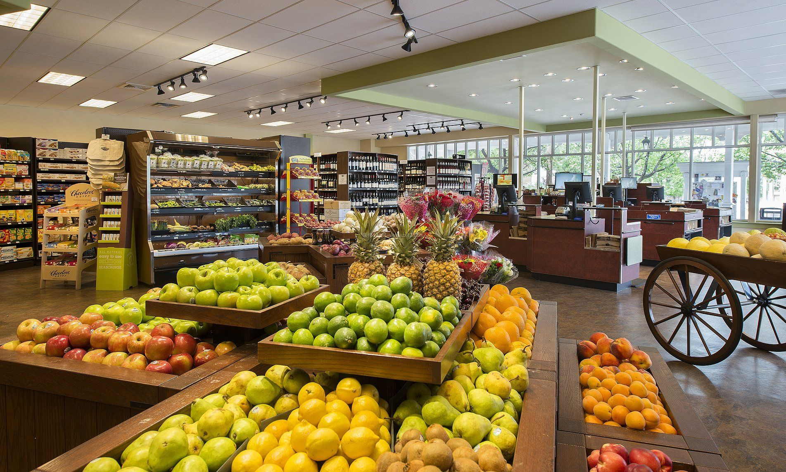
Fruit Shop

Slide 4
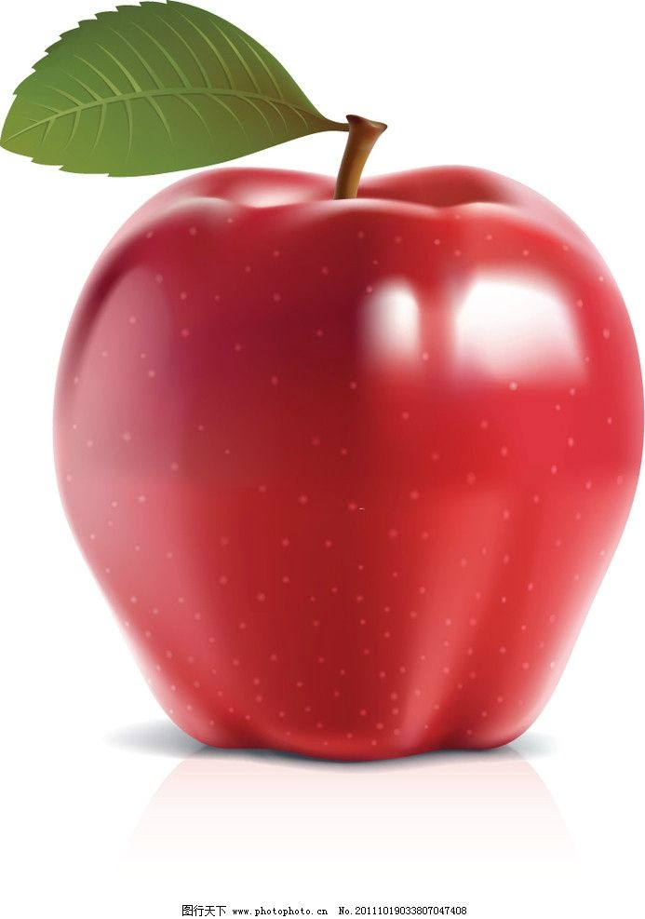
Let’s learn.
apple
bag sad
cat lamp
It’s an apple.

Slide 5
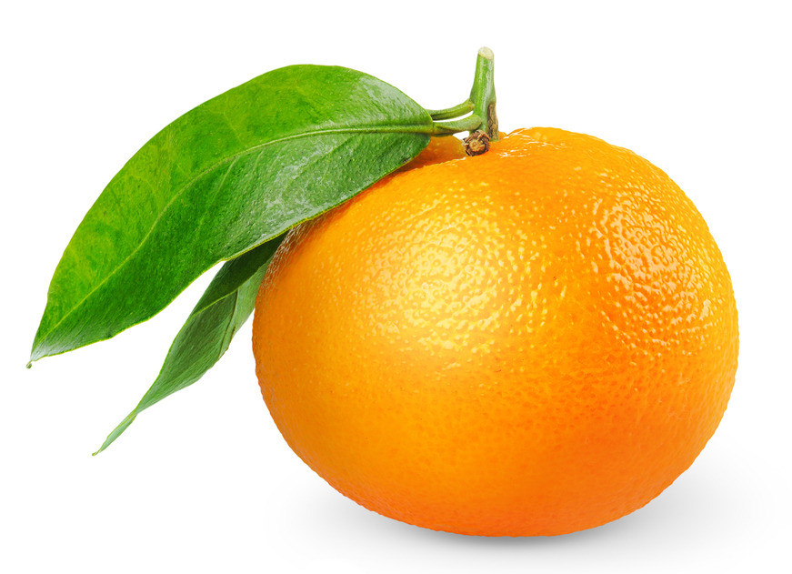
Let’s learn.
orange
It’s an orange.

Slide 6
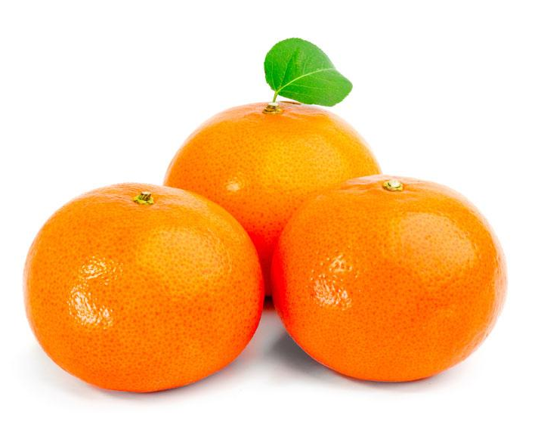
Let’s learn.
How many oranges?
Three oranges.

Slide 7
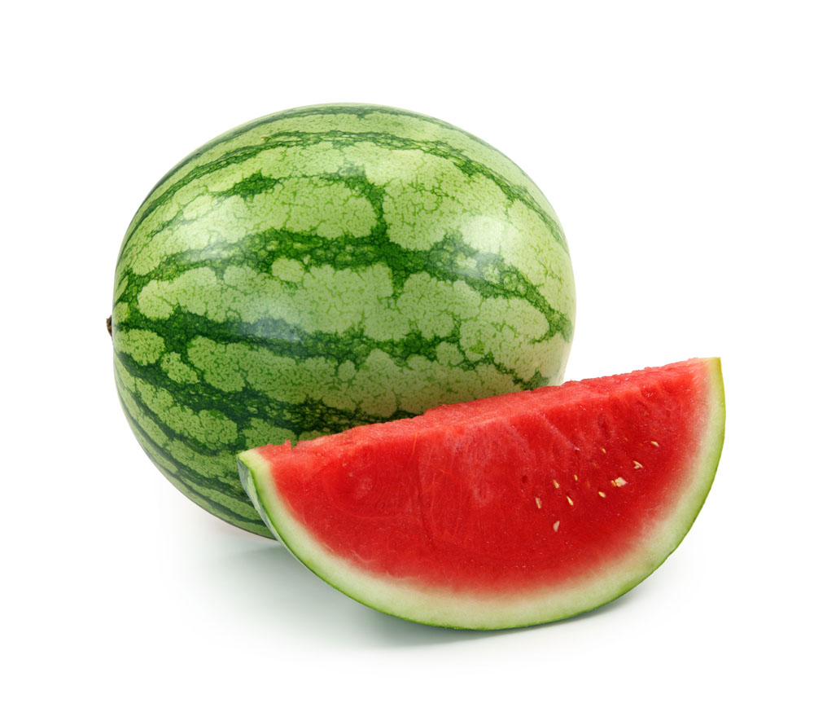

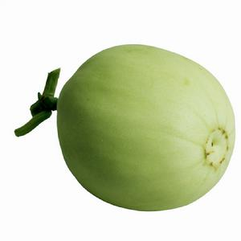
Let’s learn.
water
melon
＋

Slide 8
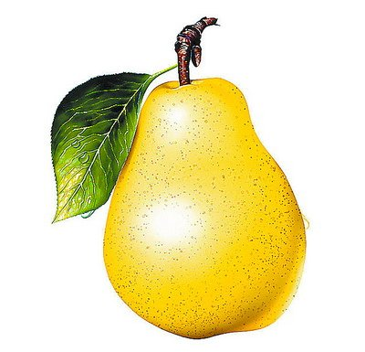
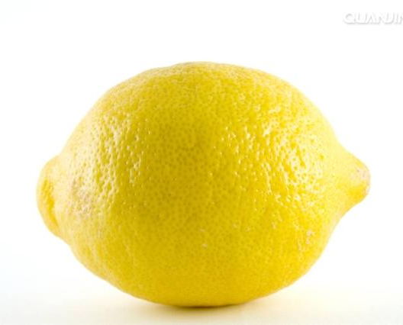
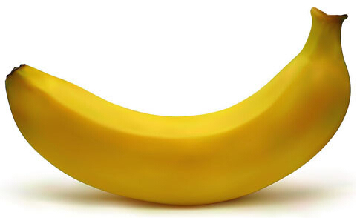
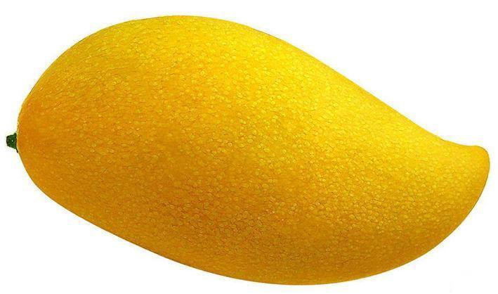
Let’s learn.
pear
It’s a pear.
banana
mango
lemon

Slide 9
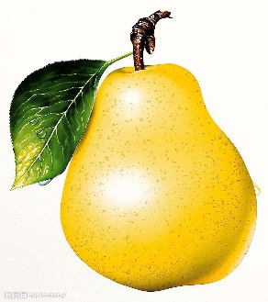
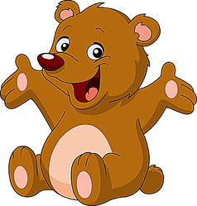
Let’s practice!
Tongue twister
绕口令
A bear likes a pear.
A pear is on the bear.

Slide 10
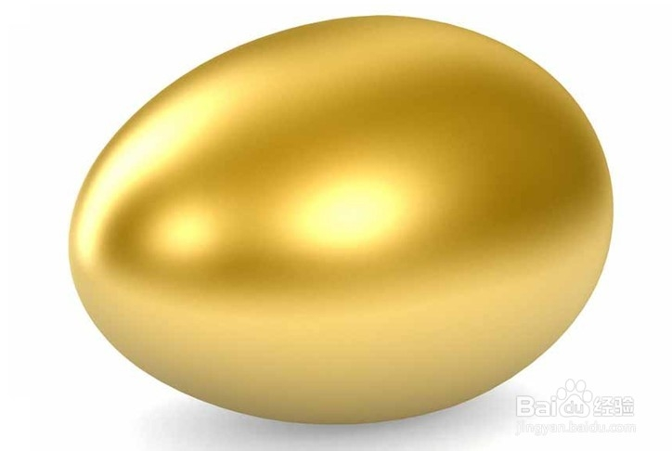
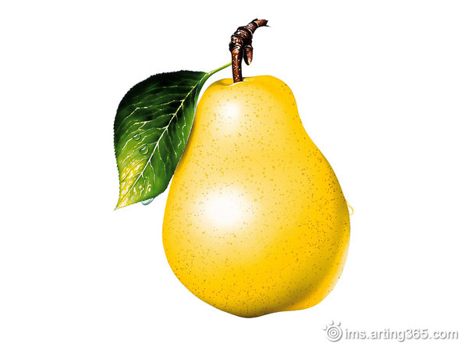





Let’s play!
What’s in it?

Slide 11
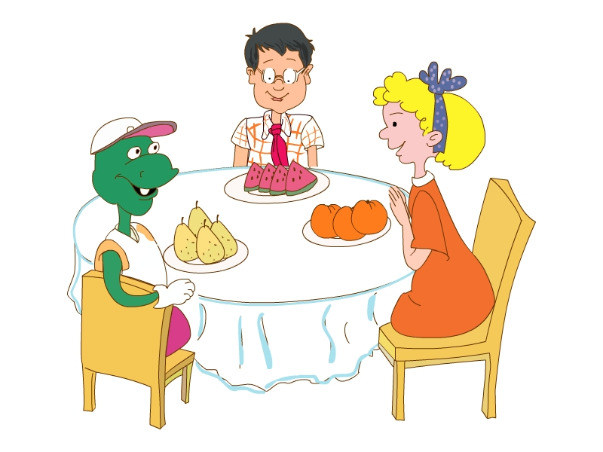

Let’s listen.

Slide 12

Let’s read.

Slide 13
Let’s practice.
A: I like ______. What do you like?
B: I like ______. What do you like?
C: I like ______. What do you like?
D: …

Slide 14
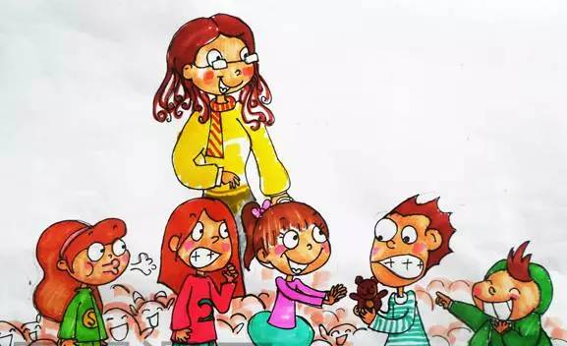
Let’s play!
What do you like? I like ______.

Slide 15

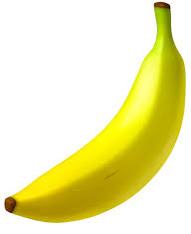
Let’s learn.
How many?
seven
eleven
bananas

Slide 16

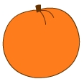
Let’s learn.
two
twelve
oranges

Slide 17



Let’s learn.
thirteen
pears

Slide 18

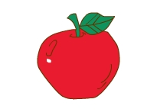
Let’s learn.
fourteen
apples

Slide 19

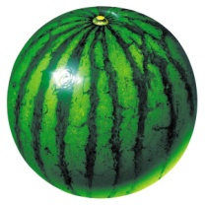
Let’s learn.
fifteen
watermelons

Slide 20
Try to remember!
Let’s play!
5 | 10 | 14
15 | 9 | 13
11 | 7 | 12

Slide 21

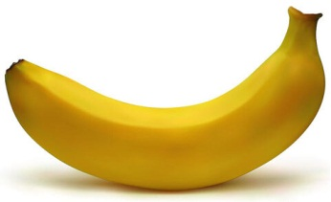
Try to remember!
Let’s play!
5 | 10 | 14
15 | 9 | 13
11 | 7 | 12
thirteen oranges

Slide 22
Try to remember!
Let’s play!
5 | 10 | 14
15 | 9 | 13
11 | 7 | 12
thirteen oranges
fifteen bananas

Slide 23
Try to remember!
Let’s play!
13 | 9 | 11 | 7
10 | 12 | 6 | 14
3 | 4 | 15 | 8

Slide 24
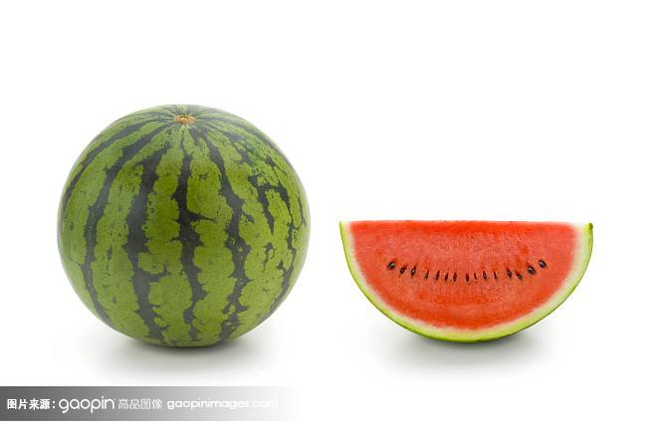

Try to remember!
Let’s play!
13 | 9 | 11 | 7
10 | 12 | 6 | 14
3 | 4 | 15 | 8
twelve watermelons

Slide 25
Try to remember!
Let’s play!
13 | 9 | 11 | 7
10 | 12 | 6 | 14
3 | 4 | 15 | 8
twelve watermelons
fourteen pears

Slide 26
Fruit Shop

Slide 27
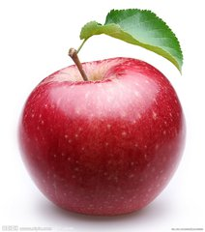


How much is it?
______ yuan.

Slide 28
I have ______ yuan.
I want ...
ten
2 oranges and 2 pears
5 apples

Slide 29
No pains, no gains.
有付出才会有收获。

Slide 30
Let’s act.
A: What do you like?
B: I like ________.
A: How many _______ do you want?
B: I want ______ _______.
oranges
oranges
twelve oranges

Slide 31
wisdom
智慧
joy
喜乐
peace
平安
An apple a day keeps the doctor away.
一天一苹果，医生远离我。

Slide 32
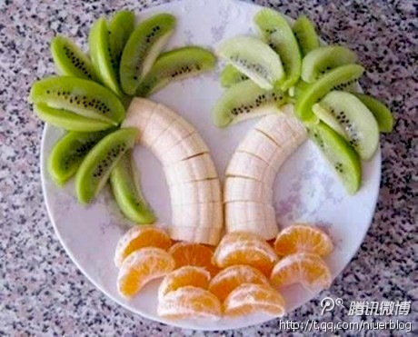
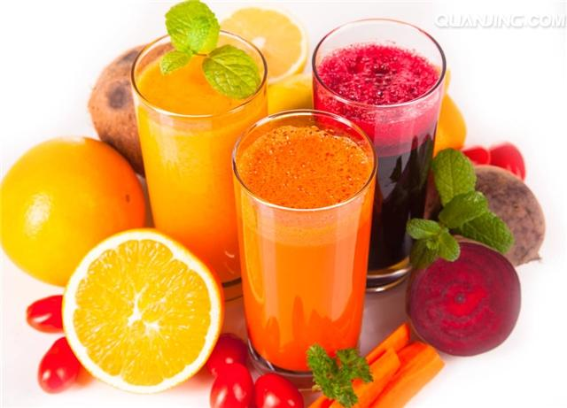
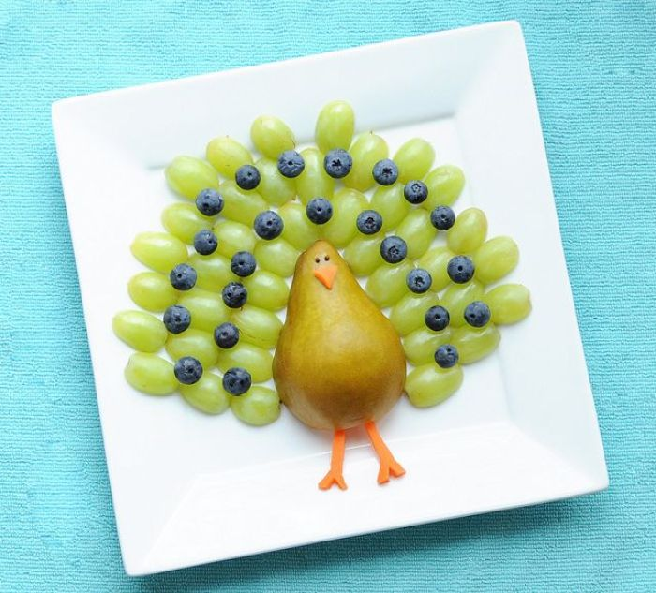
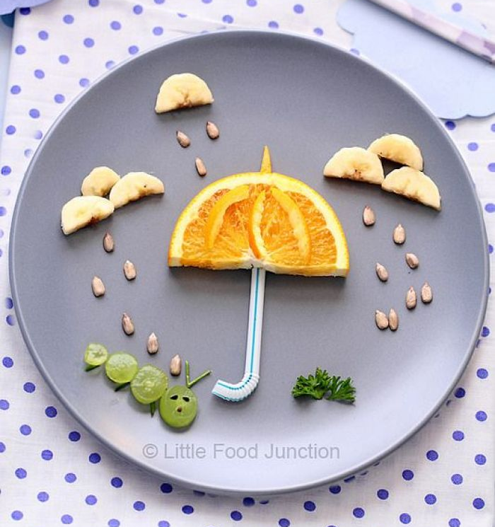
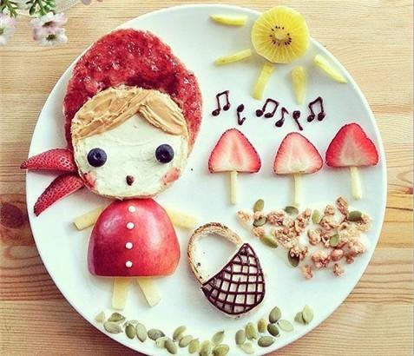
Homework:
Make a dish or some juice with fruit for your mum and dad. Talk about the fruit you need.

Slide 33
Thank you!
Good-bye!

Slide 34
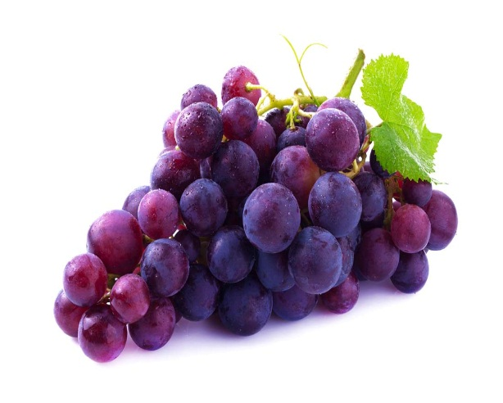
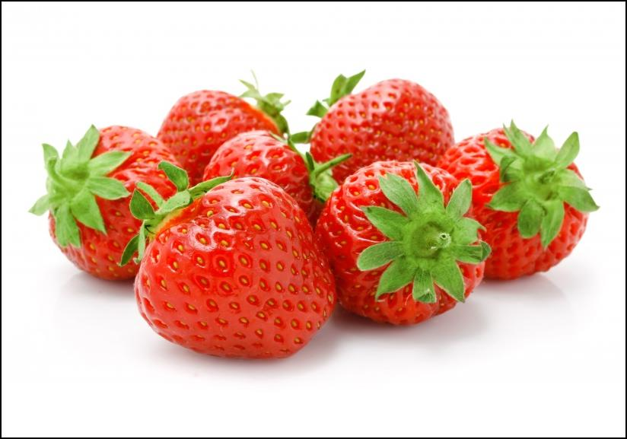
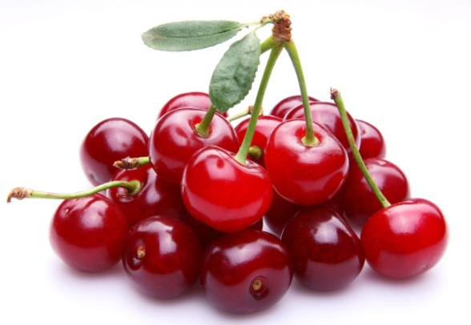
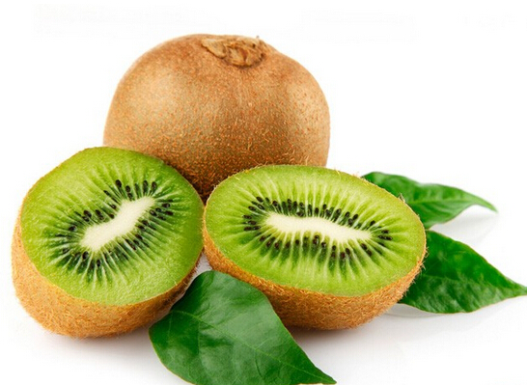
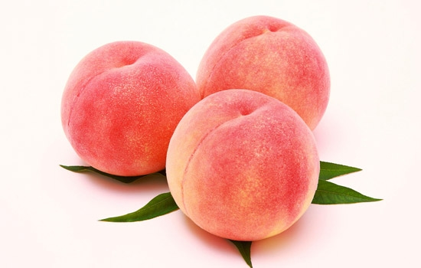
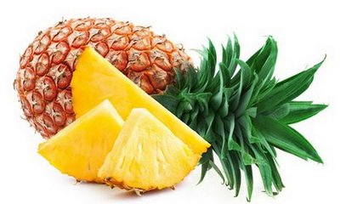
strawberries
cherries
grapes
kiwifruits
peaches
pineapples

