Slide 1
Tutorial 1 Developing a Basic Web Page

Slide 2
Computer networks
Section I

Slide 3
Network Basics
A network is a structure linking computers together for the purpose of sharing resources such as printers and files.

Slide 4
Network Basics
Users typically access a network through a computer called a host or node.

Slide 5
Network Basics
One of the most common network structures is the client-server network.

Slide 6
The Client-Server Model
A computer that makes a service available to a network is called a server.

Slide 7
The Client-Server Model
A computer or other device that requests services from a server is called a client.

Slide 8
Types of Networks
If the computers that make up a network are close together, then the network is referred to as a local area network (LAN).

Slide 9
Types of Networks
A network that covers a wide area, such as several buildings or cities, is called a wide area network (WAN).

Slide 10
The Internet
The largest WAN in existence is the Internet.

Slide 11
Section I - End

Slide 12
The internet & the www
Section II

Slide 13
The Internet
In its early days, the Internet was called ARPANET and consisted of two network nodes located at UCLA and Stanford, connected by a phone line.
Today the Internet has grown to include hundreds of millions of interconnected computers, cell phones, PDAs, televisions, and networks.
The physical structure of the Internet uses fiber-optic cables, satellites, phone lines, and other telecommunications media.

Slide 14
Services of the Internet
Communication
Remote Access
File Transfer
The World Wide Web

Slide 15
The World Wide Web
Timothy Berners-Lee and other researchers at the CERN nuclear research facility near Geneva, Switzerland laid the foundations for the World Wide Web, or the Web, in 1989.
They developed a system of interconnected hypertext documents that allowed their users to easily navigate from one topic to another.
Hypertext is a method of organizing information that gives the reader control over the order in which the information is presented.

Slide 16
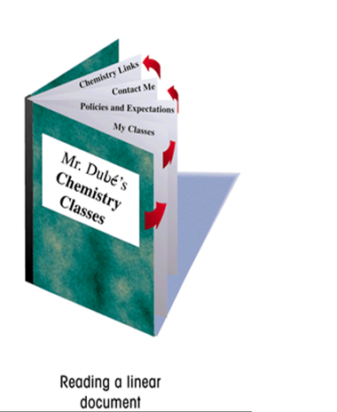
Hypertext Documents
When you read a book, you follow a linear progression, reading one page after another.

Slide 17
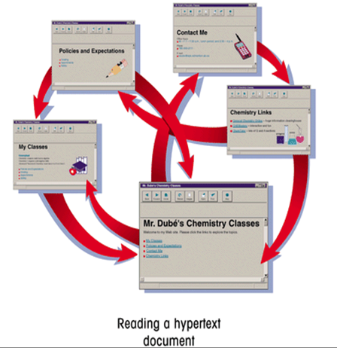
Hypertext Documents
With hypertext, you progress through pages in whatever way is best suited to you and your objectives.
Hypertext lets you skip from one topic to another.

Slide 18
Hyperlinks
The key to hypertext is the use of hyperlinks (or links)
Links are the elements in a hypertext document that allow you to jump from one topic to another.

Slide 19
Linking Hypertext Documents
A link may point to another section of the same document, or to another document entirely.
A link can open a document on your computer, or through the Internet, a document on a computer anywhere in the world.

Slide 20
Section II - End

Slide 21
Introducing web sites
Section III

Slide 22
WWW Terminology
Web Page
Home Page
Web Site
Web Server
Web Browser

Slide 23
Web Pages
Web Pages are text documents written in some special language such as HTML
Web pages can contain
Text
Links
Audio
Video
Even programs that can be run remotely!

Slide 24
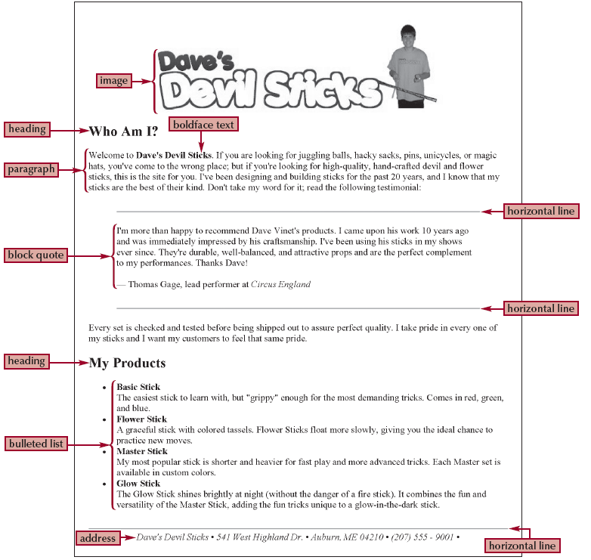
A Typical Web Page

Slide 25
Web Sites
An entire collection of linked web pages is referred to as a Web site
Web sites can consist of only a few web pages to several dozens of web pages
A web site should have an entry point. This entry document is called a home page

Slide 26
Home Pages
A home page is a web page that serves as the entry to a web site
If a home page is written in HTML, it is normally named either
index.html
home.html

Slide 27
Web Servers
A Web page is stored on a Web server, which in turn makes it available to the network.

Slide 28
Web Browsers
To view a Web page, a client runs a software program called a Web browser

Slide 29
Web Browsers
The Web browser retrieves the web page from the server and displays it

Slide 30
Types of Web Browsers
The earliest browsers, known as text-based browsers, were incapable of displaying images.
Today most computers support graphical browsers which are capable of displaying not only images, but also video, sound, animations, and a variety of graphical features.

Slide 31
Section III - End

Slide 32
Introducing HTML
Section IV

Slide 33
The Language of the Web
HTML (HyperText Markup Language) is a language that is used to write web pages
HyperText: the content of a web page is normally more than text including hyperlinks
Markup Language: is a language that describes a document’s structure and content.

Slide 34
A Typical HTML Document

Slide 35
HTML Basics
HTML
is not a programming language
is not case sensitive
is a forgiving language
provides a great deal of flexibility
ignores anything that it cannot understand

Slide 36
Tools for Creating HTML Documents
HTML Converter - converts formatted text into HTML code.
Can create the source document in a word processor and then convert it.
HTML code created using a converter is often longer and more complicated than it needs to be, resulting in larger-than-necessary files.
We will NOT use any HTML converters in this course!

Slide 37
Tools for Creating HTML Documents
HTML Editor – helps you create an HTML file by inserting HTML codes for you as you work.
They can save you a lot of time and help you work more efficiently.
Advantages and limitations similar to those of HTML converters.
Allow you to set up a Web page quickly.
Will usually still have to work with HTML code to create a finished document.
We will NOT use any HTML editors in this course!

Slide 38
Tools for Creating HTML Documents
Basic text editor such as Notepad
That is ALL we need in this course!

Slide 39
Section IV - End

Slide 40
Guidelines for creating html documents
Section V

Slide 41
Portability
Make your design portable
Test your design in a variety of browsers, operating systems, and computing platforms

Slide 42
Accessibility
Use as low a bandwidth as possible
Plan for easy access to your information:
Provide logical navigation tools
Do not make the visitor click through more than two or three pages before they get what they want

Slide 43
Look and Feel
Design a unified look for your site:
Craft an appropriate look and feel and stick with it throughout your site.
Design specifically for the computer medium:
Consider how the page layout, fonts, and colors you use will appear on the screen

Slide 44
Hypertext not Linear Text!
Strive for smooth transitions from one page to the next:
Create templates for your grid structure and apply them consistently
Leverage the power of hypertext linking.
Provide enough links for the visitors to create their own path through your information

Slide 45
Plan Ahead
In planning, identify a document’s different elements
An element is a distinct object in the document, like a paragraph, a heading, or a page’s title.

Slide 46
Formatting
Use active white space as an integral part of your design.
Use text, color, and object placement to guide the visitor's eye
Formatting features such as boldfaced font, and italicized text may be used.

Slide 47
Please Come Again!
Know your audience and design pages that suit their needs, interests, and viewing preferences
Give something away!

Slide 48
Section V - End

Slide 49
Tools of the trade
Section VI

Slide 50
Tools for Creating HTML Documents
Text Editor. HTML documents are created as plain text
Browser. Displaying an HTML document requires a browser
Internet Service Provider (ISP). Connecting to the WWW requires an Internet Service Provider (ISP)

Slide 51
Displaying an HTML File
As you work on a Web page, you should occasionally view it with your Web browser to verify that the file contains no syntax errors or other problems.
You may want to view the results using different browsers to check for compatibility.

Slide 52
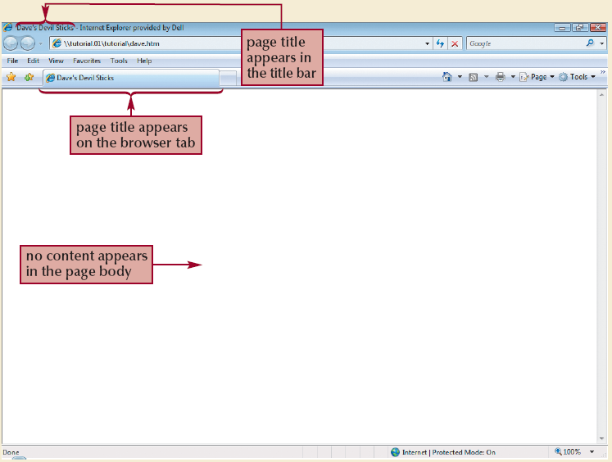
Displaying an HTML File

Slide 53
Section VI - End

Slide 54
Hypertext Markup language (HTML)
Section VII

Slide 55
HTML Rules
HTML uses entities called tags to mark content.
Learn tag names
Each tag has a set of attributes.
Learn attribute names
Each attribute has a set of values that it can assume.
Learn attribute values
We tend to insert blanks into our documents.
Learn the proper usage of spaces or blanks
Certain tags are called container tags.
Learn the proper usage of container tags

Slide 56
Learning HTML Tag Names
The core building block of HTML is the tag, which is used to mark content in a document.
HTML allows you to enter tag names in either uppercase or lowercase letters.
Recall: HTML is not case sensitive
Tags can be two-sided or one-sided.

Slide 57
Two-Sided Tags
A two-sided tag is a tag that contains some document content.
General syntax for a two-sided tag:
<tagName> content </tagName>
Tag’s Opening Tag
Tag’s
Closing Tag

Slide 58
Two-Sided Tags: Example
To create a level-one heading for a web page, we enclose the heading within the <h1> and </h1> tag as follows:
<h1> Web Design </h1>
BEGIN
heading (Opening Tag)
END
heading
(Closing Tag)

Slide 59
One-Sided Tags
A one-sided tag contains no content.
General syntax for a one-sided tag:
<tagName />
Elements that employ one-sided tags are called empty elements since they contain no content.
An example is the line breaker tag <br />

Slide 60
Line Breakers
The <br /> tag is HTML's equivalent of pressing the Enter key in a word processor
The <br /> tag can be repeated consecutively to create several blank lines
Syntax:
................... <br />

Slide 61
Where Are All These Tags?
Appendix E

Slide 62
Learning Tag Attributes
Many tags contain attributes that control the use, behavior, and in some cases the appearance, of elements in the page.
Attributes are inserted within the opening tag brackets only.
<tagName attributeName> content </tagName>
for two-side tags
<tagName attributeName />
for one-side tags

Slide 63
Learning Attributes Values
Almost all attributes have a set of valid values
An attribute must be set to one of these values only!
<tagName attributeName=“value”> content </tagName>
for two-side tags
<tagName attributeName =“value” />
for one-side tags

Slide 64
Attribute Names & Values: Example
To center a heading horizontally, we use an attribute of the <h1></h1> tag called align
Attribute Name: align
Valid Values: left, center, right
<h1 align=“center”> Web Design </h1>

Slide 65
Attribute Names & Values: Where?
Appendix E

Slide 66
Learning Proper Spacing
Do NOT leave a space right before the symbol > or right after the symbol <
Leave a space after a tag name, before an attribute name, and after an attribute value
You may repeat attributeName=“value” as many times as needed (using multiple attribute names of course)

Slide 67
Learning Container Tags
Certain HTML tags are used as containers for other tags
Example: the unordered-list tag (<ul> </ul>) is used as a container tag for the list item <li></li> tags
<ul>
<li> … </li>
<li> … </li>
</ul>
We will discuss these as we progress in the course!

Slide 68
The Comment Tags
A third type of tag is the comment tag, which you can use to add notes to your HTML code.
General Syntax:
<!– comments -->
Comments are useful in documenting your HTML code for yourself and others but they will not be processed by the browser.
Comments can be spread over several lines

Slide 69
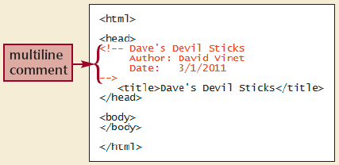
The Comment Tag: Example

Slide 70
White Space and HTML
HTML file documents are composed of text characters and white space.
White space is the blank space, tabs, and line breaks within the file.
HTML treats each occurrence of white space as a single blank space.
You can use white space to make your document more readable.

Slide 71
Section VII - End

Slide 72
STRUCTURE OF HTML FILES
Section VIII

Slide 73
The Structure of an HTML File
The opening <html> tag marks the start of an HTML document, and the closing </html> tag tells a browser when it has reached the end of that HTML document.
Anything between these two tags makes up the content of the document, including all other elements, text, and comments.

Slide 74
The Structure of an HTML Page
An HTML page is divided into a head section and a body section
The <head> </head> tag is used to encase the head section
The <body> </body> tag is used to encase the body section

Slide 75
Skeleton of an HTML Page
<html>
<head>
Elements of the head section
</head>
<body>
Elements of the body section
</body>
</html>

Slide 76
The head Section of an HTML Page
The head section of the page contains tags that
provide a title for the page
load scripts
provide information for search engines (keywords)
Author’s comments
The content of the head element is not displayed within the Web page.
The <head> </head> tag is a container tag for all elements to be included in the head section

Slide 77
The body Section of an HTML Page
The body section of the page contains all of the content to be displayed in the Web page.
The body section can contain code that tells the browser how to render the content.
The <body> </body> tag is a container tag for all elements to be included in the body section

Slide 78
Adding a Title to an HTML Page
Every HTML page should have a title
The title appears on the top bar of the browser or as the title of a tab if the browser supports tabs
The title is the text that is saved when an individual bookmarks a page
The <title> </title> tag is used to encase the title of the page and is placed within the head section
Syntax:
<title> Web Page Title </title>

Slide 79
Example HTML Page
<html>
<head>
<title>Web Design & Publishing</title>
<!-- File Name: home.html
Date: August 10, 2001
Author: Iyad A. Ajwa
-->
</head>
<body>
…
</body>
</html>

Slide 80
Section VIII - End

Slide 81
adding to the body section of a web page
Section IX

Slide 82
Working with Elements
One piece of content in a Web page is normally called an element
Elements are classified into two types:
Block-level elements
Inline elements

Slide 83
Inline Elements
An inline element is part of the same block as its surrounding content
Example: individual words or phrases within a paragraph.
Inline Elements will be discussed in details in Section XI.

Slide 84
Block-Level Elements
A block-level element contains content displayed in a separate section within the page, setting it off from other blocks such as paragraphs, headings, etc.
Examples of block-level elements are introduced in the next slides as well as Section X.

Slide 85
Headings
Headings are form of text formatting that vary the text size based on the header's level and is used to delineate new sections and subsections of a page
Six levels: h1 is the largest and heaviest; h6 is the smallest and lightest

Slide 86
Creating Headings
The <hn > </hn> tags create headings of level n
Attributes:
align = "left" | "center" | "right"
Syntax:
<hn align="value"> ... </hn>

Slide 87
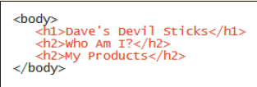

The Heading Tags: Example

Slide 88
Creating Paragraphs
The <p> </p> tags create new paragraphs
HTML uses a blank line to indicate the start of a new paragraph
Attributes:
align = "left" | "right" | "center" | "justify"
Syntax:
<p align="value"> ... </p>

Slide 89
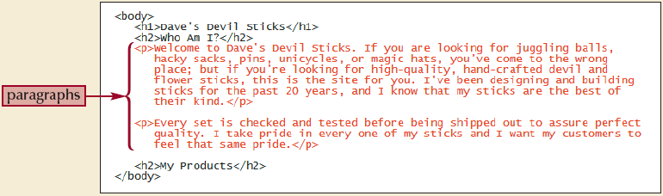
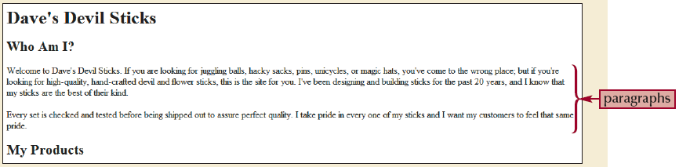
Paragraphs: Example

Slide 90
Creating Block Quotes
The <blockquote> </blockquote> tags create a new block that is indented from the surrounding paragraphs to make it stand out more
HTML uses a blank line to indicate the start of a new block quote
Attributes:
align = "left" | "right" | "center" | "justify"
Syntax:
<blockquote align="value"> ... </blockquote>

Slide 91
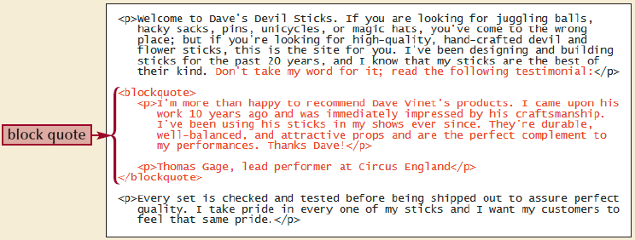
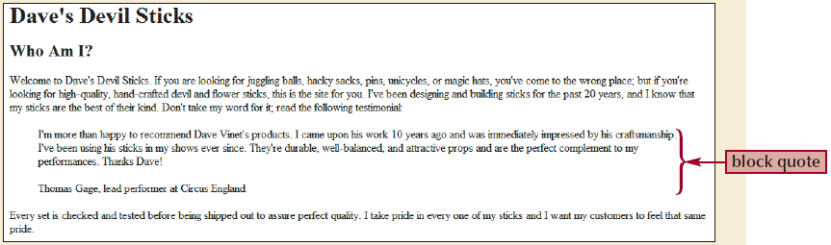
Block Quotes: Example

Slide 92
The Division Tags
The <div> </div> tags create divisions in a page similar to the paragraph tags
However, they do not separate page divisions with blank lines
Attributes:
align = "left" | "center" | "right" | "justify"
Syntax:
<div align="value">...</div>

Slide 93
The Address Element
HTML supports the address element to indicate contact information.
Most browsers display an address element in an italicized font, and some right-justify or indent addresses
The address element is created using the <address> </address> tags

Slide 94
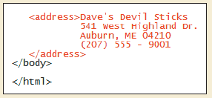
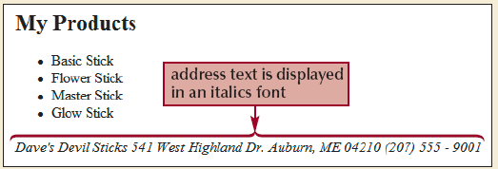
Creating an Address Element
The <address> </address> tags create address elements
They encase the contact information

Slide 95
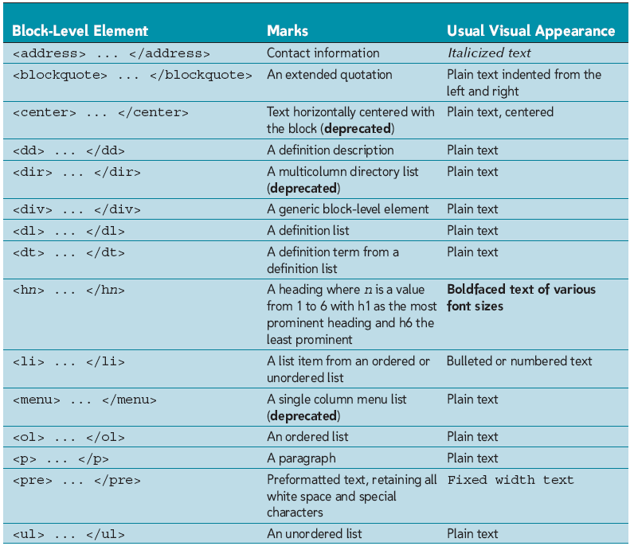
Using Other Block-Level Elements

Slide 96
Empty Elements
An empty element contains no content
Empty elements appear in code as one-sided tags
Examples:
The line break tag <br />
The horizontal rule tag <hr />

Slide 97
Creating a Horizontal Rule
The <hr /> tag places a beveled line on the page
Attributes:
size = "pixels"
width = "pixels" | "percent%"
align = "justify" | "left" | "center" | "right"
noshade = "noshade"
Syntax:
<hr size="pixels" width="value" align="value" noshade />

Slide 98
Section IX - End

Slide 99
HTML lists
Section X

Slide 100
HTML Lists
HTML supports three kinds of lists:
Unordered Lists: are used for items that do not need to occur in any special order.
Ordered Lists: are used for items that must appear in a particular sequential order.
Definition Lists: contain lists of terms where each term is followed by a definition description.
One list can contain another list. Such a structure is called a nested list.

Slide 101
Unordered Lists
Unordered lists contains items that can be arranged in any order.
Unordered lists resemble bullet lists.
List items contained within a list are indented and each list item appears on a separate line.
Unordered lists are created using the <ul> </ul> tags
They form containers for list items that are created with the <li> </li> tags.

Slide 102
Creating Unordered Lists
The <ul> </ul> tags create unordered lists
They enclose all list items tags
Attributes:
type = "disc" | "circle" | "square"
Syntax:
<ul type="value">...</ul>

Slide 103
Creating List Items
List items are created using the <li> </li> tags
Attributes:
type = "disc" | "circle" | "square"
Syntax:
<li type="value">...</li>

Slide 104
Ordered Lists
Ordered lists contains items that are arranged according to some numeric ordering principle
Ordered lists resemble numbered lists.
List items contained within a list are indented and each list item appears on a separate line
Ordered lists are created using the <ol> </ol> tags
They form containers for list items that are created with the <li> </li> tags.

Slide 105
Creating Ordered Lists
The <ol> </ol> tags create ordered lists
They enclose all list items tags
Attributes:
type = "1" | "A" | "a" | "I" | "i"
start = "number"
Syntax:
<ol type="value" start="number">...</ol>

Slide 106
Creating List Items
List items are created using the <li> </li> tags
Attributes:
type = "1" | "A" | "a" | "I" | "i"
start = "number"
Syntax:
<li type="value" start="number">...</li>

Slide 107
Definition Lists
A definition list contains a list of definition terms, each followed by a definition description.
Web browsers typically display the definition description below the definition term and slightly indented.
Example:
Chemistry I
An introductory course requiring solid algebra skills

Slide 108
Creating Definition Lists
The <dl> </dl> tags create definition lists
The <dl> </dl> tags enclose all:
Definition Terms, created using the <dt> </dt> tags
Definition Descriptions, created using the <dd> </dd> tags
Syntax:
<dl>
All dt tags
All dd tags
</dl>

Slide 109
Creating Definition Terms
The <dt> </dt> tags create definition terms.
They encase a definition term
A definition term may be a single term or a phrase.
Each term should be followed by at least one definition description tag.
Syntax:
<dt> … </dt>

Slide 110
Creating Definition Descriptions
The <dd> </dd> tags create definition descriptions.
They encase a definition description
HTML uses left indentation for the definition. Thus, the definitions “hang” beneath their associated terms.
Syntax:
<dd> … </dd>

Slide 111
Section X - End

Slide 112
Working with inline elements
Section XI

Slide 113
Inline Elements
Recall that an inline element marks a section of text within a block-level element
Inline Elements are often used to format characters and words
Hence, they are sometimes referred to as character formatting elements
Also referred to as text style tags

Slide 114
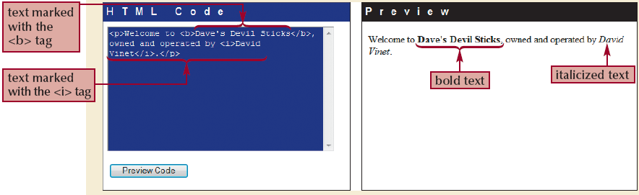
Inline Elements

Slide 115
Text Style Tags
Text style tags form containers into which we place text or other style tags
Text style tags are divided into two groups:
Physical Style Tags
Logical Style Tags

Slide 116
Physical Style Tags
Physical style tags dictate the physical appearance of the text they enclose
Examples:
The <b> </b> tags display the enclosed text in bold
The <i> </i> tags display the enclosed text in italics
The <u> </u> tags underline the enclosed text
The <strike> </strike> tags cross out the enclosed text
The <big> </big> tags display the enclosed text in a font that is larger than the standard HTML font size
The <blink> </blink> tags make the enclosed text blink on and off
The <sup> </sup> tags write the enclosed text as a superscript (12th)

Slide 117
Logical Style Tags
Logical Style Tags affect the content of the enclosed text rather than its physical appearance
Examples:
The <strong> </strong> tags display the enclosed text strong
The <em> </em> tags display the enclosed text emphasized
The <cite> </cite> tags are used for bibliographic citations
The <code> </code> tags are used for computer program source code

Slide 118
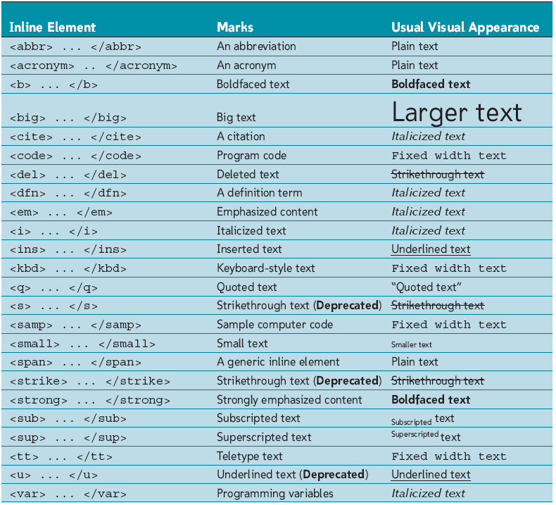
Using Other Inline Elements

Slide 119
Section XI - End

Slide 120
Working with the style attribute
Section XII

Slide 121
HTML Attributes: Recall
Most HTML tags have attributes
While an attribute works well for some tags, the same attribute does not make sense to some other tags
Example: the align attribute can be used to center a paragraph, but it cannot be used to center an image

Slide 122
Three Common HTML Attributes
There are 3 attributes that every HTML has:
The style attribute
The id attribute (will be discussed later)
The class attribute (will be discussed later)
These attributes work well for all HTML tags

Slide 123
The Style Attribute
The style attribute is used to control the appearance of an element, such as text alignment
Thus, you now have two different ways to control the appearance of an element:
Using the style attribute
Using other HTML attributes

Slide 124
The Style Attribute
Advantages:
Gives you more control
Example: you may now control text alignment, font face, and the color of the text using only one attribute (the style attribute)
Disadvantages:
Rigid syntax, not as forgiving as other HTML constructs

Slide 125
The Style Attribute: Syntax
<tagName style=“StyleDeclaration”> … </tagName>
where StyleDeclaration has the following syntax
propertyName : value

Slide 126
The Style Attribute: Syntax
You may set the style attribute to any number of style declarations:
<tagName style=“StyleDeclaration; StyleDeclaration; …; StyleDeclaration”> … </tagName>
More Organized:
<tagName style=“StyleDeclaration;
StyleDeclaration;
StyleDeclaration;
…;
StyleDeclaration”>
… </tagName>

Slide 127
The Style Attribute: Examples
<p style = “text-align: justify ; margin-left: 10pt”> …</p>
<b style = “color: blue”> … </p>
<h1 style = “text-align: center; color: blue”> … </h1>
<body style = “background-image: url(‘back.jpg’);
font-family: sans-serif;
font-size: 10pt”> …</body>

Slide 128
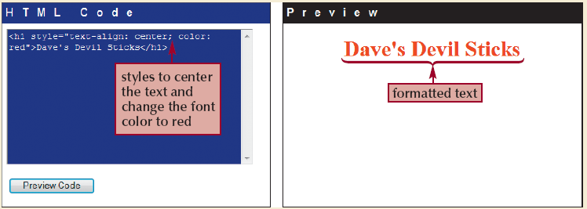
The Style Attribute: Example

Slide 129
Property Names & Values: Where?
Appendix F

Slide 130
Section XII - End

Slide 131
Working with Images
Section XIII

Slide 132
Inline Images
To display a graphic in a web page, you insert an inline image into the page.
An inline image displays a graphic image located in a separate file within the contents of a block-level element.
Inline images can be
Created by and downloaded from digital cameras
Downloaded from the Internet
Created using graphics packages such as Photoshop

Slide 133
Inline Images Formats
GIF (Graphics Interchange Format)
Can represent 256 colors
Good for images that have large areas of a solid color
JPEG (Joint Photographic Experts Group)
Can represent 16,777,216 colors
Good for highly detailed images
Does not preserve the details of the original image
PNG (Portable Network Graphics)
Preserves the sharpness of the original image
Memory hog!

Slide 134
Adding an Inline Image
The <img /> tag is used to insert an image into a page
Necessary Attributes:
src = "imageFileName"
alt = "alternateText“
Syntax:
<img src="imageFileName" alt="alternateText" />

Slide 135
The “img” Tag
Important Attributes:
border = "pixels"
height = "pixels" | "percent%"
width = "pixels" | "percent%"
Other Attributes:
align = "left" | "right" | "top" | "bottom" | "middle"
hspace = "pixels"
vspace = "pixels"
Syntax:
<img src="imagefilename" alt="alternatetext" border="pixels“ height="pixels" width="pixels" />

Slide 136
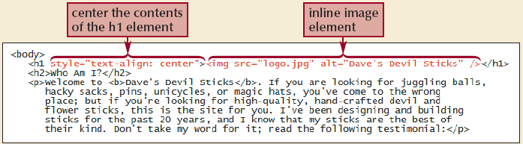
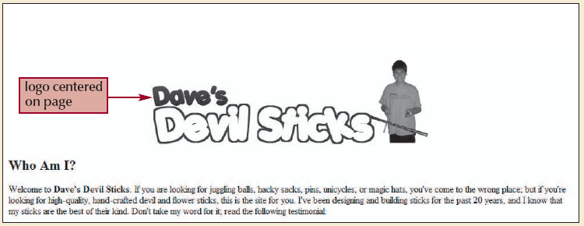
Images: Example

Slide 137
Working with Images: Tips
Always include the height and width of any image in the image tag.
When the browser loads the HTML file, it will know immediately how much screen space to give the image and will therefore lay out the page properly, even before it downloads the image.
Always maintain the original ratio of width:height when you set the width and height attributes

Slide 138
Section XIII - End

Slide 139
Working with Character Sets and Special Characters
Section XIV

Slide 140
Character Sets
Character sets come in a wide variety of sizes, based on the number of symbols required for communication in the chosen language
ASCII
American Standard Code for Information Interchange
Unicode
Universal Code

Slide 141
Character Encoding
To store a character set, browsers need to associate each symbol with a number in a process called character encoding
A character in a character set can be specified using its
Numeric Character Reference (Numerical Value)
Character Entity Reference (Name)

Slide 142
Inserting Special Characters
Using Numeric Character Reference:
&#CharacterNumber;
Using Character Entity Reference:
&CharacterCode;

Slide 143
Inserting Special Characters: Examples
Using Numeric Character Reference:
To insert the “Copyright” symbol: &#169;
To insert the “Registered Trademark” symbol: &#174;
To insert a “greater than” symbol: &#62;
Using Character Entity Reference:
To insert the “Copyright” symbol: &copy;
To insert the “Registered Trademark” symbol: &reg;
To insert a nonbreakable space: &nbsp;
To insert a copyright symbol: &copy;
To insert a “greater than or equal” symbol”: &ge;
Other: &szlig; &Ouml; &uuml;

Slide 144
Where are the Character Entities?
Appendix B

Slide 145
Summary: Tips for Good HTML Code
Use line breaks and indented text to make your HTML file easier to read.
Insert comments into your HTML file to document your work.
Enter all tag and attribute names in lowercase.
Place all attribute values in quotes.
Close all two-sided tags.
Make sure that nested elements do not cross.

Slide 146
Summary: Tips for Good HTML Code
Use styles in place of presentational elements whenever possible.
Include the alt attribute for any inline image to specify alternative text for non-graphical browsers.
Know your market and the types of browsers that your audience will use to view your Web page.
Test your Web page on all relevant browsers.

Slide 147
Tutorial 1 - End

