Slide 1
Tutorial 10
Programming with JavaScript

Slide 2
Objectives
Learn the history of JavaScript
Create a script element
Understand basic JavaScript syntax
Write text to a Web page with JavaScript
Learn about JavaScript data types

Slide 3
Objectives
Declare and work with variables
Create and call a JavaScript function
Access an external JavaScript file
Add comments to JavaScript code
Learn about basic debugging techniques and tools

Slide 4
Introducing JavaScript
Server-side programs are placed on the server that hosts a Web site
  Can be problematic
Client-side programming runs programs on each user’s computer

Slide 5
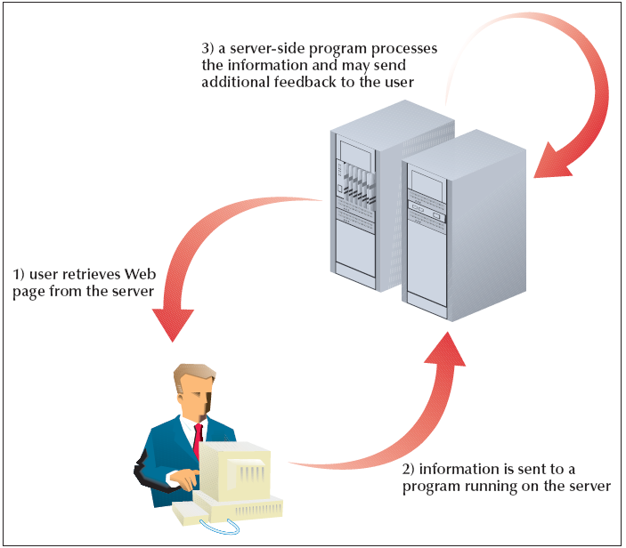
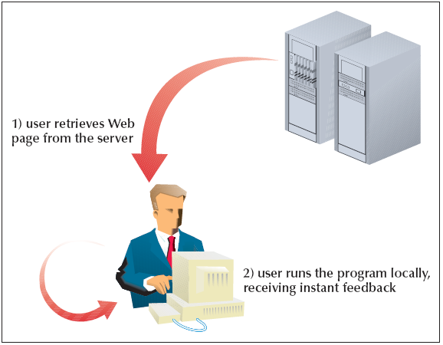
Introducing JavaScript
Server-Side Programming
Client-Side Programming

Slide 6
The Development of JavaScript
JavaScript is a subset of Java
Differences between Java and JavaScript:
  Java is a compiled language
  JavaScript is an interpreted language

Slide 7
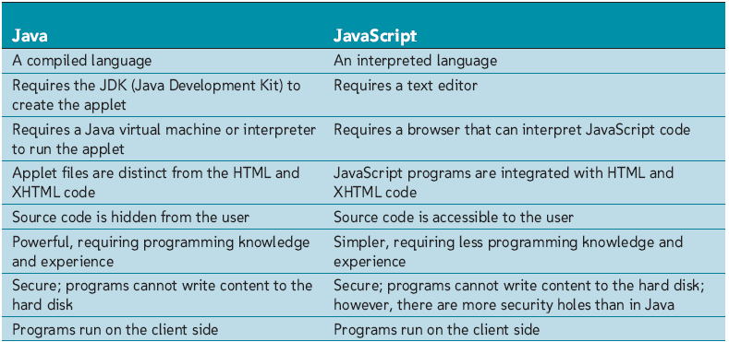
Comparing Java and JavaScript

Slide 8
The Development of JavaScript
Jscript is a version of JavaScript supported by Internet Explorer
The European Computer Manufacturers Association (ECMA) develops scripting standards
  The standard is called ECMAScript but browsers still generally call is JavaScript

Slide 9
Working with the Script Element
A JavaScript program can either be placed directly in a Web page file or saved in an external text file
Insert a client-side script in a Web page when using the script element
<script type="mime-type">
script commands
</script>

Slide 10
Inserting JavaScript into a Web Page File
Each statement—also known as a command—is a single line that indicates an action for the browser to take
The semicolon notifies the browser that it has reached the end of the statement

Slide 11
Writing Output to the Web Page
An object is any item—from the browser window itself to a document displayed in the browser to an element displayed within the document
A method is a process by which JavaScript manipulates or acts upon the properties of an object

Slide 12
Writing Output to the Web Page
To write text to a Web page, use the following JavaScript commands:
  document.write(“text”);
  or
  document.writeln(“text”)’
where text is the content to be written to the page. The doucment.write() and document.writeln() methods are identical, except that the document.writeln() method preserves any line breaks in the text string

Slide 13
Understanding JavaScript Syntax
JavaScript is case sensitive
Ignores most occurrences of extra white space
Do not break a statement into several lines
The + symbol used in this command combines several text strings into a single text string

Slide 14
Working with Variables
A variable is a named item in a program that stores information
Most JavaScript programs use variables to represent values and text strings

Slide 15
Declaring a JavaScript Variable
You can declare variables with any of the following JavaScript commands:
  var variable;
  var variable = value;
  variable = value;
where variable is the name of the variable and value is the initial value of the variable. The first command creates the variable without assigning it a value; the second and third commands both create the variable and assign it a value

Slide 16
Working with Variables and Data
JavaScript variable types:
  Numeric variables
  String variables
  Boolean variables
  Null variables
You must declare a variable before using it

Slide 17
Working with Variables and Data
Numeric variable- any number, such as 13, 22.5, etc.
  Can also be expressed in scientific notation
String variable- any group of text characters, such as “Hello” or “Happy Holidays!”
  Must be enclosed within either double or single quotations (but not both)
Boolean variable- accepts only true and false values
Null variable- has no value at all

Slide 18
Working with Variables and Data
JavaScript is a weakly typed language
The + symbol can be used with either numeric values or text strings
var total = 5 + 4;
var emLink = "cadler" + "@" + "mpl.gov";

Slide 19
Creating a JavaScript Function
A function is a collection of commands that performs an action or returns a value
A function name identifies a function
Parameters are values used by the function
The function is executed only when called by another JavaScript command
function_name(parameter values)

Slide 20
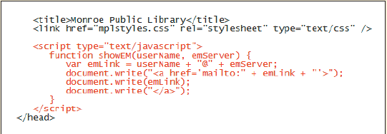
Creating a JavaScript Function

Slide 21
Creating a Function to Return a Value
For a function to return a value, it must include a return statement
function function_name(parameters){
JavaScript commands
return value;
}

Slide 22
Accessing an External JavaScript File
The code to access an external script file is:
<script src="url" type="mime-type"></script>
Place all script elements that reference external files in the document head

Slide 23
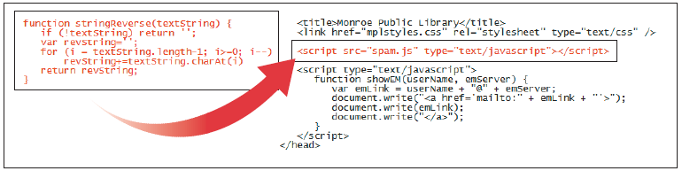
Accessing an External JavaScript File

Slide 24
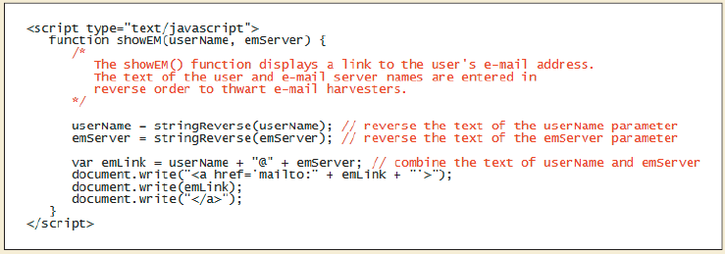
Commenting JavaScript Code
Commenting your code is an important programming practice
// comment text

Slide 25
Using Comments to
Hide JavaScript Code
<script type="text/javascript">
<!--Hide from nonJavaScript browsers
JavaScript commands
// Stop hiding from older browsers -->
</script>

Slide 26
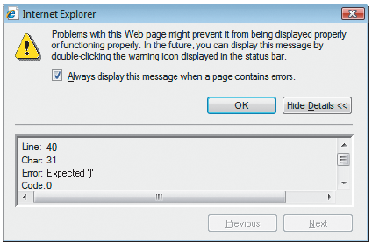
Debugging Your JavaScript Programs
Debugging is the process of searching code to locate a source of trouble
There are three types of errors:
  Load-time errors
  Run-time errors
  Logical errors

Slide 27
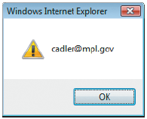
Debugging Your JavaScript Programs
Modular code entails breaking up a program’s different tasks into smaller, more manageable chunks
An alert dialog box is a dialog box generated by JavaScript that displays a text message with an OK button
alert(text);

Slide 28
Debugging Your JavaScript Programs
Microsoft offers the Microsoft Script Debugger
Firefox also provides the Firefox Error Console

Slide 29
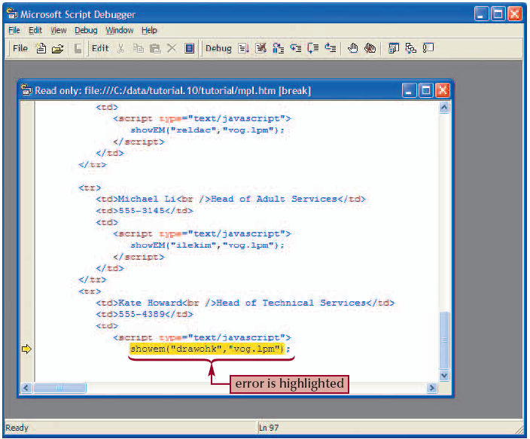
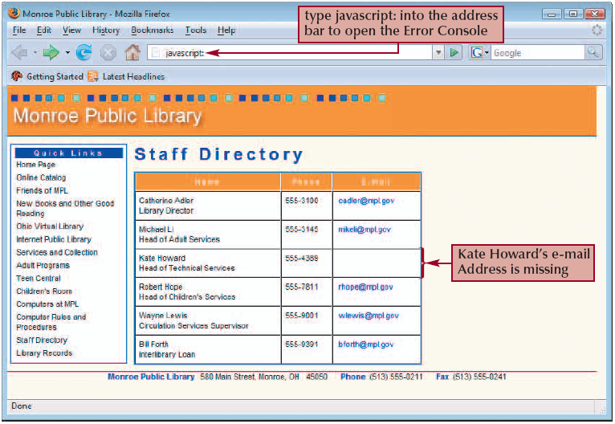
Debugging Your JavaScript Programs

