Slide 1
Tutorial 2 Developing a Basic Web Site

Slide 2
Objectives
Learn how to storyboard various Web site structures
Create links among documents in a Web site
Understand relative and absolute folder paths
Work with the base element

Slide 3
Working with Web Site Structures
A well-designed structure can ensure that users will be able to navigate the site without getting lost or missing important information
A site index is a page containing an outline of the entire site and its contents

Slide 4
Working with Web Site Structures
A storyboard is a diagram of a Web site’s structure, showing all the pages in the site and indicating how they are linked together
It is important to storyboard your Web site before you start creating your pages in order to determine which structure works best for the type of information the site contains
Types of Web Site Structures:
Linear Structures
Hierarchical Structures

Slide 5
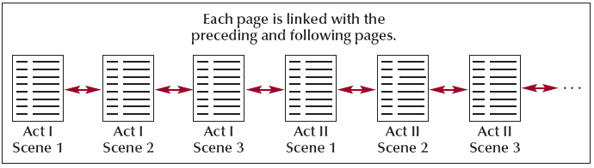
Linear Structures
In a linear structure, each page is linked with the pages that follow and precede it in an ordered chain
Linear structure works best for Web pages with a clearly defined order

Slide 6
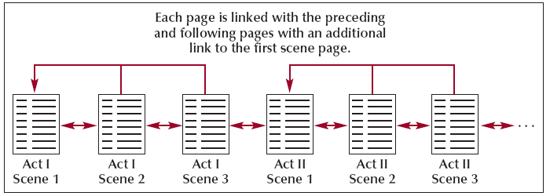
Linear Structures
In an augmented linear structure, each page contains an additional link back to an opening page

Slide 7
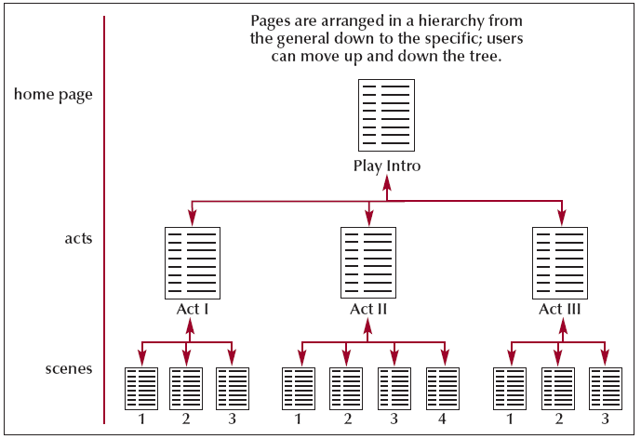
Hierarchical Structures
In the hierarchical structure, the pages are linked going from the home page down to more specific pages
Users can easily move from general to specific and back again

Slide 8
Hierarchical Structures
Within this structure, a user can move quickly to a specific scene within the page, bypassing the need to move through each scene in the play

Slide 9
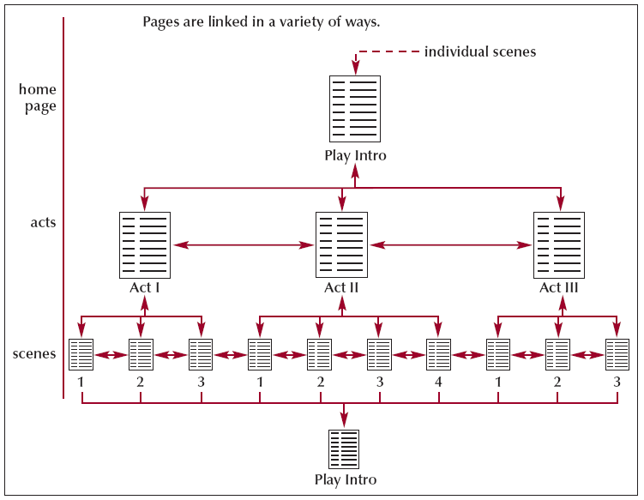
Mixed Structures
As Web sites become larger and more complex, you often need to use a combination of several different structures
The overall form can be hierarchical, allowing the user to move from general to specific; however, the links also allow users to move through the site in a linear fashion

Slide 10
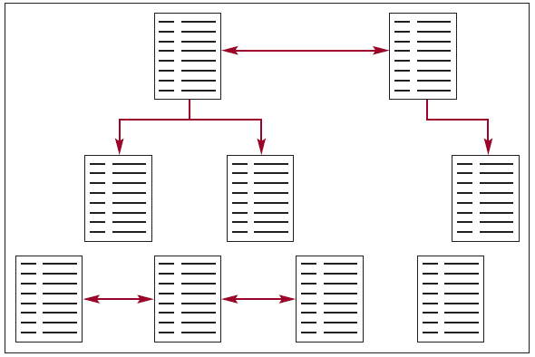
Web Site with No Coherent Structure
Unstructured Web sites
Difficult and frustrating to use
Confusing
Content and scope are not clear
Avoid!

Slide 11
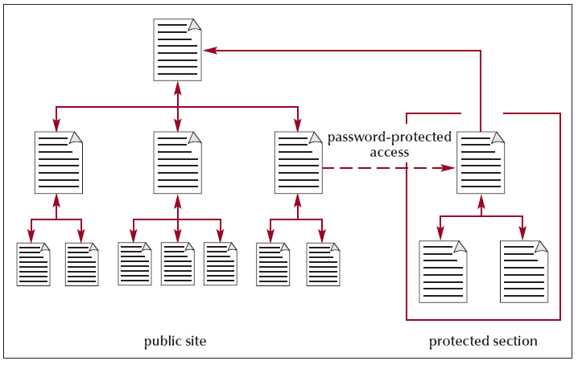
Protected Structures
Sections of most commercial Web sites are off-limits except to subscribers and registered customers

Slide 12
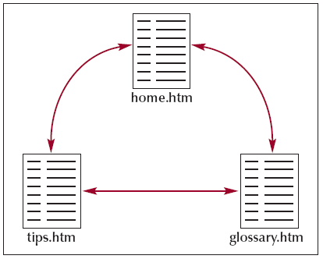
Creating a Hypertext Link
A user can select a link in a Web page, usually by clicking it with a mouse, to view another topic or document, often called the link’s destination or target.
The part of the page that users click is usually called a link’s label.

Slide 13
Creating a Hypertext Link
To link to a page, you specify the name of the file using the href attribute of the anchor tag: <a>
The anchor tags <a> ... </a> form a container for a link
Attribute:
href = “fileName"
Syntax:
<a href = “fileName”> linkLabel </a>
The “fileName" can be a simple file name or a path name

Slide 14
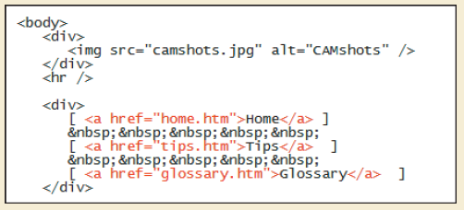
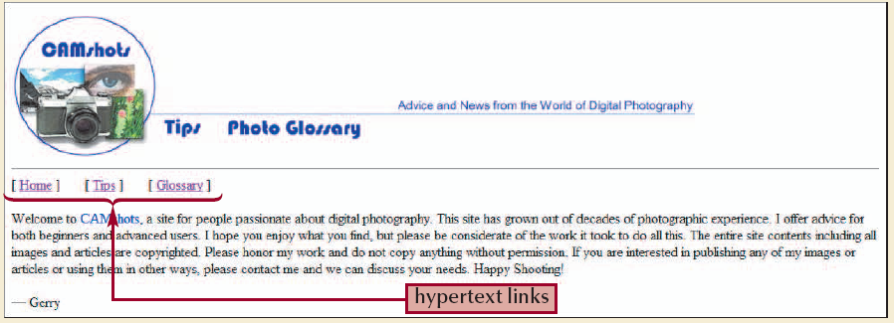
Creating a Hypertext Link

Slide 15
A Note on File Names
Filenames are case sensitive on some operating systems, including the UNIX and Macintosh, but not on others
The current standard:
Use lowercase filenames for all files on a Website
Avoid special characters such as blanks and slashes
You should also keep filenames short to avoid typing errors

Slide 16
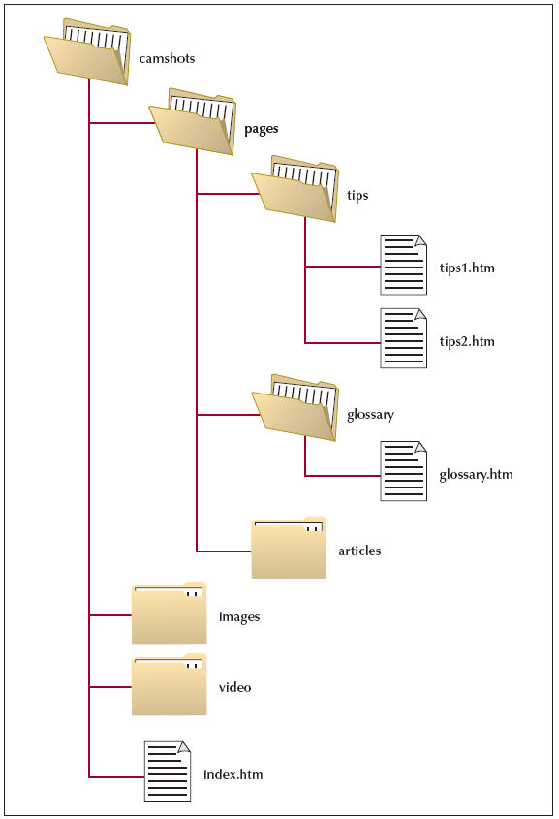
Specifying a Folder Path
To create a link to a file located in a different folder than the current document, you must specify the file’s location, or path
A path can be:
Absolute Path
Relative Path

Slide 17
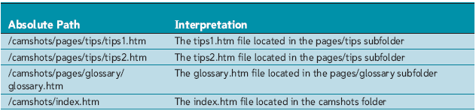
Absolute Paths
An absolute path specifies a file’s precise location within a computer’s entire folder structure

Slide 18
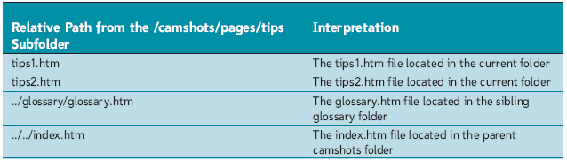
Relative Paths
A relative path specifies a file’s location in relation to the location of the current document
You should almost always use relative paths in your links

Slide 19
Specifying a Folder Path
If the file is in the same location as the current document, you do not have to specify the folder name
Examples:
<a href=“tips2.htm”>Link to Tips2</a>
<a href=“tips1.htm”>Link to Tips1</a>

Slide 20
Specifying a Folder Path
If the file is in a subfolder of the current document, you have to include the name of the subfolder
Examples:
<a href=“images/myCar.jpg”>My Car</a>
<a href=“pages/glossary/glossary.htm”>Glossary Page</a>
<a href=“pages/tips/tips1.htm”>Tips 1</a>

Slide 21
Specifying a Folder Path
If you want to go one level up the folder tree, you start the relative path with a double period (..), a forward slash, and then provide the name of the file
Examples:
<a href=“../index.htm”>Home</a>
<a href=“../../index.htm”>Home</a>

Slide 22
Specifying a Folder Path
To specify a different folder on the same level, known as a sibling folder, you move up the folder tree using the double period (..) and then down the tree using the name of the sibling folder
Examples:
<a href=“../tips/tips1.htm”>Tips 1</a>
<a href=“../glossary/glossary.htm”>Glossary</a>

Slide 23
Changing the Base
The base element is useful when a document is moved to a new folder. Rather than rewriting all of the relative paths to reflect the document’s new location, the base element can redirect browsers to the document’s old location, allowing any relative paths to be resolved

Slide 24
The Base Tag
The base element is a one sided tag
Add the base tag to the document head section
Syntax:
<base href=“path” />
where “path” is the folder location that you want the browser to use when resolving relative paths in the current document
Example:
<base href="http://personal.ashland.edu/iajwa/" />

Slide 25
Session 2.1 - End

Slide 26
Objectives
Mark a location with the id attribute
Create a link to an id
Mark an image as a link
Create an image map from an inline image
Remove an image border

Slide 27
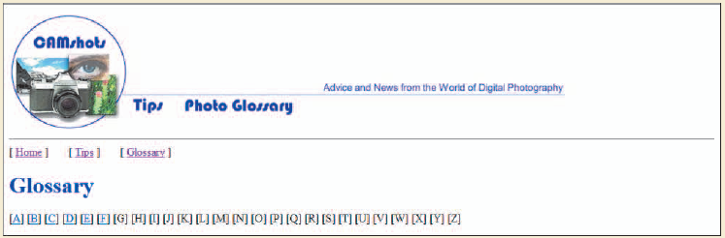
Internal Links
Using a link is a quicker way to access information at the bottom of a Web page than scrolling down.

Slide 28
Internal Links
Internal links are used to link to a place within the same document
Steps:
Mark or identify the desired location
Link to the location

Slide 29
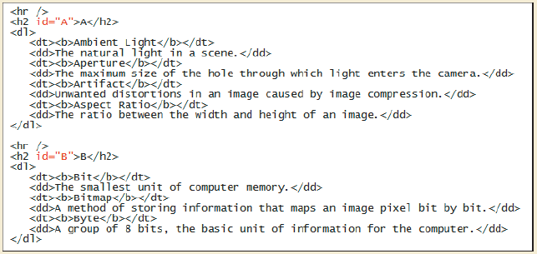
Marking the Desired Location
To jump to a specific location within a document, you first need to mark that location
One way to identify elements in an HTML document is to use the id attribute

Slide 30
Using the id Attribute
The id attribute is an attribute of ALL HTML/XHTML tags or elements:
<element id=“idName”>…</element>
<element id=“idName” />
Id names must be unique
Id names are not case sensitive

Slide 31
Linking to Locations within Documents
Now that you have marked (identified) the desired location with an idName, you want to link to it
To create a link within a document, you enclose the content that you want to format as a link in an <a> tag, and use the href attribute to identify the link target
<a href="#idName">linkLabel</a>

Slide 32
Creating Links Between Documents
To create a link to a specific location in another file, enter the code
<a href=“fileName#idName">linkLabel</a>
where fileName is the name of the targeted (destination) HTML or XHTML file and idName is the id of an element marked within that file

Slide 33
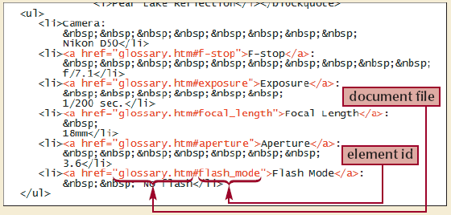
Creating Links Between Documents

Slide 34
Working with Linked Images
A standard practice on the Web is to turn the Web site’s logo into a hypertext link pointing to the home page
<a href="reference"><img src="file" alt="text" /></a>

Slide 35
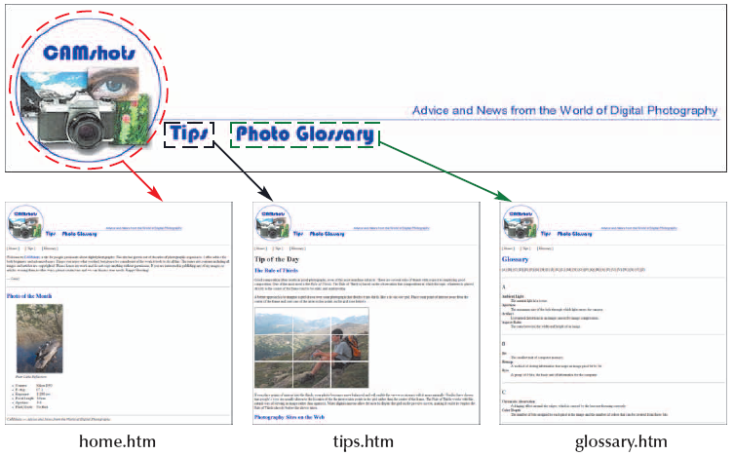
Working with Image Maps
HTML also allows you to divide an image into different zones, or hotspots, each linked to a different destination

Slide 36
Working with Image Maps
To define these hotspots, you create an image map that matches a specified region of the inline image to a specific destination

Slide 37
Creating Image Maps
To create an image map, use the <map>…</map> tags:
<map id=“mapName” name=“mapName”>
hotspot definition
hotspot definition
…
hotspot definition
</map>

Slide 38
Defining Hotspots
Define a hotspot using two properties:
Its location in the image
Its shape
Syntax of the hotspot element:
<area shape=“shape” coords=“coordinates” href=“url” alt=“text” />

Slide 39
Creating a Rectangular Hotspot
Two points define a rectangular hotspot:
the upper-left corner
the lower-right corner
A sample code for a rectangular hotspot is:
<area shape=“rect” coords=“384,61,499,271” href=“water.htm”>
Coordinates (coords) are entered as a series of four numbers separated by commas
HTML expects that the first two numbers represent the coordinates for the upper-left corner of the rectangle, and the second two numbers indicate the location of the lower-right corner
The hotspot is a hypertext link to water.htm

Slide 40
Creating a Circular Hotspot
A circular hotspot is defined by
the location of its center and
its radius
A sample code for a circular hotspot is:
<area shape=“circle” coords=“307,137,66” href=“karts.htm”>
Coordinates (coords) are entered as a series of three numbers separated by commas.
HTML expects that the first two numbers represent the coordinates for the center of the circle, and the third number indicate the raduis
The hotspot is a hypertext link to karts.htm

Slide 41
Creating a Polygonal Hotspot
To create a polygonal hotspot, you enter the coordinates for each vertex in the shape
A sample code for a polygonal hotspot is:
<area shape=“poly” coords=“13,60,13,270,370,270,370,225,230,225,230,60” href=“rides.htm”>
Coordinates (coords) are for each vertex in the shape
The hotspot is a hypertext link to rides.htm

Slide 42
Creating a Default Hotspot
To define the default hotspot for the image:
<area shape="default" coords="0, 0, x, y" href=“reference” />
where x is the width of the inline image in pixels and y is the image’s height
Any spot that is not covered by another hotspot will activate the default hotspot link

Slide 43
Applying an Image Map
To apply an image map to an image:
Add the usemap attribute to the image’s <img> tag:
<img src=“imageFileName“ usemap=“#mapName” />
where mapName is the name or id of the map element

Slide 44
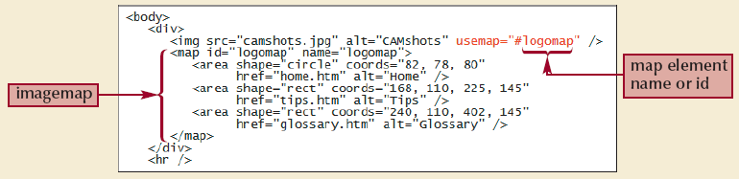
Applying an Image Map: Example

Slide 45
Section 2.2 - End

Slide 46
Objectives
Understand URLs
Link to a site on the Web
Link to an FTP site
Link to an e-mail address
Work with hypertext attributes
Work with metadata

Slide 47
Introducing URLs
To create a link to a resource on the Internet, you need to know its URL
A Uniform Resource Locator (URL) specifies the precise location of a resource on the Internet
A protocol is a set of rules defining how information is exchanged between two resources

Slide 48
Introducing URLs
Your Web browser communicates with Web servers using the Hypertext Transfer Protocol (HTTP)
The URLs for all Web pages must start with the scheme “http”
Other Internet resources use different protocols and have different scheme names

Slide 49
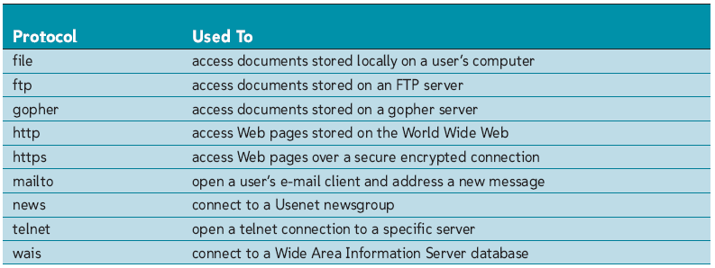
Internet Protocols

Slide 50
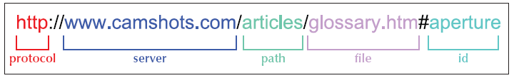
Linking to a Web Site
A sample URL for a Web page

Slide 51
Linking to a Web Site
If a URL includes no path, then it indicates the topmost folder in the server’s directory tree
If a URL does not specify a filename, the server searches for the default home page (index.html or home.html)
The server name portion of the URL is also called the domain name
The top level, called an extension, indicates the general audience supported by the Web server
<a href="http://www.apogeephoto.com">Apogee Photo</a>

Slide 52
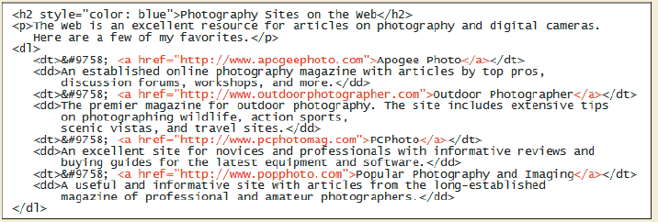
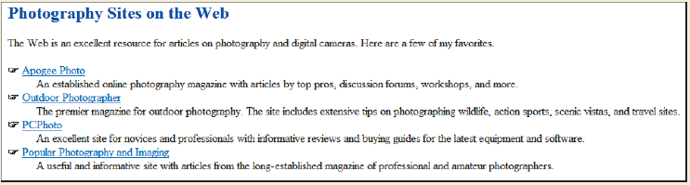
Linking to a Web Site

Slide 53
Linking to FTP Servers
FTP servers are another method of storing and sharing files on the Internet
FTP servers transfer information using a communications protocol called File Transfer Protocol, or FTP for short
An FTP server requires each user to enter a password and a username to access its files

Slide 54
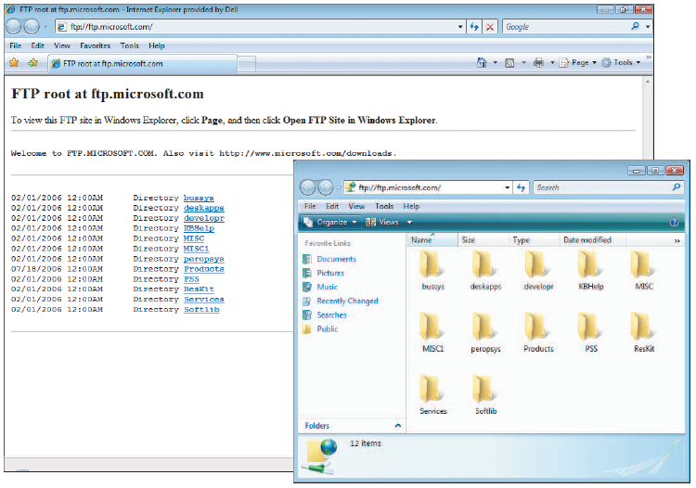
Linking to FTP Servers

Slide 55
Linking to a Local File
On occasion, you may see the URL for a file stored locally on your computer or local area network
If you are accessing a file from your own computer, the server name might be omitted and replaced by an extra slash (/)
The file scheme here does not imply any particular communication protocol; instead the browser retrieves the document using whatever method is the local standard for the type of file specified in the URL

Slide 56
Linking to an E-Mail Address
Many Web sites use e-mail to allow users to communicate with a site’s owner, sales representative, or technical support staff
You can turn an e-mail address into a hypertext link, so that when a user clicks on an address, the browser starts an e-mail program and automatically inserts the address into the “To” field of the new outgoing message

Slide 57
Linking to an E-Mail Address
The mailto protocol also allows you to add information to the e-mail, including the subject line and the text of the message
<a href=“mailto:emailAddress”>emailAddress</a>
Example:
<a href=“mailto:ghayward@camshotscom?Subject=Test&Body=This%20is%20a%20test%20message”>ghayward@camshotscom</a>
To preserve information about blank spaces, URLs use escape characters

Slide 58
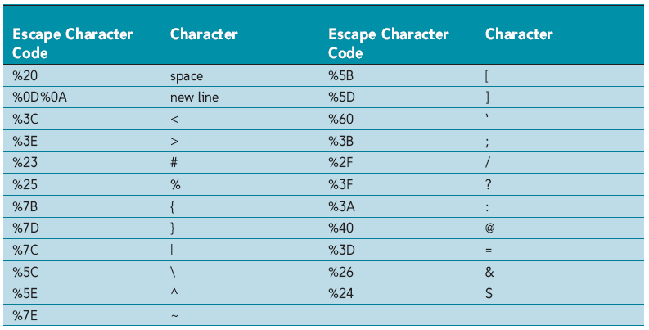
Linking to an E-Mail Address

Slide 59
Beware of Spam!
If you need to include an e-mail address in your Web page, you can take a few steps to reduce problems with spam:
Replace all e-mail addresses in your page with inline images of those addresses
Write a program in a language JavaScript to scramble any e-mail address in the HTML code
Replace the characters of the e-mail address with character codes
Replace characters with words in your Web page’s text

Slide 60
Working with Hypertext Attributes
HTML provides several attributes to control the behavior and appearance of your links
You can force a document to appear in a secondary window or tab by adding the target attribute to the opening <a> tag:
<a href=“reference” target=“value”>linkLabel</a>
value = "_self" | "_blank" | "frameName" | "_top"

Slide 61
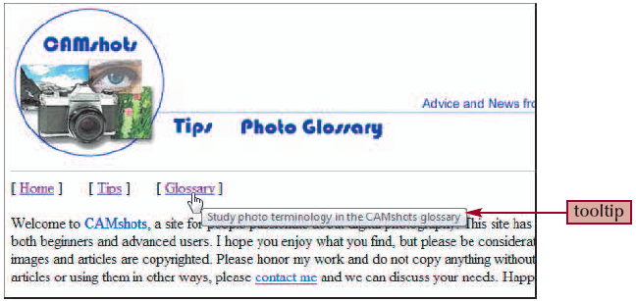
Working with Hypertext Attributes
If you want to provide additional information to your users, you can provide a tooltip to your links
A tooltip is a descriptive text that appears whenever a user positions the mouse pointer over a link

Slide 62
Working with Hypertext Attributes
To create a tooltip, add the title attribute to the opening <a> tag:
<a href=“reference” title=“text”>linkLabel</a>

Slide 63
Working with Hypertext Attributes

Slide 64
Working with Metadata
Web authors often turn to companies that specialize in making sites appear more prominently in search engines
Information about the site is called metadata
Add metadata to your Web pages by adding a meta element to the head section of the document
<meta name="text" content="text“ />

Slide 65
Metadata: Example
<meta name=“description” content=“CAMshots provides advice on digital cameras and photography” />
<meta name=“keywords” content=“photography, cameras, digital imaging” />

Slide 66
Section 2.3 & Tutorial 2 - End

