Slide 1
Tutorial 3 Working with Cascading Style Sheets

Slide 2
Objectives
Review the history and concepts of CSS
Explore inline styles, embedded styles, and external style sheets
Understand style precedence and style inheritance
Understand the CSS use of color

Slide 3
Introducing Cascading Style Sheets
Style sheets are declarations that describe the layout and appearance of a document
Goal: Separating content from style
Cascading Style Sheets (CSS) is a style sheet language used on the Web
CSS specifications are maintained by the World Wide Web Consortium (W3C)
Several versions of CSS exist: CSS1, CSS2, and CSS3

Slide 4
Applying a Style Sheet
Three ways to apply a style to an HTML or XHTML document:
Inline Styles
Embedded Style Sheet
External Style Sheet

Slide 5
Using Inline Styles
Inline styles are applied using the style attribute which is an attribute of all HTML elements:
<element style = “style1: value1;
style2: value2;
style3: value3;
…”>
where style1, style2, and so forth are the names of style properties; and value1, value2, and so on are the values associated with each style property

Slide 6
Using Inline Styles: Examples
<p style = “text-align: justify; margin-left: 10pt”> …</p>
<b style = “color: blue”> … </p>
<body style = “background-image: url(‘back.jpg’);
font-family: sans-serif;
font-size: 10pt”>
…
</body>

Slide 7
Advantages & Disadvantages of Inline Styles
Advantage:
Inline styles are easy to use and interpret because they are applied directly to the elements they affect
Disadvantages:
Applying styles directly to elements can be cumbersome!
What if you want all your headings to be displayed using the same color?
Inline styles are not consistent with the goal of separating content from style!

Slide 8
Using Embedded Styles
You can embed style definitions in a document head using the style element:
<style type=“text/css”>
style declarations
</style>
Where style declarations are the declarations of the different styles to be applied to elements in the current document

Slide 9
Using Embedded Styles: Style Declarations
Each style declaration has the syntax
selector { style1: value1;
style2: value2;
style3: value3;
…
}
where
selector identifies an element or elements within the document
style1: value1; pairs follow the same syntax used in inline styles

Slide 10
Using Embedded Styles: Example1
<head>
<title>…</title>
<style type=“text/css” id=“text” title=“text”>
p { text-align : justify }
b { color : blue }
h1 {text-align : justify ; color : blue }
body { background-image : url( ‘back.jpg’) }
</style>
</head>

Slide 11
Using Embedded Styles: Example2
<head>
<title>…</title>
<style type=“text/css” id=“text” title=“text”>
p { text-align : justify;
color : blue;
font-family : arial;
margin-left : 10pt
}
</style>
</head>

Slide 12
Working with Selectors
Selectors can be a single element or a collection of elements
If a collection of elements is used, the collection is coma-separated
selector1, selector2, ...
{
style1 : value1;
style2 : value2;
…
}

Slide 13
Working with Selectors: Example
<head>
<title>…</title>
<style type=“text/css” id=“text” title=“text”>
h1, h2 { text-align : center;
color : blue;
font-family : arial
}
</style>
</head>

Slide 14
Advantages & Disadvantages of Embedded Style Sheets
Advantage:
More control over individual HTML documents
Styles are applied only to the elements in the current document
Disadvantages:
An embedded style sheet is limited to the page elements of the current documents
What if you want all headings in the entire website to be displayed using the same color?
For a large website with many documents, this would be a cumbersome and error-prone process!

Slide 15
Using an External Style Sheet
Because an embedded style sheet only applies to the content of one file, you need to place a style declaration in an external style sheet to apply to the rest of the Web site
An external style sheet is a text file that contains style declarations

Slide 16
External Style Sheets
The extension for CSS files is .css
An external style sheet can be linked to any or all pages in the website, allowing the same style declaration to be applied to the entire site
An external style sheet looks like a list of embedded styles , except that the style declarations are not enclosed within opening and closing <style>

Slide 17
Adding Style Comments
Document the content and purpose of a style sheet using style sheet comments
Style Sheet Comment Syntax:
/* comment */
Example:
/* Kids page style sheet
December 2001
*/

Slide 18
Linking to an External Style Sheet
Use the link element to link a Web page to an external style sheet
<link href=“url” rel=“stylesheet” type=“text/css” />
where url is the path name for the external style sheet
Link elements are placed in the head section of a web page

Slide 19
Importing Style Sheets
On large websites, you might decide to use different styles for different groups of pages to give visual cue to users about where they are on the site
One way of organizing these different styles is to break them into smaller, more manageable units
The different style sheets can then be imported into a single sheet

Slide 20
Importing Style Sheets
To import the content of one style sheet (A) into another (B), place the following command in style sheet B:
@import url (url)
where url is the path name for style sheet A

Slide 21
Importing Style Sheets
Unlimited number of @import statements may be used
The @import statement:
can be added to either an embedded or an external CSS
must come before any other style declarations

Slide 22
Importing Style Sheets: Example
A website has 2 external style sheets called
Company.css: containing basic styles used in all web pages
Support.css: to be applied to web pages containing technical support information
The following embedded style sheet imports both files:
<style type=“text/css”>
@import url (Company.css)
@import url (Support.css)
</style>

Slide 23
Applying Single Style Sheet to Multiple Documents
You can link a single style sheet to multiple documents in your Web site by using the link element or the @import command

Slide 24
Applying Multiple Style Sheets to a Single Document
You can also link a single document to several style sheets by using the link element or the @import command

Slide 25
Understanding Cascading Order
Which style rule is ultimately applied to a page?
Example:
In an external style sheet, we have the following declaration
h1 { font-weight: bold; color: red}
In addition, the author has the following inline style
<h1 style=“text-align: center; color: blue”>…</h1>
Moreover, the browser specifies that all h1 elements are rendered in a regular black font that is not centered

Slide 26
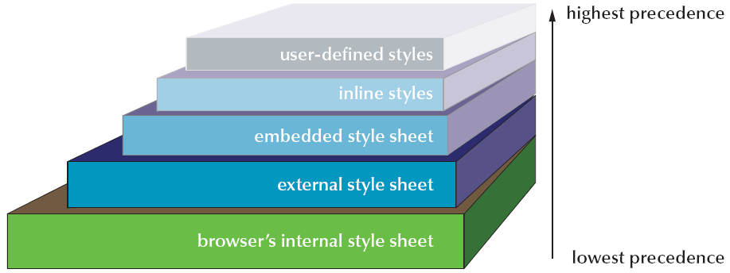
Levels of Style Precedence

Slide 27
Style Precedence
If two styles have the same weight, the one declared last has precedence
Example:
<style type=“text/css”>
h1 { color: orange; text-align: center }
h1 { color: blue }
</style>

Slide 28
Style Precedence
Precedence rules can be overridden by adding the !important property to a style declaration
Example:
<style type=“text/css”>
h1 { color: orange !important }
h1 { color: blue; text-align: center }
</style>

Slide 29
Style Inheritance
If an element (A) is nested within another element (B), then element B is referred to as the parent of element A
For example, the body element is the parent of all elements nested within <body> </body>:
Paragraphs
Headings
Lists
…

Slide 30
Style Inheritance
If a style is not specified for an element, it inherits the style of its parent element. This is called style inheritance
Example:
body {color: blue}
Every element nested within the body element (that is, every paragraph, every heading, every list, and so forth) will be rendered in blue

Slide 31
Style Inheritance
To override style inheritance, you need to specify alternate styles for the descendant elements of the parent
Example: body {color: blue}
p {color: red}
Here, every element in the page will be displayed in blue except paragraphs and elements nested within them; they will be displayed in red

Slide 32
Working with IDs: Recall…
We use an id to distinguish an element from the others in a document
<element id=“id”> … </element>
where id is a name that identifies the element

Slide 33
Applying a Style to a Specific ID
If an element is used as a selector, the styles are applied to all occurrences of the element in the document
Combined with style sheets, identities can be used to apply a specific set of styles to a particular occurrence of an element

Slide 34
Applying a Style to a Specific ID
To apply a style to an element marked with a specific id value, use the declaration
#id {style rule}
where id is the value of the element’s id attribute and style rule stands for the styles to be applied to that specific element

Slide 35
Working with CLASSes
Ids must be unique. Problem!
You can mark a group of elements with a common identifier using the class attribute.
<element class=“class”> … </element>
where class is a name that identifies the group to which the element belongs

Slide 36
Applying a Style to a CLASS
Combined with style sheets, classes can be used to apply a common set of styles to every element in a group
The syntax of the class selector is
.class { styles }
where class is the value of the class attribute for the group

Slide 37
Applying a Style to a CLASS: Example

Slide 38
Applying a Style to a CLASS and an Element
Classes can be applied to any element, not just those of the same type
<H1 class=“title”> … </H1>
<H2 class=“title”> … </H2>
If you want to apply a style to a class of elements of a particular type, include the name of the element along with the class value:
element.class { style rule(s) }
where class is the value of the class attribute for the group

Slide 39
Applying a Style to a CLASS and an Element: Example

Slide 40
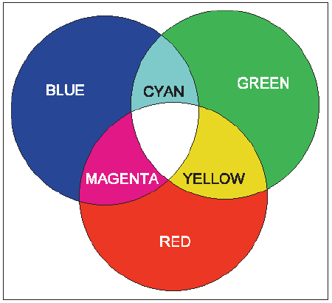
Working with Color in HTML and CSS
HTML is a text-based language, requiring you to define your colors in textual terms
Any color can be thought of as a combination of three primary colors: red, green, and blue
By varying the intensity of each primary color, you can create almost any color and any shade of color
This principle allows a computer monitor to combine pixels of red, green, and blue to create the array of colors you see to the right

Slide 41
Working with Color in HTML and CSS
The intensity of each of the three colors (red, green, blue) is assigned a number from 0 (absence of color, hex 00) to 255 (highest intensity, hex FF)
In this way, 256 × 256 × 256, or more than 16.7 million, distinct colors can be defined
Each color is represented by a triplet of numbers, called an RGB triplet, based on the strength of its Red, Green, and Blue components

Slide 42
Working with Color in HTML and CSS
HTML identifies a color in one of two ways:
By the color name
By the color value
By the RGB triplet
To have more control and more choices, specify colors using color values or RGB triplets

Slide 43
Working with Color in HTML and CSS
A color value is a hexadecimal (hex) notation for the combination of Red, Green, and Blue color values (RGB).
A hexadecimal is a number based on a base-16 numbering system rather than a base-10 numbering system that we use every day
Base 10 counting uses a combination of 10 characters (0 through 9) to represent numerical values
Hexadecimals include six extra characters: A (for 10), B (for 11), C (for 12), D (for 13), E (for 14), and F (for 15)

Slide 44
Working with Color in HTML and CSS
To represent a number in hexadecimal terms, you convert the value to multiples of 16 plus a remainder. For example:
21 is equal to (16 x 1) + 5, so its hexadecimal representation is 15
The number 255 is equal to (16 x 15) + 15, or FF in hexadecimal format (remember that F = 15 in hexadecimal)
In the case of the number 255, the first F represents the number of times 16 goes into 255 (which is 15), and the second F represents the remainder of 15
Once you know the RGB triplet of a color, the color needs to be converted to the hexadecimal format

Slide 45
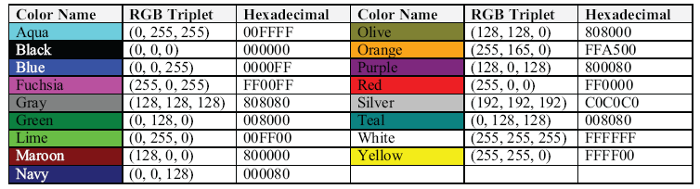
Working with Color in HTML and CSS
Using the basic color names allows you to accurately display them across different browsers and operating systems
The list of only 17 colors is limiting to Web designers

Slide 46
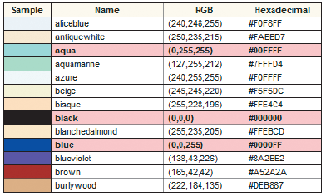
Working with Color in HTML and CSS
Partial list of extended color names

Slide 47
Defining Text and Background Colors
You can apply text and background colors to any page element
Background color declaration:
background-color: color
Text color declaration:
color: color
where color is either the RGB triplet for the color value or the color name

Slide 48
Session 3.1 - End

Slide 49
Objectives
Explore CSS styles for fonts and text
Review and compare different image formats
Display an animated graphic
Apply a background image to an element

Slide 50
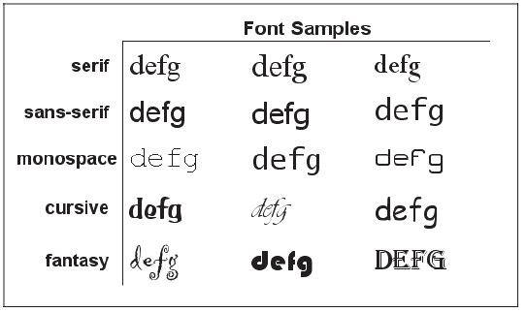
Working with Fonts and Text Styles
Generic fonts
A specific font is a font such as Times New Roman, Arial, or Garamond. The font is installed on a user’s computer
A generic font refers to the font’s general appearance

Slide 51

Working with Fonts and Text Styles
CSS allows you to specify a list of specific fonts along with a generic font
If the browser cannot find any of the specific fonts listed, it uses the generic font
font-family: Arial, Helvetica, ‘Trebuchet MS’, sans-serif

Slide 52
Setting the Font Size
The style to change the font size of text within an element is:
font-size: length
where length is a length of measure
Absolute units define a font size using one of five standard units of measurement:
Millimeters (mm)
Centimeters (cm)
Inches (in)
Points (pt)

Slide 53

Setting the Font Size
Many Web page designers opt to use relative units, which are expressed relative to the size of other objects within the Web page
Em unit
Percentages
Relative keywords
Larger
Smaller

Slide 54
Spacing and Indentation
Kerning is the amount of space between characters
letter-spacing: value
Tracking is the amount of space between words and phrases
word-spacing: value
Leading is the space between lines of text
line-height: length

Slide 55
Applying Font Features
To specify font styles, use the following style:
font-style: type
To control font weight for any page element, use the following style:
font-weight: weight
To change the appearance of your text, use the following style:
text-decoration: type

Slide 56
Applying Font Features
Underline, overline:
text-decoration: underline overline
Capitalize:
text-transform: capitalize
Uppercase letters, small font:
font-variant: type

Slide 57
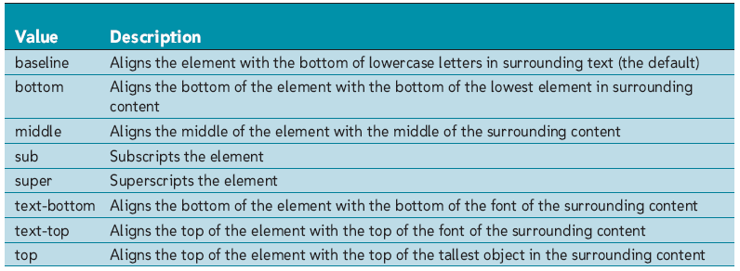
Aligning Text Vertically
Use the vertical-align attribute

Slide 58
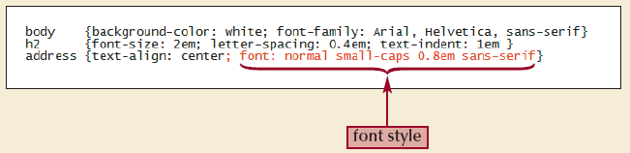
Combining All Text Formatting in a Single Style
You can combine most of them into a single declaration, using the style
font: font-style font-variant font-weight font- size/line-height font-family

Slide 59
Working with GIF Images
GIF (Graphics Interchange Format) is the most commonly used image format on the Web
Compatible with virtually all browsers
GIF files are limited to displaying 256 colors
Often used for graphics requiring fewer colors, such as clip art images, line art, logos, and icons
Images that require more color depth, such as photographs, can appear grainy when saved as GIF files

Slide 60
Working with GIF Images
A transparent color is a color that is not displayed when the image is viewed in an application
A splash screen is a Web page containing interesting animation or graphics that introduces a Web site

Slide 61
JPEG Images
JPEG stands for Joint Photographic Experts Group
Supports up to 16.7 million colors
Most often used for photographs and other images that cover a wide spectrum of color
Usually smaller than their GIF counterparts

Slide 62
PNG Images
A file format called PNG (Portable Network Graphics) has been gaining wider acceptance
PNG files use a free and open file format and can display more colors than GIFs
PNGs do allow transparent colors, but not all browsers support this feature

Slide 63
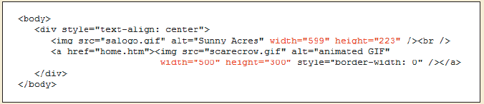
Setting the Image Size
By default, browsers display an image at its saved size
You can specify a different size by adding the HTML attributes
width="value" height="value"

Slide 64
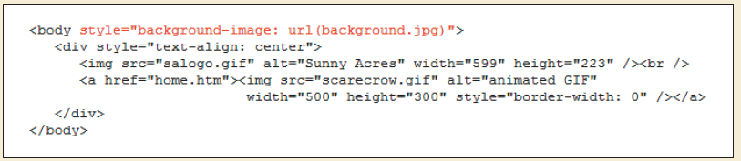
Formatting Backgrounds
The syntax for inserting a background image is: background-image: url(url)
URL is the location and filename of the graphic file you want to use for the background of the Web page

Slide 65
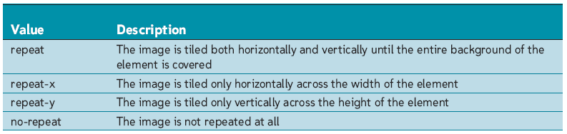
Background Image Options
By default, background images are tiled both horizontally and vertically until the entire background of the element is filled up
You can specify the direction of the tiling using the style:
background-repeat: type

Slide 66
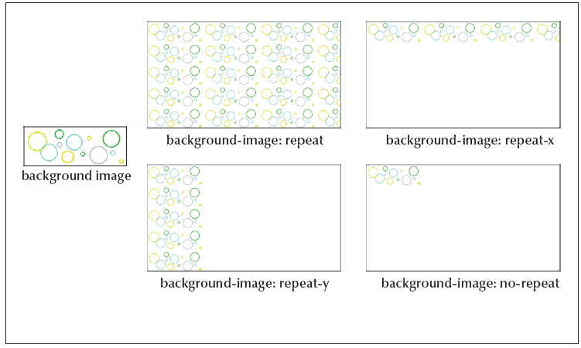
Background Image Options

Slide 67
The Background Style
You can combine the various background styles into the following single style:
background: color url(url) repeat attachment horizontal vertical

Slide 68
Session 3.2 - End

Slide 69
Objectives
Float elements on a Web page
Explore the properties of the box model
Apply border styles to an element

Slide 70
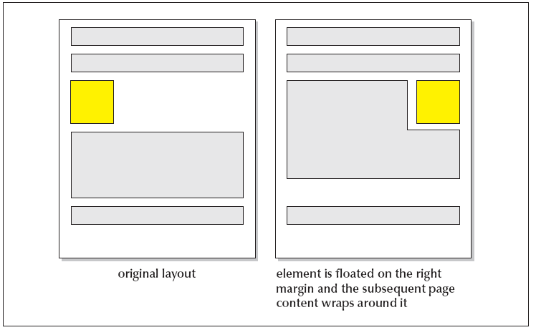
Floating an Element
The syntax for the float style is:
float: position

Slide 71
Floating an Element
To float an element, use the style
float: position
where position is none (to turn off floating), left or right
To display an element clear of a floating element, use the style
clear: position
where position is none, left, right, or both

Slide 72
Working with the Box Model
The box model describes the structure of page elements as they are laid out on the Web page:
The margin between the element and other page content
The border of the box containing the element content
The padding between the element’s content and the box border
The content of the element itself

Slide 73
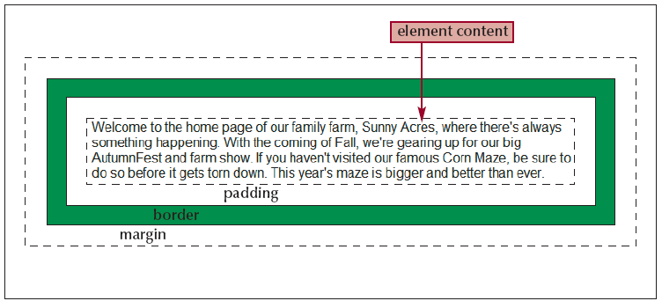
Working with the Box Model

Slide 74
Margin Styles
Control your margins with the following four styles:
margin-top: length
margin-right: length
margin-bottom: length
margin-left: length
Margin values can also be negative. This creates an overlay effect by forcing the browser to render one element on top of another
You can also combine the four margin styles into a single style:
margin: top right bottom left

Slide 75
Padding Styles
Styles to set padding are similar to styles to set margins:
padding-top: value
padding-right: value
padding-bottom: value
padding-left: value

Slide 76
Border Styles
border-top-width: length
border-right-width: length
border-bottom-width: length
border-left-width: length
border-width: top right bottom left
border-top-color: color
border-right-color: color
border-bottom-color: color
border-left-color: color
border-color: top right bottom left

Slide 77
Border Styles
border-top-style: type
border-right-style: type
border-bottom-style: type
border-left-style: type
border-style: top right bottom left

Slide 78
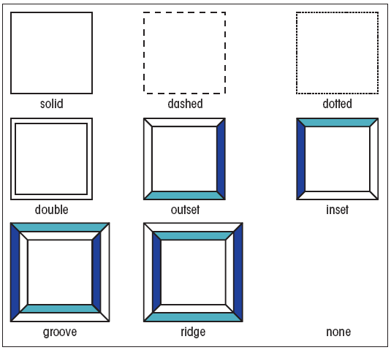
Border Styles

Slide 79
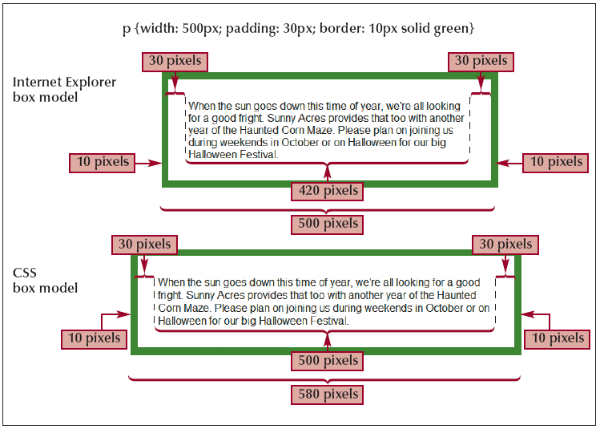
Width and Height Styles

Slide 80
Width and Height Styles
To set the box model width, use
width: length
where length is the width of the box content in one of the CSS units of measure. (Note that Internet Explorer applies the width value to the box model content, padding space, and border)
To set the box model height, use
height: length
where length is the height of the box content in one of the CSS units of measure

Slide 81
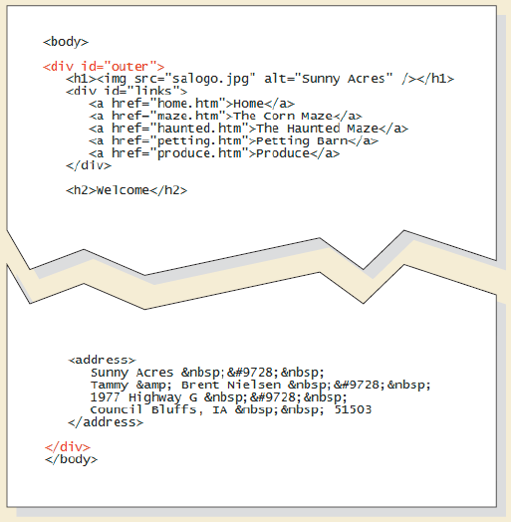
Controlling Page Layout with div Containers
div containers can be resized and floated to create different page layouts

Slide 82
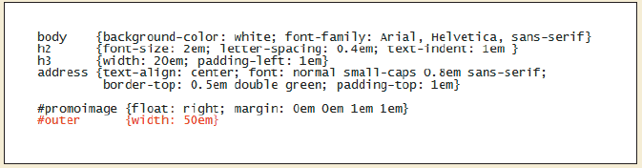
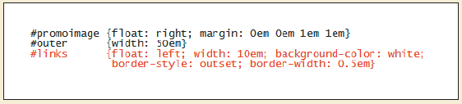
Controlling Page Layout with div Containers

Slide 83
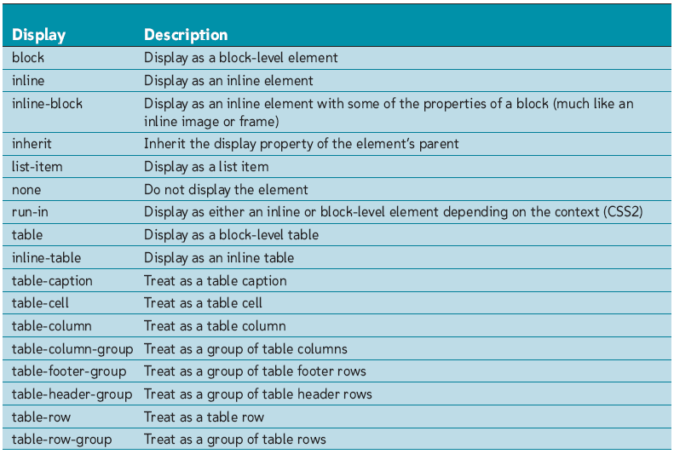
Setting the Display Style
Values of the display style

Slide 84
Setting the Display Style
To set the display style of an element, use
display: type
where type is the type of display. Use inline for inline elements and block for block-level elements

Slide 85
Tutorial 3- End

