Slide 1
Tutorial 5 Working with Web Tables

Slide 2
Objectives
Explore the structure of a Web table
Create headings and cells in a table
Create cells that span multiple rows and columns
Create row and column groups
Add a caption and a summary to a table

Slide 3
Introducing Web Tables
Each table in a Web page follows a basic structure consisting of the table element and a collection of table rows nested in the table element
<table>
<tr>
table cells
</tr>
<tr>
table cells
</tr>
...
</table>

Slide 4
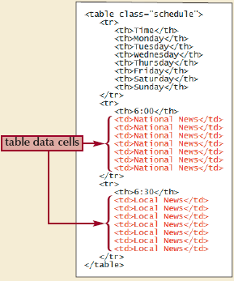
Introducing Web Tables
Table headings, the cells that identify the contents of a row or column, are marked using a <th> tag
Data cells are marked with the <td> tag and are used for any content that is not considered a heading

Slide 5
Introducing Web Tables: Example
<table>
<tr>
<td> First Cell </td>
<td> Second Cell </td>
</tr>
<tr>
<td> Third Cell </td>
<td> Fourth Cell </td>
</tr>
</table>

Slide 6
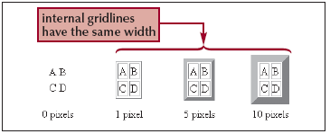
Introducing Web Tables
To add a border to a Web table using HTML, use the border attribute
<table border="value"> ... </table>
where value is the size of the border in pixels

Slide 7
Spanning Rows and Columns
A spanning cell is a single cell that occupies more than one row or one column in the table
To create a table cell that spans several columns, add the attribute
colspan="value"
to the cell, where value is the number of columns covered by the cell
To create a table cell that spans several rows, add the attribute
rowspan="value"
to the cell, where value is the number of rows covered by the cell

Slide 8
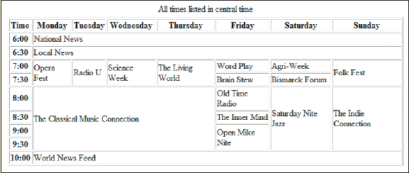
Creating a Table Caption
To create a table caption, add the caption element directly below the opening <table> tag with the syntax
<caption>content</caption>
where content is the content of the table caption

Slide 9
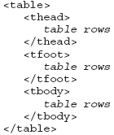
Marking Row Groups
You can divide a table’s rows into row groups, in which each group element contains different types of content and can be formatted differently
A table can have multiple table body row groups

Slide 10
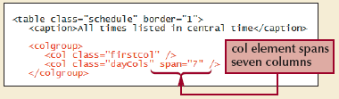
Marking Column Groups
Once the table columns have been determined by the browser, you can reference them through the use of column groups

Slide 11
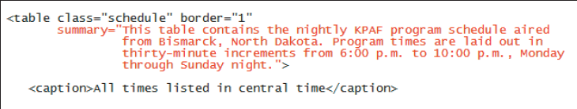
Adding a Table Summary
The summary attribute allows you to include a more detailed description about the table
<table summary="description"> ... </table>

Slide 12
Session 5.1 - End

Slide 13
Objectives
Format a table using HTML attributes
Format a table using CSS styles
Collapse table borders
Display page elements in tabular form
Create a jigsaw layout

Slide 14
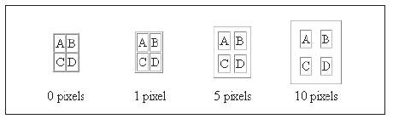
Setting Cell Spacing with HTML
The amount of space between table cells is known as the cell spacing
<table cellspacing=“value”>
where value is the number of pixels to be used.

Slide 15
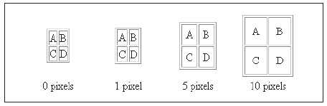
Setting Cell Padding with HTML
The cell padding is the space between the cell contents and the cell border
<table cellpadding=“value”>
where value is the number of pixels to be used.

Slide 16
Setting Table Widths with HTML
To set the width of the table to a specific value, add the width attribute
<table width="value"> ... </table>
where value is
A fixed number of pixels to be used, or
A percentile of the browser window

Slide 17
Setting Table Heights with HTML
Many browsers also support the height attribute
To set the height of the table to a specific value, add the height attribute
<table height="value"> ... </table>
where value is
A fixed number of pixels to be used, or
A percentile of the browser window

Slide 18
Setting Row Heights with HTML
You can use HTML to set the row heights by applying the height attribute
<tr height="value"> ... </tr>

Slide 19
Formatting Table Borders with HTML
The border attribute adds a border around the table and each of the table cells
You can modify the placement of the table borders using table frames and table rules.
A table frame specifies which sides of the table (or which sides of the table cells) will have borders
<table border="value" frame="type"> ... </table>
where value specifies border’s width and type specifies which sides have borders

Slide 20
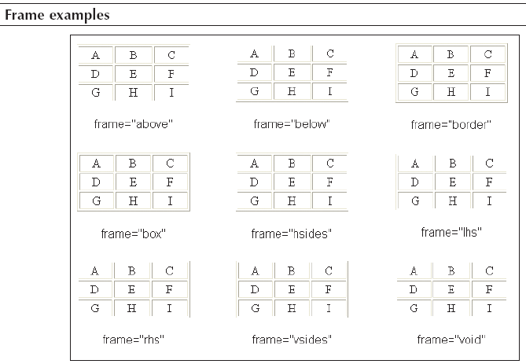
Values of the Frame Attribute

Slide 21
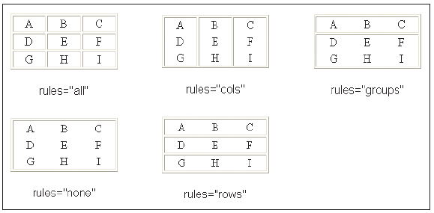
Formatting Table Gridlines with HTML
A table rule specifies how the internal gridlines are drawn within the table
<table border="value" rules="type"> ... </table>

Slide 22
Aligning Cell Contents Horizontally in HTML
By default, browsers horizontally center the contents of table header cells and left-align the contents of table data cells
To control the horizontal alignment, apply the align attribute to table rows (<tr>), row groups, columns, column groups, or individual table cells (<td>):
align="position”
where position is left, center, right, or justify

Slide 23
Vertical Alignment in HTML
By default, browsers place the contents of table cells in the middle
To control the vertical alignment, apply the valign attribute to table rows (<tr>), row groups, columns, column groups, or individual table cells (<td>):
valign="position”
where position is top, middle, bottom, or baseline

Slide 24
Formatting Tables with CSS
Starting with CSS2, Cascading Style Sheets included support for Web tables
You can apply one set of borders to the Web table itself and another set of borders to the individual cells within the table

Slide 25
Formatting Tables with CSS
To define the border model used by the table, apply the table style
border-collapse: type
where type is separate (the default) to keep all borders around cells and the table itself, separate, or collapse to merge all adjacent borders
To set the space between separated borders, apply the table style
border-spacing: value
where value is the space between the borders in any of the CSS units of measure

Slide 26
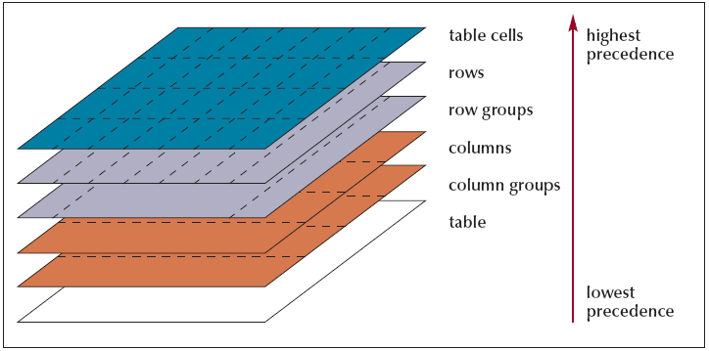
Formatting Tables with CSS
The most general styles are those applied to the entire table

Slide 27

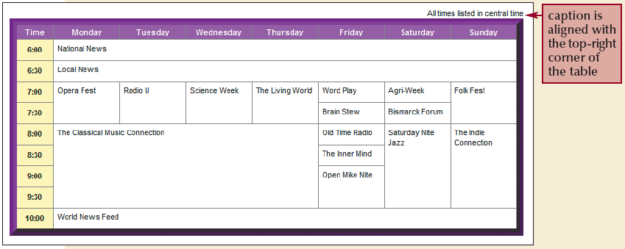
Formatting Tables with CSS
To position a table caption, apply the style
caption-side: position
where position is top or bottom

Slide 28
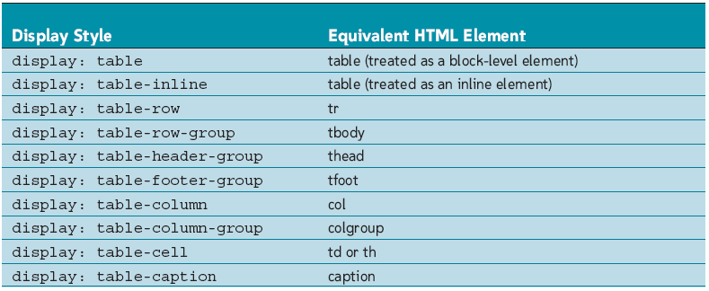
Applying Table Styles to Other Page Elements

Slide 29
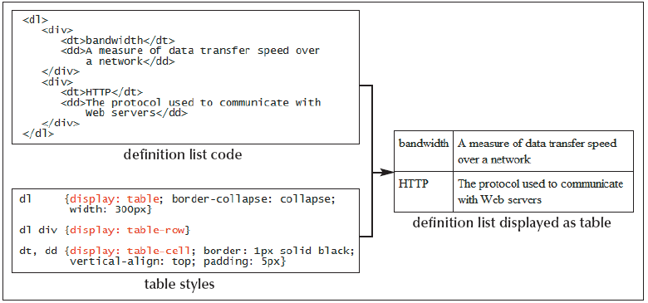
Applying Table Styles to Other Page Elements

Slide 30
Session 5.2 - End

Slide 31
Objectives
Explore the use of tables for page layout
Create rounded borders

Slide 32
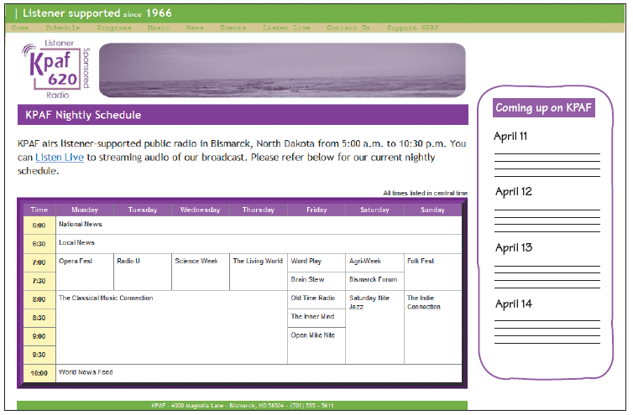
Using Tables for Page Layout

Slide 33
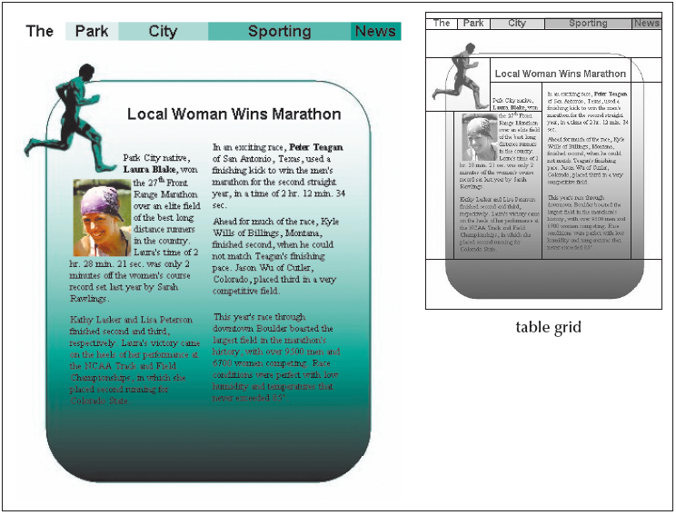
Using Tables for Page Layout
The jigsaw layout involves breaking up the page content into separate table cells that are then joined together like pieces in a jigsaw puzzle

Slide 34
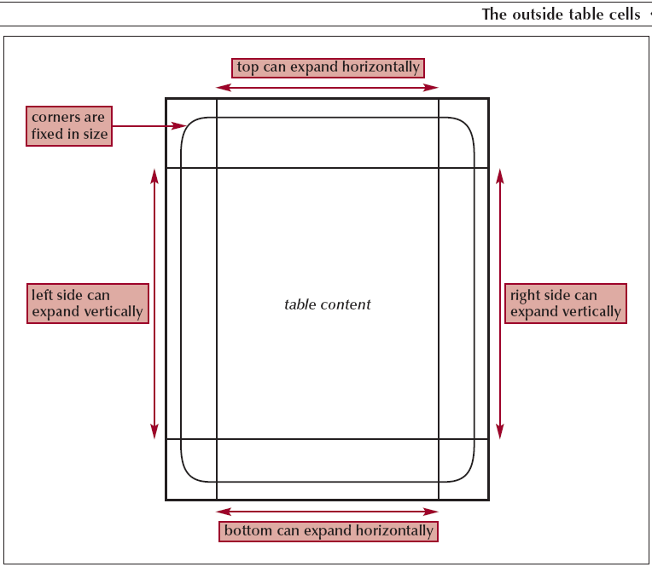
Using Tables for Page Layout

Slide 35
Exploring the Controversy over Table Layouts
Table layouts are not in the spirit of HTML
Table layouts are difficult to revise
Tables take longer to render
Tables can be code-heavy
Tables can be inaccessible to users with disabilities

Slide 36
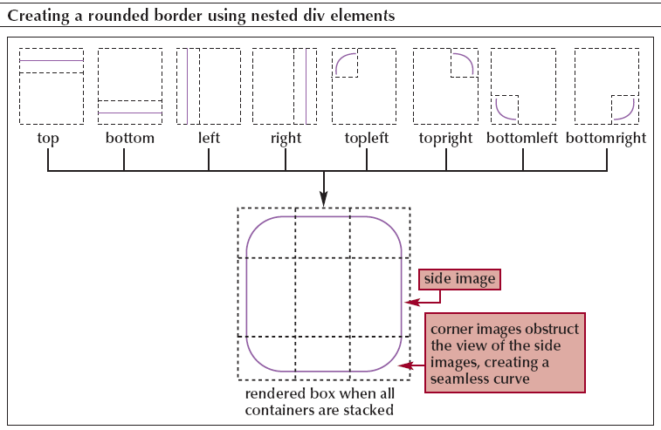
Creating a Rounded Box Using div Containers

Slide 37
Creating a Rounded Box Using div Containers
<div class="top"><div class="bottom">
<div class="left"><div class="right">
<div class="topLeft"><div class="topRight">
<div class="bottomLeft"><div class="bottomRight">
<div class="boxContent">
content
</div>
</div></div></div></div>
</div></div></div></div>

Slide 38
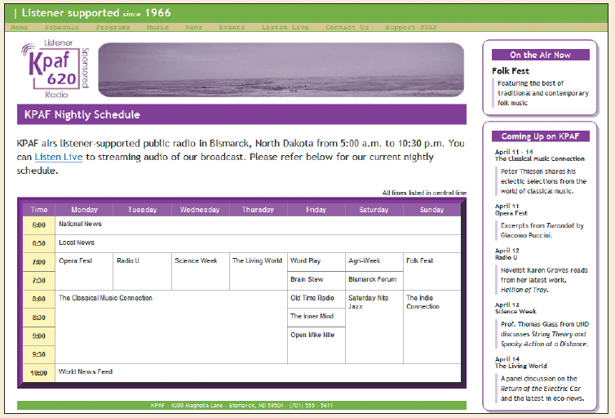
Creating a Rounded Box Using div Containers

Slide 39
Tutorial 5 - End

