Slide 1
Tutorial 6 Working with Web Forms

Slide 2
Objectives
Explore how Web forms interact with Web servers
Create form elements
Create field sets and legends
Create input boxes and form labels

Slide 3
Introducing Web Forms
Web forms collect information from Web site visitors.
Web forms include different control elements:
Input boxes
Option buttons or radio buttons
Selection lists
Drop-down lists boxes
Check boxes
Text areas

Slide 4
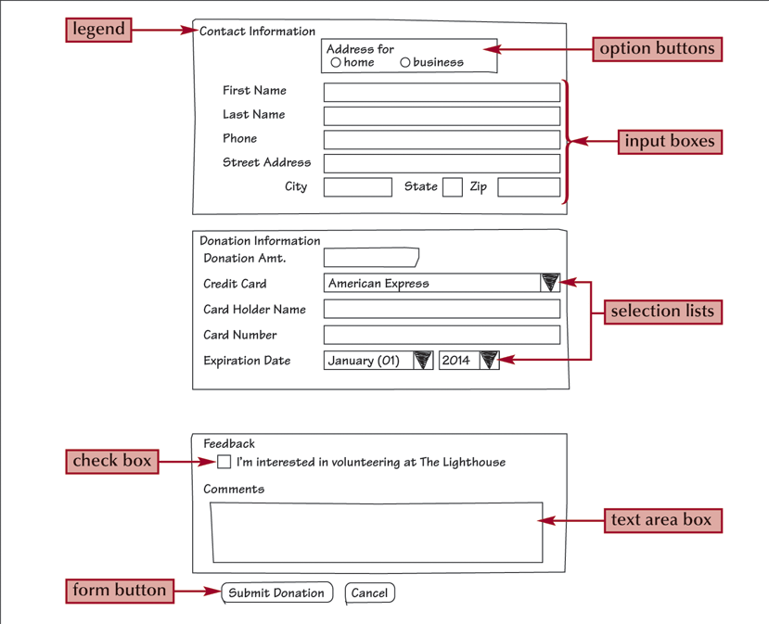
Parts of a Web Form

Slide 5
Forms and Server-Based Programs
While HTML supports the creation of forms, it does not include tools to process the information.
The information can be processed through a program running on a Web server.

Slide 6
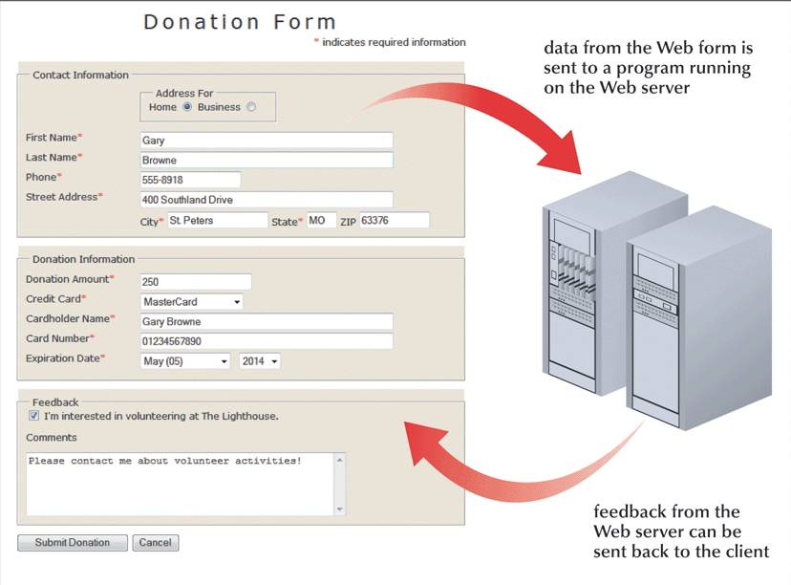
Interaction Between a Web Form and a Web Server

Slide 7
Forms and Server-Based Programs
Server-based programs are written in many languages
The earliest and most commonly used are Common Gateway Interface (CGI) scripts that are written in Perl.
Other popular languages include:
ASP
ColdFusion
C/C++
PHP
VBScript

Slide 8
Creating a Web Form
Forms are created using the form element, structured as follows:
<form attributes>
Controls
</form>
Where attributes are the attributes that control how the form is processed and Controls are control elements placed within the form.
Notes:
Notes:
This example illustrates a common use of frames: displaying a table of contents in one frame, while showing individual pages from the site in another.

Slide 9
Form Attributes
The form tag has several attributes but every form should be named and/or identified
Always specify an id and/or name for the form.
Two attributes are available to identify the form: id and name.
Other attributes of form will be discussed later
They usually tell the browser the location of the server-based program to be applied to the form’s data.
Notes:
Notes:
This example illustrates a common use of frames: displaying a table of contents in one frame, while showing individual pages from the site in another.

Slide 10
Form Attributes: Syntax
The syntax of the id and name attributes are as follows:
<form name=“formId” id=“formId”>
Controls
</form>
Where formId is the name and id of the form (same value); and Controls are the control elements placed within the form.
Notes:
Notes:
This example illustrates a common use of frames: displaying a table of contents in one frame, while showing individual pages from the site in another.

Slide 11
Example
Create a form with name donationForm and id donationForm
<form name=“donationForm” id=“donationForm”>
</form>

Slide 12
Creating a Field Set
HTML and XHTML allow you to organize control elements into a group of fields called field sets.
<fieldset id=“id”>
controls
</fieldset>
where id identifies the field set and controls are the control elements associated with fields within the field set

Slide 13
Example
Add 3 field sets ided contact, donation, and feedback to our form
<form name=“donationForm” id=“donationForm”>
<fieldset id=“contact”>
</fieldset>
<fieldset id=“donation”>
</fieldset>
<fieldset id=“feedback”>
</fieldset>
</form>

Slide 14
Adding Caption to a Field Set
To add a caption to a field set, add the following tag after the opening <fieldset> tag:
<legend> text </legend>
Where text is the text of the field set caption.

Slide 15
Example
Add 3 captions Contact Information, Donation Information, and Feedback to the three field sets in our form
<form name=“donationForm” id=“donationForm”>
<fieldset id=“contact”>
<legend>Contact Information</legend>
</fieldset>
<fieldset id=“donation”>
<legend>Donation Information</legend>
</fieldset>
<fieldset id=“feedback”>
<legend>Feedback</legend>
</fieldset>
</form>

Slide 16
Creating Input Elements
The general syntax of input elements is as follows: <input type=“type” name=“name” id=“id” />
Where type specifies the type of input control, and the name and id attributes provide the control’s name and id.

Slide 17
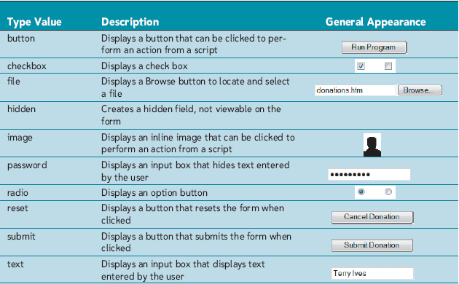
Types of Input Controls

Slide 18
Example
Add 2 text boxes First Name and Last Name to the contact field sets in our form
<form name=“donationForm” id=“donationForm”>
<fieldset id=“contact”>
<legend>Contact Information</legend>
First Name
<input type=“text” name=“fname” id=“fname” />
Last Name
<input type=“text” name=“lname” id=“lname” />
</fieldset>
…
</form>

Slide 19
Adding Field Labels Explicitly
You can also expressly link a label with an associated text element for scripting purposes.
The syntax for creating a form label is as follows:
<label for=“id”>label text</label>
Where id is the value of the id attribute for a field’s control element, and label text is the text of the label.
Notes:
Notes:

Slide 20
Example
Add 2 text boxes labeled First Name and Last Name to the contact field sets in our form
<form name=“donationForm” id=“donationForm”>
<fieldset id=“contact”>
<legend>Contact Information</legend>
<label for=“fname”>First Name</label>
<input type=“text” name=“fname” id=“fname” />
<label for=“lname”>Last Name</label>
<input type=“text” name=“lname” id=“lname” />
</fieldset>
…
</form>

Slide 21
Adding Field Labels Implicitly
The syntax for creating an implicit form label is as follows:
<label>
label text
Control
</label>
Where label text is the text of the label and Control is the control element to be associated with the label.
Notes:
Notes:

Slide 22
Example
Add 2 text boxes labeled (implicitly) First Name and Last Name to the contact field sets in our form
<form name=“donationForm” id=“donationForm”>
<fieldset id=“contact”>
<legend>Contact Information</legend>
<label>
First Name
<input type=“text” name=“fname” id=“fname” />
</label>
<label>
Last Name
<input type=“text” name=“lname” id=“lname” />
</label>
</fieldset>
…
</form>

Slide 23
Working with Form Styles
To layout a form, we can use
Tables
Style rules
Positioning styles placed in an external CSS are a better choice to layout a form
Advantage: you can easily modify the form layout without modifying the markup code

Slide 24
Some Useful Positioning Styles
label.blockLabel
{
display: block;
position: relative;
margin: 12px 0px
}

Slide 25
Some Useful Positioning Styles
label.blockLabel input
{
position: absolute;
left: 150px
}

Slide 26
Example
Apply the above two styles to our donation form
Create a css file called forms.css
Add the above two rules to the forms.css file
Modify forms.html
Add class=“blockLabel” to the intended label elements
Check your work by reloading forms.html in your web browser

Slide 27
Note: Required Form Fields
Server-Side programs usually requires that certain elements in a form be marked “required”
This is important to process the forms properly
Usually, “required fields” are marked with a red asterisk:
First Name*

Slide 28
Example
Mark the First Name and Last Name fields in our donation form as required:
Modify forms.css
Add the rule:
#donationForm span {color: red}
Modify forms.html
Add <span>*</span> to the intended fields
Reload forms.html in your web browser

Slide 29
Setting the Width of an Input Box
To change the width of an input box:
Use the width style, which is displayed as follows:
#id {width: value}
Where id is the id of the control and value is the width you want to apply to the input box
Use the size attribute of the input element
<input type=“text” name=“fname” id=“fname” size=“number” />

Slide 30
Example
Set the width of the fields: First Name, Last Name, and Street Address to 25 em; Phone and City to 10 em; State to 3em; and Zip to 7em.
Modify forms.css
Add the rule:
#donationForm span {color: red}
#fName, #lName, #street {width: 25em}
#phone, #city {width: 10em}
#state {width: 3em}
#zip {width: 7em}
Modify forms.html
Add proper ids to the intended fields
Reload forms.html in your web browser

Slide 31
Setting the Maximum Length of an Input Box
Maximum length refers to the largest number of characters a user can enter in an input box
To set the maximum length of an input box:
Use the maxlength attribute of the input element
<input type=“text” name=“fname” id=“fname” size=“number” maxlength=“number” />

Slide 32
Example
Set the maximum length of the State field to 2 characters and the maximum length of the Zip field to 10 characters.
Modify forms.html
Add maxlength=“2” to the State field
Add maxlength=“10” to the Zip field
Reload forms.html in your web browser

Slide 33
Setting a Default Value for a Field
To set a default value for a field:
Use the value attribute of the input element
<input type=“text” name=“fname” id=“fname” size=“number” maxlength=“number” value=“value” />

Slide 34
Example
Set the City field to the default value Ashland, the State field to the default value OH, and the Zip field to 44805.
Modify forms.html
Add value=“Ashland” to the City field
Add value=“OH” to the State field
Add value=“44805” to the State field
Reload forms.html in your web browser

Slide 35
Session 6.1 - End

Slide 36
Objectives
Creation option buttons
Create selection lists
Create check boxes
Create text area boxes
Apply styles to Web forms

Slide 37
Option (Radio) Buttons
Option buttons, or radio buttons allow users to select a data value from a limited set of possible values
With option buttons, users can select only one button at a time from a group.

Slide 38
Creating a Group of Option Buttons
The syntax to create a group of option buttons is:
<input type="radio" name="name" id="id1" value="value1" />
<input type="radio" name="name" id="id2" value="value2" />
<input type="radio" name="name" id="id3" value="value3" />
where name identifies the field associated with the collection of option buttons; id1, id2, id3, etc. identify the specific options; and value1, value2, value3, etc. are the field values associated with each option.

Slide 39
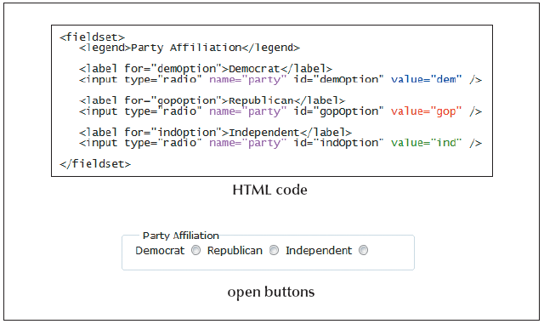
Creating Option Buttons: Example

Slide 40
Specifying a Default Option Button
To specify the default option, use the checked attribute of the input element:
<input type="radio" name="name" id="id1" value="value1" checked="checked" />

Slide 41
Example
Insert two option buttons at the top of the Contact Information field set to specify the type of address users are using.
Modify forms.html by adding the following markup code immediately after the Contact Information legend:
<fieldset id="addressFor">
<legend>Address For</legend>
<label for="homeAdd">Home</label>
<input type="radio" name="homeAdd" id="homeAdd“ value="hAdd" />
<label for="busAdd">Business</label>
<input type="radio" name="busAdd" id="busAdd" value="bAdd" />
</fieldset>

Slide 42
Example
Change the appearance of the option group by setting its width to 180px and left margin to 150px.
Modify forms.css by adding the following style rule:
#addressFor {width: 180px; margin-left: 150px}

Slide 43
Selection Lists
A selection list is a list box that presents users with a group of possible field values
Therefore, it has the same role as a group of option buttons and is used when there are too many options to select from
Users select a particular field value or set of field values.
Selection lists are useful when there are a fixed set of possible responses from the user.

Slide 44
Creating a Selection List
You can create a selection list using the select element.
You can specify each individual selection item using the option element.
<select name=“name” id=“id”>
<option value=“value1”>Text1</option>
<option value=“value2”>Text2</option>
…
</select>
Where name and id identify the field associated with the selection; value1, value2, etc. are the possible field values (for script use); and Text1, Text2, etc. are entries in the selection list (visible to users).

Slide 45
Example
Add a selection element to the form with options American Express, Discover, Mastercard, and Visa.
<select name="credCard" id="credCard">
<option value="AmEx">American Express</option>
<option value="Disc">Discover</option>
<option value="MC">Mastercard</option>
<option value="Visa">Visa</option>
</select>

Slide 46
Setting the Selection List Size
You can change the number of options displayed in the selection list by applying the size attribute.
Syntax:
<select size= “value”>… </select>
Where value is the number of items that the selection list displays in the form.

Slide 47
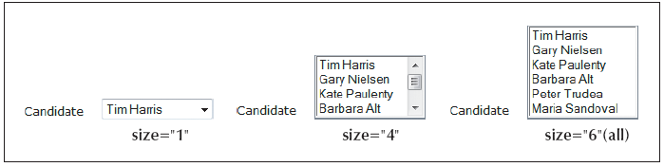
Setting the Selection List Size

Slide 48
Allowing for Multiple Selections
Selection lists allow for multiple selections by applying the multiple attribute to the select element:
<select multiple=“multiple”>…</select>
Note that the multiple attribute does not have a value. Therefore, it is set to itself in XHTML

Slide 49
Working with Check Boxes
To create a check box, use:
<input type=“checkbox” name=“name” id=“id” value=“value” />
Where the name and id attributes identify the check box controls and the value attribute specifies the value sent to the server if the check box is selected.

Slide 50
Working with Check Boxes
To specify that a check box be selected by default, use the checked attribute as follows:
<input type=“checkbox” checked=“checked” />

Slide 51
Specifying the Tab Order
Users typically navigate through a form with the tab key.
You can specify an alternate tab order by adding the tabindex attribute to any control element in your form:
<input name=“fName” id=“fName” tabindex=“1” />
This syntax assigns the tab index number “1” to the fName field from the registration form.

Slide 52
Working with Text Area Control
Text area boxes allow users to enter comments.
An input box would be too small to accommodate the length of text for this use.

Slide 53
Working with Text Area Control
To create a text area box, use the textarea element:
<textarea rows="value" cols="value">...</textarea>
Where the rows and cols attributes define the dimensions of the input box and the rows attribute indicates the number of lines in the input box.

Slide 54
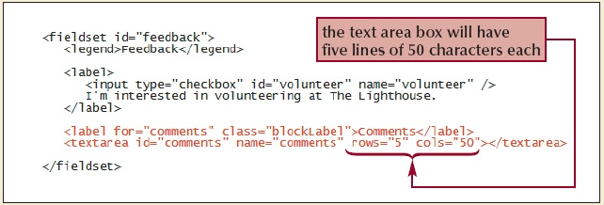
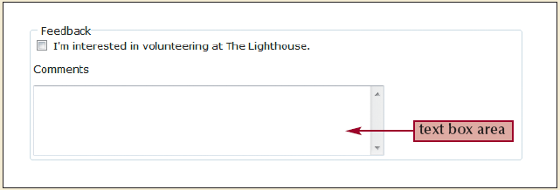
Working with Text Area Control

Slide 55
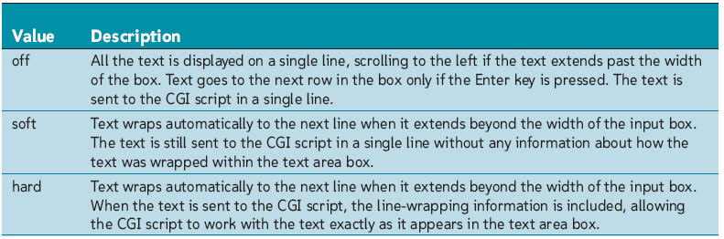
Working with the wrap Attribute

Slide 56
Session 6.2 - End

Slide 57
Objectives
Work with form buttons
Explore image elements and hidden fields
Work with form actions and methods

Slide 58
Working with Form Buttons
Buttons are a type of control element that performs an action.
Types of buttons:
Command button
Submit button
Reset button

Slide 59
Creating a Command Button
A command button runs a command on the Web page
This command can be a call to a program running on a Web server or a program installed within the Web browser
Syntax:
<input type=“button” value=“text” />

Slide 60
Creating a Submit Button
Submit buttons submit forms to the server for processing when clicked.
Syntax:
<input type=“submit” value=“text” />

Slide 61
Creating a Reset Button
Reset buttons reset forms to their original (default) values.
They clear any text entered and uncheck any checked boxes
Syntax:
<input type=“reset” value=“text” />

Slide 62
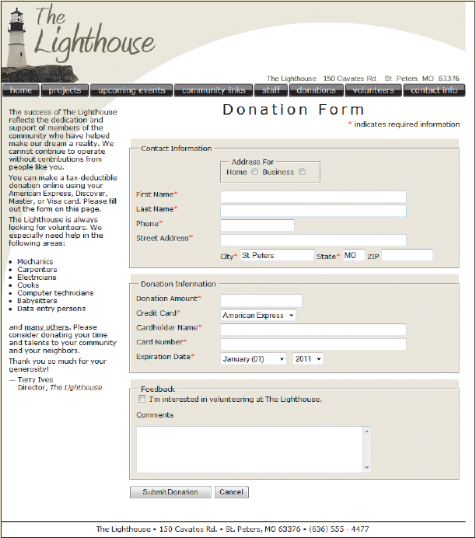
Completed Form

Slide 63
Designing a Custom Button
Use the button element for greater artistic control over the appearance of a button.
<button name=“name” id=“id” value=“value” type=“type”>
content
</button>
Where the name and value attributes specify the name of the button and the value sent to a server-based program, the id attribute specifies the button’s id, the type attribute specifies the button type, and the content is page content displayed within the button.

Slide 64
Creating File Buttons
File buttons are used to select files so that their contents can be submitted for processing to a program.
Syntax:
<input type=“file” value=“text” />

Slide 65
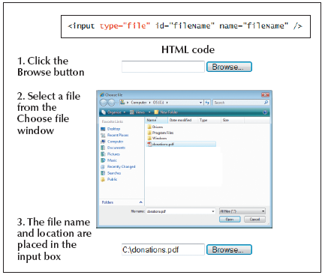
Creating File Buttons

Slide 66
Working with Hidden Fields
Hidden fields are added to a form, but not displayed in the Web page.
Syntax:
<input type=“hidden” value=“value” />

Slide 67
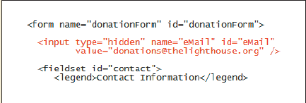
Working with Hidden Fields

Slide 68
Working with Form Attributes
After adding the elements to your form, you’ll need to specify where to send the form data.
Use the action attribute:
<form action=“url”>
…
</form>
Where url specifies the filename and location of the program that processes the form

Slide 69
Working with Form Attributes
You also need to specify how to send the form data.
Use the method attribute:
<form method=“value”>
…
</form>
Where method specifies how your Web browser sends data to the server.

Slide 70
Working with Form Attributes
The method attribute can have one of two values:
Post
Get
The get method is the default; get appends the form data to the end of the URL specified in the action attribute.
The post method sends form data in a separate data stream, allowing the Web server to receive the data through “standard input.”

Slide 71
Using the “mailto” Action
The mailto action accesses the user’s own e-mail program and uses it to mail form information to a specified e-mail address.
Bypasses the need for server-based programs.

Slide 72
Using the “mailto” Action
Syntax:
<form action-mailto:email_address method=“post” enctype=“text/plain”>
…
</form>
Where email_address is the e-mail address of the recipient in the form.

Slide 73
Tips for Creating Effective Forms
Mark fields that are required, but also limit the number of unrequired fields. Don’t overwhelm your users with requests for information that is not really essential. Keep your forms short and to the point.
If you need to collect a lot of information, break the form into manageable sections spread out over several pages. Allow users to easily move backward and forward through the forms without losing data.

Slide 74
Tips for Creating Effective Forms
Provide detailed instructions about what users are expected to do. Don’t assume that your form is self-explanatory.
If you ask for personal data and financial information, provide clear assurances that the data will be secure. If possible, provide a link to a Web page describing your security practices.
Clearly indicate what users will receive once the form is submitted, and provide feedback on the Web site and through e-mail that tells them when their data has been successfully submitted.

Slide 75
Tutorial 6 – End

