Slide 1
The Heart of Ajax—the
XMLHTTPRequest Object
Chapter 10
CS 275 – Web Programming - AJAX

Slide 2
Introducing XMLHTTPRequest
XMLHTTPRequest is supported by virtually all modern browsers
  including Microsoft's Internet Explorer 5+ and a variety of non-Microsoft browsers, including Mozilla, Firefox, Konqueror, Opera, and Safari, and is supported on a wide range of platforms, including Microsoft Windows, UNIX/Linux, and Mac OS X.
  Some browsers may require attention to their security settings to allow the XMLHTTPRequest object to operate correctly. See your browser's documentation for details.
The purpose of the XMLHTTPRequest object is to allow JavaScript to formulate HTTP requests and submit them to the server.
  Traditionally programmed web applications normally make such requests synchronously, in conjunction with a user-initiated event such as clicking on a link or submitting a form, resulting in a new or updated page being served to the browser.
Using XMLHTTPRequest, however, you can have your page make such calls asynchronously in the background, allowing you to continue using the page without the interruption of a browser refresh and the loading of a new or revised page.
  This capability underpins all Ajax applications, making the XMLHTTPRequest object the key to Ajax programming.
Although the object's name begins with XML, in fact, any type of document may be returned from the server; ASCII text, HTML, and XML are all popular choices, and we will encounter all of these in the course of the book.
CS 275 – Web Programming - AJAX

Slide 3
Creating the XMLHTTPRequest Object
You cannot use of the XMLHTTPRequest until you have created an instance of it.
  Creating an instance of an object in JavaScript is usually just a matter of making a call to a method known as the object's constructor.
  In the case of XMLHTTPRequest, however, you must change this routine a little to cater to the peculiarities of different browsers, as you see in the following section.
There are Different Rules for Different Browsers
Microsoft first introduced the XMLHTTPRequest object, implementing it in Internet Explorer 5 as an ActiveX object.
  ActiveX is a proprietary Microsoft technology for enabling active objects into web pages. Among the available web browsers, it is currently only supported in Microsoft's Internet Explorer. Internet Explorer uses its built-in XML parser, MSXML, to create the XMLHTTPRequest object.
Most other browser developers have now included into their products an equivalent object, but implemented as a native object in the browser's JavaScript interpreter.
  For the majority of browsers that support XMLHTTPRequest as a native object (Mozilla, Opera, and the rest), creating an instance of this object is straightforward.
  The following line creates an XMLHTTPRequest object called request:
  var request = new XMLHTTPRequest();
    Here we have declared a variable request and assigned to it the value returned from the statement new XMLHTTPRequest(), which is invoking the constructor method for the XMLHTTPRequest object.
  To achieve the equivalent result in Microsoft Internet Explorer, you need to create an ActiveX object. Here's an example:
  var request = new ActiveXObject("Microsoft.XMLHTTP");
    Once again, this assigns the name request to the new object.
  To complicate matters a little more, some versions of Internet Explorer have a different version of MSXML, the Microsoft XML parser, installed; in those cases you need to use the following instruction:
  var request = new ActiveXObject("Msxml2.XMLHTTP");
CS 275 – Web Programming - AJAX

Slide 4
A Solution for All Browsers
You need, therefore, to create a script that will correctly create an instance of a XMLHTTPRequest object regardless of which browser you are using (provided, of course, that the browser supports XMLHTTPRequest).
A good solution to this problem is to have your script try in turn each method of creating an instance of the object, until one such method succeeds.
Using Object Detection for a Cross-Browser Solution
function getXMLHTTPRequest() {
var request = false;
try {
request = new XMLHttpRequest(); /* e.g. Firefox */
}
catch(err1) {
try {
vrequest = new ActiveXObject("Msxml2.XMLHTTP"); /* some versions IE */
}
catch(err2) {
try {
request = new ActiveXObject("Microsoft.XMLHTTP");/* some versions IE */
}
catch(err3) {
request = false;
}
}
}
return request;
}
CS 275 – Web Programming - AJAX

Slide 5
A Solution for All Browsers
An alternative, and equally valid, technique would be to detect which type of browser is in use by testing which objects are defined in the browser.
function getXMLHTTPRequest() {
var request = false;
if(window.XMLHTTPRequest) {
request = new XMLHTTPRequest();
} else {
if(window.ActiveXObject) {
try {
request = new ActiveXObject("Msml2.XMLHTTP");
}
catch(err1) {
try {
request = new ActiveXObject("Microsoft.XMLHTTP");
}
catch(err2) {
request = false;
}
}
}
}
return request;
}
CS 275 – Web Programming - AJAX

Slide 6
A Solution for All Browsers
JavaScript also makes available a navigator object that holds information about the browser being used to view the page. Another method we could have used to branch our code is to use this object's appName property to find the name of the browser:
var myBrowser = navigator.appName;
This would return "Microsoft Internet Explorer" for IE.
CS 275 – Web Programming - AJAX

Slide 7
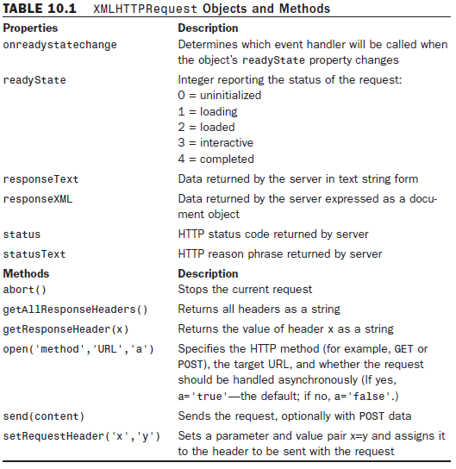
XMLHTTPRequest Object
CS 275 – Web Programming - AJAX

Slide 8
XMLHTTPRequest Object
The open() Method
The open() method prepares the XMLHTTPRequest object to communicate with the server. You need to supply at least the two mandatory arguments to this method:
First, specify which HTTP method you intend to use, usually GET or POST.
Next, the destination URL of the request is included as the second argument.
  If making a GET request, this URL needs to be suitably encoded with any parameters and their values as part of the URL.
For security reasons, the XMLHTTPRequest object is allowed to communicate only with URLs within its own domain.
  An attempt to connect to a remote domain results in a "permission denied" error message.
A common mistake is to reference your domain as mydomain.com in a call made from www.mydomain.com.
  The two will be regarded as different by the JavaScript interpreter, and connection will not be allowed.
Optionally you may include a third argument to the send request, a Boolean value to declare whether the request is being sent in asynchronous mode.
  If set to false, the request will not be sent in asynchronous mode, and the page will be effectively locked until the request is completed. The default value of true will be assumed if the parameter is omitted, and requests will then be sent asynchronously.
CS 275 – Web Programming - AJAX

Slide 9
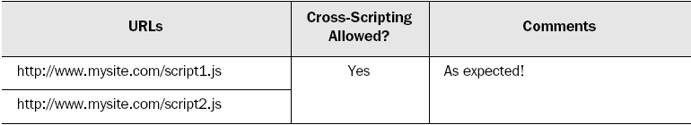
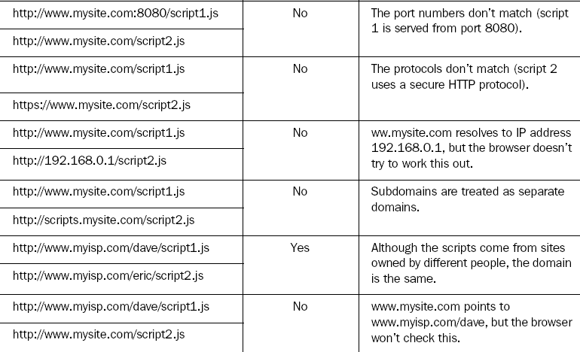
AJAX Security – Server of Origin Policy
CS 275 – Web Programming - AJAX

Slide 10
XMLHTTPRequest Object
The send() Method
Having prepared the XMLHTTPRequest using the open() method, you can send the request using the send() method. One argument is accepted by the send() function.
If your request is a GET request, the request information will be encoded into the destination URL, and you can then simply invoke the send() method using the argument null:
objectname.send(null);
However, if you are making a POST request, the content of the request (suitably encoded) will be passed as the argument.
objectname.setRequestHeader('Content-Type',
➥'application/x-www-form-urlencoded');
objectname.send(var1=value1&var2=value2);
  In this case we use the setRequestHeader method to indicate what type of content we are including.
CS 275 – Web Programming - AJAX

Slide 11
Talking with the Server
Now that we have XMLHTTPRequest object, let's consider how to create and send server requests, and what messages we might expect to get back from the server.
We'll write a JavaScript function called callAjax() to send an asynchronous request to the server using that object.
function getXMLHTTPRequest() {
var req = false;
try {
req = new XMLHttpRequest(); /* e.g. Firefox */
}
catch(err1) {
try {
req = new ActiveXObject("Msxml2.XMLHTTP");/* some versions IE */
}
catch(err2) {
try {
req = new ActiveXObject("Microsoft.XMLHTTP");
}
catch(err3) {
req = false;
}
}
}
return req;
}
CS 275 – Web Programming - AJAX

Slide 12
var myRequest = getXMLHTTPRequest();
function callAjax() {
// declare a variable to hold some information to pass to the server
var lastname = 'Smith';
// build the URL of the server script we wish to call
var url = "myserverscript.php?surname=" + lastname;
// ask our XMLHTTPRequest object to open a server connection
myRequest.open("GET", url, true);
// prepare a function responseAjax() to run when the response has
// arrived
myRequest.onreadystatechange = responseAjax;
// and finally send the request
myRequest.send(null);
}
CS 275 – Web Programming - AJAX

Slide 13
Dealing with the Browser Cache
All browsers maintain a so-called cache of visited web pages
  a local record of page contents stored on the hard disk of the browser's computer.
  When you request a particular web page, the browser first tries to load the page from its cache, rather than submitting a new HTTP request.
  This appears to be more of a problem with IE than with the non-Microsoft browsers.
Only GET requests are affected; POST requests are not cached.
Although this can sometimes be advantageous in terms of page load times, it creates a difficulty when trying to write Ajax applications.
  Ajax is all about talking to the server, not reloading information from cache; so when you make an asynchronous request to the server, a new HTTP request must be generated every time.
It is possible to add HTTP headers to the data returned by server-side routines, intended to tell the browser not to cache a particular page. Examples include
"Pragma: no-cache"
and
"Cache-Control: must-revalidate"
among others.
Unfortunately such strategies vary widely in their effectiveness. Different browsers have different cache handling strategies and support different header declarations, making it difficult to ensure that pages are not cached.
CS 275 – Web Programming - AJAX

Slide 14
Dealing with the Browser Cache
A commonly used trick to work around this problem involves the adding of a parameter with a random and meaningless value to the request data.
  In the case of a GET request, this necessitates adding a further parameter and value pair to the end of the URL.
  If the random part of the URL is different each time, this effectively "fools" the browser into believing that it is to send the asynchronous request to an address not previously visited. This results in a new HTTP request being sent on every occasion.
  In JavaScript you can generate random numbers using the Math.random() method of the native Math() object.
function getXMLHTTPRequest() {
/// … same as before … }
var myRequest = getXMLHTTPRequest();
function callAjax() {
// declare a variable to hold some information to pass to the server
var lastname = 'Smith';
// build the URL of the server script we wish to call
var url = "myserverscript.php?surname=" + lastname;
// generate a random number
var myRandom=parseInt(Math.random()*99999999);
// ask our XMLHTTPRequest object to open a server connection
myRequest.open("GET", url + "&rand=" + myRandom, true);
// prepare a function responseAjax() to run when the response has arrived
myRequest.onreadystatechange = responseAjax;
// and finally send the request
myRequest.send(null);
}
CS 275 – Web Programming - AJAX

Slide 15
Monitoring Server Status
The XMLHTTPRequest object contains mechanisms by which we can stay informed of the progress of our Ajax request and determine when the information returned by the server is ready to use in our application.
The readyState Property
The readyState property of the XMLHTTPRequest object gives you information from the server about the current state of a request you have made. This property is monitored by the onreadystatechange property, and changes in the value of readyState cause onreadystatechange to become true and therefore cause the appropriate function (responseAjax() in our example) to be executed.
The function called on completion of the server request is normally referred to as the callback function.
readyState can take the following values:
0 = uninitialized
1 = loading
2 = loaded
3 = interactive
4 = completed
CS 275 – Web Programming - AJAX

Slide 16
Monitoring Server Status
When a server request is first made, the value of readyState is set to zero, meaning uninitialized.
As the server request progresses, data begins to be loaded by the server into the XMLHTTPRequest object, and the value of the readyState property changes accordingly, moving to 1 and then 2.
An object readyState value of 3, interactive, indicates that the object is sufficiently progressed so that certain interactivity with it is possible, though the process is not yet fully complete.
When the server request has completed fully and the object is available for further processing, the value of readyState changes finally to 4.
  Not all of the possible values may exist for any given object. The object may "skip" certain states if they bear no relevance to the object's content type.
In most practical cases, you should look for the readyState property to achieve a value of 4, at which point you can be assured that the server has finished its task and the XMLHTTPRequest object is ready for use.
Server Response Status Codes
In addition to the readyState property, you have a further means to check that an asynchronous request has executed correctly: the HTTP server response status code.
If you look up response status codes, you'll see that a response status code of 200 corresponds to an OK message from the server.
CS 275 – Web Programming - AJAX

Slide 17
The Callback Function
We now know how
  to create an instance of an XMLHTTPRequest object
  declare the identity of a callback function
  and prepare and send an asynchronous server request.
  We also know which property tells you when the server response is available for use.
Let's look at our callback function, responseAjax().
First, note that this function is called every time there is a change in the value of the onreadystatechange property.
  Usually, then, when this function is called, it is required to do absolutely nothing because the value of the readyState property has not yet reached 4 and we therefore know that the server request has not completed its processing.
  We can achieve this simply by using a JavaScript if statement:
function responseAjax() {
// we are only interested in readyState of 4, i.e. "completed"
if(myRequest.readyState == 4) {
… program execution statements …
}
}
  In addition to checking that the server request has completed, we also want to check the HTTP response status code to ensure that it is equal to 200, indicating a successful response to our asynchronous HTTP request.
CS 275 – Web Programming - AJAX

Slide 18
The Callback Function
Our XMLHTTPRequest object myRequest has two properties that report the HTTP status response. These are
myRequest.status
  which contains the status response code, and
myRequest.statusText
  containing the reason phrase.
We can employ these properties by using a further loop:
function responseAjax() {
// we are only interested in readyState of 4, i.e. "loaded"
if(myRequest.readyState == 4) {
// if server HTTP response is "OK"
if(myRequest.status == 200) {
… program execution statements …
} else {
// issue an error message for any
// other HTTP response
alert("An error has occurred: " + myRequest.statusText);
}
}
}
CS 275 – Web Programming - AJAX

Slide 19
Using the Callback Function
Let's see an example. Here's the code for a simplified form in an HTML page:
<form name='form1'>
Name: <input type='text' name='myname'><br>
Tel: <input type='text' name='telno'><br>
<input type='submit'>
</form>
We'll launch the function using the onBlur event handler of a text input field in a form:
<form name='form1'>
Name: <input type='text' name='myname' onBlur='callAjax()'><br>
Tel: <input type='text' name='telno'><br>
<input type='submit'>
</form>
  The onBlur event handler is activated when the user leaves the field in question. In this case, when the user leaves the field, callAjax() will be executed, creating an instance of the XMLHTTPRequest object and making an asynchronous server request to myserverscript.php?surname=Smith
  That doesn't sound very useful. However, what if we were to now make a slight change to the code of callAjax()?
function callAjax() {
// declare a variable to hold some
// information to pass to the server
var lastname = document.form1.myname.value;
…
}
CS 275 – Web Programming - AJAX

