Slide 1
Working with Your MySQL
Database
Chapter 10
CS 260 – Web Programming – Ch. 10

Slide 2
Introduction
• What is SQL?
• Inserting data into the database
• Retrieving data from the database
• Joining tables
• Updating records from the database
• Altering tables after creation
• Deleting records from the database
• Dropping tables
CS 260 – Web Programming – Ch. 10

Slide 3
What Is SQL?
Structured Query Language
It’s the most standard language for accessing relational database management systems (RDBMS).
  SQL is used to store and retrieve data to and from a database.
  It is used in database systems such as MySQL, Oracle, PostgreSQL, Sybase, and Microsoft SQL Server among others.
  There’s an ANSI standard for SQL, and database systems such as MySQL implement this standard.
  They also typically add some bells and whistles of their own. The privilege system in MySQL is one of these.
  You might have heard the phrases Data Definition Languages (DDL), used for defining databases, and Data Manipulation Languages (DML), used for querying databases. SQL covers both of these bases. In Chapter 9, we looked at data definition (DDL) in SQL. You use DDL when you’re initially setting up a database.
  You will use the DML aspects of SQL far more frequently because these are the parts that we use to store and retrieve real data in a database.
CS 260 – Web Programming – Ch. 10

Slide 4
Inserting Data into the Database
RDBMSs contain tables
  Each row in a table normally describes some real-world object or relationship
  The column values for that row store information about the real-world object.
  We can use the INSERT statement to put rows of data into the database.
The usual form of an INSERT statement is
INSERT [INTO] table [(column1, column2, column3,...)] VALUES
(value1, value2, value3,...);
For example, to insert a record into Book-O-Rama’s Customers table, you could type
insert into customers values
(NULL, “Julie Smith”, “25 Oak Street”, “Airport West”);
  Strings should always be enclosed in pairs of single or double quotes in MySQL. (We will use both in this book.) Numbers and dates do not need quotes.
There are a few interesting things to note about the INSERT statement.
  This fills in the table columns in order. If you want to fill in only some of the columns, or you want to specify them in a different order, you can list the specific columns in the columns part of the statement:
insert into customers (name, city) values
(“Melissa Jones”, “Nar Nar Goon North”);
  This approach is useful if you have only partial data about a particular record, or if some fields in the record are optional. You can also achieve the same effect with the following syntax:
insert into customers
set name=”Michael Archer”,
address=”12 Adderley Avenue”,
city=”Leeton”;
CS 260 – Web Programming – Ch. 10

Slide 5
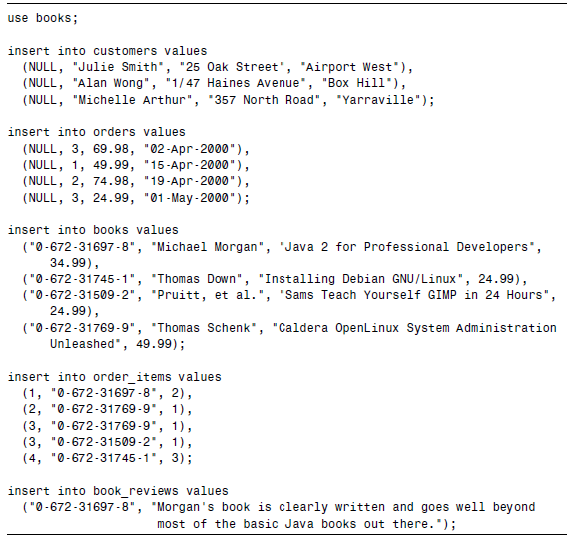
Inserting Data into the Database
We specified a NULL value for the customerid column when adding Julie Smith and ignored that column when adding the other customers.
  Earlier, we created customerid as the primary key for the Customers table, so this might seem strange. However, we specified the field as AUTOINCREMENT. This means that, if we insert a row with a NULL value or no value in this field, MySQL will generate the next number in the autoincrement sequence and insert it for us automatically.
  You can also insert multiple rows into a table at once. Each row should be in its own set of brackets, and each set of brackets should be separated by a comma.
CS 260 – Web Programming – Ch. 10

Slide 6
Retrieving Data from the Database
the SELECT statement
Used to retrieve data from DB by selecting rows that match specified criteria from a table. There are a lot of options and different ways to use the SELECT statement.
The basic form of a SELECT is
SELECT items
FROM tables
[ WHERE condition ]
[ GROUP BY group_type ]
[ HAVING where_definition ]
[ ORDER BY order_type ]
[LIMIT limit_criteria ] ;
Let’s look at a query that selects some items from a particular table. Typically, these items are columns from the table. (They can also be the results of any MySQL expressions.
select name, city
from customers;
+-----------------+--------------------+--------
| name | city |
+-----------------+--------------------+--------
| Julie Smith | Airport West |
| Alan Wong | Box Hill |
| Michelle Arthur | Yarraville |
| Melissa Jones | Nar Nar Goon North |
| Michael Archer | Leeton |
+-----------------+--------------------+--------
CS 260 – Web Programming – Ch. 10

Slide 7
Retrieving Data from the Database
You can specify as many columns as you like from a table by listing them out after the select keyword.
You can also specify some other items.
  One useful one is the wildcard operator, *, which matches all the columns in the specified table or tables.
  For example, to retrieve all columns and all rows from the order_items table, we would use
select *
from order_items;
  which will give the following output:
+---------+---------------+----------+
| orderid | isbn | quantity |
+---------+---------------+----------+
| 1 | 0-672-31697-8 | 2 |
| 2 | 0-672-31769-9 | 1 |
| 3 | 0-672-31769-9 | 1 |
| 3 | 0-672-31509-2 | 1 |
| 4 | 0-672-31745-1 | 3 |
+---------+---------------+----------+
CS 260 – Web Programming – Ch. 10

Slide 8
Retrieving Data with Specific Criteria
The WHERE clause
select *
from orders
where customerid = 3;
  will select all the columns from the orders table, but only the rows with a customerid of 3.
Here’s the output:
+---------+------------+--------+------------+
| orderid | customerid | amount | date |
+---------+------------+--------+------------+
| 1 | 3 | 69.98 | 0000-00-00|
| 4 | 3 | 24.99 | 0000-00-00|
+---------+------------+--------+------------+
The WHERE clause specifies the criteria used to select particular rows.
  In this case, we have selected rows with a customerid of 3.
  The single equal sign is used to test equality—note that this is different from PHP, and it’s easy to become confused when you’re using them together.
  In addition to equality, MySQL supports a full set of operators and regular expressions. The ones you will most commonly use in WHERE clauses are listed in Table on the next slide. Note that this is not a complete list—if you need something not listed here, check the MySQL manual.
CS 260 – Web Programming – Ch. 10

Slide 9

CS 260 – Web Programming – Ch. 10

Slide 10
Retrieving Data from Multiple Tables
if you wanted to know which customers placed orders this month
  you would need to look at the Customers table and the Orders table.
  If you also wanted to know what, specifically, they ordered, you would also need to look at the Order_Items table.
  These items are in separate tables because they relate to separate real-world objects. This is one of the principles of good database design.
To put this information together in SQL, you must perform an operation called a join.
  This simply means joining two or more tables together to follow the relationships between the data.
  For example, if we want to see the orders that customer Julie Smith has placed, we will need to look at the Customers table to find Julie’s CustomerID, and then at the Orders table for orders with that CustomerID.
  Although joins are conceptually simple, they are one of the more subtle and complex parts of SQL. Several different types of join are implemented in MySQL, and each is used for a different purpose.
Simple Two-Table Joins
select orders.orderid, orders.amount, orders.date
from customers, orders
where customers.name = ‘Julie Smith’
and customers.customerid = orders.customerid;
+---------+--------+------------+
| orderid | amount | date |
+---------+--------+------------+
| 2 | 49.99 | 0000-00-00 |
+---------+--------+------------+
CS 260 – Web Programming – Ch. 10

Slide 11
Retrieving Data from Multiple Tables
  We have also specified a type of join
INNER JOIN or CROSS JOIN
The comma between the names of the tables is equivalent to typing INNER JOIN or CROSS JOIN.
This is a type of join sometimes also referred to as a full join, or the Cartesian product of the tables.
It means, “Take the tables listed, and make one big table. The big table should have a row for each possible combination of rows from each of the tables listed, whether that makes sense or not.”
  That doesn’t make a lot of sense in most cases. Often what we want is to see the rows that really do match, that is, the orders placed by a particular customer matched up with that customer.
EQUI-JOIN
We achieve this by placing a join condition in the WHERE clause.
  This is a special type of conditional statement that explains which attributes show the relationship between the two tables.
  In this case, our join condition was
  customers.customerid = orders.customerid
  which tells MySQL to only put rows in the result table if the CustomerId from the Customers table matches the CustomerID from the Orders table.
  By adding this join condition to the query, we’ve actually converted the join to a different type, called an equi-join.
  You’ll also notice the dot notation we’ve used to make it clear which table a particular column comes from, that is, customers.customerid refers to the customerid column from the Customers table, and orders.customerid refers to the customerid column from the Orders table.
CS 260 – Web Programming – Ch. 10

Slide 12
Retrieving Data from Multiple Tables
This dot notation is required if the name of a column is ambiguous, that is, if it occurs in more than one table.
As an extension, it can also be used to disambiguate column names from different databases.
In our example, we have used a table.column notation. You can specify the database with a database.table.column notation, for example, to test a condition such as
books.orders.customerid = other_db.orders.customerid
  You can use the dot notation. This can be a good idea, particularly after your queries begin to become complex.
  MySQL doesn’t require it, but it does make your queries much more humanly readable and maintainable. You’ll notice that we have followed this convention in the rest of the previous query, for example, with the use of the condition for all column references in a query.
customers.name = ‘Julie Smith’
  The column name only occurs in the table customers, so we do not need to specify this, but it does make it clearer.
CS 260 – Web Programming – Ch. 10

Slide 13
Joining More Than Two Tables
As a general rule, you need to join tables in pairs with join conditions.
  Think of it as following the relationships between the data from table to table to table.
For example, if we want to know which customers have ordered books on Java (perhaps so we can send them information about a new Java book), we need to trace these relationships through quite a few tables.
  We need to find customers who have placed at least one order that included an order_item that is a book about Java.
  To get from the Customers table to the Orders table, we can use the customerid as we did previously.
  To get from the Orders table to the Order_Items table, we can use the orderid.
  To get from the Order_Items table to the specific book in the Books table, we can use the ISBN.
  After making all those links, we can test for books with Java in the title, and return the names of customers who bought any of those books.
  Let’s look at a query that does all those things:
select customers.name
from customers, orders, order_items, books
where customers.customerid = orders.customerid
and orders.orderid = order_items.orderid
and order_items.isbn = books.isbn
and books.title like ‘%Java%’;
  This query will return the following output:
+-----------------+
| name |
+-----------------+
| Michelle Arthur |
+-----------------+
We traced the data through four different tables, and to do this with an equi-join, we needed three different join conditions.
It is generally true that you need one join condition for each pair of tables that you want to join, and therefore a total of join conditions one less than the total number of tables you want to join.
This rule of thumb can be useful for debugging queries that don’t quite work.
CS 260 – Web Programming – Ch. 10

Slide 14
Finding Rows That Don’t Match
LEFT JOIN
In the previous examples, you’ll notice that only the rows where there was a match between the tables were included.
Sometimes we specifically want the rows where there’s no match—for example, customers who have never placed an order, or books that have never been ordered.
  The easiest way to answer this type of question in MySQL is to use a left join.
A left join will match up rows on a specified join condition between two tables.
  If there’s no matching row in the right table, a row will be added that contains NULL values in the right columns.
  Let’s look at an example:
  select customers.customerid, customers.name, orders.orderid
  from customers left join orders
  on customers.customerid = orders.customerid;
  This SQL query uses a left join to join Customers with Orders. You will notice that the left join uses a slightly different syntax for the join condition—in this case, the join condition goes in a special ON clause of the SQL statement.
  The result of this query is
  +------------+-----------------+-------------+
  | customerid | name | orderid |
  +------------+-----------------+-------------+
  | 1 | Julie Smith | 2 |
  | 2 | Alan Wong | 3 |
  | 3 | Michelle Arthur | 1 |
  | 3 | Michelle Arthur | 4 |
  | 4 | Melissa Jones | NULL |
  | 5 | Michael Archer | NULL |
  +------------+-----------------+--------------+
This output shows us that there are no matching orderids for customers Melissa Jones and Michael Archer because the orderids for those customers are NULLs.
CS 260 – Web Programming – Ch. 10

Slide 15
Finding Rows That Don’t Match
If we want to see only the customers who haven’t ordered anything, we can do this by checking for those NULLs in the primary key field of the right table (in this case orderid) as that should not be NULL in any real rows:
select customers.customerid, customers.name
from customers left join orders
using (customerid)
where orders.orderid is null;
The result is
+------------+--------------------+
| customerid | name |
+------------+--------------------+
| 4 | Melissa Jones |
| 5 | Michael Archer |
+------------+--------------------+
  You’ll also notice that we used a different syntax for the join condition in this example.
Left joins support either the ON syntax we used in the first example, or the USING syntax in the second example.
Notice that the USING syntax doesn’t specify the table from which the join attribute comes—for this reason, the columns in the two tables must have the same name if you want to use USING.
CS 260 – Web Programming – Ch. 10

Slide 16
Using Other Names for Tables: Aliases
You can create aliases at the start of a query and then use them throughout.
  They are often handy as shorthand.
  Consider the huge query we looked at earlier, rewritten with aliases:
select c.name
from customers as c, orders as o, order_items as oi, books as b
where c.customerid = o.customerid
and o.orderid = oi.orderid
and oi.isbn = b.isbn
and b.title like ‘%Java%’;
As we declare the tables we are going to use, we add an AS clause to declare the alias for that table.
  We can also use aliases for columns, but we’ll return to this when we look at aggregate functions in a minute.
We need to use table aliases when we want to join a table to itself.
  This sounds more difficult and esoteric than it is. It is useful, if, for example, we want to find rows in the same table that have values in common. If we want to find customers who live in the same city—perhaps to set up a reading group—we can give the same table (Customers) two different aliases:
select c1.name, c2.name, c1.city
from customers as c1, customers as c2
where c1.city = c2.city
and c1.name != c2.name;
  What we are basically doing is pretending that the table Customers is two different tables, c1 and c2, and performing a join on the City column.
  You will notice that we also need the second condition, c1.name != c2.name—this is to avoid each customer coming up as a match to herself.
CS 260 – Web Programming – Ch. 10

Slide 17
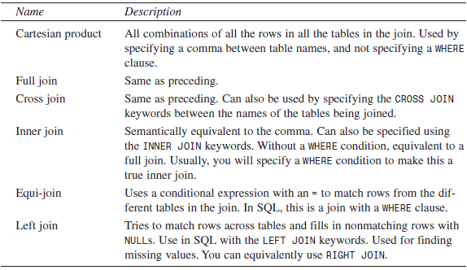
Summary of Joins
CS 260 – Web Programming – Ch. 10

Slide 18
Retrieving Data in a Particular Order
If you want to display rows retrieved by a query in a particular order, you can use the ORDER BY clause of the SELECT statement.
  Handy for presenting output in a good human-readable format.
The ORDER BY clause is used to sort the rows on one or more of the columns listed in the SELECT clause. For example,
select name, address
from customers
order by name;
This query will return customer names and addresses in alphabetical order by name, like this:
+-----------------+---------------------------+
| name | address |
+-----------------+---------------------------+
| Alan Wong | 1/47 Haines Avenue |
| Julie Smith | 25 Oak Street |
| Melissa Jones | |
| Michael Archer | 12 Adderley Avenue |
| Michelle Arthur | 357 North Road |
+-----------------+---------------------------+
  Notice that in this case, because the names are in firstname, lastname format, they are alphabetically sorted on the first name. If you wanted to sort on last names, you’d need to have them as two different fields.
  The default ordering is ascending (a to z or numerically upward). You can specify descending using the DESC keyword:
select name, address
from customers
order by name desc;
  You can sort on more than one column. You can also use column aliases or even their position numbers (for example, 3 is the third column in the table) instead of names.
CS 260 – Web Programming – Ch. 10

Slide 19
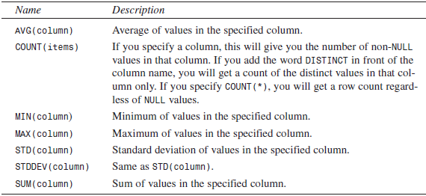
Grouping and Aggregating Data
We can calculate the average total of an order like this:
select avg(amount)
from orders;
The output will be something like this:
+-------------+
| avg(amount) |
+-------------+
| 54.985002 |
+-------------+
CS 260 – Web Programming – Ch. 10

Slide 20
Grouping and Aggregating Data
In order to get more detailed information, we can use the GROUP BY clause. This enables us to view the average order total by group—say, for example, by customer number. This will tell us which of our customers place the biggest orders:
select customerid, avg(amount)
from orders
group by customerid;
When you use a GROUP BY clause with an aggregate function, it actually changes the behavior of the function. Rather than giving an average of the order amounts across the table, this query will give the average order amount for each customer (or, more specifically, for each customerid):
+------------+-------------+
| customerid | avg(amount) |
+------------+-------------+
| 1 | 49.990002 |
| 2 | 74.980003 |
| 3 | 47.485002 |
+------------+-------------+
In ANSI SQL, if you use an aggregate function or GROUP BY clause, the only things that can appear in your SELECT clause are the aggregate function(s) and the columns named in the GROUP BY clause.
Also, if you want to use a column in a GROUP BY clause, it must be listed in the SELECT clause.
CS 260 – Web Programming – Ch. 10

Slide 21
Grouping and Aggregating Data
MySQL actually supports an extended syntax, which enables you to leave items out of the SELECT clause if you don’t actually want them.
In addition to grouping and aggregating data, we can actually test the result of an aggregate using a HAVING clause.
  This comes straight after the GROUP BY clause and is like a WHERE that applies only to groups and aggregates.
To extend our previous example, if we want to know which customers have an average order total of more than $50, we can use the following query:
select customerid, avg(amount)
from orders
group by customerid
having avg(amount) > 50;
Note that the HAVING clause applies to the groups. This query will return the following output:
+------------+-------------+
| customerid | avg(amount) |
+------------+-------------+
| 2 | 74.980003 |
+------------+-------------+
CS 260 – Web Programming – Ch. 10

Slide 22
Choosing Which Rows to Return
One clause of the SELECT statement that can be particularly useful in Web applications is the LIMIT clause.
  This is used to specify which rows from the output should be returned. It takes two parameters: the row number from which to start and the number of rows to return.
  This query illustrates the use of LIMIT:
  select name
  from customers
  limit 2, 3;
  This query can be read as, “Select name from customers, and then return 3 rows, starting from row 2 in the output.” Note that row numbers are zero indexed—that is, the first row in the output is row number zero.
  This is very useful for Web applications, such as when the customer is browsing through products in a catalog, and we want to show 10 items on each page.
CS 260 – Web Programming – Ch. 10

Slide 23
Subqueries
A query that is nested inside another query
  They introduce no new functionality, but they might be easier to write and implement
CS 260 – Web Programming – Ch. 10

Slide 24
Updating Records in the Database
In addition to retrieving data from the database, we often want to change it.
  For example, we might want to increase the prices of books in the database.
We can do this using an UPDATE statement. The usual form of an UPDATE statement is
UPDATE tablename
SET column1=expression1,column2=expression2,...
[WHERE condition]
[LIMIT number]
The basic idea is to update the table called tablename, setting each of the columns named to the appropriate expression.
You can limit an UPDATE to particular rows with a WHERE clause, and limit the total number of rows to affect with a LIMIT clause.
  If we want to increase all the book prices by 10%, we can use an UPDATE statement without a WHERE clause:
  update books
  set price=price*1.1;
  If, on the other hand, we want to change a single row—say, to update a customer’s address— we can do it like this:
  update customers
  set address = ‘250 Olsens Road’
  where customerid = 4;
CS 260 – Web Programming – Ch. 10

Slide 25
Altering Tables After Creation
We might want to alter the structure of the tables within your database.
For this purpose, you can use the flexible ALTER TABLE statement. The basic form of this statement is
ALTER TABLE tablename alteration [, alteration ...]
Note that in ANSI SQL you can make only one alteration per ALTER TABLE statement, but MySQL allows you to make as many as you like. Each of the alteration clauses can be used to change different aspects of the table.
The different types of alteration you can make with this statement are shown in the following slide.
CS 260 – Web Programming – Ch. 10

Slide 26
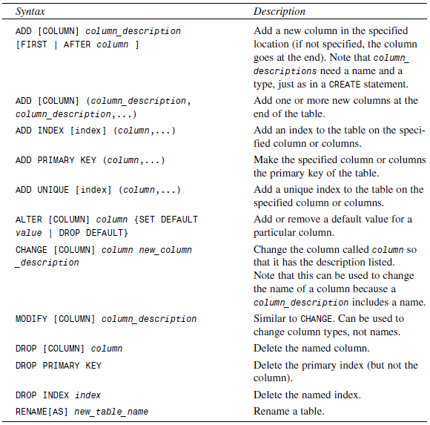
And a few more (see your text, page 263)
CS 260 – Web Programming – Ch. 10

Slide 27
Altering Tables After Creation
One thing that comes up frequently is the realization that you haven’t made a particular column “big enough” for the data it has to hold.
  For example, in our Customers table, we have allowed names to be 30 characters long. After we start getting some data, we might notice that some of the names are too long and are being truncated.
We can fix this by changing the data type of the column so that it is 45 characters long instead:
alter table customers
modify name char(45) not null;
Another common occurrence is the need to add a column.
  Imagine that a sales tax on books is introduced locally, and that Book-O-Rama needs to add the amount of tax to the total order, but keep track of it separately. We can add a tax column to the Orders table as follows:
alter table orders
add tax float(6,2) after amount;
Getting rid of a column is another case that comes up frequently. We can delete the column we just added as follows:
alter table orders
drop tax;
CS 260 – Web Programming – Ch. 10

Slide 28
Deleting Records from the Database
You can delete records using the DELETE statement, which generally looks like this:
DELETE FROM table
[WHERE condition] [LIMIT number]
If you write:
DELETE FROM table;
on its own, all the rows in a table will be deleted, so be careful!
  Usually, you want to delete specific rows, and you can specify the ones you want to delete with a WHERE clause.
  You might do this, if, for example, a particular book were no longer available, or if a particular customer hadn’t placed any orders for a long time, and you wanted to do some housekeeping:
  delete from customers
  where customerid=5;
The LIMIT clause can be used to limit the maximum number of rows that are actually deleted.
CS 260 – Web Programming – Ch. 10

Slide 29
Dropping Tables and Databases
At times you may want to get rid of an entire table. You can do this with the DROP TABLE statement :
DROP TABLE table;
This will delete all the rows in the table and the table itself, so be careful using it.
You can go even further and eliminate an entire database with the DROP DATABASE statement, which looks like this:
DROP DATABASE database;
This will delete all the rows, all the tables, all the indexes, and the database itself, so it goes without saying that you should be somewhat careful using this statement.
CS 260 – Web Programming – Ch. 10

