Slide 1
Advanced MySQL
Chapter 12
CS 260 – Web Programming – Ch. 12

Slide 2
Introduction
• Understanding the privilege system in detail
• Making your MySQL database secure
• Getting more information about databases
• Speeding things up with indexes
• Optimization tips
• Different table types
CS 260 – Web Programming – Ch. 12

Slide 3
Understanding the Privilege System in Detail
To set up users and grant them privileges, we used the GRANT command.
  If you’re going to administer a MySQL database, it can be useful to understand exactly what GRANT does and how it works.
When you issue a GRANT statement, it affects tables in the special database called mysql.
  Privilege information is stored in five tables in this database. Given this, when granting privileges on databases, you should be cautious about granting access to the mysql database.
  One side note is that the GRANT command is only available from MySQL version 3.22.11 onward.
We can look at what’s in the mysql database by logging in as an administrator and typing
use mysql;
If you do this, you can then view the tables in this database by typing
show tables;
+----------------+
| Tables in mysql|
+----------------+
| columns_priv |
| db |
| host |
| tables_priv |
| user |
+----------------+
CS 260 – Web Programming – Ch. 12

Slide 4
Understanding the Privilege System in Detail
Each of these tables stores information about privileges.
They are sometimes called grant tables.
  These tables vary in their specific function but all serve the same general function, which is to determine what users are and are not allowed to do.
Each of them contains two types of fields:
  scope fields, which identify the user, host, and part of a database; and
  privilege fields, which identify which actions can be performed by that user in that scope.
The user table is used to decide whether a user can connect to the MySQL server and whether she has any administrator privileges.
The db and host tables determine which databases the user can access.
The tables_priv table determines which tables within a database a user can use, and the columns_priv table determines which columns within tables they have access to.
CS 260 – Web Programming – Ch. 12

Slide 5
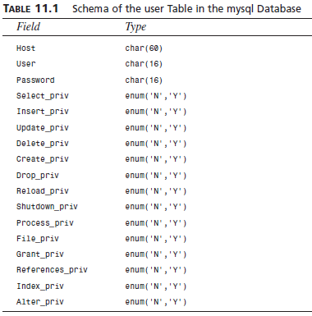
The user Table
This table contains details of global user privileges. It determines whether a user is allowed to connect to the MySQL server at all, and whether she has any global level privileges; that is, privileges that apply to every database in the system.
We can see the structure of this table by issuing a describe user; statement.
CS 260 – Web Programming – Ch. 12

Slide 6
The user Table
Each row in this table corresponds to a set of privileges for a user coming from a host and logging in with the password Password.
  These are the scope fields for this table, as they describe the scope of the other fields, called privilege fields.
The privileges listed in this table (and the others to follow) correspond to the privileges we granted using GRANT.
  For example, Select_priv corresponds to the privilege to run a SELECT command.
  If a user has a particular privilege, the value in that column will be Y. Conversely, if a user has not been granted that privilege, the value will be N.
All the privileges listed in the user table are global, that is, they apply to all the databases in the system (including the mysql database).
  Administrators will therefore have some Ys in there, but the majority of users should have all Ns. Normal users should have rights to appropriate databases, not all tables.
CS 260 – Web Programming – Ch. 12

Slide 7
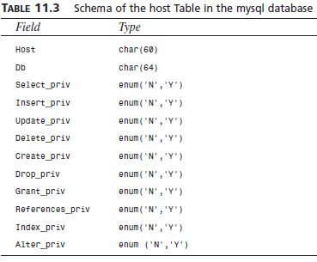
The db and host Tables
Most of your average users’ privileges are stored in the tables db and host.
The db table determines which users can access which databases from which hosts. The privileges listed in this table apply to whichever database is named in a particular row.
The host table supplements the db table. If a user is to connect to a database from multiple hosts, no host will be listed for that user in the db table. Instead, she will have a set of entries in the host table, one to specify the privileges for each user-host combination.
Schema of the db Table in the mysql Database
Field Type
Host char(60)
Db char(64)
User char(16)
Select_priv enum(‘N’,’Y’)
Insert_priv enum(‘N’,’Y’)
Update_priv enum(‘N’,’Y’)
Delete_priv enum(‘N’,’Y’)
Create_priv enum(‘N’,’Y’)
Drop_priv enum(‘N’,’Y’)
Grant_priv enum(‘N’,’Y’)
References_priv enum(‘N’,’Y’)
Index_priv enum(‘N’,’Y’)
Alter_priv enum(’N’,’Y’)
CS 260 – Web Programming – Ch. 12

Slide 8
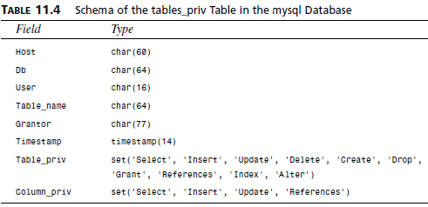
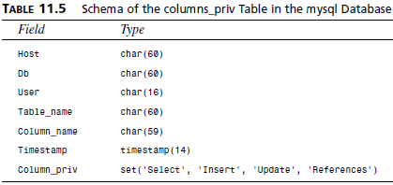
The tables_priv and columns_priv Tables
These two tables are used to store table-level privileges and column-level privileges
  They work like the db table, except that they provide privileges for tables within a specific database and columns within a specific table respectively.
  These tables have a slightly different structure to the user, db, and host tables
CS 260 – Web Programming – Ch. 12

Slide 9
Access Control: How MySQL Uses the Grant Tables
MySQL uses the grant tables to determine what a user is allowed to do in a two-stage process:
1. Connection verification.
  Here, MySQL checks whether you are allowed to connect at all, based on information from the user table, as shown previously. This is based on your username, hostname, and password. If a username is blank, it matches all users.
  Hostnames can be specified with a wildcard character (%). This can be used as the entire field—that is, % matches all hosts—or as part of a hostname, for example,
  %.cookiesandcreme.com
  matches all hosts ending in .cookiesandcreme.com. If the password field is blank, then no password is required.
  It’s more secure to avoid having blank users, wildcards in hosts, and users without passwords.
2. Request verification.
  Each time you enter a request, after you have established a connection, MySQL checks whether you have the appropriate level of privileges to perform that request. The system begins by checking your global privileges (in the user table) and if they are not sufficient, checks the db and host tables. If you still don’t have sufficient privileges, MySQL will check the tables_priv table, and, if this is not enough, finally it will check the columns_priv table.
CS 260 – Web Programming – Ch. 12

Slide 10
Updating Privileges: When Do Changes Take Effect?
The MySQL server automatically reads the grant tables when it is started, and when you issue GRANT and REVOKE statements.
We can also alter privileges manually, since we know where they are stored.
When you update them manually, the MySQL server will not notice that they have changed.
You need to point out to the server that a change has occurred, and there are three ways you can do this.
1. You can type
FLUSH PRIVILEGES;
at the MySQL prompt (you will need to be logged in as an administrator to do this). This is the most commonly used way of updating the privileges.
2 & 3. Alternatively, from your operating system, you can run either
mysqladmin flush-privileges
or
mysqladmin reload
  After this, global level privileges will be checked the next time a user connects; database privileges will be checked when the next use statement is issued; and table and column level privileges will be checked on a user’s next request.
CS 260 – Web Programming – Ch. 12

Slide 11
Making Your MySQL Database Secure
It’s a bad idea to run the MySQL server (mysqld) as root if you are running a UNIX-like operating system.
  This gives a MySQL user with a full set of privileges the right to read and write files anywhere in the operating system.
  This is an important point, easily overlooked, which was famously used to hack Apache’s Web site.
It’s a good idea to set up a MySQL user specifically for this purpose.
In addition, you can then make the directories (where the physical data is stored) accessible only by the MySQL user.
  In many installations, the server is set up to run as userid mysql, in the mysql group.
You should also set up your MySQL server behind your firewall. This way you can stop connections from unauthorized machines
  check and see whether you can connect from outside to your server on port number 3306. This is the default port that MySQL runs on, and should be closed on your firewall.
CS 260 – Web Programming – Ch. 12

Slide 12
Passwords
Make sure that all your users have passwords (especially root!)
  Make sure passwords are well chosen and regularly changed.
  The basic rule to remember here is that passwords that are or contain words from a dictionary are a bad idea. Combinations of letters and numbers are best.
If you are going to store passwords in script files, then make sure only the user whose password is stored can see that script. The two main places this can arise are
1. In the mysql.server script, you might need to use the UNIX root password.
  If this is the case, make sure only root can read this script.
2. In PHP scripts that are used to connect to the database
  you will need to store the password for that user.
  This can be done securely by putting the login and password in a file called, for example, dbconnect.php, that you then include when required. This script can be stored outside the Web document tree and made accessible only to the appropriate user.
  Remember that if you put these details in a .inc or some other extension file in the Web tree, you must be careful to check that your Web server knows these files must be interpreted as PHP so that the details cannot be viewed in a Web browser.
Don’t store passwords in plain text in your database.
  MySQL passwords are not stored that way, but commonly in Web applications you additionally want to store Web site member’s login names and passwords.
You can encrypt passwords (one-way) using MySQL’s PASSWORD() or MD5() functions.
  Remember that if you INSERT a password in one of these formats when you run a SELECT (to try and log a user in), you will need to use the same function again to check the password a user has typed.
CS 260 – Web Programming – Ch. 12

Slide 13
User Privileges
Don’t grant more privileges to any user than she needs.
  You can check this by looking at the grant tables.
In particular, don’t grant the PROCESS, FILE, SHUTDOWN, and RELOAD privileges to any user other than an administrator unless absolutely necessary.
  The PROCESS privilege can be used to see what other users are doing and typing, including their passwords. The FILE privilege can be used to read and write files to and from the operating system (including, say, /etc/password on a UNIX system). The GRANT privilege should also be granted with caution as this allows users to share their privileges with others.
Make sure that when you set up users, you only grant them access from the hosts that they will be connecting from.
  If you have jane@localhost as a user, that’s fine, but plain jane is pretty common and could log in from anywhere—and she might not be the jane you think she is.
Avoid using wildcards in hostnames for similar reasons.
You can further increase security by using IPs rather than domain names in your host table.
  This avoids problems with errors or crackers at your DNS. You can enforce this by starting the MySQL daemon with the --skip-name-resolve option, which means that all host column values must be either IP addresses or localhost.
Another alternative is to start mysqld with the --secure option.
  This checks resolved IPs to see whether they resolve back to the hostname provided. (This is on by default from 3.22)
You should also prevent non-administrative users from having access to the mysqladmin program on your Web server.
  Because this runs from the command line, it is an issue of operating system privilege.
CS 260 – Web Programming – Ch. 12

Slide 14
Web Issues
It’s not a bad idea to setup a special user just for the purpose of Web connections.
This way you can give them the minimum privilege necessary and not grant, for example, DROP, ALTER, or CREATE privileges to that user.
  You might grant SELECT only on catalog tables, and INSERT only on order tables. Again, follow the principle of least privilege.
CAUTION!!!
It’s important to remember to use PHP’s addslashes() and stripslashes() functions to get rid of any problematic characters in strings, and to do a general data clean up before sending anything to MySQL.
Always use the doubleval() function to check that the numeric data was really numeric. It’s a common error to forget this—people remember to use addslashes() but not to check numeric data.
You should always check all data coming in from a user !!!
  Even if your HTML form consisted of select boxes and radio buttons, someone might alter the URL to try to crack your script. It’s also worth checking the size of the incoming data. If users are typing in passwords or confidential data to be stored in your database, remember that it will be transmitted from the browser to the server in plain text unless you use SSL.
CS 260 – Web Programming – Ch. 12

Slide 15

Getting Information with SHOW
Previously we had used SHOW TABLES; to get a list of tables in the database.
The statement show databases; will display a list of available databases. You can then use the SHOW TABLES statement to see a list of tables in one of those databases:
show tables from books;
  When you use SHOW TABLES without specifying a database, it defaults to the one in use.
  When you know what the tables are, you can get a list of the columns:
show columns from orders from books;
  If you leave the database parameter off, the SHOW COLUMNS statement will default to the database currently in use. You can also use the table.column notation:
show columns from books.orders;
  One other very useful variation of the SHOW statement can be used to see what privileges a user has. For example, if we run the following, we’ll get the output shown in Figure 11.1:
show grants for bookorama;
  The GRANT statements shown are not necessarily the ones that were executed to give privileges to a particular user, but rather summary equivalent statements that would produce the user’s current level of privilege.
CS 260 – Web Programming – Ch. 12

Slide 16
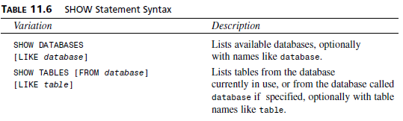
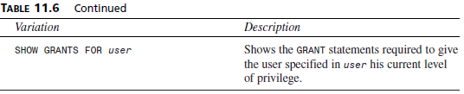
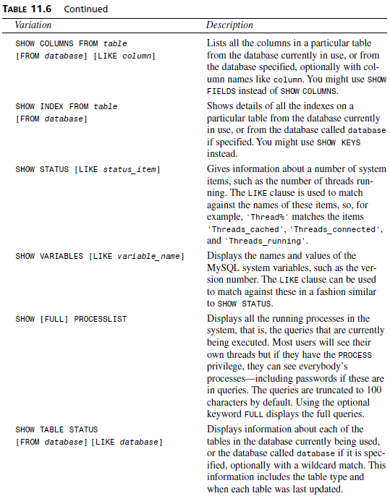
CS 260 – Web Programming – Ch. 12

Slide 17
Getting Information About Columns with DESCRIBE
As an alternative to the SHOW COLUMNS statement, you can use the DESCRIBE statement, similar to the DESCRIBE statement in Oracle (another RDBMS). The basic syntax for it is
DESCRIBE table [column];
This will give information about all the columns in the table or a specific column if column is specified. You can use wildcards in the column name if you like.
CS 260 – Web Programming – Ch. 12

Slide 18

Understanding How Queries Work with EXPLAIN
The EXPLAIN statement can be used in two ways.
First, you can use
EXPLAIN table;
  This gives very similar output to DESCRIBE table or SHOW COLUMNS FROM table.
The second and more interesting way you can use EXPLAIN allows you to see exactly how MySQL evaluates a SELECT query.
  To use it this way, just put the word explain in front of a SELECT statement.
  You can use the EXPLAIN statement when you are trying to get a complex query to work and clearly haven’t got it quite right, or when a query’s taking a lot longer to process than it should. If you are writing a complex query, you can check this in advance by running the EXPLAIN command before you actually run the query. With the output from this statement, you can rework your SQL to optimize it if necessary. It’s also a handy learning tool.
  For example, try running the following query on the Book-O-Rama database. It produces the output shown in Figure 11.2.
explain
select customers.name
from customers, orders, order_items, books
where customers.customerid = orders.customerid
and orders.orderid = order_items.orderid
and order_items.isbn = books.isbn
and books.title like ‘%Java%’;
CS 260 – Web Programming – Ch. 12

Slide 19
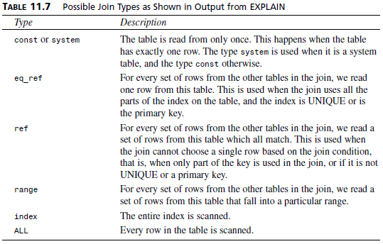
Understanding How Queries Work with EXPLAIN
The type column explains how the table is being used in joins in the query.
  The set of values this column can have is shown in Table 11.7.
  These values are listed in order from fastest to slowest in terms of query execution. It gives you an idea of how many rows need to be read from each table in order to execute a query.
CS 260 – Web Programming – Ch. 12

Slide 20
Understanding How Queries Work with EXPLAIN
In the previous example, one of the tables is joined using eq_ref (books), and one is joined using ref (order_items), but the other two (orders and customers) are joined by using ALL; that is, by looking at every single row in the table.
  The rows column backs this up—it lists (roughly) the number of rows of each table that has to be scanned to perform the join. You can multiply these together to get the total number of rows examined when a query is performed. We multiply these numbers because a join is like a product of rows in different tables. Remember that this is the number of rows examined, not the number of rows returned, and that it is only an estimate—MySQL can’t know the exact number without performing the query.
  Obviously, the smaller we can make this number, the better. When the database starts to increase in size, this query would blow out in execution time.
  The possible_keys column lists, as you might expect, the keys that MySQL might use to join the table. In this case, you can see that the possible keys are all PRIMARY keys.
  The key column is either the key from the table MySQL actually used, or NULL if no key was used. Although there are possible PRIMARY keys for the orders and customers tables, they were not used in this query.
  The key_len column indicates the length of the key used. You can use this to tell whether only part of a key was used. This is relevant when you have keys that consist of more than one column.
    In this case, where the keys were used (order_items and books), the full key was used.
    The ref column shows the columns used with the key to select rows from the table.
  Finally, the Extra column tells you any other information about how the join was performed.
CS 260 – Web Programming – Ch. 12

Slide 21
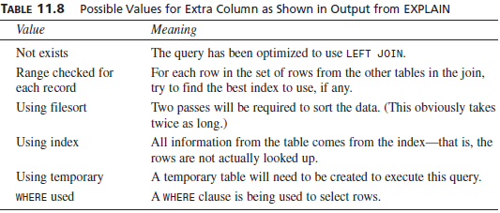
Understanding How Queries Work with EXPLAIN
There are several ways you can fix problems you spot in the output from EXPLAIN.
First, check column types and make sure they are the same.
  This applies particularly to column width. Indexes can’t be used to match columns if they have different widths. You can fix this by changing the types of columns to match, or building this in to your design to begin with.
Second, you can tell the join optimizer to examine key distributions and therefore optimize joins more efficiently using the myisamchk utility.
  You can invoke this by typing
>myisamchk --analyze pathtomysqldatabase/table
  You can check multiple tables by listing them all on the command line, or by using
>myisamchk --analyze pathtomysqldatabase/*.MYI
  You can check all tables in all databases by running the following, which will produce the output shown in Figure 11.3:
>myisamchk --analyze pathtomysqldatadirectory/*/*.MYI
CS 260 – Web Programming – Ch. 12

Slide 22

Understanding How Queries Work with EXPLAIN
  You’ll notice that the way the query is evaluated has changed quite a lot. We’re now only using all the rows in one of the tables (books), which is fine. In particular, we’re now using eq_ref for two of the tables and index for the other. MySQL is also now using the whole key for order_items (17 characters as opposed to 4 previously).
  You’ll also notice the number of rows being used has actually gone up. This is probably caused by the fact that we have little data in the actual database at this point. Remember that the number of rows listed is only an estimate—try performing the actual query and checking this. If these numbers are way off, the MySQL manual suggests using a straight join and listing the tables in your FROM clause in a different order.
Third, you might want to consider adding a new index to the table. If this query is a) slow, and b) common, you should seriously consider this. If it’s a one-off query that you’ll never use again, such as an obscure report requested once, it won’t be worth the effort, as it will slow other things down. We’ll look at how to do this in the next section.
CS 260 – Web Programming – Ch. 12

Slide 23
General Optimization Tips
Speeding Up Queries with Indexes
If you are in the situation mentioned previously, in which the possible_keys column from an EXPLAIN contains some NULL values, you might be able to improve the performance of your query by adding an index to the table in question.
If the column you are using in your WHERE clause is suitable for indexing, you can create a new index for it using ALTER TABLE:
ALTER TABLE table ADD INDEX (column);
Design Optimization
Basically you want everything in your database to be as small as possible.
  You can achieve this in part with a decent design that minimizes redundancy.
  You can also achieve it by using the smallest possible data type for columns.
  You should also minimize NULLs wherever possible, and make your primary key as short as possible.
  Avoid variable length columns if at all possible (like VARCHAR, TEXT, and BLOB). If your tables have fixed-length fields they will be faster to use but might take up a little more space.
Permissions
In addition to using the suggestions mentioned in the previous section on EXPLAIN, you can improve the speed of queries by simplifying your permissions.
  We discussed earlier the way that queries are checked with the permission system before being executed. The simpler this process is, the faster your query will run.
CS 260 – Web Programming – Ch. 12

Slide 24
General Optimization Tips
Table Optimization
If a table has been in use for a period of time, data can become fragmented as updates and deletions are processed.
  This will increase the time taken to find things in this table. You can fix this by using the statement
  OPTIMIZE TABLE tablename;
  or by typing the following at the command prompt:
  >myisamchk -r table
  You can also use the myisamchk utility to sort a table index and the data according to that index:
  >myisamchk --sort-index --sort-records=1 pathtomysqldatadirectory/*/*.MYI
Using Indexes
Use indexes where required to speed up your queries.
  Keep them simple, and don’t create indexes that are not being used by your queries.
  You can check which indexes are being used by running EXPLAIN as shown previously.
Use Default Values
Wherever possible, use default values for columns, and only insert data if it differs from the default. This reduces the time taken to execute the INSERT statement.
Use Persistent Connections
This particular optimization tip applies particularly to Web databases.
CS 260 – Web Programming – Ch. 12

Slide 25
Different Table Types
You can choose a table type when you create a table, using
CREATE TABLE table TYPE=type ....
The possible table types are
MyISAM. This is the default, and what we have used to date. This is based on ISAM, which stands for Indexed Sequential Access Method, a standard method for storing records and files.
HEAP. Tables of this type are stored in memory, and their indexes are hashed. This makes HEAP tables extremely fast, but, in the event of a crash, your data will be lost. These characteristics make HEAP tables ideal for storing temporary or derived data. You should specify the MAX_ROWS in the CREATE TABLE statement, or these tables can hog all your memory. Also, they cannot have BLOB, TEXT, or AUTO INCREMENT columns.
BDB. These tables are transaction safe; that is, they provide COMMIT and ROLLBACK capabilities. They are slower to use than the MyISAM tables, and are based on the Berkeley DB.
These additional table types can be useful when you are striving for extra speed or transactional safety.
CS 260 – Web Programming – Ch. 12

Slide 26
Loading Data from a File
The LOAD DATA INFILE statement.
This can be used to load table data in from a file. It executes very quickly.
This is a flexible command with many options, but typical usage is something like the following:
LOAD DATA INFILE “newbooks.txt” INTO TABLE books;
This will read row data from the file newbooks.txt into the table books.
  By default, data fields in the file must be separated by tabs and enclosed in single quotes, and each row must be separated by a newline (\n).
  Special characters must be escaped out with a slash (\).
  All these characteristics are configurable with the various options of the LOAD statement—see the MySQL manual for more details.
To use the LOAD DATA INFILE statement, a user must have the FILE privilege discussed earlier.
CS 260 – Web Programming – Ch. 12

