Slide 1
Storing and Retrieving Data
Chapter 2
CS 260 – Web Programming – Ch. 2

Slide 2
Topics
Saving data for later
Opening a file
Creating and writing to a file
Closing a file
Reading from a file
File locking
Deleting files
Other useful file functions
Doing it a better way: database management systems
CS 260 – Web Programming – Ch. 2

Slide 3
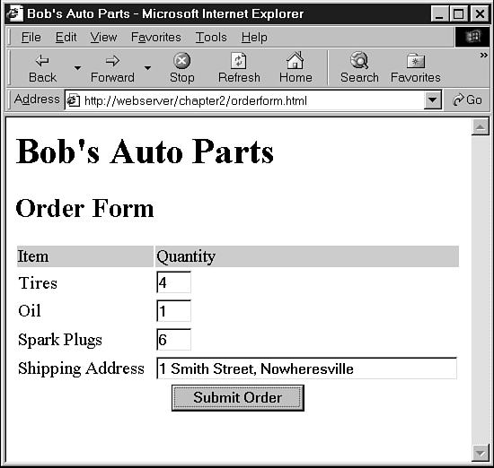
Saving Data for Later
In a file or in a Database
CS 260 – Web Programming – Ch. 2

Slide 4
Overview of File Processing
There are three steps to writing data to a file:
  1. Open the file. If the file doesn’t already exist, it will need to be created.
  2. Write the data to the file.
  3. Close the file.
Similarly, there are three steps to reading data from a file:
  1. Open the file. If the file can’t be opened (for example, if it doesn’t exist), we need to recognize this and exit gracefully.
  2. Read data from the file.
  3. Close the file.
CS 260 – Web Programming – Ch. 2

Slide 5
Opening a File
fopen()
$fp = fopen(“$DOCUMENT_ROOT/../orders/orders.txt”, “w”);
$DOCUMENT_ROOT
  This variable points at the base of the document tree on your Web server. We’ve used the “..” to mean “the parent directory of the $DOCUMENT_ROOT directory
You could also specify an absolute path to the file
  However, this makes our code less portable
If no path is specified:
  the file will be created or looked for in the same directory as the script itself.
CS 260 – Web Programming – Ch. 2

Slide 6
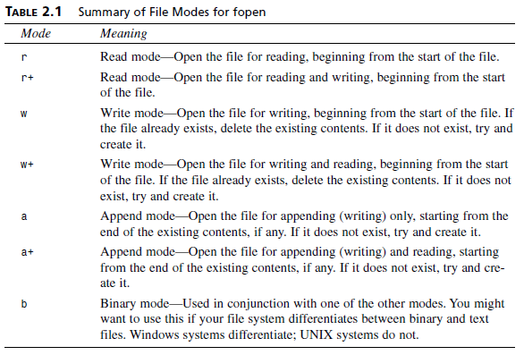
Opening a File
File mode
Also, “x” and “x+”
CS 260 – Web Programming – Ch. 2

Slide 7
Opening a File
The third parameter of fopen() is optional.
  You can use it if you want to search the include_path (set in your PHP configuration—see Appendix A, “Installing PHP and MySQL”) for a file.
  If you want to do this, set this parameter to 1. If you tell PHP to search the include_path, you do not need to provide a directory name or path:
$fp = fopen(“orders.txt”, “a”, 1);
If fopen()opens the file successfully, a pointer to the file is returned and should be stored in a variable, in this case $fp.
  You will use this variable to access the file when you actually want to read from or write to it.
CS 260 – Web Programming – Ch. 2

Slide 8
Opening a File
If the filename you use begins with ftp://:
  a passive mode FTP connection will be opened to the server you specify and a pointer to the start of the file will be returned.
If the filename you use begins with http://:
  an HTTP connection will be opened to the server you specify and a pointer to the response will be returned.
  When using HTTP mode, you must specify trailing slashes on directory names, as shown in the following:
    http://www.server.com/
  not
    http://www.server.com
  When you specify the latter form of address (without the slash), a Web server will normally use an HTTP redirect to send you to the first address (with the slash). Try it in your browser.
  The fopen() function does not support HTTP redirects, so you must specify URLs that refer to directories with a trailing slash.
CS 260 – Web Programming – Ch. 2

Slide 9
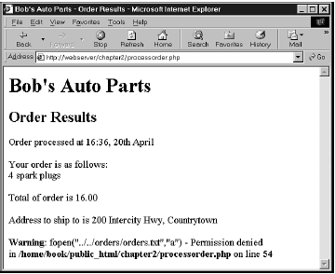
Problems Opening Files
A common error you might make while trying to open a file is trying to open a file you don’t have permission to read or write to.
If you get this error, you need to make sure that the user that the script runs as has permission to access the file you are trying to use.
CS 260 – Web Programming – Ch. 2

Slide 10
Problems Opening Files
If the call to fopen() fails, the function will return false. You can deal with the error in a more user-friendly way by suppressing PHP’s error message and giving your own:
@ $fp = fopen(“$DOCUMENT_ROOT/../orders/orders.txt”, “a”, 1);
if (!$fp)
{
echo “<p><strong> Your order could not be processed at this time. “.”Please try again later.</strong></p></body></html>”;
exit;
}
The @ symbol in front of the call to fopen() tells PHP to suppress any errors resulting from the function call.
  Usually it’s a good idea to know when things go wrong, but in this case we’re going to deal with that elsewhere.
CS 260 – Web Programming – Ch. 2

Slide 11
Writing to a File
fwrite()
  fputs() is an alias for fwrite()
  fwrite($fp, $outputstring, int [length]);
  Since PHP 5:
  int file_put_contents( string filename, string data,
  [, int flags [, resource context]] )
  No need for fopen() or fclose()!
CS 260 – Web Programming – Ch. 2

Slide 12
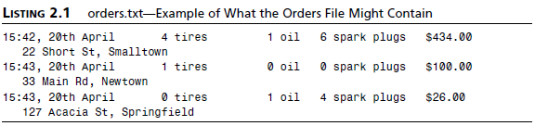
File formats
$outputstring = $date.”\t”.$tireqty.” tires t”.$oilqty.” oil\t” .$sparkqty.” spark plugs\t\$”.$total.”\t”. $address.”\n”;
Closing a File
  When you’ve finished using a file, you need to close it. You should do this with the fclose() function as follows:
fclose($fp);
CS 260 – Web Programming – Ch. 2

Slide 13
Reading from a File
LISTING 2.2 vieworders.php—Staff Interface to the Orders File
<html>
<head> <title>Bob’s Auto Parts - Customer Orders</title>
</head>
<body>
<h1>Bob’s Auto Parts</h1>
<h2>Customer Orders</h2>
<?php
@ $fp = fopen(“$DOCUMENT_ROOT/../orders/orders.txt”, “r”);
if (!$fp) {
echo “<p><strong>No orders pending.”.”Please try again later.</strong></p></body></html>”;
exit;
}
while (!feof($fp)) {
$order= fgets($fp, 100);
echo $order.”<br>”;
}
fclose($fp);
?>
</body>
</html>
CS 260 – Web Programming – Ch. 2

Slide 14
Reading from a File
Reading a Line at a Time: fgets(), fgetss(), and fgetcsv()
  $order= fgets($fp, 100);
  string fgetss(resource fp, int length, string [allowable_tags]);
    Strips out any PHP and HTML tags (except allowable ones)
  array fgetcsv(resource fp, int length[, string delimiter[, string enclosure]]);
    Breaks up a line into array elements (separated by a delimiter)
  Example:
    $order = fgetcsv($fp, 100, “\t”);
CS 260 – Web Programming – Ch. 2

Slide 15
Reading from a File
Reading the Whole File: readfile(), fpassthru(), file(), file_get_contents
int readfile(string filename[, int use_include_path]);
  opens the file, echoes the content to standard output (the browser), and then closes the file
  e.g., readfile(“$DOCUMENT_ROOT/../orders/orders.txt”);
$fp = fopen(“$DOCUMENT_ROOT/../orders/orders.txt”, “r”);
fpassthru($fp);
  dump the contents of the file from the pointer’s position onward to standard output. It closes the file when it is finished
$filearray = file($fp);
  Identical to readfile() except that instead of echoing the file to standard output, it turns it into an array.
file_get_contents()
  Identical to readfile(), except it returns file content as a string
CS 260 – Web Programming – Ch. 2

Slide 16
Reading from a File
Reading a Character: fgetc()
  while (!feof($fp)) {
  $char = fgetc($fp);
  if (!feof($fp))
  echo ($char==”\n” ? “<br>”: $char);
  }
  A minor side effect of using fgetc() instead of fgets() is that it will return the EOF character whereas fgets() will not.
  We need to test feof() again after we’ve read the character because we don’t want to echo the EOF to the browser.
Reading an Arbitrary Length: fread()
string fread(int fp, int length);
  read up to length bytes or to the end of file, whichever comes first.
CS 260 – Web Programming – Ch. 2

Slide 17
Other Useful File Functions
file_exists()
  if (file_exists(“$DOCUMENT_ROOT/../orders/orders.txt”))
  echo “There are orders waiting to be processed.”;
  else
  echo “There are currently no orders.”;
filesize() (in bytes)
  $fp = fopen(“$DOCUMENT_ROOT/../orders/orders.txt”, “r”);
  echo fread( $fp, filesize(“$DOCUMENT_ROOT/../orders/orders.txt” ));
  fclose( $fp );
unlink() (delete a file)
  unlink(“$DOCUMENT_ROOT/../orders/orders.txt”);
  Returns a Bool
CS 260 – Web Programming – Ch. 2

Slide 18
Navigating Inside a File
rewind()
  resets the file pointer to the beginning of the file.
ftell()
  reports how far into the file the pointer is in bytes
fseek()
  int fseek (resource fp, int offset [, int whence])
  can be used to set the file pointer to some point within the file
echo “Final position of the file pointer is “.(ftell($fp));
echo “<br>”;
rewind($fp);
echo “After rewind, the position is “.(ftell($fp));
echo “<br>”;
CS 260 – Web Programming – Ch. 2

Slide 19
File Locking
bool flock(resource fp, int operation [,int &wouldblock]);
CAREFUL! Not all systems allow locks!!!
$fp = fopen(“$DOCUMENT_ROOT/../orders/orders.txt”, “a”, 1);
flock($fp, 2); // lock the file for writing
fwrite($fp, $outputstring);
flock($fp, 3); // release write lock
fclose($fp);
You should also add locks to vieworders.php:
$fp = fopen(“$DOCUMENT_ROOT /../orders/orders.txt”, “r”);
flock($fp, 1); // lock file for reading
// read from the file
flock($fp, 3); // release read lock
fclose($fp);
Value of operation | meaning
LOCK_SH (1) | Reading (shared)
LOCK_EX (2) | Writing (exclusive)
LOCK_UN (3) | Release lock
LOCK_NB (4) | Blocking is prevented
CS 260 – Web Programming – Ch. 2

Slide 20
Problems with Using Flat Files
When a file gets large, it can be very slow to work with.
Searching for a particular record or group of records in a flat file is difficult.
Dealing with concurrent access can become problematic.
Random access to a record is difficult
Beyond the limits offered by file permissions, there is no easy way of enforcing different levels of access to data.
CS 260 – Web Programming – Ch. 2

Slide 21
Doing It a Better Way: Database Management Systems
Relational database management systems address all of previous issues:
  RDBMSs can provide faster access to data than flat files. And MySQL, the database system we use in this book, has some of the fastest benchmarks of any RDBMS.
  RDBMSs can be easily queried to extract sets of data that fit certain criteria.
  RDBMSs have built-in mechanisms for dealing with concurrent access so that you as a programmer don’t have to worry about it.
  RDBMSs provide random access to your data.
  RDBMSs have built-in privilege systems. MySQL has particular strengths in this area.
CS 260 – Web Programming – Ch. 2

