Slide 1
Managing the Date and Time
Chapter 21
CS 275 – Web Programming – Ch. 21

Slide 2
Introduction
• Getting the date and time in PHP
• Converting between PHP and MySQL date formats
• Calculating dates
• Using the calendar functions
CS 275 – Web Programming – Ch. 21

Slide 3
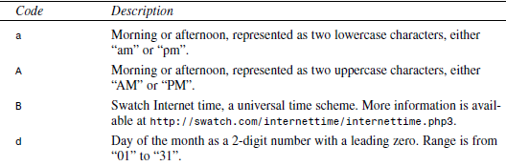
Getting the Date and Time from PHP
Using the date() Function
The date() function takes two parameters, one of them optional. The first one is a format string, and the second, optional one is a UNIX time stamp. If you don't specify a time stamp, then date() will default to the current date and time. It returns a formatted string representing the appropriate date.
A typical call to the date function could be
echo date(“jS F Y”);
This will produce a date of the format “27th August 2000”.
The format codes accepted by date are listed in the Table below:
CS 275 – Web Programming – Ch. 21

Slide 4
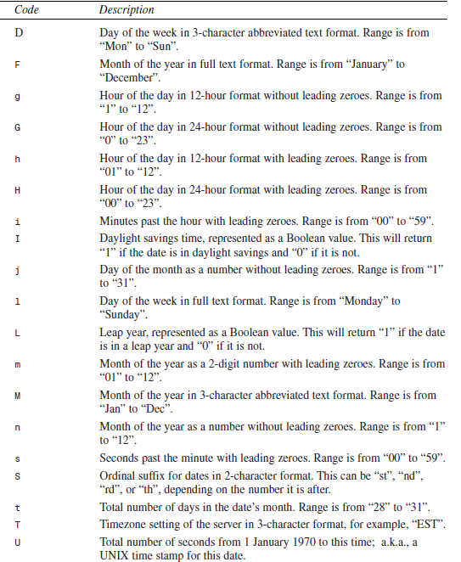
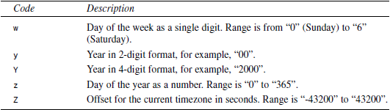
CS 275 – Web Programming – Ch. 21

Slide 5
Dealing with UNIX Time Stamps
The second parameter to the date() function is a UNIX time stamp.
Most UNIX systems store the current time and date as a 32-bit integer containing the number of seconds since midnight, January 1, 1970, GMT
  also known as the UNIX Epoch.
  This can seem a bit esoteric if you are not familiar with it, but it's a standard.
UNIX timestamps are a compact way of storing a date and time
  it is worth noting that they do not suffer from the year 2000 (Y2K) problem that affects some other compact or abbreviated date formats.
  If your software is still in use in 2038, there will be similar problems though. As timestamps do not have a fixed size, but are tied to the size of a C long, which is at least 32 bits, the most likely solution is that by 2038, your compiler will use a larger type.
Even if you are running PHP on a Windows server, this is still the format that is used by date() and a number of other PHP functions.
If you want to convert a date and time to a UNIX time stamp, you can use the mktime() function:
int mktime (int hour, int minute, int second, int month, int day, int year [, int is_dst])
  The parameters are fairly self-explanatory, with the exception of the last one, is_dst, which represents whether the date was in daylight savings time or not. You can set this to 1 if it was, 0 if it wasn't, or -1 (the default value) if you don't know. This is optional so you will rarely use it anyway.
CS 275 – Web Programming – Ch. 21

Slide 6
Dealing with UNIX Time Stamps
The main trap to avoid with this function is that the parameters are in a fairly unintuitive order.
The ordering doesn't lend itself to leaving out the time.
  If you are not worried about the time, you can pass in 0s to the hour, minute, and second parameters.
  You can, however, leave out values from the right side of the parameter list.
  If you leave the parameters blank, they will be set to the current values. Hence a call such as
  $timestamp = mktime();
  will return the UNIX time stamp for the current date and time. You could, of course, also get this by calling
  $timestamp = date(“U”);
You can pass in a 2- or 4-digit year to mktime(). Two-digit values from 0 to 69 will be interpreted as the years 2000 to 2069, and values from 70 to 99 will be interpreted as 1970 to 1999.
CS 275 – Web Programming – Ch. 21

Slide 7
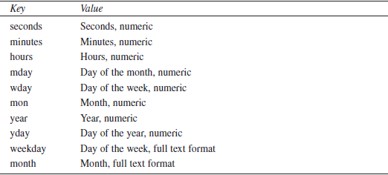
Using the getdate() Function
Another date-determining function you might find useful is the getdate() function. This function has the following prototype:
array getdate (int timestamp)
It takes a time stamp as parameter and returns an associative array representing the parts of that date and time as shown in the Table below:
CS 275 – Web Programming – Ch. 21

Slide 8
Validating Dates
You can use the checkdate() function to check whether a date is valid. This is especially useful for checking user input dates. The checkdate() function has the following prototype:
int checkdate (int month, int day, int year)
It will check whether the year is a valid integer between 0 and 32767, whether the month is an integer between 1 and 12, and whether the day given exists in that particular month. The function takes leap years into consideration.
For example,
checkdate(9, 18, 1972);
will return true while
checkdate(9, 31, 2000)
will not.
CS 275 – Web Programming – Ch. 21

Slide 9
Formatting Timestamps
You can format a timestamp according to the system's locale using the strftime function:
strftime(string $format [, int $timestamp]);
If no timestamp is passed in, the local system timestamp is used (when the script is run)
<?php
echo strftime('%A<br />');
echo strftime('%x<br />');
echo strftime('%c<br />');
echo strftime('%Y<br />');
?>
Output:
Friday
03/23/10
03/23/10 17:34:55
2010
A complete list of formatting codes is in our text, on page 475.
CS 275 – Web Programming – Ch. 21

Slide 10
Converting Between PHP and MySQL Date Formats
Dates and times in MySQL are retrieved in a slightly different way than you might expect.
Times work relatively normally, but MySQL expects dates to be entered year first.
  For example, the 29th of August 2000 could be entered as either 2000-08-29 or as 00-08-29. Dates retrieved from MySQL will also be in this order by default.
To communicate between PHP and MySQL then, we usually need to perform some date conversion. This can be done at either end.
When putting dates into MySQL from PHP, you can easily put them into the correct format using the date() function as shown previously.
  One minor caution is that you should use the versions of the day and month with leading zeroes to avoid confusing MySQL.
If you choose to do the conversion in MySQL, two useful functions are DATE_FORMAT() and UNIX_TIMESTAMP().
The DATE_FORMAT() function works similarly to the PHP one but uses different format codes.
  The most common thing we want to do is format a date in MM-DD-YYYY format rather than in the YYYY-MM-DD format native to MySQL. You can do this by writing your query as follows:
  SELECT DATE_FORMAT(date_column, '%m %d %Y')
  FROM tablename;
  The format code %m represents the month as a 2-digit number; %d, the day as a 2-digit number; and %Y, the year as a 4-digit number. A summary of the more useful MySQL format codes for this purpose is shown in the Table on the following slide:
CS 275 – Web Programming – Ch. 21

Slide 11
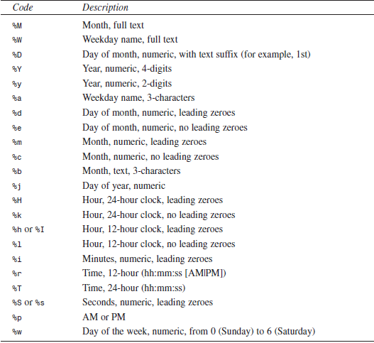
Converting Between PHP and MySQL Date Formats
The UNIX_TIMESTAMP function works similarly, but converts a column into a UNIX time stamp.
  For example,
  SELECT UNIX_TIMESTAMP(date_column)
  FROM tablename;
  will return the date formatted as a UNIX time stamp. You can then do as you will with it in PHP.
  As a rule of thumb, use a UNIX timestamp for date calculations and the standard date format when you are just storing or showing dates. It is simpler to do date calculations and comparisons with the UNIX timestamp.
CS 275 – Web Programming – Ch. 21

Slide 12
Date Calculations
The simplest way to work out the length of time between two dates in PHP is to use the difference between UNIX time stamps. We have used this approach in the following script :
//calc_age.php—Script Works Out a Person's Age Based on His Birthdate
<?php
// set date for calculation
$day = 18;
$month = 9;
$year = 1972;
// remember you need bday as day month and year
$bdayunix = mktime (“”, “”, “”, $month, $day, $year); // get unix ts for bday
$nowunix = time(); // get unix ts for today
$ageunix = $nowunix - $bdayunix; // work out the difference
$age = floor($ageunix / (365 * 24 * 60 * 60)); // convert from seconds to years
echo “Age is $age”;
?>
In this script, we have set the date for calculating the age. In a real application it is likely that this information might come from an HTML form.
We begin by calling mktime() to work out the time stamp for the birthday and for the current time:
$bdayunix = mktime (“”, “”, “”, $month, $day, $year);
$nowunix = mktime(); // get unix ts for today
CS 275 – Web Programming – Ch. 21

Slide 13
Date Calculations
Now that these dates are in the same format, we can simply subtract them:
$ageunix = $nowunix - $bdayunix;
Now, the slightly tricky part—to convert this time period back to a more human-friendly unit of measure.
This is not a time stamp but instead the age of the person measured in seconds.
We can convert it back to years by dividing by the number of seconds in a year. We then round it down using the floor() function as a person is not said to be, for example 20, until the end of his twentieth year:
$age = floor($ageunix / (365 * 24 * 60 * 60)); // convert from seconds to years
Note, however, that this approach is somewhat flawed as it is limited by the range of UNIX time stamps (generally 32-bit integers).
CS 275 – Web Programming – Ch. 21

Slide 14
Date Calculations in MySQL
PHP does not have many date manipulation functions built in.
  As of PHP 5.3, we have date_add(), date_sub(), and date_diff().
Instead, we can use MySQL for date manipulations.
  They work for times outside UNIX's reliable time range
You do need to connect to MySQL to run the query
  But you do not have to connect to a specific database!
The following query adds one day to the specified date:
select addDate('1700-02-28', interval 1 day);
Extensive syntax san be found at:
http://dev.mysql.com/doc/refman/5.6/en/date-and-time-functions.html
There is still no easy way to get number of years between two dates:
<?php
$day = 18; $month = 9; $year = 1972;
$bdayISO = date(“c”, mktime(0, 0, 0, $month, $day, $year));
$db = mysqli_connect('localhost', 'user', 'pass');
$res = mysqli_query($db, “select datediff(now(), '$bdayISO')”);
$age = mysqli_fetch_array($res);
echo “Age is “.floor($age[0]/365.25);
?>
CS 275 – Web Programming – Ch. 21

Slide 15
Using the Calendar Functions
PHP has a set of functions that enables you to convert between different calendar systems. The main calendars you will work with are the Gregorian, Julian, and the Julian Day Count.
The Gregorian calendar is the one most Western countries currently use.
  The Gregorian date October 15, 1582 is equivalent to October 5, 1582, in the Julian calendar. Prior to that date, the Julian calendar was commonly used.
  Different countries converted to the Gregorian calendar at different times, and some not until early in the 20th century.
Although you might have heard of these two calendars, you might not have heard of the Julian Day Count.
  This is similar in many ways to a UNIX time stamp. It is a count of the number of days since a date around 4000 BC. In itself, it is not particularly useful, but it is useful for converting between formats.
  To convert from one format to another, you first convert to a Julian Day Count (JD) and then to the desired output calendar.
To use these functions, you will need to have compiled the calendar extension into PHP.
To give you a taste for these functions, consider the prototypes for the functions you would use to convert from the Gregorian calendar to the Julian calendar:
int gregoriantojd (int month, int day, int year)
string jdtojulian(int julianday)
To convert a date, we would need to call both these functions:
$jd = gregoriantojd (9, 18, 1582);
echo jdtojulian($jd);
This echoes the Julian date in a mm/dd/yyyy format.
Variations of these functions exist for converting between the Gregorian, Julian, French, and Jewish calendars and UNIX time stamps.
CS 275 – Web Programming – Ch. 21

