Slide 1
Session Control
Chapter 23
CS 275 – Web Programming – Ch. 23

Slide 2
• What is session control
• Cookies
• Setting up a session
• Session variables
• Sessions and authentication
CS 275 – Web Programming – Ch. 23

Slide 3
What Is Session Control
"HTTP is a stateless protocol."
The idea of session control is to be able to track a user during a single session on a Web site.
If we can do this, we can easily support logging in a user and showing content according to her authorization level or personal preferences. We can track the user's behavior. We can implement shopping carts.
In earlier versions of PHP, session control was supported via PHPLib, the PHP Base Library, which is still a useful toolkit. You can read about it at http://phplib.netuse.de/index.php3
As of version 4, PHP includes native session control functions.
PHP5 introduces superglobal variables
CS 275 – Web Programming – Ch. 23

Slide 4
Basic Session Functionality
Sessions in PHP are driven by a unique session ID, a cryptographically random number.
  This session ID is generated by PHP and stored on the client side for the lifetime of a session.
  It can be either stored on a user's computer in a cookie, or passed along through URLs.
The session ID acts as a key that allows you to register particular variables as so-called session variables.
  The contents of these variables are stored at the server. The session ID is the only information visible at the client side.
  If, at the time of a particular connection to your site, the session ID is visible either through a cookie or the URL, you can access the session variables stored on the server for that session.
  By default, the session variables are stored in flat files on the server. (You can change this to use a database if you are willing to write your own)
You have probably used Web sites that store a session ID in the URL.
  If there's a string of random looking data in your URL, it is likely to be some form of session control.
Cookies are a different solution to the problem of preserving state across a number of transactions while still having a clean looking URL.
CS 275 – Web Programming – Ch. 23

Slide 5
Cookies
A cookie is a small piece of information that scripts can store on a client-side machine.
You can set a cookie on a user's machine by sending an HTTP header containing data in the following format:
Set-Cookie: NAME=VALUE; [expires=DATE;] [path=PATH;]
[domain=DOMAIN_NAME;] [secure]
This will create a cookie called NAME with the value VALUE.
  The other parameters are all optional.
  The expires field sets a date beyond which the cookie is no longer relevant. (Note that if no expiry date is set, the cookie is effectively permanent unless manually deleted by you or the user.)
  Together, the path and domain can be used to specify the URL or URLs for which the cookie is relevant. The secure keyword means that the cookie will not be sent over a plain HTTP connection.
When a browser connects to an URL, it first searches the cookies stored locally. If any of them are relevant to the URL being connected to, they will be transmitted back to the server.
CS 275 – Web Programming – Ch. 23

Slide 6
Setting Cookies from PHP
You can manually set cookies in PHP using the setcookie() function :
int setcookie (string name [, string value [, int expire [, string path [, string domain [, int secure]]]]])
The parameters correspond exactly to the ones in the Set-Cookie header mentioned previously.
If you set a cookie as
setcookie ("mycookie", "value");
when the user visits the next page in your site (or reloads the current page), you will have access to a variable called $mycookie containing the value "value". You can also access it via
$HTTP_COOKIE_VARS["mycookie"].
You can delete a cookie by calling setcookie() again with the same cookie name but no value.
  If you set the cookie with other parameters (such as specific URLs or expiry dates), you will need to send the same parameters again, or you won't be able to delete the cookie.
You can also set a cookie manually via the Header() function and the cookie syntax given previously.
  One tip is that cookie headers must be sent before any other headers, or they will not work.
CS 275 – Web Programming – Ch. 23

Slide 7
Using Cookies with Sessions
Cookies have some associated problems: Some browsers do not accept cookies, and some users might have disabled cookies in their browsers.
  This is one of the reasons PHP sessions use a dual cookie/URL method.
When you are using PHP sessions, you will not have to manually set cookies. The session functions will take care of this for you.
You can use the function session_get_cookie_params() to see the contents of the cookie set by session control. It returns an associative array containing the elements lifetime, path, and domain.
You can also use
session_set_cookie_params($lifetime, $path, $domain);
to set the session cookie parameters.
CS 275 – Web Programming – Ch. 23

Slide 8
Storing the Session ID
PHP will use cookies by default with sessions.
If possible, a cookie will be set to store the session ID.
The other method is to add the session ID to URL:
session.use_trans_sid
in php.ini (off by default)
Alternatively, you can manually embed the session ID in links so that it is passed along. The session ID is stored in the constant SID. To pass it along manually, you add it to the end of a link similar to a GET parameter:
<A HREF="link.php?<?=SID?>">
It is generally easier to compile with
--enable-trans-sid
where possible.
  Note also that the SID constant will only work like this if you have configured PHP with --enable-track-vars.
CS 275 – Web Programming – Ch. 23

Slide 9
Implementing Simple Sessions
The basic steps of using sessions are
Starting a session
Registering session variables
Using session variables
Deregistering variables and destroying the session
Note that these steps don't necessarily all happen in the same script, and some of them will happen in multiple scripts.
CS 275 – Web Programming – Ch. 23

Slide 10
Starting a Session
Before you can use session functionality, you need to actually begin a session. There are two ways you can do this.
1. The first, and simplest, is to begin a script with a call to the session_start() function:
session_start();
  This function checks to see if there is already a current session ID.
  If not, it will create one, providing access to the superglobal $_SESSION array
  If one already exists, it essentially loads the registered session variables so that you can use them.
  It is essential to call session_start() at the start of all your scripts that use sessions.
2. The second way you can begin a session is to set PHP to start one automatically when someone comes to your site. You can do this with the session.auto_start option in your php.ini file—we'll look at this when we discuss configuration.
  This method has a big disadvantage: with auto-start enabled, you cannot use objects as session variables
CS 275 – Web Programming – Ch. 23

Slide 11
Session Variables
Registering Session Variables
To create a session variable, you simply set an element in this array as follows:
$_SESSION['myvar'] = 5;
  This session variable will be tracked until the session ends or until you manually unset it.
  The session may also naturally expire based on session.gc_maxlifetime (in seconds) from php.ini
Using Session Variables
To bring a session variable into scope so that it can be used, you must first start a session using session_start(). You can then access the variable via the $_SESSION superglobal array.
When you are using an object as a session variable, it is important to include class definition before calling session_start() to reload the session variables.
To check if session variables are set, use $_SESSION superglobal array:
if (isset($_SESSION['myvar']…
CS 275 – Web Programming – Ch. 23

Slide 12
Unsetting Variables and Destroying the Session
When you are finished with a session variable, you can unset it:
unset($_SESSION['myvar']);
  You should try not to unset the whole $_SESSION array, as it will disable session.
To unset all the session variables, use
$_SESSION = array();
When you are done with a session, you should first unset all the session variables, and then call
session_destroy()
To clean up the session ID.
CS 275 – Web Programming – Ch. 23

Slide 13
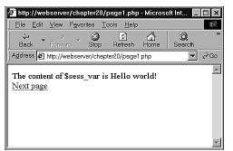
Simple Session Example
page1.php—Starting a Session and Registering a Variable
<?php
session_start();
$_SESSION['sess_var'] = "Hello world!";
echo 'The content of $_SESSION[\'sess_var\'] is '
.$_SESSION["sess_var"].<BR>;
?>
<a href = "page2.php">Next page</a>
The final value of the variable on the
page is the one that will be available on
subsequent pages. At the end of the
script, the session variable is serialized,
or frozen, until it is reloaded via the next
call to session_start().
We therefore begin the next script by calling
session_start().
CS 275 – Web Programming – Ch. 23

Slide 14
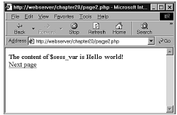
page2.php—Accessing a Session Variable and Unsetting It
<?php
session_start();
echo 'The content of $_SESSION[\'sess_var\'] is '
.$_SESSION['sess_var'].<BR>;
unset($_SESSION['sess_var']);
?>
<a href = "page3.php">Next page</a>
After calling session_start(), the variable $sess_var is available with its previously stored value.
After using the variable, we unset the variable. This way, the session still exists, but the variable $sess_var is no longer a registered variable.
Finally we pass along to page3.php, the final script in our example.
CS 275 – Web Programming – Ch. 23

Slide 15
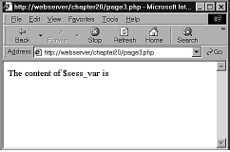
page3.php—Ending the Session
<?php
session_start();
echo 'The content of $_SESSION[\'sess_var\'] is '
.$_SESSION['sess_var'].<BR>;
session_destroy();
?>
As you can see in Figure, we no longer have access to the persistent value of $sess_var.
CS 275 – Web Programming – Ch. 23

Slide 16
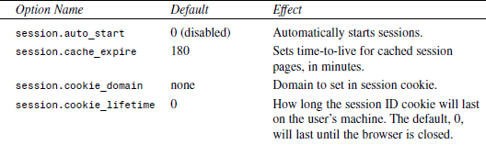
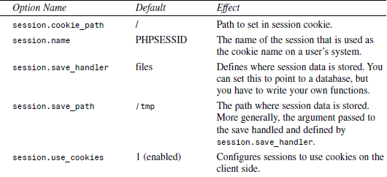
Configuring Session Control
There is a set of configuration options for sessions that you can set in your php.ini file. Some of the more useful options, and a description of each, are shown in the following Table:
A complete list can be found at http://www.php.net/manual/en/session.configuration.php
Also, there are:
session.cookie_secure
and
session.hash_function
CS 275 – Web Programming – Ch. 23

Slide 17
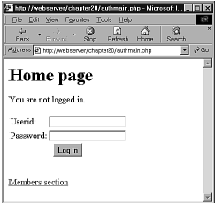
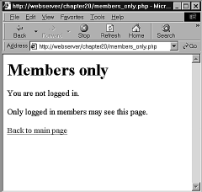
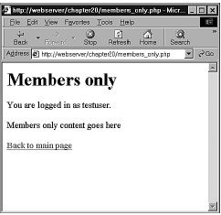
Implementing Authentication with Session Control
Finally, we will look at a more substantial example using session control.
Possibly the most common use of session control is to keep track of users after they have been authenticated via a login mechanism.
  In this example, we will combine authentication from a MySQL database with use of sessions to provide this functionality.
We will reuse the authentication database we set up in Chapter "Implementing Authentication for PHP and MySQL,".
The example consists of three simple scripts.
  The first, authmain.php, provides a login form and authentication for members of our Web site.
  The second, members_only.php, displays information only to members who have logged in successfully.
  The third, logout.php, logs out a member.
CS 275 – Web Programming – Ch. 23

Slide 18
authmain.php—The Main Part of the Authentication Application
<?php
session_start();
if (isset($__POST['userid']) && isset($__POST['password'])) {
// if the user has just tried to log in
$userid = $__POST['userid'];
$password = $__POST['password']);
$db_conn = new mysqli('localhost', 'webauth', 'webauth', 'auth');
if (mysqli_connect_errno()) {
echo 'Connection failed!'.mysqli_connect_error();
exit;
}
$query = "select * from auth "
."where name='$userid' "
." and pass=password('$password')";
$result = $db_conn->query($query);
if ($result->num_rows) {
// if they are in the database register the user id
$__SESSION['valid_user'] = $userid;
}
$db_conn->close();
}
?>
CS 275 – Web Programming – Ch. 23

Slide 19
authmain.php—continued
<html> <body> <h1>Home page</h1>
<?php
if (isset($__SESSION['valid_user'])) {
echo "You are logged in as:". $__SESSION['valid_user']."<br>";
echo "<a href=\"logout.php\">Log out</a><br>";
}
else {
if (isset($userid)) // if they've tried and failed to log in
echo "Could not log you in";
else // they have not tried to log in yet or have logged out
echo "You are not logged in.<br>";
// provide form to log in
echo "<form method=post action=\"authmain.php\">";
echo "<table>";
echo "<tr><td>Userid:</td>";
echo "<td><input type=text name=userid></td></tr>";
echo "<tr><td>Password:</td>";
echo "<td><input type=password name=password></td></tr>";
echo "<tr><td colspan=2 align=center>";
echo "<input type=submit value=\"Log in\"></td></tr>";
echo "</table></form>";
}
?>
<br> <a href="members_only.php">Members section</a>
</body> </html>
CS 275 – Web Programming – Ch. 23

Slide 20
members_only.php—The Code for the Members' Section of Our Web Site Checks for Valid Users
<?php
session_start();
echo "<h1>Members only</h1>";
// check session variable
if (isset($__SESSION['valid_user'])) {
echo "<p>You are logged in as ". $__SESSION['valid_user']." </p>";
echo "<p>Members only content goes here</p>";
}
else {
echo "<p>You are not logged in.</p>";
echo "<p>Only logged in members may see this page.</p>";
}
echo "<a href=\"authmain.php\">Back to main page</a>";
?>
CS 275 – Web Programming – Ch. 23

Slide 21
logout.php—This Script Deregisters the Session Variable and Destroys the Session
<?php
session_start();
$old_user = $__SESSION['valid_user']; // store to test if they *were* logged in
unset($__SESSION['valid_user']);
session_destroy();
?>
<html> <body> <h1>Log out</h1>
<?php
if (!empty($old_user)) {
echo "Logged out.<br>";
}
else {
// if they weren't logged in but came to this page somehow
echo "You were not logged in, and so have not been logged out.<br>";
}
?>
<a href="authmain.php">Back to main page</a>
</body>
</html>
CS 275 – Web Programming – Ch. 23

