Slide 1
Creating Your Web Database
Chapter 9
CS 260 – Web Programming – Ch. 9

Slide 2
Introduction
In this chapter:
  Creating a database
  Users and privileges
  Introduction to the privilege system
  Creating database tables
  Column types in MySQL
As a reminder, here is the schema for the Book-O-Rama application:
Customers(CustomerID, Name, Address, City)
Orders(OrderID, CustomerID, Amount, Date)
Books(ISBN, Author, Title, Price)
Order_Items(OrderID, ISBN, Quantity)
Book_Reviews(ISBN, Reviews)
Remember that primary keys are underlined and foreign keys have a dotted underline.
CS 260 – Web Programming – Ch. 9

Slide 3
How to Log In to MySQL
  To do this, go to a command line interface on your machine and type the following:
> mysql -h hostname -u username –p
The mysql command invokes the MySQL monitor. This is a command line client that connects you to the MySQL server.
The -h switch is used to specify the host to which you want to connect; that is, the machine on which the MySQL server is running.
  If you’re running this command on the same machine as the MySQL server, you can leave out this switch and the hostname parameter. If not, you should replace the hostname parameter with the name of the machine where the MySQL server is running.
The -u switch is used to specify the username you want to connect as.
  If you do not specify, the default will be the username you are logged into the operating system as.
If you have installed MySQL on your own machine or server, you will need to log in as root and create the database we’ll use in this section. Assuming that you have a clean install, root is the only user you’ll have to begin with.
If you are using MySQL on a machine administered by somebody else, use the username they gave you.
The -p switch tells the server you want to connect using a password.
  You can leave it out if a password has not been set for the user you are logging in as.
CS 260 – Web Programming – Ch. 9

Slide 4
How to Log In to MySQL
Without a root password, your system is insecure.
You don’t need to include the password on this line. The MySQL server will ask you for it.
  In fact, it’s better if you don’t. If you enter the password on the command line, it will appear as plain text on the screen, and will be quite simple for other users to discover.
After you have entered the previous command, you should get a response something like this:
Enter password: ****
  (If this hasn’t worked, verify that the MySQL server is running, and the mysql command is somewhere in your path.)
  You should enter your password. If all goes well, you should see a response something like this:
Welcome to the MySQL monitor. Commands end with ; or \g.
Your MySQL connection id is 9 to server version: 3.22.34-shareware-debug
Type ‘help’ for help.
mysql>
  On your own machine: If you don’t get a response similar to this, make sure that you have run mysql_install_db if required, you have set the root password, and you’ve typed it in correctly.
  If it isn’t your machine, make sure that you typed in the password correctly.
  You should now be at a MySQL command prompt, ready to create the database.
  If you are using your own machine, follow the guidelines in the next section.
CS 260 – Web Programming – Ch. 9

Slide 5
Creating Database and Users
At the MySQL command prompt, type
mysql> create database dbname;
You should substitute the name of the database you want to create for dbname. To begin creating the Book-O-Rama example, you can create a database called books. You should see a response like
Query OK, 1 row affected (0.06 sec)
This means everything has worked.
  If you don’t get this response, make sure that you typed the semicolon at the end of the line. A semicolon tells MySQL that you are finished, and it should actually execute the command.
Users and Privileges
A MySQL system can have many users.
The root user should generally be used for administration purposes only, for security reasons.
  For each user who needs to use the system, you will need to set up an account and password. It is a good idea to have different passwords for the system and for MySQL, especially when it comes to the root password.
It isn’t compulsory to set up passwords for users, but we strongly recommend that you set up passwords for all the users that you create.
For the purposes of setting up a Web database, it’s a good idea to set up at least one user per Web application.
You might ask, “Why would I want to do this?”—the answer lies in privileges.
CS 260 – Web Programming – Ch. 9

Slide 6
Introducing MySQL Privilege System
One of the best features of MySQL is that it supports a sophisticated privilege system.
A privilege is the right to perform a particular action on a particular object, and is associated with a particular user.
  The concept is very similar to file permissions.
When you create a user within MySQL, you grant her a set of privileges to specify what she can and cannot do within the system.
Principle of Least Privilege
The principle of least privilege can be used to improve the security of any computer system. It’s a basic, but very important principle that is often overlooked. The principle is as follows:
A user (or process) should have the lowest level of privilege required in order to perform her assigned task.
  For example, to run queries from the Web, a user does not need all the privileges to which root has access.
  We should therefore create another user who only has the necessary privileges to access the database we have just created.
CS 260 – Web Programming – Ch. 9

Slide 7
Setting Up Users: The GRANT Command
The GRANT and REVOKE commands are used to give and take away rights to and from MySQL users at four levels of privilege. These levels are
Global
Database
Table
Column
The GRANT command is used to create users and give them privileges. The general form of the GRANT command is
GRANT privileges [columns]
ON item
TO user_name [IDENTIFIED BY ‘password’]
[WITH GRANT OPTION]
The clauses in square brackets are optional. There are a number of placeholders in this syntax.
  The first, privileges, should be a comma-separated list of privileges. MySQL has a defined set of these. They are described in the next section.
  The columns placeholder is optional. You can use it to specify privileges on a column-bycolumn basis. You can use a single column name or a comma-separated list of column names. The item placeholder is the database or table to which the new privileges apply.
  You can grant privileges on all the databases by specifying *.* as the item. This is called granting global privileges. You can also do this by specifying * alone if you are not using any particular database.
CS 260 – Web Programming – Ch. 9

Slide 8
Setting Up Users: The GRANT Command
More commonly, you will specify all tables in a database as dbname.*, on a single table as dbname.tablename, or on specific columns by specifying dbname.tablename and some specific columns in the columns placeholder.
  These represent the three other levels of privilege available: database, table, and column, respectively.
  If you are using a specific database when you issue this command, tablename on its own will be interpreted as a table in the current database.
The user_name should be the name you want the user to log in as in MySQL.
  The user_name in MySQL can also contain a hostname. You can use this to differentiate between, say, laura (interpreted as laura@localhost) and laura@somewhere.com. This is quite useful because
    users from different domains often have the same name.
    It also increases security because you can specify where users can connect from, and even which tables or databases they can access from a particular location.
The WITH GRANT OPTION option, if specified, allows the specified user to grant her own privileges to others.
Privileges are stored in four system tables, in the database called mysql. These four tables are called
mysql.user, mysql.db, mysql.tables_priv, and mysql.columns_priv
they relate directly to the four levels of privilege mentioned earlier.
  As an alternative to GRANT, you can alter these tables directly.
CS 260 – Web Programming – Ch. 9

Slide 9
Types and Levels of Privilege
Three basic types of privileges exist in MySQL:
privileges suitable for granting to regular users
privileges suitable for administrators
a couple of special privileges.
Any user can be granted any of these privileges, but it’s usually sensible to restrict the administrator type ones to administrators, according to the principle of least privilege.
You should grant privileges to users only for the databases and tables they need to use.
You should not grant access to the mysql database to anyone except an administrator.
  This is where all the users, passwords, and so on are stored.
Privileges for regular users directly relate to specific types of SQL commands and whether a user is allowed to run them.
CS 260 – Web Programming – Ch. 9

Slide 10
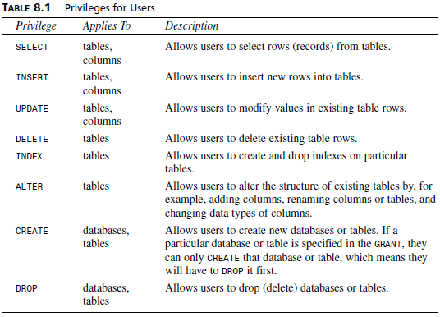
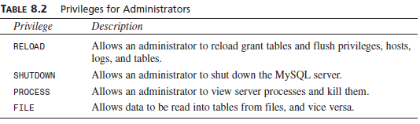
Types and Levels of Privilege
In addition to the privileges listed in Table 8.1, a REFERENCES privilege exists that is currently unused, and a GRANT privilege exists that is granted with WITH GRANT OPTION rather than in the privileges list.
It is possible to grant admin privileges to non-administrators, but extreme caution should be used if you are considering doing so. The average user should have no need to use the RELOAD, SHUTDOWN, and PROCESS privileges.
CS 260 – Web Programming – Ch. 9

Slide 11
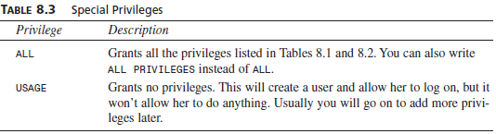
Types and Levels of Privilege
The FILE privilege is a bit different.
  It is useful for users because loading data from files can save a lot of time re-entering data each time to get it into the database.
  However, file loading can be used to load any file that the MySQL server can see, including databases belonging to other users and, potentially, password files.
  Grant FILE privilege with caution, or offer to load the data for the user.
Two special privileges also exist:
CS 260 – Web Programming – Ch. 9

Slide 12
The REVOKE Command
It is used to take privileges away from a user. It is very similar to GRANT in syntax:
REVOKE privileges [(columns)]
ON item
FROM user_name
If you have given the WITH GRANT OPTION clause, you can revoke this by doing:
REVOKE GRANT OPTION
ON item
FROM user_name
To set up an administrator, you can type
mysql> grant all
-> on *
-> to fred identified by ‘mnb123’
-> with grant option;
  This grants all privileges on all databases to a user called Fred with the password mnb123, and allows him to pass on those privileges.
  Chances are you don’t want this user in your system, so go ahead and revoke him:
mysql> revoke all
-> on *
-> from fred;
CS 260 – Web Programming – Ch. 9

Slide 13
The REVOKE Command
Now let’s set up a regular user with no privileges:
mysql> grant usage
-> on books.*
-> to sally identified by ‘magic123’;
After talking to Sally, we know a bit more about what she wants to do, so we can give her the appropriate privileges:
mysql> grant select, insert, update, delete, index, alter, create, drop
-> on books.*
-> to sally;
Note that we don’t need to specify Sally’s password in order to do this.
If we decide that Sally has been up to something in the database, we might decide to reduce her privileges:
mysql> revoke alter, create, drop
-> on books.*
-> from sally;
And later, when she doesn’t need to use the database any more, we can revoke her privileges altogether:
mysql> revoke all
-> on books.*
-> from sally;
CS 260 – Web Programming – Ch. 9

Slide 14
Setting Up a User for the Web
You will need to set up a user for your PHP scripts to connect to MySQL.
  Again we can apply the privilege of least principle: What should the scripts be able to do?
In most cases they’ll only need to SELECT, INSERT, DELETE, and UPDATE rows from tables. You can set this up as follows:
mysql> grant select, insert, delete, update
-> on books.*
-> to bookorama identified by ‘bookorama123’;
  Obviously, for security reasons, you should choose a better password than this.
If you use a Web hosting service, you’ll usually get access to the other user-type privileges on a database they create for you.
  They will typically give you the same user_name and password for command-line use (setting up tables and so on) and for Web script connections (querying the database).
  This is marginally less secure. You can set up a user with this level of privilege as follows:
mysql> grant select, insert, update, delete, index, alter, create, drop
-> on books.*
-> to bookorama identified by ‘bookorama123’;
CS 260 – Web Programming – Ch. 9

Slide 15
Using the Right Database
The first thing you’ll need to do when you log in is to specify which database you want to use:
mysql> use dbname;
  where dbname is the name of your database.
Alternatively, you can avoid the use command by specifying the database when you log in, as follows:
mysql -h hostname -u username dbname –p
In this example, we’ll use the books database:
mysql> use books;
When you type this command, MySQL should give you a response such as
Database changed
If you don’t select a database before starting work, MySQL will give you an error message such as
ERROR 1046: No Database Selected
CS 260 – Web Programming – Ch. 9

Slide 16
Creating Database Tables
SQL command CREATE TABLE.
CREATE TABLE tablename(columns)
You should replace the tablename placeholder with the name of the table you want to create, and the columns placeholder with a comma-separated list of the columns in your table.
Each column will have a name followed by a datatype.
Here’s the Book-O-Rama schema:
Customers(CustomerID, Name, Address, City)
Orders(OrderID, CustomerID, Amount, Date)
Books(ISBN, Author, Title, Price)
Order_Items(OrderID, ISBN, Quantity)
Book_Reviews(ISBN, Review)
  Listing 8.1 shows the SQL to create these tables, assuming you have already created the database called books. You can find this SQL on the CD-ROM in the file chapter8/bookorama.sql
  You can run an existing SQL file, such as one loaded from the CD-ROM, through MySQL by typing
  > mysql -h host -u bookorama books -p < bookorama.sql
  Using file redirection is pretty handy for this because it means that you can edit your SQL in the text editor of your choice before executing it.
CS 260 – Web Programming – Ch. 9

Slide 17
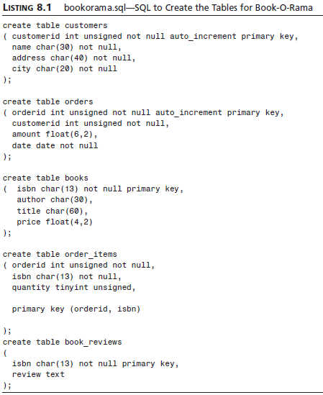
Creating Database Tables
CS 260 – Web Programming – Ch. 9

Slide 18
Creating Database Tables
NOT NULL means that all the rows in the table must have a value in this attribute. If it isn’t specified, the field can be blank (NULL).
AUTO_INCREMENT is a special MySQL feature you can use on integer columns. It means if we leave that field blank when inserting rows into the table, MySQL will automatically generate a unique identifier value. The value will be one greater than the maximum value in the column already. You can only have one of these in each table. Columns that specify AUTO_INCREMENT must be indexed.
PRIMARY KEY after a column name specifies that this column is the primary key for the table. Entries in this column have to be unique. MySQL will automatically index this column. Notice that where we’ve used it above with customerid in the customers table we’ve used it with AUTO_INCREMENT. The automatic index on the primary key takes care of the index required by AUTO_INCREMENT.
Specifying PRIMARY KEY after a column name can only be used for single column primary keys. The PRIMARY KEY clause at the end of the order_items statement is an alternative form. We have used it here because the primary key for this table consists of the two columns together.
UNSIGNED after an integer type means that it can only have a zero or positive value.
CS 260 – Web Programming – Ch. 9

Slide 19
Understanding the Column Types
Let’s take the first table as an example:
create table customers
( customerid int unsigned not null auto_increment primary key,
name char(30) not null,
address char(40) not null,
city char(20) not null
);
When creating any table, you need to make decisions about column types.
The first column, customerid, is the primary key, which we’ve specified directly.
  We’ve decided this will be an integer (data type int) and that these IDs should be unsigned.
  We’ve also taken advantage of the auto_increment facility so that MySQL can manage these for us—it’s one less thing to worry about.
The other columns are all going to hold string type data.
  We’ve chosen the char type for these. This specifies fixed width fields. The width is specified in the brackets, so, for example, name can have up to 30 characters.
  This data type will always allocate 30 characters of storage for the name, even if they’re not all used. MySQL will pad the data with spaces to make it the right size.
  The alternative is varchar, which uses only the amount of storage required (plus one byte). It’s a small trade off—varchars will use less space but chars are faster.
  For real customers with real names and real addresses, these column widths will be far too narrow.
Note that we’ve declared all the columns as NOT NULL. This is a minor optimization you can make wherever possible that also will make things run a bit faster.
CS 260 – Web Programming – Ch. 9

Slide 20
Understanding the Column Types
Some of the other CREATE statements have variations in syntax. Let’s look at the orders table:
create table orders
( orderid int unsigned not null auto_increment primary key,
customerid int unsigned not null,
amount float(6,2),
date date not null
);
The amount column is specified as a floating point number of type float.
  With most floating point data types, you can specify the display width and the number of decimal places.
  In this case, the order amount is going to be in dollars, so we’ve allowed a reasonably large order total (width 6) and two decimal places for the cents.
The date column has the data type date.
In this particular table, we’ve specified that all columns bar the amount as NOT NULL.
  When an order is entered into the database, we’ll need to create it in orders, add the items to order_items, and then work out the amount.
  We might not know the amount when the order is created, so we’ve allowed for it to be NULL.
CS 260 – Web Programming – Ch. 9

Slide 21
Understanding the Column Types
The books table has some similar characteristics:
create table books
( isbn char(13) not null primary key,
author char(30),
title char(60),
price float(4,2)
);
  In this case, we don’t need to generate the primary key because ISBNs are generated elsewhere.
  We’ve left the other fields NULL because a bookstore might know the ISBN of a book before they know the title, author, or price.
The order_items table demonstrates how to create multicolumn primary keys:
create table order_items
( orderid int unsigned not null,
isbn char(13) not null,
quantity tinyint unsigned,
primary key (orderid, isbn)
);
  We’ve specified the quantity of a particular book as a TINYINT UNSIGNED, which holds an integer between 0 and 255.
  As we mentioned before, multicolumn primary keys need to be specified with a special primary key clause. This is used here.
Lastly, if you consider the book_reviews table:
create table book_reviews
( isbn char(13) not null primary key,
review text );
CS 260 – Web Programming – Ch. 9

Slide 22
Looking at the Database
You can view the tables in the database by typing
mysql> show tables;
+-------------------+
| Tables in books |
+-------------------+
| book_reviews |
| books |
| customers |
| order_items |
| orders |
+-------------------+
You can also use show to see a list of databases by typing
mysql> show databases;
You can see more information about a particular table, for example, books, using DESCRIBE:
mysql> describe books;
MySQL will display the information you supplied when creating the database:
+--------+------------+------+-----+---------+-------+-------+-------+
| Field | Type | Null | Key | Default | Extra |
+--------+------------+------+-----+---------+-------+
| isbn | char(13) | | PRI | | |
| author | char(30) | YES | | NULL | |
| title | char(60) | YES | | NULL | |
| price | float(4,2) | YES | | NULL | |
+--------+------------+------+-----+---------+-------+-------+-------+
4 rows in set (0.05 sec)
CS 260 – Web Programming – Ch. 9

Slide 23
Creating Indexes
Attempts to speed up the performance
If you find out that your are running many queries on a column that is not a key, you might want to add an index on the column to improve performance.
CREATE INDEX Statement
CREATE [UNIQUE | FULLTEXT] INDEX index_name
ON table_name (index_column_name [(length)] {ASC\DESC],…])
CS 260 – Web Programming – Ch. 9

Slide 24
MySQL Identifiers
There are four kinds of identifiers in MySQL—databases, tables, and columns (which we’re familiar with), and aliases (which we’ll cover in the next chapter).
Databases in MySQL map to directories in the underlying file structure, and tables map to files.
  This has a direct effect on the names you can give them.
  It also affects the case sensitivity of these names—if directory and filenames are case sensitive in your operating system, database and table names will be case sensitive (for example, in UNIX), otherwise they won’t (for example, under Windows).
  Column names and alias names are not case sensitive, but you can’t use versions of different cases in the same SQL statement.
As a side note, the location of the directory and files containing the data will be wherever it was set in configuration. You can check the location on your system by using the mysqladmin facility as follows:
mysqladmin variables
CS 260 – Web Programming – Ch. 9

Slide 25
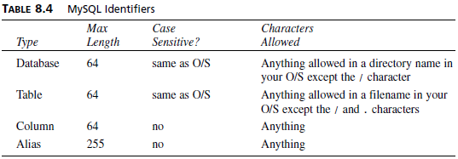
MySQL Identifiers
A summary of possible identifiers is shown in Table 8.4. The only additional exception is that you cannot use ASCII(0) or ASCII(255) in identifiers.
You can even have reserved words and special characters of all kinds in identifiers (as of MySQL 3.23.6), the only limitation being that if you use anything weird like this, you have to put it in back quotes (located under the tilde key on the top left of most keyboards). For example
create database `create database`;
The rules in versions of MySQL (prior to 3.23.6) are more restrictive, and don’t allow you to do this.
Of course, you should apply common sense to all this freedom.
  Just because you can call a database `create database`, it doesn’t that mean that you should.
  The same principle applies as in any other kind of programming—use meaningful identifiers.
CS 260 – Web Programming – Ch. 9

Slide 26
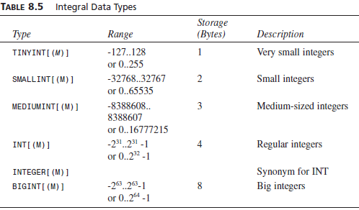
Column Data Types
Numeric Types
The numeric types are either integers or floating point numbers. For the floating point numbers, you can specify the number of digits after the decimal place. This is shown in this book as D. The maximum value you can specify for D is 30 or M-2 (that is, the maximum display length minus two—one character for a decimal point and one for the integral part of the number), whichever is lower.
For integer types you can also specify if you want them to be UNSIGNED
For all numeric types, you can also specify the ZEROFILL attribute. When values from a ZEROFILL column are displayed, they will be padded with leading zeroes.
CS 260 – Web Programming – Ch. 9

Slide 27

Column Data Types
CS 260 – Web Programming – Ch. 9

Slide 28
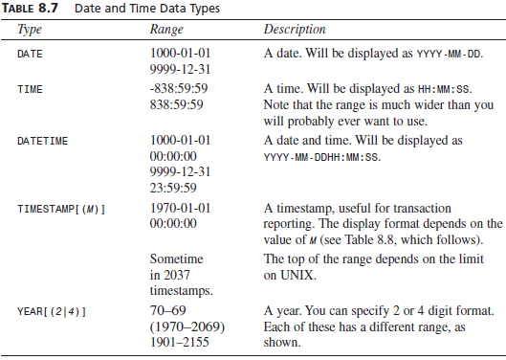
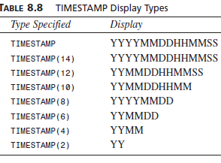
Column Data Types
Date and Time
CS 260 – Web Programming – Ch. 9

Slide 29
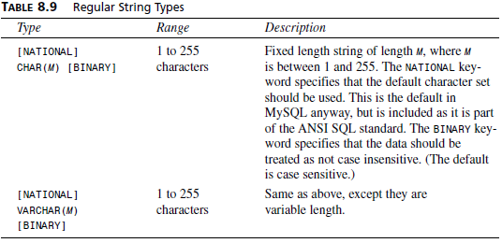
Column Data Types
String types fall into three groups.
First, there are plain old strings, that is, short pieces of text.
  These are the CHAR (fixed length character) and VARCHAR (variable length character) types.
  You can specify the width of each. Columns of type CHAR will be padded with spaces to the maximum width regardless of the size of the data, whereas VARCHAR columns vary in width with the data. (Note that MySQL will strip the trailing spaces from CHARs when they are retrieved, and from VARCHARs when they are stored.)
  There is a space versus speed trade off with these two types, which we will discuss in more detail in Chapter 12.
Second, there are TEXT and BLOB types.
  These are for longer text or binary data, respectively. BLOBs are binary large objects. These can hold anything you like, for example, image or sound data.
  In practice, BLOB and TEXT columns are the same except that TEXT is case sensitive and BLOB is not. Because these column types can hold large amounts of data, they require some special considerations.
The third group has two special types, SET and ENUM.
  The SET type is used to specify that values in this column must come from a particular set of specified values. Column values can contain more than one value
  from the set. You can have a maximum
  of 64 things in the specified set.
  ENUM is an enumeration. It is very similar to
  SET, except that columns of this type can
  have only one of the specified values
  or NULL, and that you can have a maximum
  of 65535 things in the enumeration.
CS 260 – Web Programming – Ch. 9

Slide 30
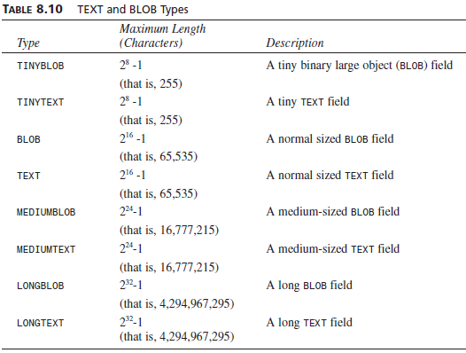
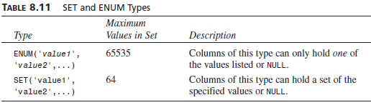
Column Data Types
CS 260 – Web Programming – Ch. 9

