Slide 1
CS275
Web Programming
Introduction

Slide 2
Client/Server Structure
The Internet computers rely on the client/protocol: servers provide services, clients use them
  Example servers: email server, web server, ftp server
  Frequently, a “server” is actually many computers acting as one
Protocol: client packages a request and sends it to a server; Server does the service and sends a reply

Slide 3
History of the WWW
http://w3.org/2004/Talks/w3c10-HowItAllStarted/
Issues that drove development of the Web
  No transparent way to link documents or objects
    References by citation or ftp address
  No automatic way to retrieve linked documents
    Downloading via ftp required human intervention
  No standard document format
    Each format required its own application
  Even with links, no way to find documents
    except by being told where to find them, following links
Web beginnings
  1989: Tim Berners-Lee
    URLs, http, first browser
  1993: NCSA Mosaic
    Then Netscape, then Mozilla
  1994: World Wide Web Consortium
    http://w3.org/
    Standards organization for Web protocols and formats
  1994-5: Web crawlers and search engines
    WebCrawler, Lycos, AltaVista, Yahoo
Notes:
Almost from the beginning, the Internet allowed people to make files available for downloading. This was by means of ftp, the file transfer protocol, which you’ve already used. Ftp was developed over the years 1971-1974. But there was no mechanism for automatically fetching a document that was referred to in another document – a human had to run the ftp tool, log in on the remote machine, navigate to the directory, and request the file.
Except for plain text documents, any formatting required having the correct application to display the particular format, and formats and applications were specific to each type of operating system.
Even if automated linking of documents had existed, the only way to find out about a document would be for one person to tell another, or to find a link to some other document in a document one already had.

Slide 4
World Wide Web
URL -- uniform resource locator
HTTP -- hypertext transfer protocol
HTML -- hypertext markup language

Slide 5
Dissecting a URL
Web addresses are URL (uniform resource locator)
  A server address and a path to a particular file
  URLs are often redirected to other places
    http://personal.ashland.edu/bkerkez/Teaching/CS275/Syllabus.html
protocol = http://
web server = personal
domain = .ashland.edu
path = /bkerkez/Teaching/CS275/ (dirs(folders))
file = Syllabus
file extension = .html (hypertext markup language)

Slide 6
World Wide Web
World Wide Web (WWW) is a collection of servers (subset of Internet computers) and the info they give access to using the HTTP protocol
  WWW is not the same as the Internet
  The “server” is a web site computer and the “client” is a web browser (like Internet Explorer)
  Many Web server’s domain names begin with www by tradition, but any name is OK
  Often multiple servers map to the same site:
  moma.org and www.moma.org

Slide 7
Client/Server Interaction
For Web pages, the client requests a page the server returns it: there’s no permanent connection, just a short conversation
  Details of the conversation are specified by HTTP
Server
Client
Server
Server
Client
Client
request
Server
Client
Server
Client
response
Server
Server
Client
Client
Server
Client

Slide 8
HTTP Demystified
HTTP 1.1 request methods
  GET By far the most common, for statically requesting a resource by specifying a URL.
  POST Similar to GET, except that a message body, typically containing key-value pairs from an HTML form submission, is included in the request.
  PUT Used for uploading files to a specified URI on a web-server.
  DELETE Rarely implemented, and self-explanatory.
  HEAD Identical to GET, except that the page content is not returned; just the headers are. Useful for retrieving meta-information.
  TRACE Echoes back the received request, so that a client can see what intermediate servers are adding or changing in the request.
  OPTIONS Returns the HTTP methods that the server supports. This can be used to check the functionality for a web server.
  CONNECT Rarely implemented, for use with a proxy that can change to being an SSL tunnel.
Notes:
HTTP differs from other TCP-based protocols such as FTP, in that connections are usually terminated once a particular request (or related series of requests) has been completed.

Slide 9
Simple HTTP Request
request
protocol
method
GET /pub/WWW/TheProject.html HTTP/1.1
Host: www.w3.org
host

Slide 10
A Typical Browser Request
GET /pub/WWW/TheProject.html HTTP/1.1
Accept: image/gif, image/x-xbitmap, image/jpeg, image/pjpeg, application/vnd.ms-powerpoint, application/vnd.ms-excel, application/msword, application/x-shockwave-flash, */*
Accept-Language: en-us
Accept-Encoding: gzip, dflate
User-Agent: Mozilla/4.0 (compatible; MSIE 6.0; Windows NT 5.0; APC)
Host: www.w3.org
Connection: Keep-Alive

Slide 11
Server Response
HTTP/1.1 200 OK
Date: Monday, 23 May 2005 22:38:34 GMT
Server: Apache/1.3.27 (Unix) (Red-Hat/Linux)
Last-Modified: Wed, 08 Jan 2003 23:11:55 GMT
Etag: "3f80f-1b6-3e1cv03b"
Accept-Ranges: bytes
Content-Length: 438
Connection: close
Content-Type: text/html
<html>
<head><title>A Sample Page</title></head>
<body>
…

Slide 12
HTTP status codes
100s: Informational
  100: Continue
  101: Switching Protocols
200s: Success
  200: OK
  201: Created
  202: Accepted
300s: Redirection
  301: Moved Permanently
400s: Client Error
  400: Bad Request
  401: Forbidden
  404: Not Found
500s: Server Error
  500: Internal Server Error
  501: Not Implemented

Slide 13
A More Complicated Request
GET /acct/presentation/editAccount.php?id=6 HTTP/1.1
Accept: */*
Accept-Language: en-us
Accept-Encoding: gzip, dflate
User-Agent: Mozilla/4.0 (compatible; MSIE 6.0; Windows NT 5.0; APC)
Host: www.w3.org
Connection: Keep-Alive

Slide 14
A POST Request
POST /test/post/postTest.php HTTP/1.1
Accept: image/gif, image/x-xbitmap, image/jpeg, image/pjpeg, application/vnd.ms-powerpoint, application/vnd.ms-excel, application/msword, application/x-shockwave-flash, */*
Referer: http://db2/test/post/postTestClientSimple.html
Accept-Language: en-us
Accept-Encoding: gzip, dflate
User-Agent: Mozilla/4.0 (compatible; MSIE 6.0; Windows NT 5.0; APC)
Host: db2
Content-Length: 16
Connection: Keep-Alive
textBox=Tribbles

Slide 15
More Sources for Info on HTTP
World wide web consortium
  http://www.w3c.org
RFC 2616
  http://www.ietf.org/rfc/rfc2616.txt

Slide 16
Language Layers
Markup language
  information structure and content, hyperlinking
Lightweight scripting language
  dynamic creation of HTML, response to events
Heavyweight programming language
  active graphics creation, numerical computation

Slide 17
Markup Language - HTML
HyperText Markup Language
  a language for describing the content and presentation of a web page
    content: The meaning and structure of the web page
    presentation: How the page is to be presented
  HTML pages have a basic hierarchical structure defined by the tags
    <html>, <head>, <body>, and so on
  Basic HTML describes a static page
    once parsed and rendered, the page doesn’t change
    hyperlinking was the big step forward in basic HTML

Slide 18
Content vs. Presentation
Early versions of HTML mixed these two ideas
  For example: <p align=“left”>
  The <p> tag identifies the basic structure of the page content
  The align=“left” attribute guides the presentation
Newer versions are separating content and presentation
  All "presentation attributes" of HTML elements were deprecated in HTML 4.01.
  All "presentation attributes" of HTML elements are not supported in XHTML 1.0 Strict DTD.

Slide 19
Why is this distinction useful?
Once you have easy access to the structure and meaning, there are many useful ways to manage and present the information that is available
Manage the information
  extract a travel map from a directions page
  filter an inventory list to select only certain attributes
Present the information
  graphical browser on a full-size screen
  cell-phone browser display

Slide 20
Manage the information
Information that is well structured can be
  filtered, reorganized, used as program input, presented in a variety of reports, ...
This is what a database program is used for
  If we can separate the content from the presentation in web pages, we can use the web as a giant database
  Not a single database, but we can use it like one
Web scraping, screen scraping
  extract the content and discard the presentation

Slide 21
Present the information
Once you have a database with a defined structure, you can present the information it contains in many different ways
Define a style for presenting the data
  Cascading Style Sheets associate style with structure
Use a browser appropriate to the requirements
  desktop graphical: MSIE, Mozilla, Opera, Safari
  desktop text-only: Lynx, Links, WannaBe
  Audio: IBM Home Page Reader 3.0
  PDA and cell phone: Opera, WAP browsers, Pocket IE
The information you want exists, but presenting it in a useful, timely, accessible fashion is a real challenge

Slide 22
Dynamic HTML
Dynamic HTML is a technique of creating interactive web sites by using a combination of
  the static markup language HTML
  the style definition language Cascading Style Sheets
  a scripting language
A scripting language provides
  Adaptivity … the page can be customized
  Interactivity … get user input and display results
  Applications … build a general purpose program

Slide 23
Language Layers
Markup language
  information structure and content, hyperlinking
Lightweight scripting language
  dynamic creation of HTML, response to events
Heavyweight programming language
  active graphics creation, numerical computation

Slide 24
Scripting Languages
Javascript is an HTML-embedded, client-side scripting language. The goal of the language is to allow web developers to write dynamically generated pages quickly.
VBScript. Microsoft Visual Basic Scripting Edition brings active scripting to a wide variety of environments, including Web client scripting in Microsoft Internet Explorer and Web server scripting in Microsoft Internet Information Service.
Python is an interpreted, interactive, object-oriented programming language. It is often compared to Tcl, Perl, Scheme or Java. Python is also usable as an extension language for applications that need a programmable interface.
Perl is a language optimized for scanning arbitrary text files, extracting information from those text files, and printing reports based on that information. It's also a good language for many system management tasks. The language is intended to be practical (easy to use, efficient, complete) rather than beautiful (tiny, elegant, minimal).
PHP is an interpreted, object-oriented programming language. It is often compared to Perl, JSP, or other CGI languages. It's forte is for interactive websites, especially processing web forms and accessing databases over the web.
Notes:
Server-side vs. client-side

Slide 25
A Lightweight Scripting Language
PHP is a scripting language
  has many features of larger languages but intended for more casual or rapid development
Such languages are used to provide dynamic control of the content and display
  intended to be used by web page developers, system administrators, and others to quickly develop useful applications

Slide 26
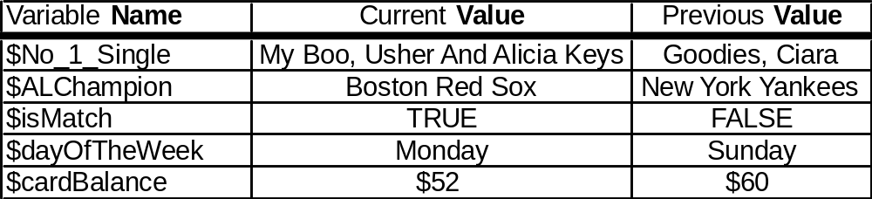
Variables In PHP Programming
Program variables have names and values
  Names (also called identifiers)
    Must always begin with a dollar-sign ($)
    generally start with a letter and can contain letters, numbers, and underscore characters “_”
    Names are case sensitive
  Values
    can be numbers, strings, boolean, etc
    change as the program executes
Notes:
No Spaces!
No punctuation characters other than underscore
Variable names should usually start with a lowercase letter.

Slide 27
HTML Forms
Forms allow us to create interactive websites, by accepting input from users
Types of input we can collect via forms:
  Text via text boxes and text areas
  Selections via radio buttons, check boxes, pulldown menus, and select boxes
Form actions do all of the work
  Usually through button clicks

Slide 28
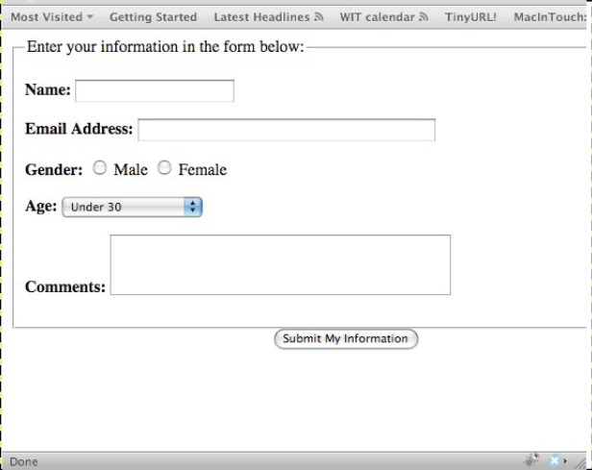
Forms
<form> … </form> tag
method attribute (post/get)
action attribute (the url/script to run)
various input fields
  text, radio buttons, drop down menus

Slide 29
HTML Forms: text fields
Used to enter different types of text data
Attributes:
  input type = “text” / ”submit” / ”password”
  name = “someName” (returns the value)
  size = “30” etc. (space to enter data)
  maxlength = “40” etc. (maximum data size)
  <form method="post"
  action="mailto:bkerkez@ashland.edu">
  Name: <input type="text" size="10" maxlength="40“ name="name"> <br />
  Password: <input type="password" size="10"
  maxlength="10" name="password">
  <input type="submit" value="Send">
  </form>

Slide 30
HTML Forms: radio buttons
Used to select one among several options
  e.g. in quizzes, exams, surveys, gender selection (you cannot usually be both male and female) etc.
Attributes:
  input type = “radio”
  name = “someName” (defines the group, returns the value)
  value = “someValue” (this is returned by the form)
  <form method="post" action="mailto:bkerkez@ashland.edu">
  What kind of shirt are you wearing? <br />
  Shade:
  <input type="radio" name="shade" value="dark">Dark
  <input type="radio" name="shade" value="light">Light <br />
  Size:
  <input type="radio" name="size" value="small">Small
  <input type="radio" name="size" value="large">Large <br />
  <input type="submit" value="Email Myself">
  </form>

Slide 31
HTML Forms: drop down lists
Also used to select between one of several options. Can be used to select several options
  enclosed in <select ></select>
  a series of <option></option> tags
  Attributes:
    name = “someName”
  <form method="post" action="mailto:bkerkez@ashland.edu">
  Age?
  <select name="age">
    <option>Choose One</option>
    <option>Under 20</option>
    <option>20-25</option>
    <option>Under Thirty (25-30)</option>
    <option>Over Thirty but not over the hill (30-40)</option>
    <option>Over the hill (40+)</option>
    <input type="submit" value="Email Yourself">
  </select>
  </form>

Slide 32
HTML Forms: text areas
Free text areas for comments or feedback (e.g. in blogs).
  <textarea > … </textarea>
Attributes:
  rows (= rows of text about 12 pixels high)
  colums (no. characters wide)
  wrap = “off” | ”virtual” | ”physical”
  <form method="post"
  action="mailto:bkerkez@ashland.edu">
  <textarea rows="5" cols="20" wrap="physical“ name="comments">
  Enter Comments Here
  </textarea>
  <input type="submit" value="Email Yourself">
  </form>

Slide 33
Example
<form action="w7_handle_form.php" method="post">
<fieldset><legend>Enter your information in the form below:</legend>
<p> <b>Name:</b> <input type="text" name="name" size="20" maxlength="40" /></p>
<p> <b>Email Address:</b> <input type="text" name="email" size="40" maxlength="60" /
></p>
<p> <b>Gender:</b>
<input type="radio" name="gender" value="M" /> Male
<input type="radio" name="gender" value="F" /> Female</p>
<p><b>Age:</b>
<select name="age">
<option value="0-29">Under 30</option>
<option value="30-60">Between 30 and 60</option>
<option value="60+">Over 60</option>
</select></p>
<p><b>Comments:</b> <textarea name="comments" rows="3" cols="40"></textarea></p>
</fieldset>
<div align="center"><input type="submit" name="submit" value="Submit My
Information" /></div>
</form>
This form calls a PHP file
There are many pieces of information.
  Where do they go?
We need arrays

Slide 34
Arrays
An array is a container for data
  “a data structure accessed by indexing”
In PHP arrays have key=value
Two types:
  Indexed arrays
  Associative arrays
PHP has predefined arrays

Slide 35
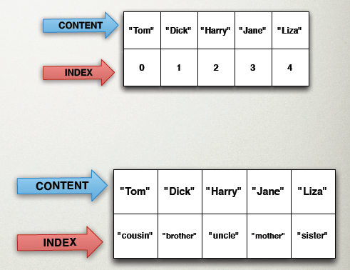
Arrays
Indexed arrays
  $arrayName[1]
Associative arrays
  $arrayName[‘brother’]

Slide 36
PHP Arrays: superglobals
PHP has predefined arrays - superglobals:
  $_GET, $_POST, $_REQUEST, $_SERVER,
  $_ENV, $_SESSION, $_COOKIE
$_GET, $_POST, are subsets of $_REQUEST
  (better to use more specific form)
  <?php # Script 2.2 - handle_form.php
  // Create a shorthand for the form data:
  $name = $_REQUEST['name'];
  $email = $_REQUEST['email'];
  $comments = $_REQUEST['comments'];
  // Print the submitted information:
  echo "<p>Thank you, <b>$name</b>, for the following
  comments:<br />
  <tt>$comments</tt></p>
  <p>We will reply to you at <i>$email</i>.</p>\n";
  ?>

