Slide 1
Introduction to JavaScript
Chapter ?
CS 275 – Web Programming – Ch. ?

Slide 2
A First JavaScript Program
The <script> Tag
  JavaScript programs are run from within an HTML document
  <script> and </script>
    Used to notify the browser that JavaScript statements are contained within
  language attribute
    Denotes the scripting language being used
      Default → JavaScript
      Other languages (e.g., VBScript) may be used
      Can also specify script language version
        No space between name and version
        Checked by browser, scripts ignored if browser doesn’t support version
      For ECMAScript compatible browsers, omit version
CS 275 – Web Programming – Ch. ?

Slide 3
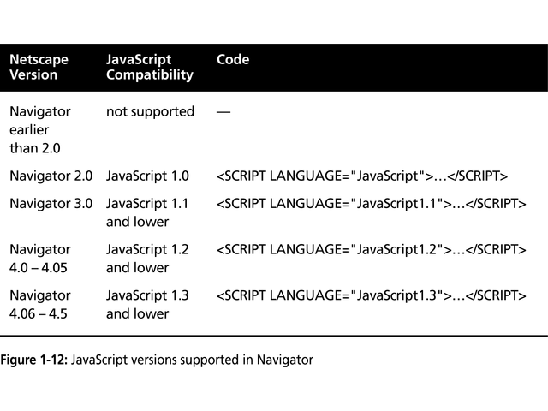
CS 275 – Web Programming – Ch. ?

Slide 4
A First JavaScript Program
The <script> Tag
  JavaScript
    Object-based language
      Object
        Programming code and data that can be treated as an individual unit or component
      Statements
        Individual lines in a programming language
      Methods
        Groups of statements related to a particular object
  Document object
    Represents the content of a browser’s window
  write() & writeln() methods of Document object
    Creates new text on a web page
    Called by appending method to object with a period
    Methods accept arguments
      Information passed to a method
CS 275 – Web Programming – Ch. ?

Slide 5
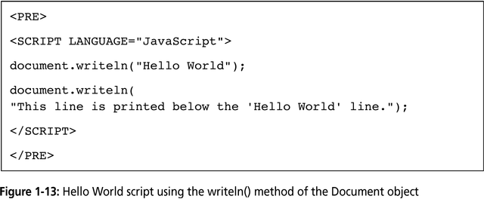
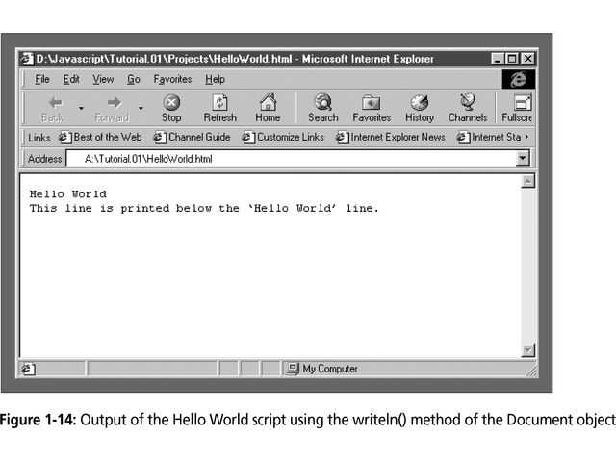
A First JavaScript Program
The <script> Tag
  Preformatted text
    <pre> and </pre> tags
      Tag set known as a container element because it contains text and other HTML tags
    Translates literal text to presentation area
    Required to get carriage return in writeln() method to be sent to presentation area
CS 275 – Web Programming – Ch. ?

Slide 6
A First JavaScript Program
The <script> Tag
  Document object
    Considered a top-level object
    Naming convention
      Capitalize first letter of object
  Unlike HTML, JavaScript is case sensitive
CS 275 – Web Programming – Ch. ?

Slide 7
A First JavaScript Program
Creating a JavaScript Source File
  JavaScript programs can be used in two ways:
    Incorporated directly into an HTML file
      Using <script> tag
    Placed in an external (source) file
      Has file extension .js
      Contains only JavaScript statements
  JavaScript source files
    Use src attribute of <script> tag to denote source of JavaScript statements
      Browser will ignore any JavaScript statements inside <script> and </script> if src attribute is used
    Cannot include HTML tags in source file
    <script language=“JavaScript” src=“c:\source.js”>
    </script>
CS 275 – Web Programming – Ch. ?

Slide 8
A First JavaScript Program
Creating a JavaScript Source File
  Advantages of JavaScript source files
    Makes HTML document neater (less confusing)
    JavaScript can be shared among multiple HTML files
    Hides JavaScript code from incompatible browsers
  Can use a combination of embedded and non–embedded code
    Allows finer granularity in coding functionality
    JavaScript sections executed in order of location within HTML document
CS 275 – Web Programming – Ch. ?

Slide 9
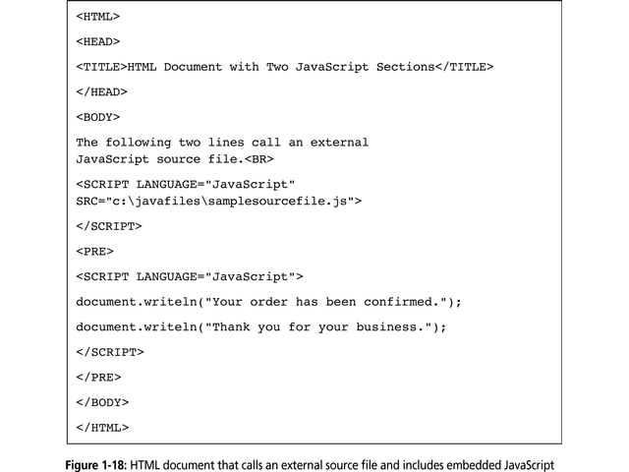
CS 275 – Web Programming – Ch. ?

Slide 10
A First JavaScript Program
Adding comments to a JavaScript Program
  Comments
    Non-printing lines that are placed in the code to contain various remarks about the code
      Makes it easier to understand the code operation
    Two types
      Line comments
        // ignore all text to the end of the line
      Block comments
        /* ignore all text between these symbols */
CS 275 – Web Programming – Ch. ?

Slide 11
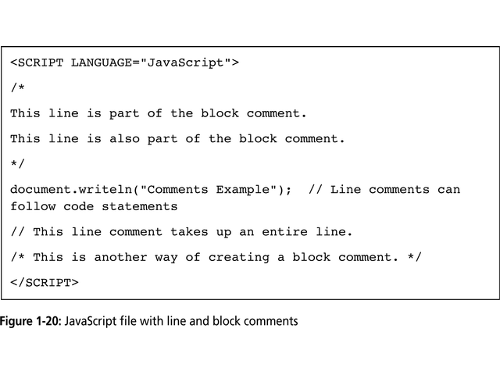
CS 275 – Web Programming – Ch. ?

Slide 12
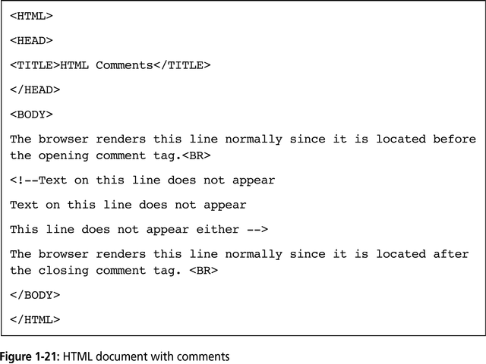
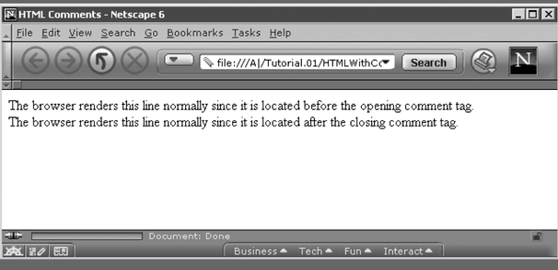
A First JavaScript Program
Hiding JavaScript from Incompatible Browsers
  Two methods
    Place JavaScript in external source file
    Enclose the code within HTML comments
      <!-- beginning of HTML block comment
      end of HTML block comments -->
  Alternate message display
    If browser doesn’t support JavaScript
      Use <noscript> & </noscript> to place alternate message to users of back-level browsers
CS 275 – Web Programming – Ch. ?

Slide 13
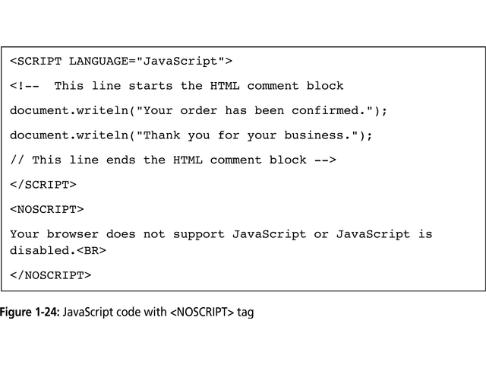

CS 275 – Web Programming – Ch. ?

Slide 14
A First JavaScript Program
Placing JavaScript in <head> or <body> sections
  Script statements interpreted in order of document rendering
  <head> section rendered before <body> section
    Good practice to place as much code as possible in <head> section
CS 275 – Web Programming – Ch. ?

