Slide 1
Events
JavaScript
CS 275 – JavaScript - Events

Slide 2
Introduction
Using Events
  About events
  About HTML tags and events
  How to use event handlers
  About links
  How to use link events
  How to create an image map
CS 275 – JavaScript - Events

Slide 3
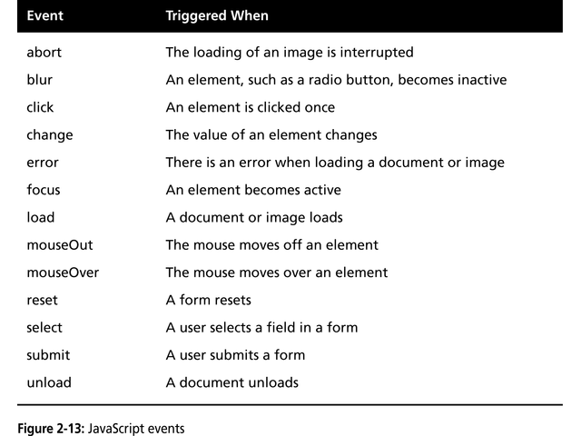
Using Events
Event
  A specific circumstance that is monitored by JavaScript or,
  A trigger that fires specific JavaScript code in response to a given situation
    e.g., an action that a user takes
  Two basic types
    User-generated events
      e.g., mouse-click
    System-generated events
      e.g., load event → triggered by
      web browser when HTML
      document finishes loading
CS 275 – JavaScript - Events

Slide 4
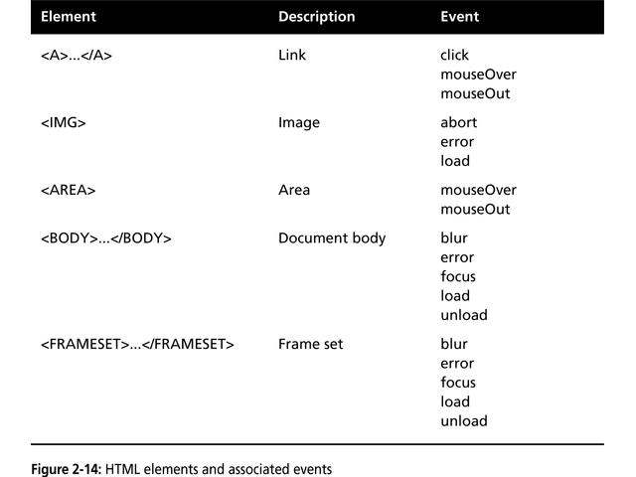
Using Events
HTML Tags and Events
HTML elements allow user to trigger events
  <input> tag
    Creates input fields that interact with users
    <input type=“input-type”>
    Type attribute determines type of input field
      <input type=“text”> creates a text field
    Name attribute assigns a unique
    name to the element that
    JavaScript can use to reference it
CS 275 – JavaScript - Events

Slide 5
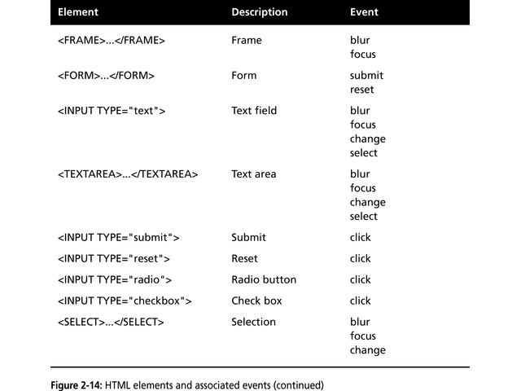
CS 275 – JavaScript - Events

Slide 6
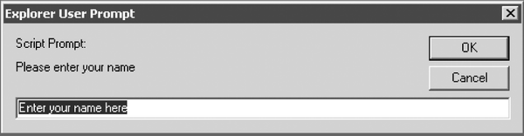
Using Events
Event Handlers
  Event handler
    Code that executes in response to a specific event
    <HTMLtag eventHandler=“JavaScript-code”>
    Event handler naming convention
      Event name with a prefix of “on”
      E.g., onClick
      <input type=“button” onClick=“alert(‘You clicked the button!’)”>
  Built-in JavaScript utility methods
    alert() method
      Displays a pop-up dialog box with an OK button
    prompt() method
      Displays a pop-up dialog box with a message, a text box, an OK button, and a Cancel button
CS 275 – JavaScript - Events

Slide 7
Using Events
Links
  Used to open files or navigate to other documents on the web
  Text or image used to represent a link in an HTML document is called an anchor
  Use anchor tag <a> to process a URL
  Two types of URL
    Absolute
      Refers to the specific location of the document
        http://www.site.com/index.html
        C:\webpages\homepage.html
    Relative
      Refers to location of document according to the location of currently loaded document
        /subdirectory/otherpage.html
        Increases portability of web site
Links Events
  Primary event is the click event
    For default operation, no event handler is required
  Overriding the default click event
    Add onClick event handler that executes custom code
    Event handler must return true or false
    Can use built-in confirm() method to generate Boolean value
CS 275 – JavaScript - Events

Slide 8
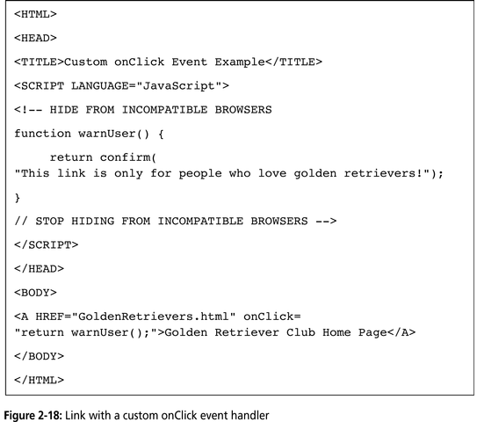
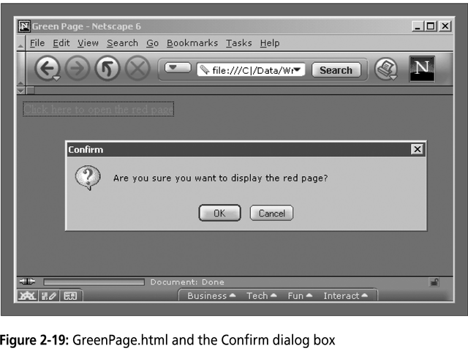
CS 275 – JavaScript - Events

Slide 9
Using Events
Links Events
  Other events:
    MouseOver event
      Occurs when the mouse moves over a link
    MouseOut event
      Occurs when the mouse moves off a link
    Can be used to change the text that appears in the browser’s status bar
      Use JavaScript status property
CS 275 – JavaScript - Events

Slide 10
Using Events
Creating an Image Map
  An image divided into regions
    Each region associated with URL via the <a> tag
    Use <img>, <map>, and <area> tags to create an image map
    Areas are divided using pixel coordinates of image
      Picture elements
  Two basic types
    Client-side
      Part of an HTML document
    Server-side
      Code resides on a web server
CS 275 – JavaScript - Events

Slide 11
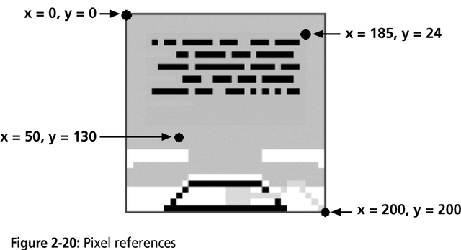
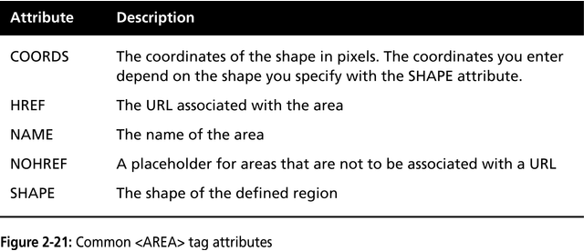
CS 275 – JavaScript - Events

Slide 12
Using Events
Creating an Image Map
  Process
    Place image in document using <img> tag
      Use usemap attribute to reference image map by name
    Define image map using <map> tag
      Use name attribute to give map a name
    Define image map regions using <area> tag
      Use shape attribute to specify shape of region
        rect, circle, poly
CS 275 – JavaScript - Events

