Slide 1
DOM - Windows
JavaScript
CS 275 – JavaScript – DOM - Windows

Slide 2
Introduction
Working with Windows
  About the browser Document Object Model (DOM)
  About the window object
  How to open and close windows
  How to work with timeouts and intervals
CS 275 – JavaScript – DOM - Windows

Slide 3
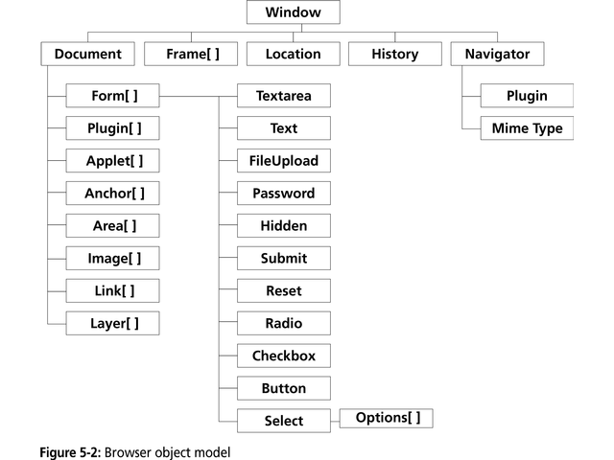
Working with Windows
The JavaScript Object Model
  Browser object model
    A hierarchy of objects, each of which provides programmatic access to a different aspect of the HTML page or the Web browser window
    Created automatically when a Web browser opens an HTML document
CS 275 – JavaScript – DOM - Windows

Slide 4
Document Object Model
  Standard
    W3C organization created a platform independent and browser neutral version of the DOM
      DOM Level 1
        Defined basic document functionality, such as navigation and HTML element manipulation
      DOM Level 2
        Introduced style sheet functionality and event handling
    The Document object contains various properties used for manipulating HTML objects
    Varying degrees of compliance across different browsers and browser versions
  Document Object Methods
    Can be used for dynamically generating and manipulating Web pages
    Cannot be used to change content in a Web page after it has been rendered
CS 275 – JavaScript – DOM - Windows

Slide 5
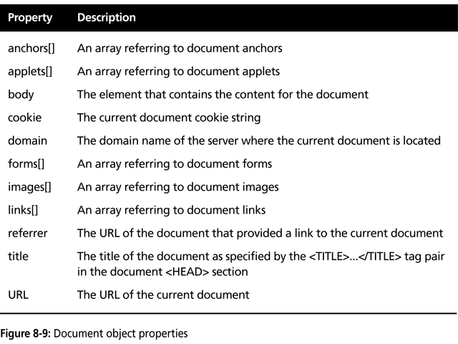
CS 275 – JavaScript – DOM - Windows

Slide 6
Working with Windows
The JavaScript Object Model
  Window object
    Represents a Web browser window or an individual frame within a window
    Top-level object in the browser object model
    Its properties and methods can be used to control the Web browser window
  Document object
    Represents an HTML document displayed in a window
    Descended from a Window object
    Ancestor (parent) for all elements contained on an HTML page
      e.g., all HTML elements descend from the Document object
  Referencing objects
    To refer to a JavaScript object in code, you must list all of its ancestors as a series of properties separated by periods (the dot operator)
    It is not necessary to explicitly refer to the Window object, it is assumed by the browser
    In some browser versions, it is not necessary to explicitly refer to the Document object
CS 275 – JavaScript – DOM - Windows

Slide 7
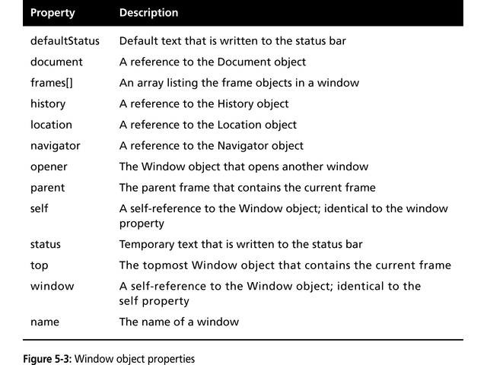
The Window Object
  Includes several properties that contain information about the Web browser window
  e.g., status property
    Contains information displayed in a Web browser’s status bar
CS 275 – JavaScript – DOM - Windows

Slide 8
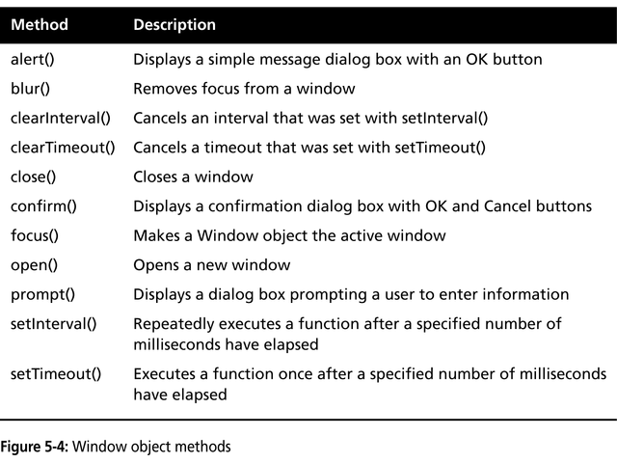
CS 275 – JavaScript – DOM - Windows

Slide 9
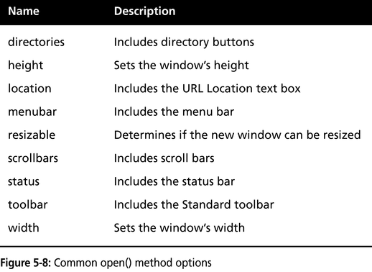
Working with Windows
Opening and Closing Windows
  Netscape and Internet Explorer both allow the opening of new Web Browser windows
    Creates a new window object
    Use open() method of the Window object
    Syntax
      window.open(“URL”, “name”, options);
  When opening a new window, it can be customized using the options argument of the open() method
    Multiple items in the options
    string must be separated by
    commas
    Defaults are provided if no options
    are specified
    If any option is specified, than all
    desired options must be specified
CS 275 – JavaScript – DOM - Windows

Slide 10
Working with Windows
Opening and Closing Windows
  Referencing a window
    A Window object’s name property can only be used to specify a target window, and cannot be used in JavaScript code
    To reference a window in code, the new Window object reference must be assigned to a variable
      var newWindow = window.open(“http://course.com”);
Working with Timeouts and Intervals
  setTimeout()
    Used to execute code after a specific amount of time has elapsed
    Executes only once
    Syntax:
      var variable setTimeout(“code”, milleseconds);
  clearTimeout()
    Used to cancel a setTimeout() method
  setInterval()
    Similar to setTimeout() except it repeatedly executes the same code after being called once
    Syntax:
      var variable setInterval(“code”, milleseconds);
  clearInterval()
    Used to cancel a setInterval() method
CS 275 – JavaScript – DOM - Windows

