Slide 1
DOM – Frames and Other Objects
JavaScript
CS 260 – JavaScript – DOM - Frames

Slide 2
Introduction
Working with Frames and Other Objects
  How to create frames
  How to use the TARGET attribute
  How to create nested frames
  How to format frames
  About the NOFRAMES tag
  About the Location object
  About the History object
  About the Navigator object
  How to reference frames and windows
CS 260 – JavaScript – DOM - Frames

Slide 3
Working with Frames & Other Objects
Creating Frames
  Frame
    Independent, scrollable portions of a Web browser window, with each frame capable of containing its own URL
    JavaScript treats each frame in an HTML document as an independent window
    Each frame has its own Window object
  <frameset> tag
    A frame container
    Can only contain <frame> and other <frameset> tags
      Others are ignored
    Do not use <body> tags
  Frames can be created in rows, columns or both
  <frameset> attributes
    ROWS
      Determines number of horizontal frames to create
    COLS
      Determines number of vertical frames to create
CS 260 – JavaScript – DOM - Frames

Slide 4
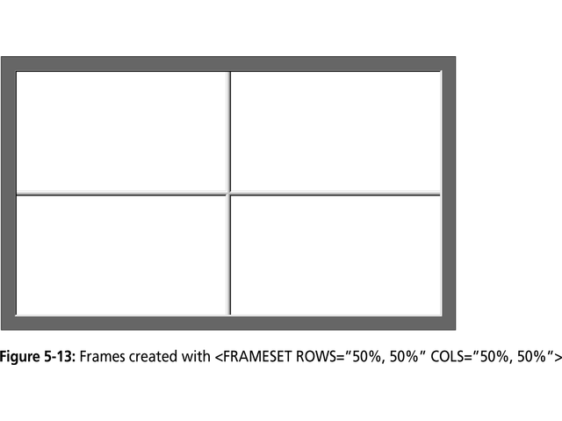
CS 260 – JavaScript – DOM - Frames

Slide 5
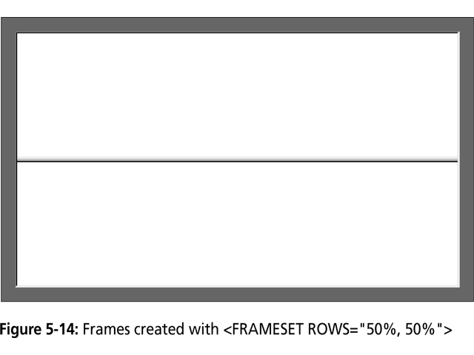
CS 260 – JavaScript – DOM - Frames

Slide 6
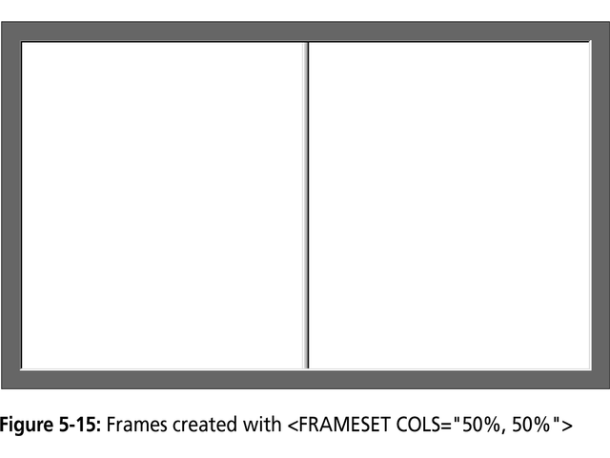
CS 260 – JavaScript – DOM - Frames

Slide 7
Working with Frames & Other Objects
Creating Frames
  Frame dimensions
    Can be specified in:
      Pixels
        Absolute sizing
      Percentages
        Relative sizing
        Asterisk (*) designates remainder of visible window
  <frame> tag
    Used to specify options for individual frames
      e.g., URLs
    Placed within <frameset> tags
    Can be assigned a name using the NAME attribute, which can be used as a target for a hyperlink
  Example:
    <html>
    <title><head>Frame Example</head></title>
    <frameset rows=“50%, 50%” cols=“50%, 50%”>
    <frame src=“FirstURL.html”>
    <frame src=“SecondURL.html”>
    <frame src=“ThirdURL.html”>
    <frame src=“FourthURL.html”>
    </frameset>
    </html>
CS 260 – JavaScript – DOM - Frames

Slide 8
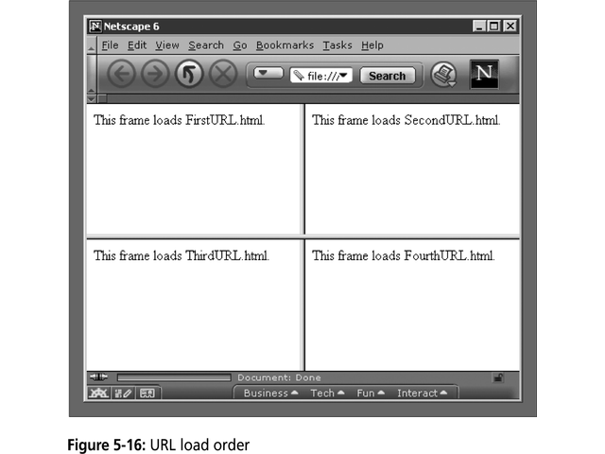

CS 260 – JavaScript – DOM - Frames

Slide 9
Working with Frames & Other Objects
Using the TARGET attribute
  Menu systems
    Popular use of frames
    One frame to contain the hypertext links
    Second frame to contain selected URLs
  TARGET attribute
    Determines in which frame or Web browser window a URL opens
    <base> tag
      Used to specify a default target for all links in a document
CS 260 – JavaScript – DOM - Frames

Slide 10
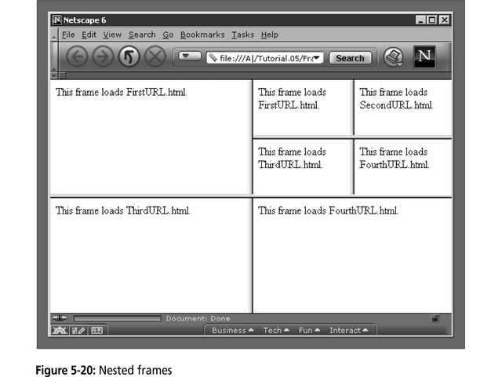
Working with Frames & Other Objects
Nesting Frames
  Nested frame
    Frame contained within another frame
    URLs of frames are loaded in the order in which each <frame> tag is encountered
  Example:
    <frameset rows=“50%, 50%” cols=“50%, 50%”>
    <frame src=FirstURL.html”>
    <frameset rows=“50%, 50%” cols=“50%, 50%”>
    <frame src=“FirstURL.html”>
    <frame src=“SecondURL.html”>
    <frame src=“ThirdURL.html”>
    <frame src=“FourthURL.html”>
    </frameset>
    <frame src=“ThirdURL.html”>
    <frame src=“FourthURL.html”>
    </frameset>
CS 260 – JavaScript – DOM - Frames

Slide 11
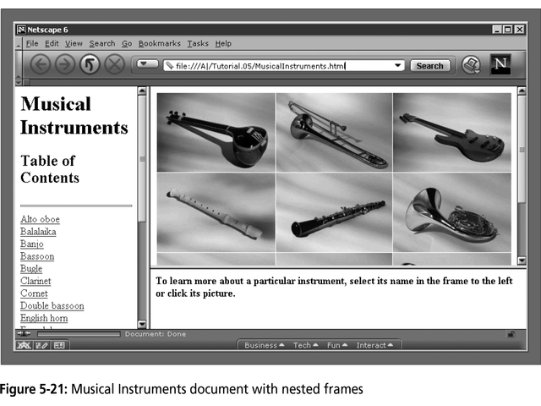
Working with Frames & Other Objects
Nesting Frames
  Example:
    <frameset cols=“200, *”>
    <frame src=“InstrumentsList.html” name=“list”>
    <frameset rows=“75%, *>
    <frame src=“Instruments.jpg” name=“picture”>
    <frame src=“Welcome.html” name=“description”>
    </frameset>
    </frameset>
CS 260 – JavaScript – DOM - Frames

Slide 12
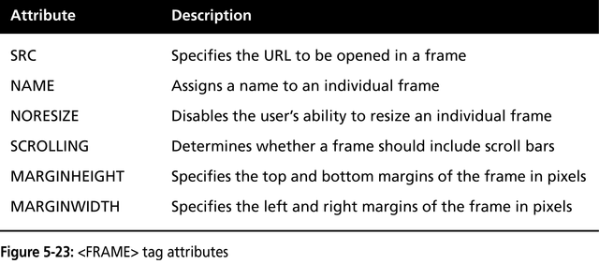
Working with Frames & Other Objects
Frame Formatting
  <frame> attributes
    Several attributes are available to change a frame’s appearance and behavior
<frameset rows=“20%, *, 20%”>
<frame src=“header.html” noresize scrolling=no>
<frame src=“body.html”>
<frame src=“navigationbar.html” noresize scrolling=no>
</frameset>
CS 260 – JavaScript – DOM - Frames

Slide 13
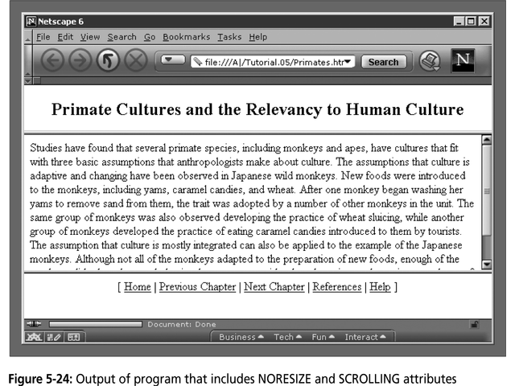
CS 260 – JavaScript – DOM - Frames

Slide 14
Working with Frames & Other Objects
The <noframes> tag
  Some older browsers are incompatible with frames
    <noframes> tag displays an alternate message to users of those browsers
  Example:
    <frameset rows=“20%, *, 20%”>
    <frame src=“header.html” noresize scrolling=no>
    <frame src=“body.html”>
    <frame src=“navigationbar.html” noresize scrolling=no>
    </frameset>
    <noframes> You cannot view… </noframes>
CS 260 – JavaScript – DOM - Frames

Slide 15
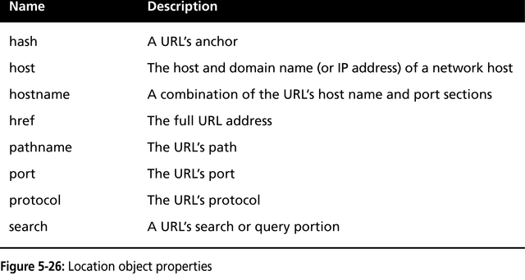
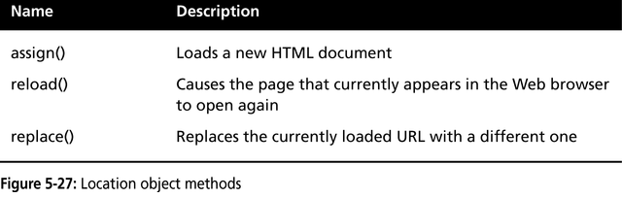
Working with Frames & Other Objects
The Location Object
  Allows you to change to a new web page from within JavaScript code
  Contains several properties and methods for working with the URL of the document currently open in a Web browser window
CS 260 – JavaScript – DOM - Frames

Slide 16
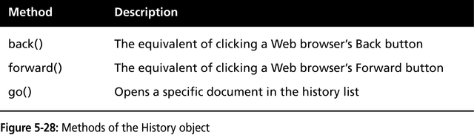
Working with Frames & Other Objects
The History Object
  Maintains a history list of all the documents that have been opened during the current Web browser session
  Security features
    History object will not display the URLs on the list
    In IE: only allows navigation if page is in same domain
CS 260 – JavaScript – DOM - Frames

Slide 17
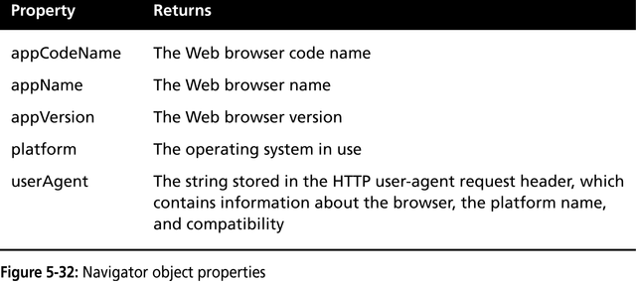
Working with Frames & Other Objects
The Navigator Object
  Used to obtain information about the current web browser
  Typically used to identify browser
    with (navigator) {
    document.writeln(“Browser code name: “ + appCodeName);
    document.writeln(“Web browser name: “ + appName);
    document.writeln(“Web browser version: “ + appVersion);
    document.writeln(“Operating platform: “ + platform);
    document.writeln(“User agent: “ + userAgent);
    }
CS 260 – JavaScript – DOM - Frames

Slide 18
Working with Frames & Other Objects
Referring to Frames and Windows
  Frames object
    Includes a frames[] array that contains all the frames in a window
      frames[0], frames[1], etc.
  Parent property
    Used to refer to a frame within the same frameset
      parent.frames[0], parent.frames[1]
  Example:
    <frameset rows=“50%, *, 50%”>
    <frame src=“frame1.html” name=“FirstFrame”>
    <frame src=“frame2.html” name=“SecondFrame”>
    </frameset>
CS 260 – JavaScript – DOM - Frames

Slide 19
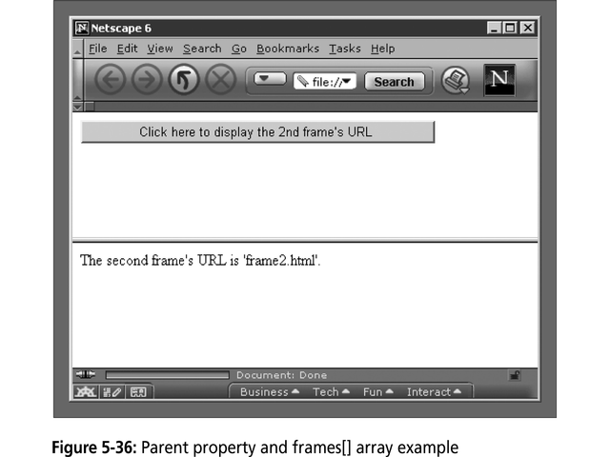
CS 260 – JavaScript – DOM - Frames

